Slide 1
Time correlators
as a measure of quantum chaos in quantum optics models
Pavel Stránský
www.pavelstransky.cz
Outline:
1. Review on classical and quantum chaos
2. Brief introduction to Dicke model
3. Time correlators, OTOCs (Otočky)
4. Isolated unstable points
Institute of Scientific Instruments, CAS, Brno
20th January 2020

Slide 2
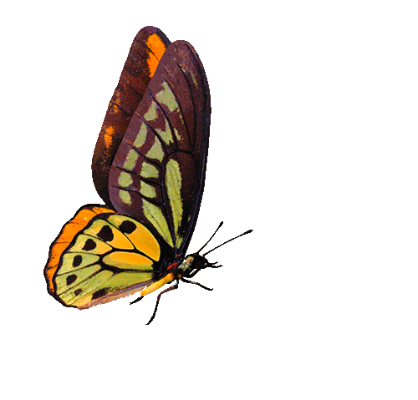
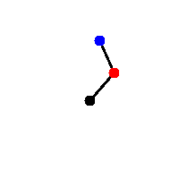
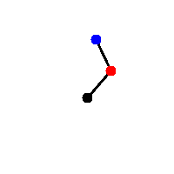
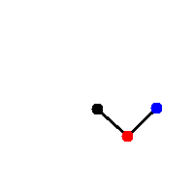

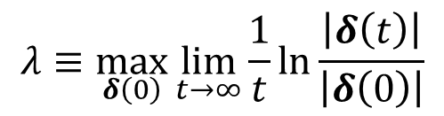



Classical chaos: Instability of trajectories
Stable (regular, quasiperiodic) trajectories
Unstable (chaotic) trajectories
$$δ(0)$$
$$δ(0)$$
$$\left|δ\left(t\right)\right|∝t^{α}$$
$$\left|δ\left(t\right)\right|∝e^{λt}$$
At most polynomial divergence
Exponential divergence
(of a bunch of neigbouring trajectories)
$$λ≡\max_{δ\left(0\right)}{\lim_{t→∞}\frac{1}{t}}\ln{\frac{\left|δ\left(t\right)\right|}{\left|δ\left(0\right)\right|}}$$
Instability quantified by the Lyapunov exponent

Slide 3




Classical chaos: Instability of trajectories
Stable (regular, quasiperiodic) trajectories
Unstable (chaotic) trajectories
$$δ(0)$$
$$δ(0)$$
$$\left|δ\left(t\right)\right|∝t^{α}$$
$$\left|δ\left(t\right)\right|∝e^{λt}$$
Integrability
At most polynomial divergence
Exponential divergence
Hamiltonian:
$$H=H\left(q_{1},…,q_{f},p_{1},…,p_{f}\right)$$
(of a bunch of neigbouring trajectories)
Conservative system:
$$E=H=const.$$
Integrals of motion:
$$I_{j}=I_{j}\left(q_{1},…,q_{f},p_{1},…p_{f}\right)=const.$$
(connected with additional symmetries)
$${\left\{I_{j},I_{k}\right\}}_{Poisson}=0$$
Number of independent integrals of motion
=
number of degrees of freedom
Integrable system:
$$λ≡\max_{δ\left(0\right)}{\lim_{t→∞}\frac{1}{t}}\ln{\frac{\left|δ\left(t\right)\right|}{\left|δ\left(0\right)\right|}}$$
Instability quantified by the Lyapunov exponent
All trajectories quasiperiodic

Slide 4
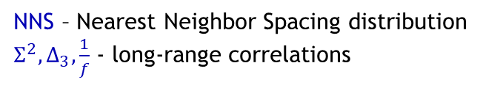
Quantum chaos: Correlations in spectra
Schrödinger equation is linear quantum suppression of chaos
No trajectories, no phase space
Energy spectra
NNS – Nearest Neighbor Spacing distribution
$Σ^{2},Δ_{3},\frac{1}{f}$ - long-range correlations
Correlation between individual levels:
„Wigner surmise” (1950s):
Hamiltonian of a complex quantum system (e.g. a highly excited atomic nucleus) can be described by a random matrix.

Slide 5

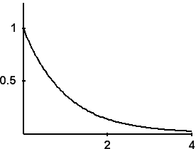
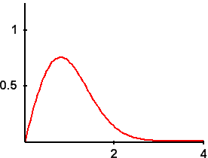
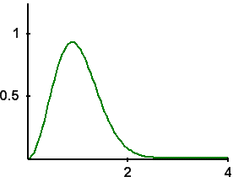
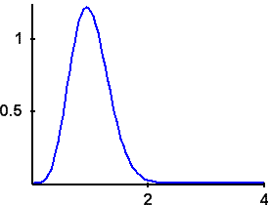




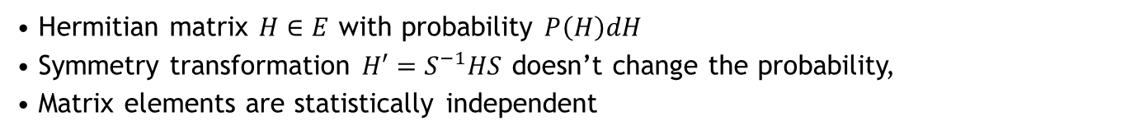
Quantum chaos: Correlations in spectra
Schrödinger equation is linear quantum suppression of chaos
No trajectories, no phase space
Energy spectra
Nearest neighbour spacing distribution
E
NNS – Nearest Neighbor Spacing distribution
$Σ^{2},Δ_{3},\frac{1}{f}$ - long-range correlations
Correlation between individual levels:
„Wigner surmise” (1950s):
Hamiltonian of a complex quantum system (e.g. a highly excited atomic nucleus) can be described by a random matrix.
P(s)
Poisson
GOE
GUE
GSE
Gaussian random matrix ensembles
Hermitian matrix $H∈E$ with probability $P\left(H\right)dH$
Symmetry transformation $H′=S^{−1}HS$ doesn’t change the probability,
Matrix elements are statistically independent
REGULAR system
CHAOTIC system
$$P\left(H^{′}\right)dH^{′}=P\left(H\right)dH$$
ensemble | S | H | T invariance | Angular momentum | R invariance
GOE | Orthogonal | Symmetric | YES YES | n n/2 | YES
GUE | Unitary | Hermitian | NO
GSE | Symplectic |  | YES | n/2 | NO
Brody distribution
Smoothly (but artificially) connects Poisson and GOE NNSDs
Brody parameter ω – chaoticity measure of the system

Slide 6
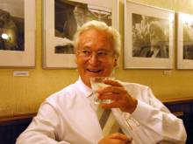
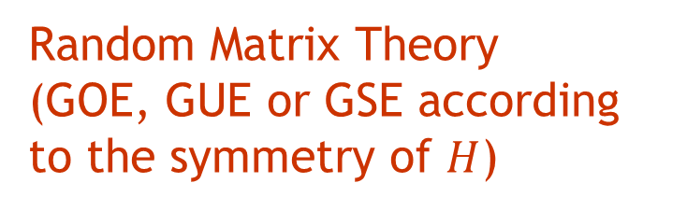
Bohigas conjecture (1984)
(connection between classical and quantum chaos)
Classical counterpart of a quantum system is
Statistics of the quantum energy spectrum follows
chaotic
regular
Random Matrix Theory
(GOE, GUE or GSE according to the symmetry of $H$)
Poissonian distribution
O. Bohigas, M. J. Giannoni, C. Schmit, Phys. Rev. Lett. 52 (1984), 1

Slide 7
Classical chaos
Quantum chaos
Any dynamical connection?

Slide 8
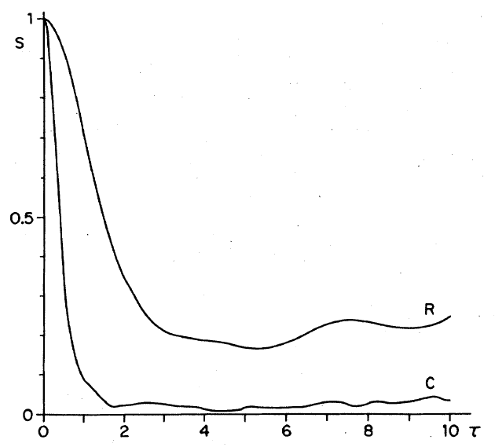


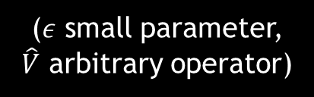
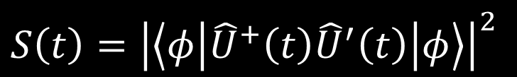




Quantum fidelity (Loschmidt echo)
$$S\left(t\right)={\left|\left\langle φ | {\hat{U}}^{+}\left(t\right){\hat{U}}^{′}\left(t\right) | φ\right\rangle \right|}^{2}$$
$${\hat{H}}^{′}=\hat{H}+ε\hat{V}$$
($ε$ small parameter,
$\hat{V}$ arbitrary operator)
$$e^{−\frac{i}{ℏ}H^{′}t}$$
$$|φ〉$$
$$e^{−\frac{i}{ℏ}Ht}$$
Overlap $≡$ fidelity
Fidelity decays to a much lower value if the system described by $\hat{H}$ is chaotic.
The fluctuations are also lower in chaotic systems.
A. Peres, Phys. Rev. A 30, 1610 (1984)
T. Gorin, T. Prozen, T. Seligman, M. Žnidarič, Phys. Rep. 435, 33 (2006)

Slide 9

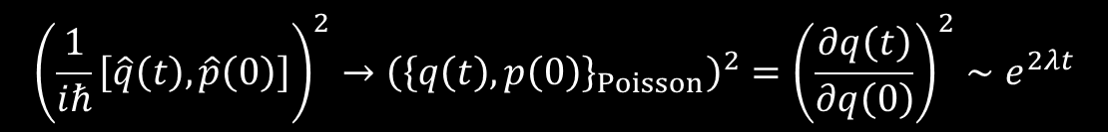
Out-of-Time Ordered Commutator
$$C\left(t\right)≡−\left\langle {\left[\hat{W}\left(t\right),\hat{V}\left(0\right)\right]}^{2}\right\rangle$$
1. A special choice $\hat{W}≡\hat{q}$, $\hat{V}≡\hat{p}$ leads, performing the classical limit, to
$${\left(\frac{1}{iℏ}\left[\hat{q}\left(t\right),\hat{p}\left(0\right)\right]\right)}^{2}→{\left({\left\{q\left(t\right),p\left(0\right)\right\}}_{Poisson}\right)}^{2}={\left(\frac{∂q\left(t\right)}{∂q\left(0\right)}\right)}^{2}∼e^{2λt}$$
Exponential divergence of the OTOC in chaotic states expected.
A. Larkin, Y.N. Ovchinnikov, Quasiclassical method in the theory of superconductivity, J. Exp. Theor. Phys. 28, 1200 (1969)

Slide 10
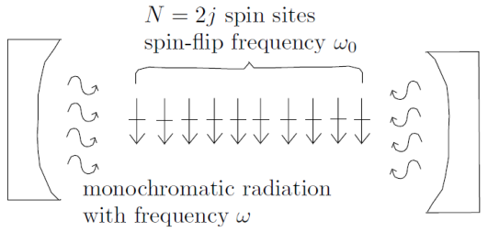
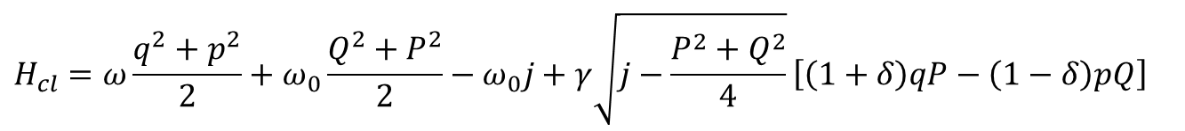
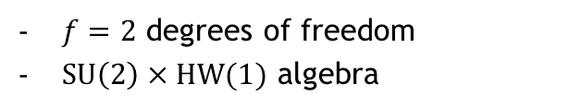
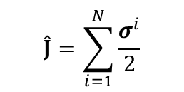
Dicke model of superradiance
interaction of a single-mode bosonic field with a chain of two-level atoms
$${\hat{H}}_{Dicke}^{γ}=ω{\hat{b}}^{+}\hat{b}+ω_{0}{\hat{J}}_{z}+\frac{γ}{\sqrt{2j}}\left[{\hat{b}}^{+}{\hat{J}}_{−}+\hat{b}J_{+}+δ\left({\hat{b}}^{+}{\hat{J}}_{+}+\hat{b}J_{−}\right)\right]$$
$f=2$ degrees of freedom
$SU\left(2\right)×HW(1)$ algebra
R.H, Dicke, Phys. Rev. 93, 99 (1954)
K. Hepp, E. Lieb, Ann. Phys. 76, 360 (1973)
$$\hat{J}=\sum_{i=1}^{N}{\frac{σ^{i}}{2}}$$
Semiclassical Hamiltonian
$$H_{cl}=ω\frac{q^{2}+p^{2}}{2}+ω_{0}\frac{Q^{2}+P^{2}}{2}−ω_{0}j+γ\sqrt{j−\frac{P^{2}+Q^{2}}{4}}\left[\left(1+δ\right)qP−\left(1−δ\right)pQ\right]$$
M. Kloc, P. Stránský, P. Cejnar, Ann. Phys. 382, 85 (2017)

Slide 11
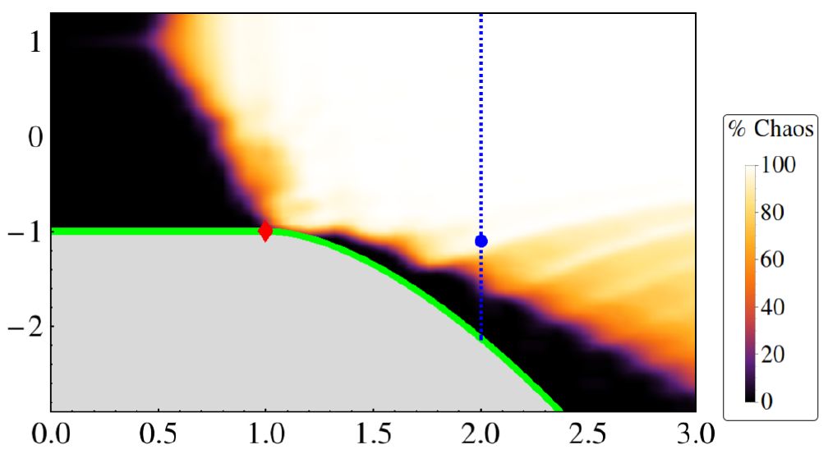


Map of the classical chaos
(general behaviour in a low-dimensional classical system)
(in the Dicke model)
$$E$$
External parameter(s) $γ$

Slide 12
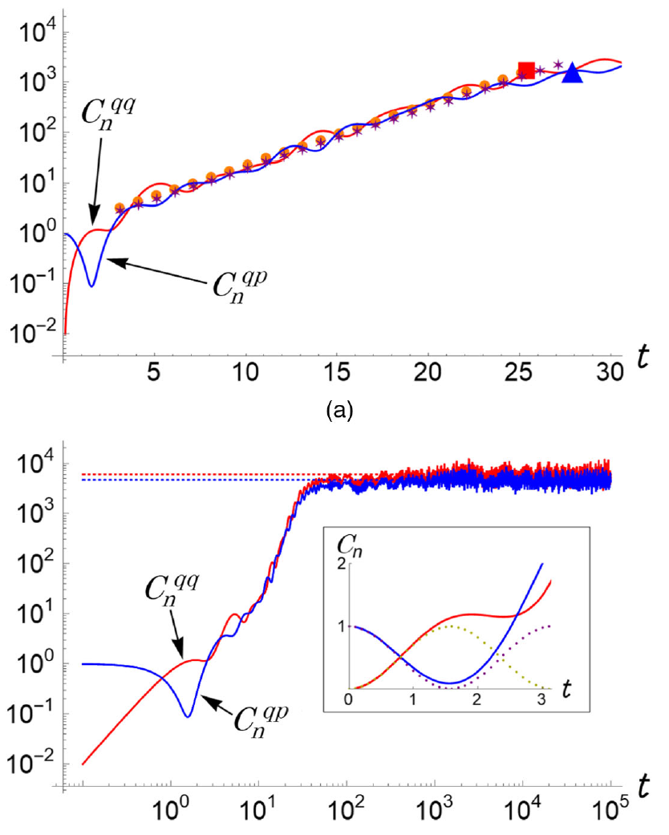
OTOC for chaotic states
Ehrenfest (scrambling) time
Exponential growth
Short-time universal behaviour
Dissipation (collision) time
Saturation

Slide 13
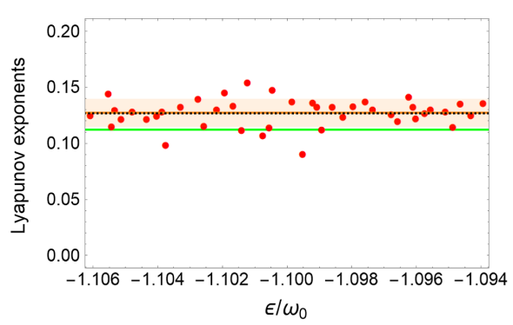
OTOC for chaotic states
Ehrenfest (scrambling) time
Exponential growth
Short-time universal behaviour
Dissipation (collision) time
Quantum Lyapunov exponent
Saturation

Slide 14
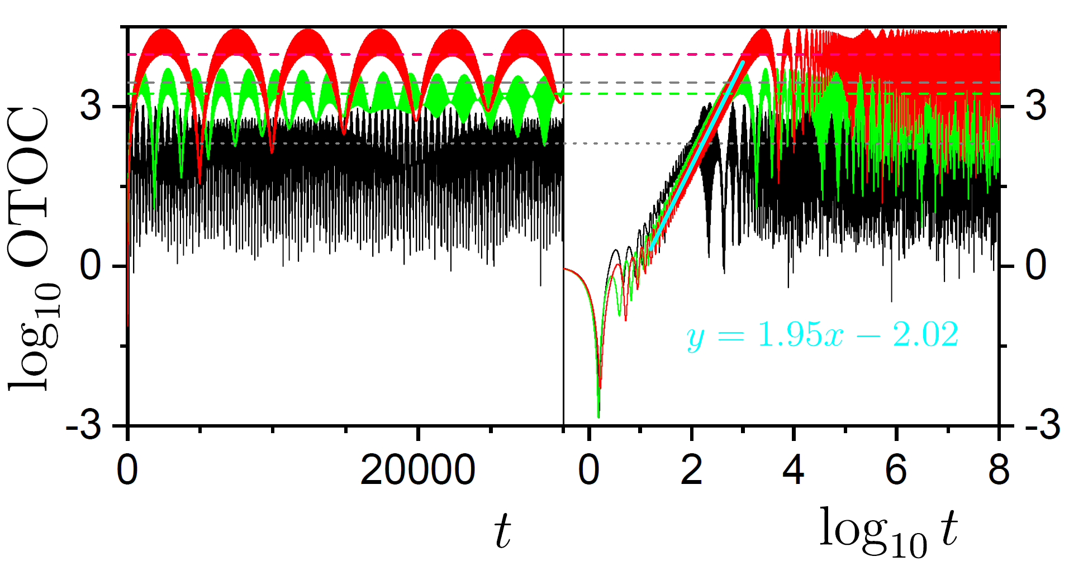
OTOC for regular states
Short-time universal behaviour
Strong recurrences
(no saturation / thermalization)
Polynomial rise

Slide 15
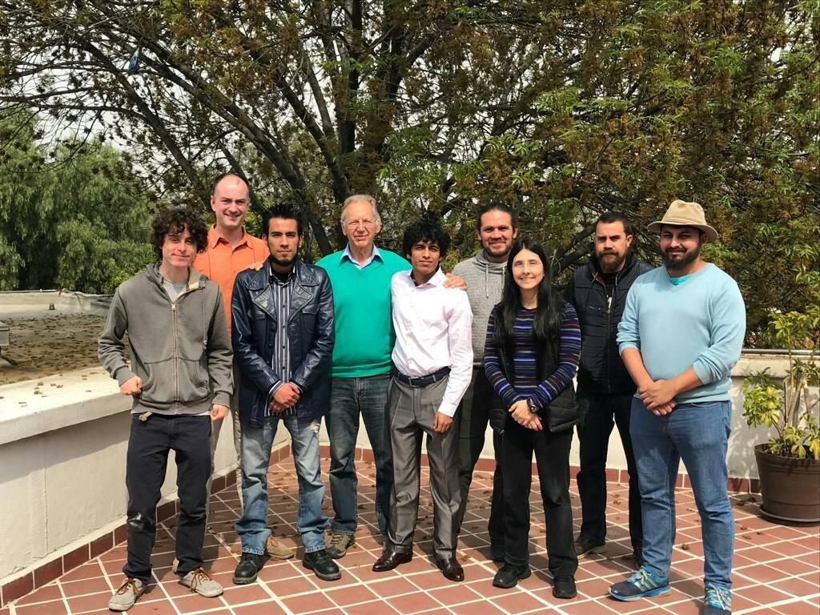
January 2019
J. Chávez-Carlos, B. López-del-Caprio, M.A. Bastarrachea-Magnani, P. Stránský, S. Lerma-Hernández, L.F. Santos, J. Hirsch
Quantum and classical Lyapunov exponents in atom-field interaction systems
Physical Review Letters 122, 024101 (2019)

Slide 16
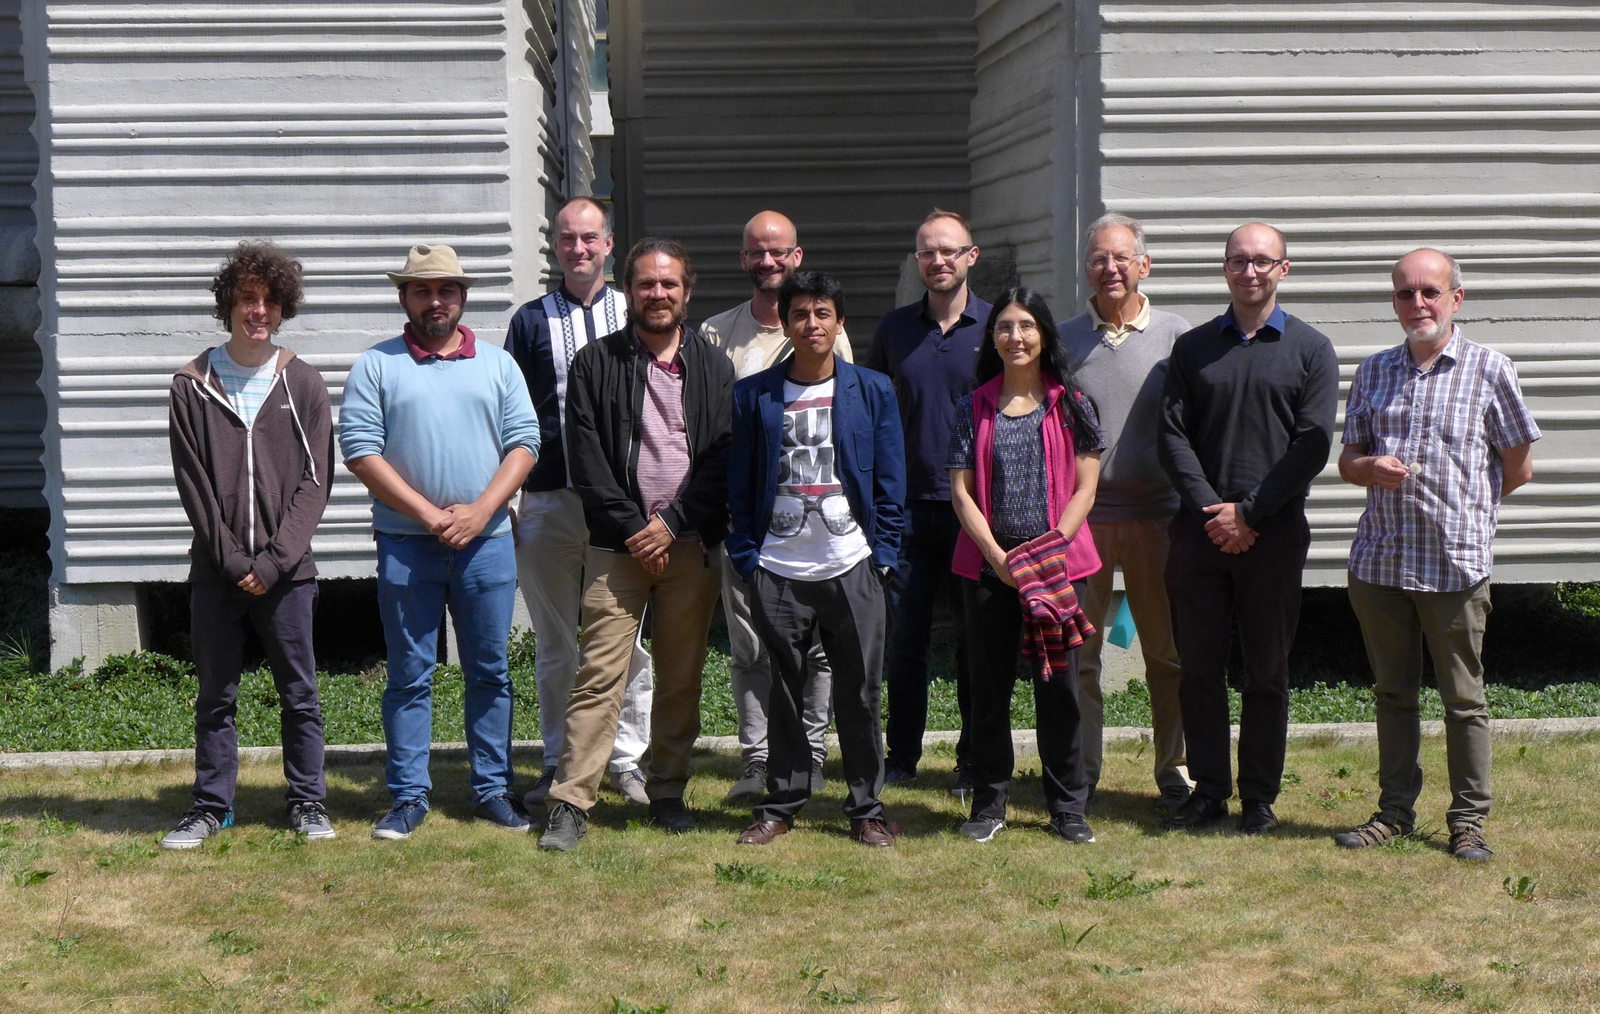
July 2019

Slide 17


Out-of-Time Ordered Commutator
$$C\left(t\right)≡−\left\langle {\left[\hat{W}\left(t\right),\hat{V}\left(0\right)\right]}^{2}\right\rangle$$
1. A special choice $\hat{W}≡\hat{q}$, $\hat{V}≡\hat{p}$ leads, performing the classical limit, to
$${\left(\frac{1}{iℏ}\left[\hat{q}\left(t\right),\hat{p}\left(0\right)\right]\right)}^{2}→{\left({\left\{q\left(t\right),p\left(0\right)\right\}}_{Poisson}\right)}^{2}={\left(\frac{∂q\left(t\right)}{∂q\left(0\right)}\right)}^{2}∼e^{2λt}$$
Exponential divergence of the OTOC in chaotic states expected.
A. Larkin, Y.N. Ovchinnikov, Quasiclassical method in the theory of superconductivity, J. Exp. Theor. Phys. 28, 1200 (1969)
2. A special choice $\hat{W}≡e^{iφ\hat{G}}$, $\hat{V}≡\left|\left.ψ_{0}\right\rangle \left\langle ψ_{0}\right.\right|$ leads to the Fidelity OTOC
$$F\left(t\right)≡\frac{C\left(t\right)}{φ^{2}}=var \hat{G}(t)$$
Experimentally accessible
Easy to perform large-scale semiclassical calculations
R.J. Lewis-Swan, A. Safavi-Naini, J.J. Bollinger, A.M. Rey, Unifying scrambling, thermalization and entanglement through measurement of fidelity out-of-time-order correlators in the Dicke model, Nature Communications 10, 1581 (2019)

Slide 18
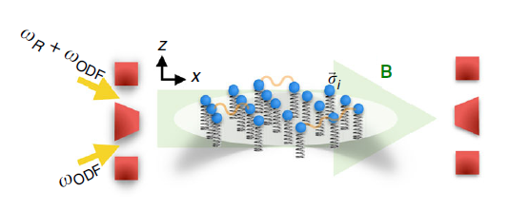
Engineering of the Dicke system
Ion crystal in a Penning trap under a pair of lasers:
center-of-mass mode generates the spin-photon interaction
Resonant microwaves generate transverse field
R.J. Lewis-Swan, A. Safavi-Naini, J.J. Bollinger, A.M. Rey, Unifying scrambling, thermalization and entanglement through measurement of fidelity out-of-time-order correlators in the Dicke model, Nature Communications 10, 1581 (2019)

Slide 19
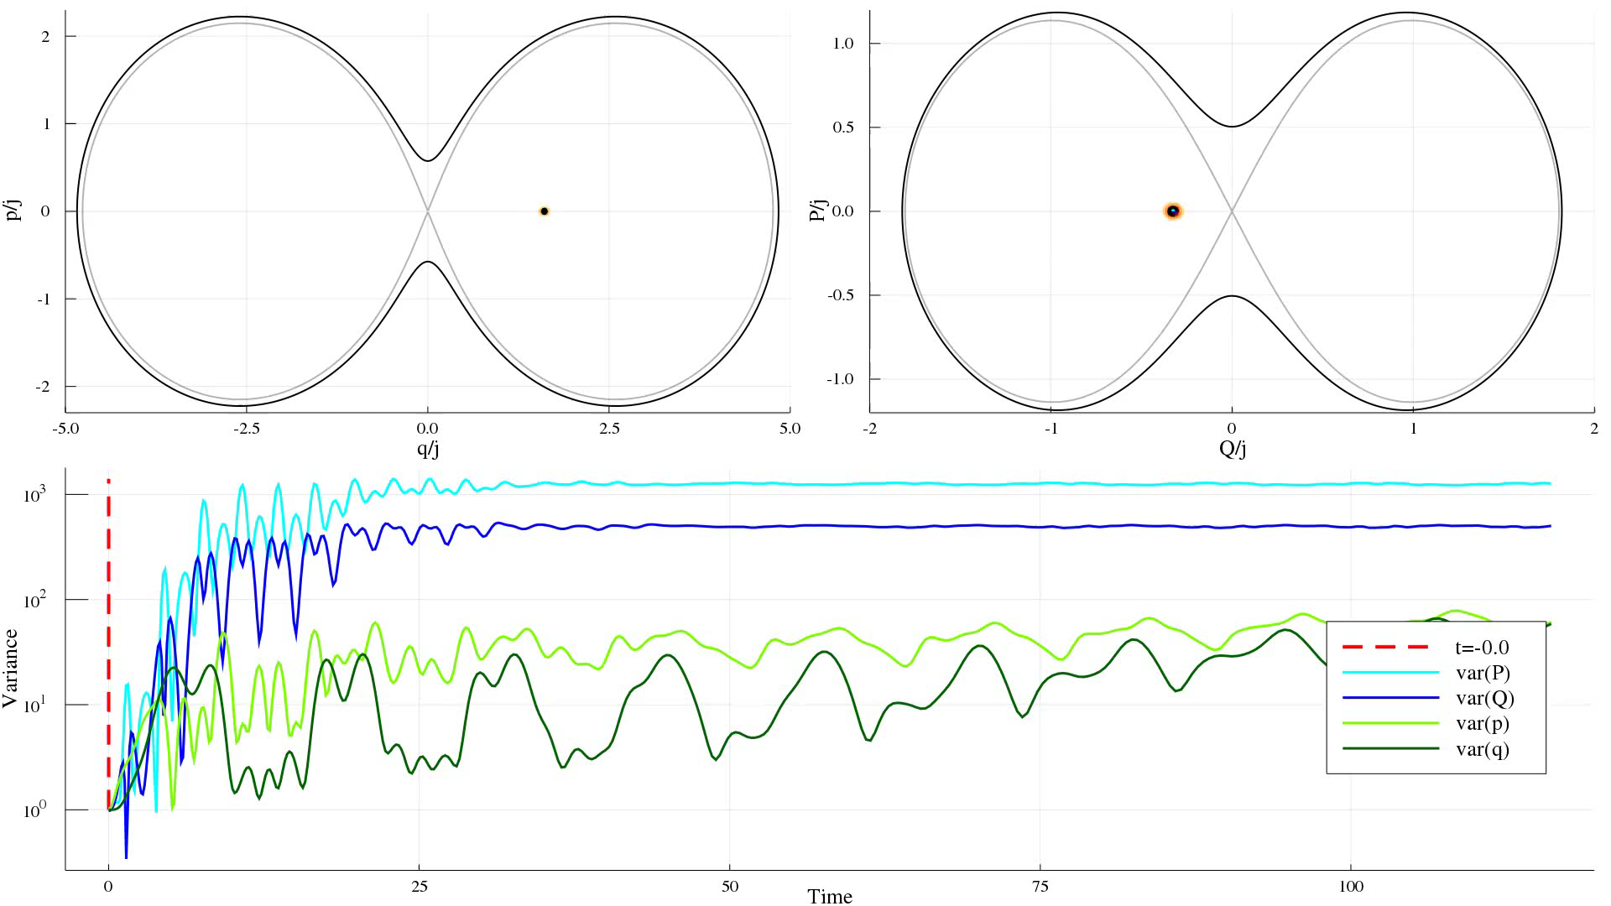
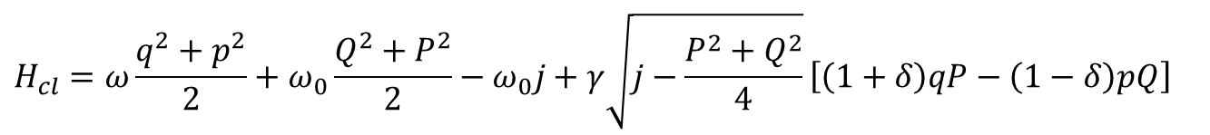
FOTOC Classically (Truncated Wigner approximation)
$$H_{cl}=ω\frac{q^{2}+p^{2}}{2}+ω_{0}\frac{Q^{2}+P^{2}}{2}−ω_{0}j+γ\sqrt{j−\frac{P^{2}+Q^{2}}{4}}\left[\left(1+δ\right)qP−\left(1−δ\right)pQ\right]$$

Slide 20
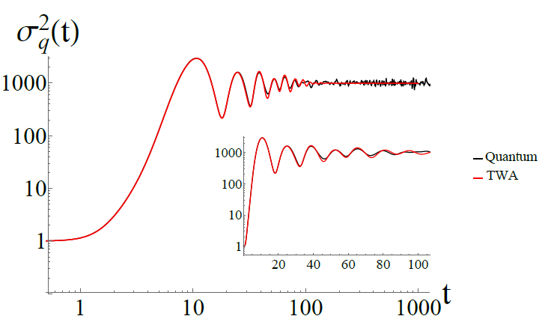
Full quantum computation $×$ Truncated Wigner approximation

Slide 21
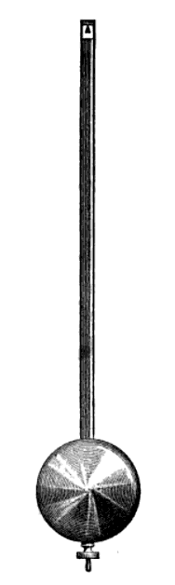
Isolated unstable trajectories
Pendulum
All trajectories periodic except for the separatrix
(having positive Lyapunov exponent)
Classical physics - impossible to prepare (measure) the unstable trajectory
Quantum physics – OTOC is sensitive to the unstable trajectory in a wider energy window!
E.B. Rozenbaum, L.A. Bunimovich, V. Galitski, Quantum chaos in classically non-chaotic systems, arXiv:1902.05466

Slide 22
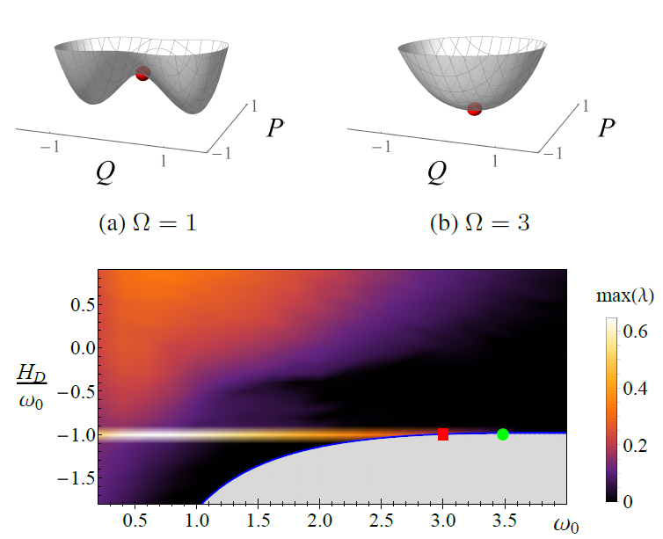
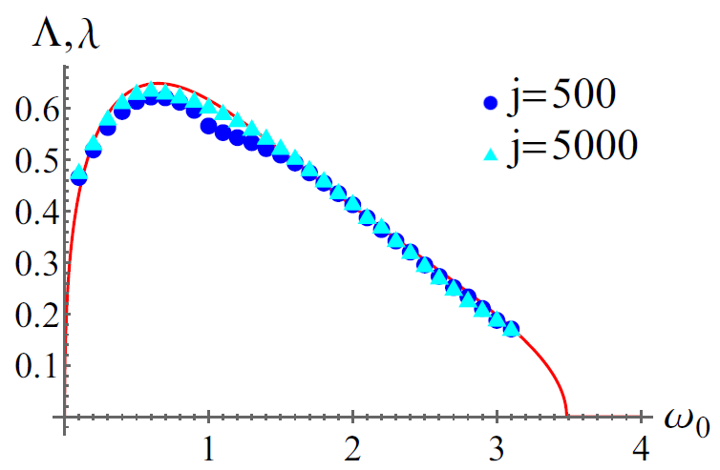

Dicke model - Isolated unstable trajectories
Singular Lyapunov exponent
$$γ=0.66$$
$$ω=0.5$$
Accepted for publication in Phys. Rev. E
ESQPT

Slide 23
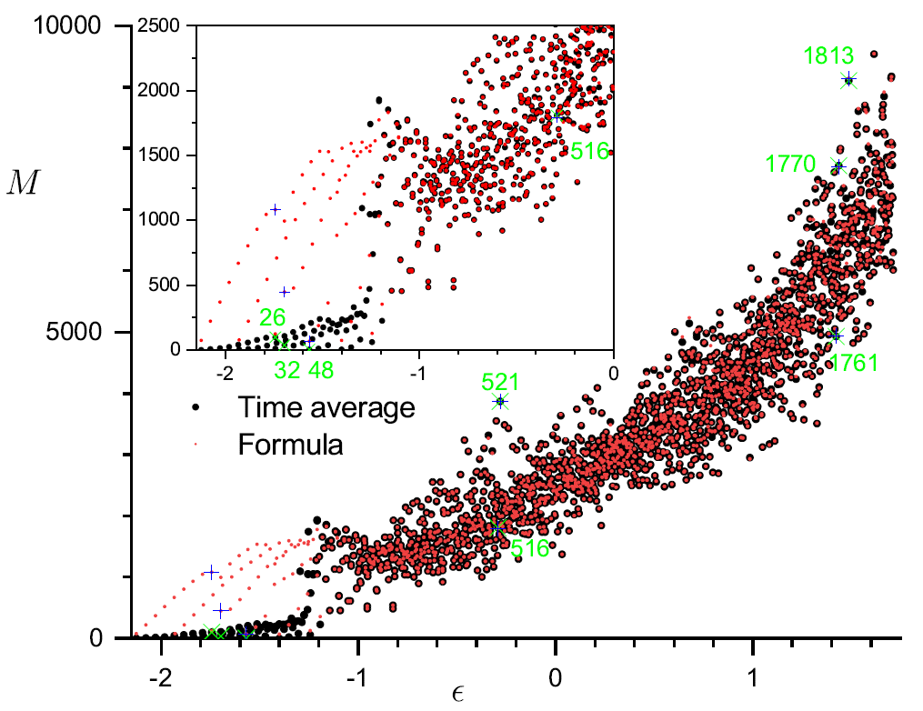

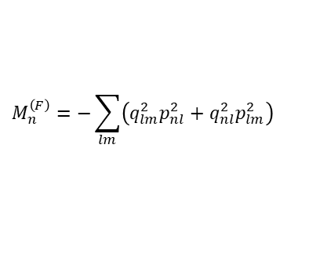
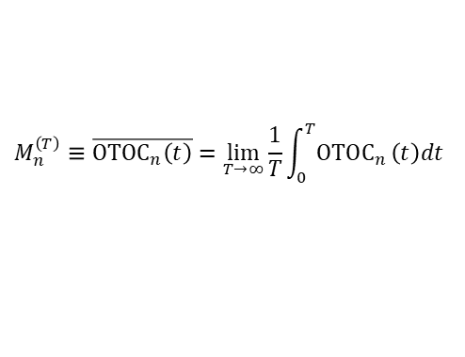
Asymptotic OTOC
$$δ=1, ω=ω_{0}=1,λ=2λ_{c}$$
SR phase
$$M_{n}^{\left(T\right)}≡\overline{OTOC_{n}\left(t\right)}=\lim_{T→∞}{\frac{1}{T}}\int_{0}^{T}{OTOC_{n}}\left(t\right)dt$$
$$M_{n}^{\left(F\right)}=−\sum_{lm}{\left(q_{lm}^{2}p_{nl}^{2}+q_{nl}^{2}p_{lm}^{2}\right)}$$
Region with parity dublets

Slide 24
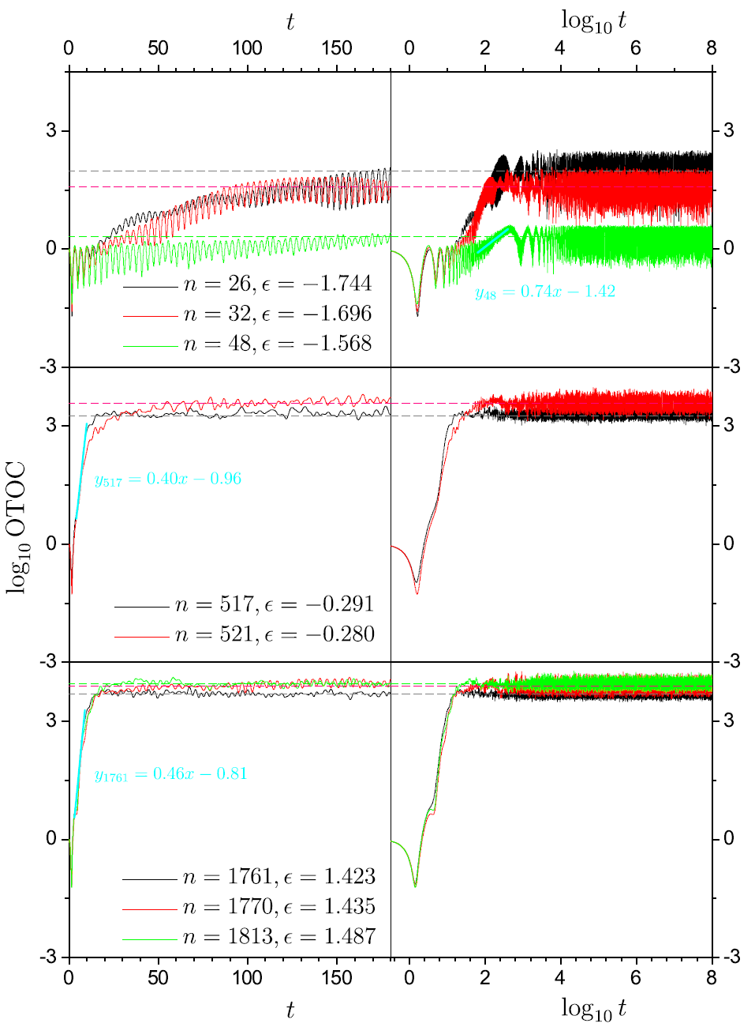
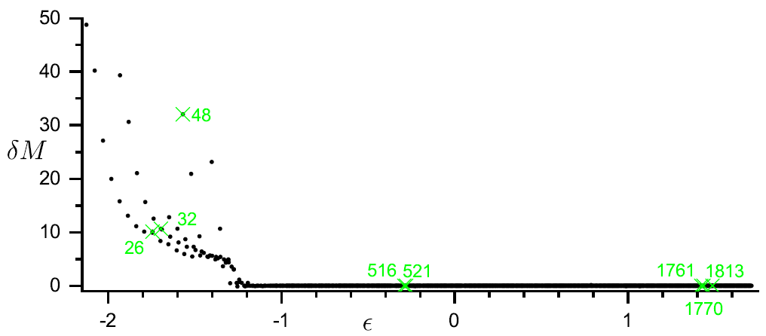
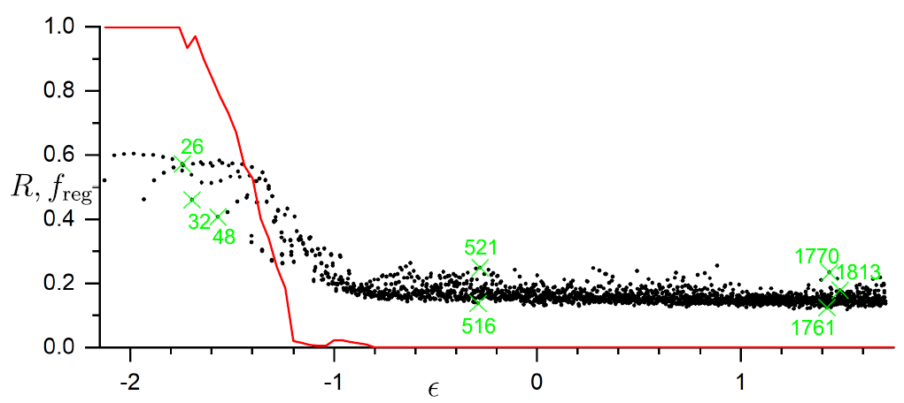



Asymptotic OTOC
SR phase
OTOC
$$δM_{n}≡\frac{M_{n}^{\left(F\right)}−M_{n}^{\left(T\right)}}{M_{n}^{\left(T\right)}}$$
Classical $f_{reg}$
$$R_{n}≡\frac{var {OTOC}_{n}}{M_{n}}$$

Slide 25
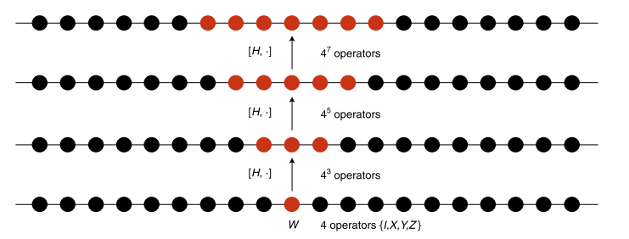

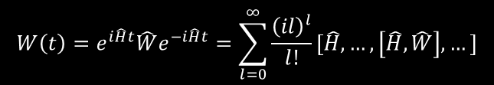


Out-of-Time Ordered Commutator
$$C\left(t\right)≡−\left\langle {\left[\hat{W}\left(t\right),\hat{V}\left(0\right)\right]}^{2}\right\rangle$$
Out-of-Time-Ordered Correlator
$$c\left(t\right)≡\left\langle {\hat{W}}^{+}\left(t\right){\hat{V}}^{+}\left(0\right)\hat{W}\left(t\right)\hat{V}\left(0\right)\right\rangle$$
Overlap between two vectors:
$$|\left.ψ_{1}\left(t\right)\right\rangle =\hat{W}\left(t\right)\hat{V}\left(0\right)\left.|ψ_{0}\right\rangle$$
$$|\left.ψ_{2}\left(t\right)\right\rangle =\hat{V}\left(0\right)\hat{W}\left(t\right)\left.|ψ_{0}\right\rangle$$
$$W\left(t\right)=e^{i\hat{H}t}\hat{W}e^{−i\hat{H}t}=\sum_{l=0}^{∞}{\frac{{\left(il\right)}^{l}}{l!}}[\hat{H},…,\left[\hat{H},\hat{W}\right],…]$$
B. Swingle, Unscrambling the physics of OTOCs, Nature Physics 14, 988 (2018)

Slide 26

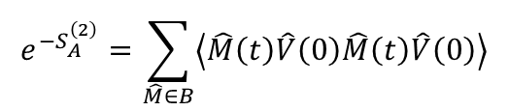



Fundamental OTOC literature
S.H. Shenker, D. Stanford, Black holes and the butterfly effect, JHEP 2014:067
- For operators separated in space $c\left(t,x\right)∼e^{\left[λ\left(t−t^{∗}−\frac{\left|x\right|}{v_{B}}\right)\right]}$
Butterfly velocity
Gauge gravity duality: Black holes in asymptotically AdS spaces are dual to strongly coupled many-body quantum systems. Chaotic nature of quantum many-body systems characterized by OTOCs are related to the collision of shock waves close to the black hole horizon.
P. Hosur, X.L. Qi, D.A. Roberts, B. Yoshida, Chaos in quantum channels, JHEP 2016:004
J. Maldacena, S.H. Shenker, D. Stanford, A bound on chaos, JHEP 2016:106
Bound for Lyapunov exponent: $λ≤\frac{2π}{β}$
K. Hashimoto, K. Murata, R. Yoshii, OTOCs in quantum mechanics, JHEP 2017:138
E.B. Rozenbaum, S. Ganeshan, V. Galitski, Lyapunov exponent and OTOC’s growth rate in a chaotic system, Physical Review Letters 118, 086801 (2017)
R. Fan, P. Zhang, H. Shen, H. Zhai, OTOC for many-body localization, Science Bulletin 62, 707 (2017)
Relation between Rényi entropy of a subsystem and OTOC:
$$S_{A}^{\left(2\right)}=Tr_{B}{\hat{ρ}}_{AB}^{2}$$
$$e^{−S_{A}^{\left(2\right)}}=\sum_{\hat{M}∈B}{\left\langle \hat{M}\left(t\right)\hat{V}\left(0\right)\hat{M}\left(t\right)\hat{V}\left(0\right)\right\rangle }$$
$\hat{V}=\hat{O}e^{−β\hat{H}}{\hat{O}}^{+}$ an arbitrary operator
E.B. Rozenbaum, S. Ganeshan, V. Galitski, Universal Level Statistics of the OTOC, arXiv:1801.10591
Lyapunovian: operator with GOE level statistics and OTOC expectation value

