Slide 1
Time correlators
as a measure of quantum chaos
Pavel Stránský
www.pavelstransky.cz
Outline:
1. Classical chaos
2. Quantum chaos
3. Time correlators, OTOCs (Otočky)
4. Examples
Institute of Plasma Physics, CAS
12th November 2019

Slide 2
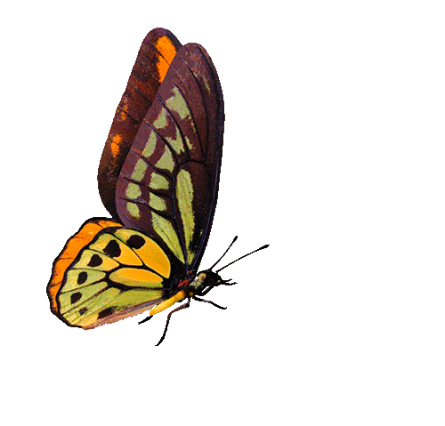
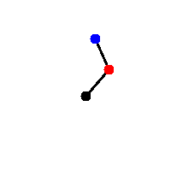
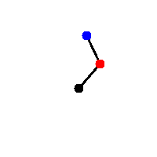
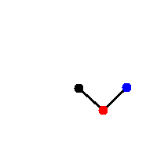

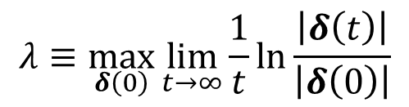



Classical chaos: Instability of trajectories
Stable (regular, quasiperiodic) trajectories
Unstable (chaotic) trajectories
$$δ(0)$$
$$δ(0)$$
$$\left|δ\left(t\right)\right|∝t^{α}$$
$$\left|δ\left(t\right)\right|∝e^{λt}$$
At most polynomial divergence
Exponential divergence
(of a bunch of neigbouring trajectories)
$$λ≡\max_{δ\left(0\right)}{\lim_{t→∞}\frac{1}{t}}\ln{\frac{\left|δ\left(t\right)\right|}{\left|δ\left(0\right)\right|}}$$
Instability quantified by the Lyapunov exponent

Slide 3




Classical chaos: Instability of trajectories
Stable (regular, quasiperiodic) trajectories
Unstable (chaotic) trajectories
$$δ(0)$$
$$δ(0)$$
$$\left|δ\left(t\right)\right|∝t^{α}$$
$$\left|δ\left(t\right)\right|∝e^{λt}$$
Integrability
At most polynomial divergence
Exponential divergence
Hamiltonian:
$$H=H\left(q_{1},…,q_{f},p_{1},…,p_{f}\right)$$
(of a bunch of neigbouring trajectories)
Conservative system:
$$E=H=const.$$
Integrals of motion:
$$I_{j}=I_{j}\left(q_{1},…,q_{f},p_{1},…p_{f}\right)=const.$$
(connected with additional symmetries)
$${\left\{I_{j},I_{k}\right\}}_{Poisson}=0$$
Number of independent integrals of motion
=
number of degrees of freedom
Integrable system:
$$λ≡\max_{δ\left(0\right)}{\lim_{t→∞}\frac{1}{t}}\ln{\frac{\left|δ\left(t\right)\right|}{\left|δ\left(0\right)\right|}}$$
Instability quantified by the Lyapunov exponent
All trajectories quasiperiodic

Slide 4
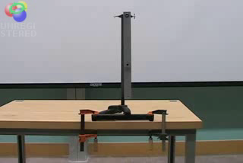
3. Double pendulum

Slide 5
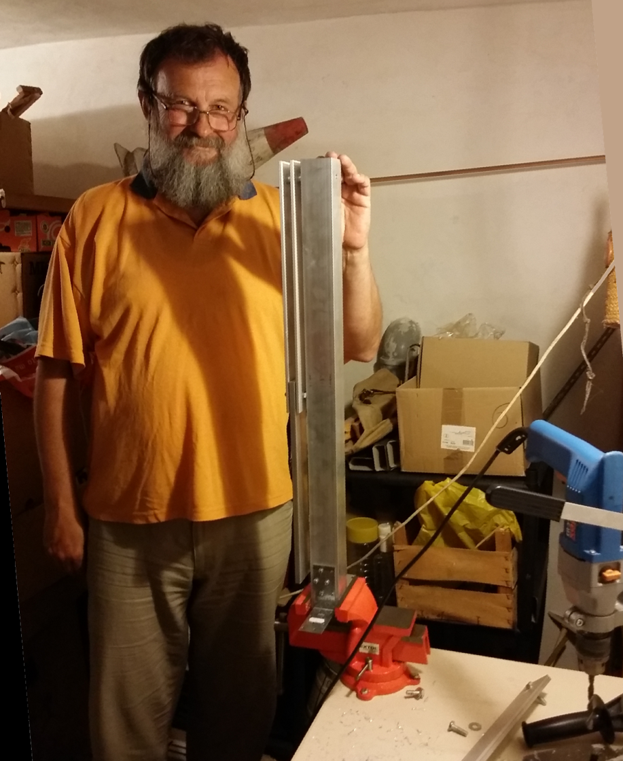

When you see it, you must have it.
Double pendulum construction.

Slide 6
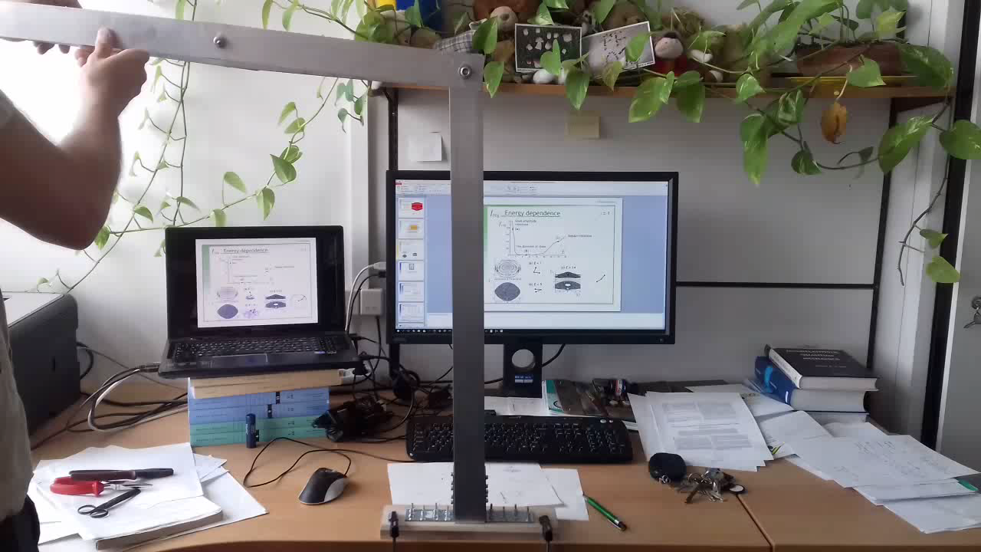

Slide 7
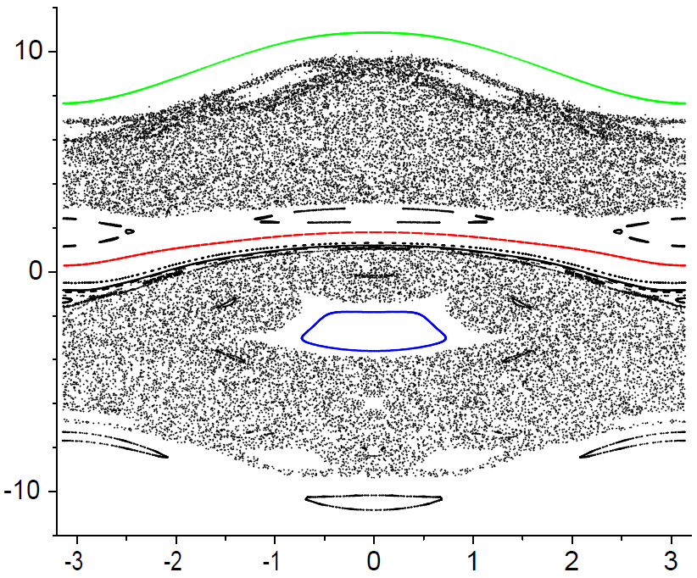


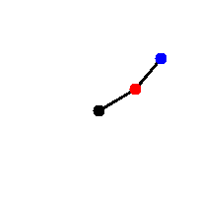
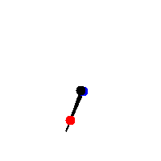
Poincaré sections
γ = 1
E = 12
We plot a point each time M₂ crosses the marked yellow line
Section at ϕ₂ = 0
ordered case – “circles”
chaotic case – “fog” of points
Various initial conditions at energy E = 12

Slide 8
Fraction of regularity
Measure of classical chaos
γ = 1
E = 12
Surface of the section covered with regular trajectories
Total kinematically accessible surface of the section

Slide 9
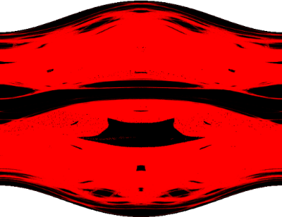
Fraction of regularity
Measure of classical chaos
γ = 1
E = 12
Surface of the section covered with regular trajectories
Total kinematically accessible surface of the section
REGULAR area
CHAOTIC area
f_{reg}=0.29

Slide 10
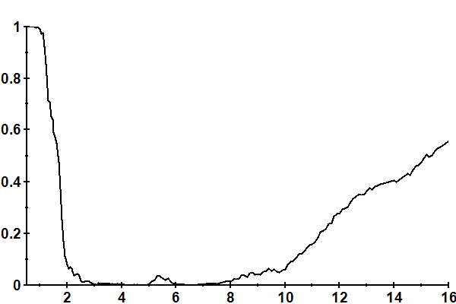


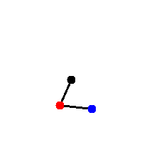
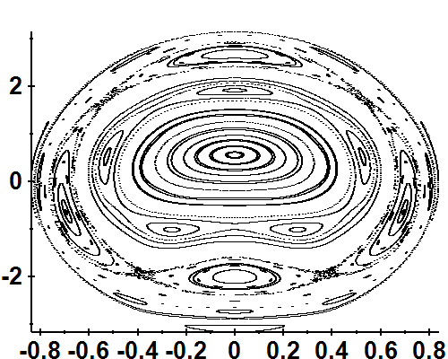
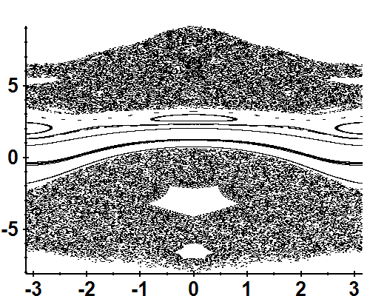
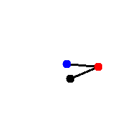
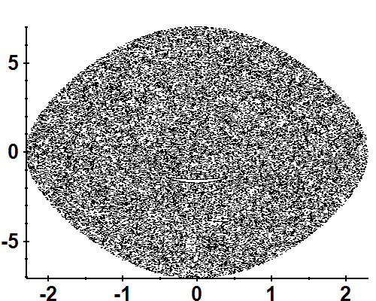
f_{reg} depends on energy!
γ = 1
Small amplitude vibrations
(a)
(c)
Regular vibrations
The dominion of chaos
(b)
(a) E = 1
(c) E = 14
(b) E = 5

Slide 11
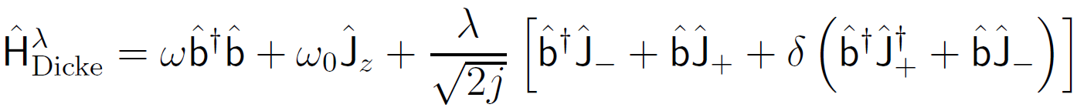
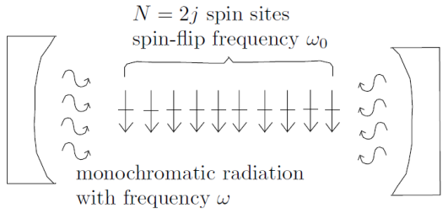
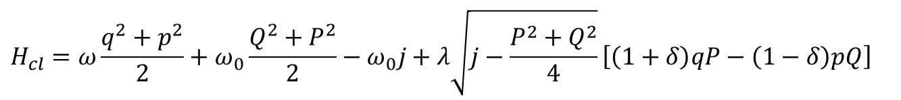
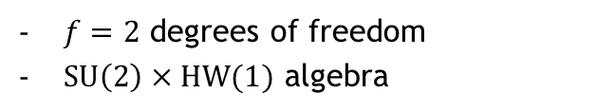
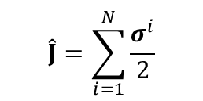
Dicke model of superradiance
interaction of a single-mode bosonic field with a chain of two-level atoms
$f=2$ degrees of freedom
$SU\left(2\right)×HW(1)$ algebra
R.H, Dicke, Phys. Rev. 93, 99 (1954)
K. Hepp, E. Lieb, Ann. Phys. 76, 360 (1973)
$$\hat{J}=\sum_{i=1}^{N}{\frac{σ^{i}}{2}}$$
Semiclassical Hamiltonian
$$H_{cl}=ω\frac{q^{2}+p^{2}}{2}+ω_{0}\frac{Q^{2}+P^{2}}{2}−ω_{0}j+λ\sqrt{j−\frac{P^{2}+Q^{2}}{4}}\left[\left(1+δ\right)qP−\left(1−δ\right)pQ\right]$$
M. Kloc, P. Stránský, P. Cejnar, Ann. Phys. 382, 85 (2017)

Slide 12
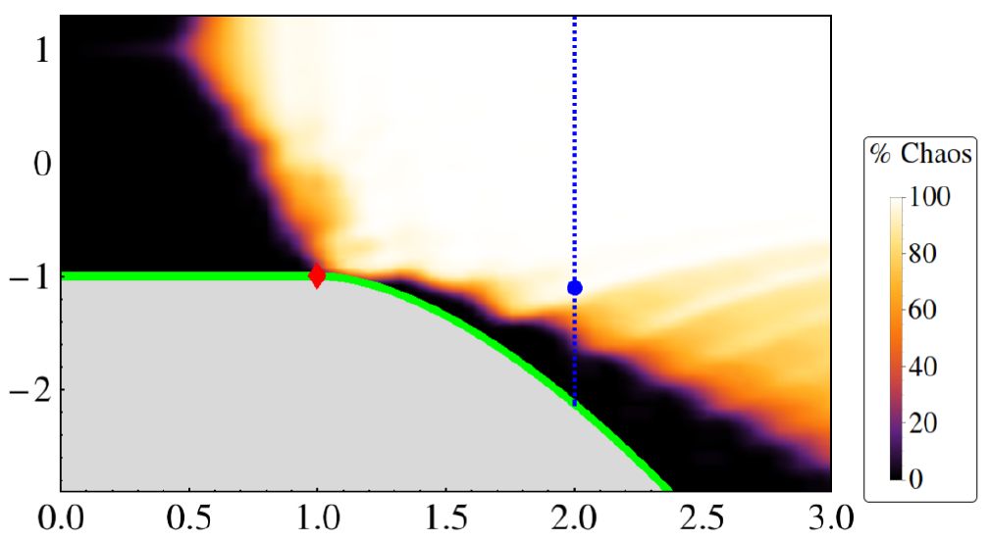


Map of the classical chaos
(general behaviour in a low-dimensional classical system)
(in the Dicke model)
$$E$$
External parameter(s) $λ$

Slide 13
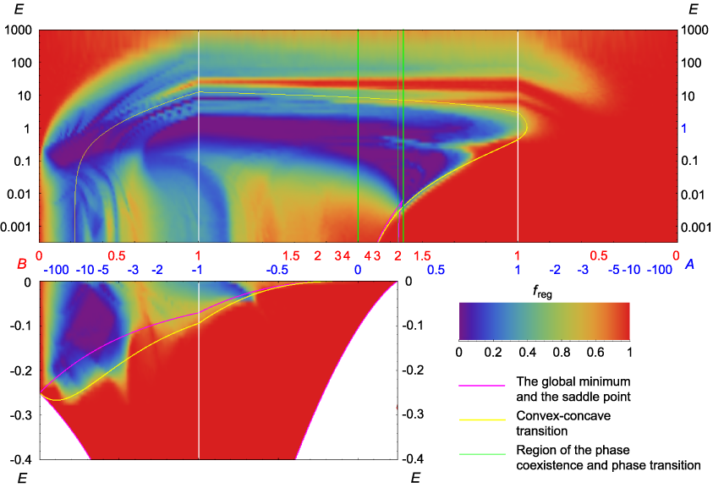
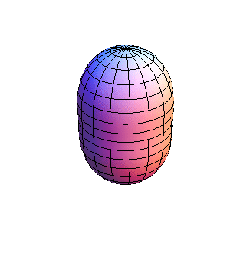
Quadrupole vibrations of atomic nuclei
integrable
integrable
Veins
of
regularity
chaotic
Shape-phase transition
regular
“Arc of regularity”
control parameter
HO approximation

Slide 14
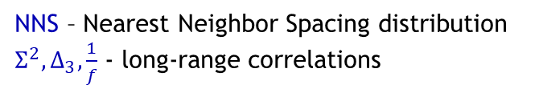
Quantum chaos: Correlations in spectra
Schrödinger equation is linear quantum suppression of chaos
No trajectories, no phase space
Energy spectra
NNS – Nearest Neighbor Spacing distribution
$Σ^{2},Δ_{3},\frac{1}{f}$ - long-range correlations
Correlation between individual levels:
„Wigner surmise” (1950s):
Hamiltonian of a complex quantum system (e.g. a highly excited atomic nucleus) can be described by a random matrix.

Slide 15

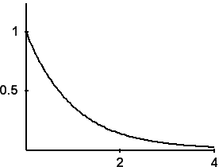
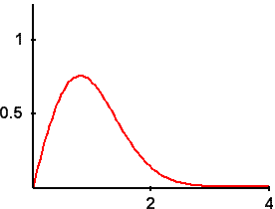
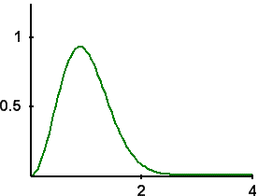
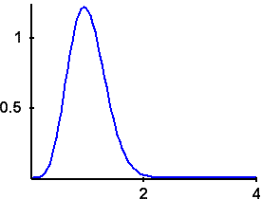




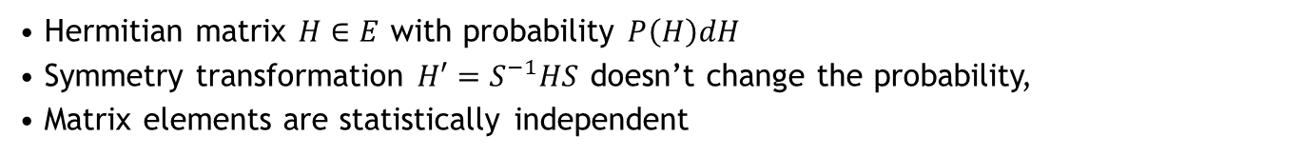
Quantum chaos: Correlations in spectra
Schrödinger equation is linear quantum suppression of chaos
No trajectories, no phase space
Energy spectra
Nearest neighbour spacing distribution
E
NNS – Nearest Neighbor Spacing distribution
$Σ^{2},Δ_{3},\frac{1}{f}$ - long-range correlations
Correlation between individual levels:
„Wigner surmise” (1950s):
Hamiltonian of a complex quantum system (e.g. a highly excited atomic nucleus) can be described by a random matrix.
P(s)
Poisson
GOE
GUE
GSE
Gaussian random matrix ensembles
Hermitian matrix $H∈E$ with probability $P\left(H\right)dH$
Symmetry transformation $H′=S^{−1}HS$ doesn’t change the probability,
Matrix elements are statistically independent
REGULAR system
CHAOTIC system
$$P\left(H^{′}\right)dH^{′}=P\left(H\right)dH$$
ensemble | S | H | T invariance | Angular momentum | R invariance
GOE | Orthogonal | Symmetric | YES YES | n n/2 | YES
GUE | Unitary | Hermitian | NO
GSE | Symplectic |  | YES | n/2 | NO
Brody distribution
Smoothly (but artificially) connects Poisson and GOE NNSDs
Brody parameter ω – chaoticity measure of the system

Slide 16
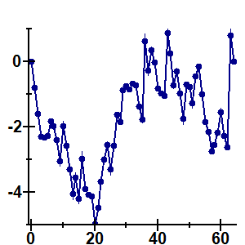
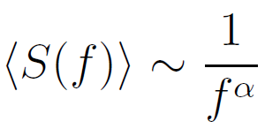
1/f noise
Time series representation of quantum spectra
Fourier transformation – a study of fluctuations in the frequency spectrum of energy levels
δ_{n} = 0
δ₄
δ_{k}
δ₃
δ₂
k
δ₁ = 0
α = 2
α = 2
α = 1
REGULAR system
CHAOTIC system
α = 1
A. Relaño et al., Phys. Rev. Lett. 89, 244102 (2002)
E. Faleiro et al., Phys. Rev. Lett. 93, 244101 (2004)
J. M. G. Gómez et al., Phys. Rev. Lett. 94, 084101 (2005)

Slide 17
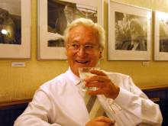
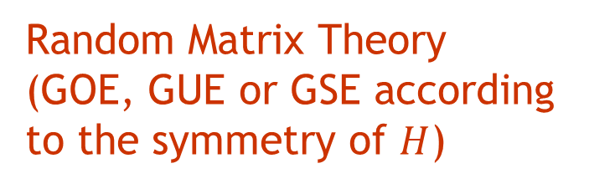
Bohigas conjecture (1984)
(connection between classical and quantum chaos)
Classical counterpart of a quantum system is
Statistics of the quantum energy spectrum follows
chaotic
regular
Random Matrix Theory
(GOE, GUE or GSE according to the symmetry of $H$)
Poissonian distribution
O. Bohigas, M. J. Giannoni, C. Schmit, Phys. Rev. Lett. 52 (1984), 1

Slide 18

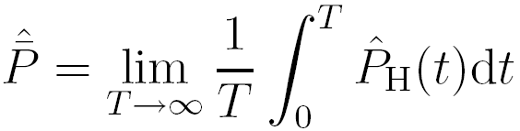
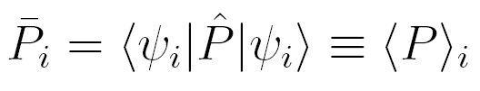
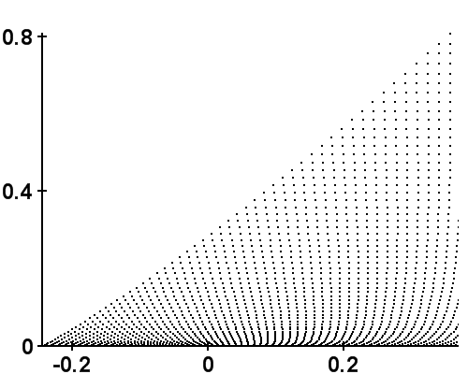
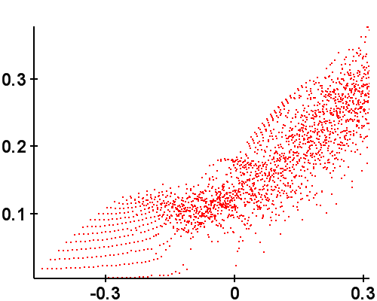
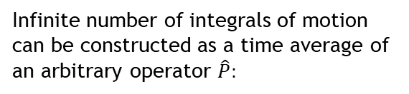
Peres lattice
Quantum system:
Infinite number of integrals of motion can be constructed as a time average of an arbitrary operator $\hat{P}:$
Lattice: energy E_{i} versus value of
lattice always ordered for any operator P
nonintegrable
partly ordered,
partly disordered
Integrable
B = 0
B = 0.445
<P>
<P>
regular
E
E
regular
chaotic
A. Peres, Phys. Rev. Lett. 53, 1711 (1984)

Slide 19
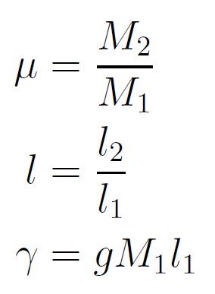
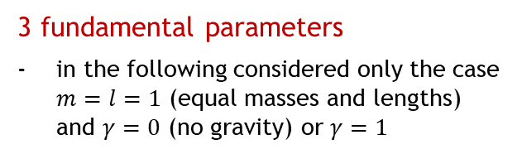
Double pendulum: Quantization
3 fundamental parameters
in the following considered only the case $m=l=1$ (equal masses and lengths) and $γ=0$ (no gravity) or $γ=1$
Angular momenta
(associated with the angles ϕ)
Quantization:
Ambiguous procedure
(noncommuting in the kintetic term)
Peres operators:
L. Perotti, Phys. Rev. E 34, 066218 (2004)

Slide 20
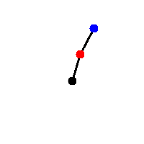
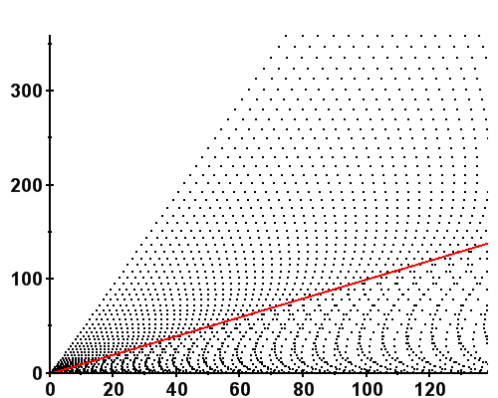
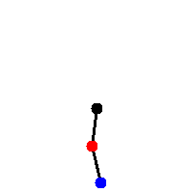
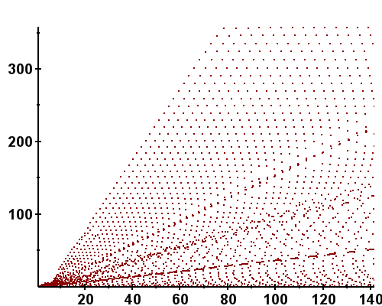


Double Pendulum: Peres lattice
$γ=0$(no gravity): integrable
Libration
in
Rotation
Peres lattices
$γ=1$: nonintegrable
capable of distinguishing different classes of motion
Band of strong level interaction
Chaotic band
Just at the border between libration and rotation types of motion (separatrix)

Slide 21
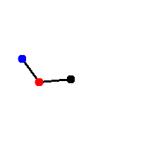
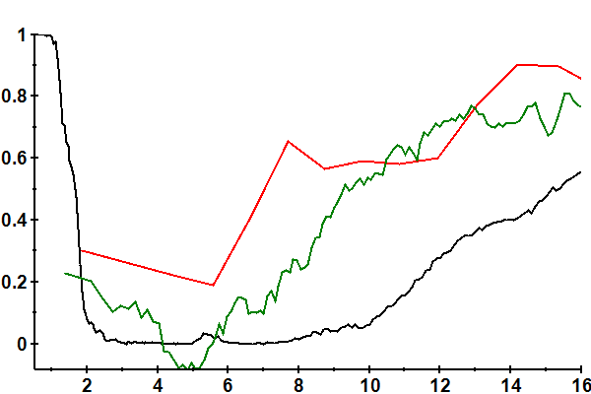
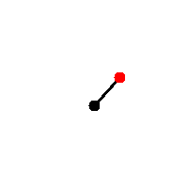

Classical-Quantum Correspondence
(c) mixed
(a) regular
Classical and quantum measures of chaos
α - 1
1 - ω
regularity
f_{reg}
(b) chaotic
(c)
Dominion of chaos
Harmonic approximation
Prevalence of rotations
(a)
(b)

Slide 22

Classical-Quantum Correspondence
(c)
Dominion of chaos
Harmonic approximation
Prevalence of rotations
(a)
(b)
Classical and quantum measures of chaos
α - 1
1 - ω
regularity
f_{reg}

Slide 23
Classical chaos
Quantum chaos
Any dynamical connection?

Slide 24









Quantum fidelity (Loschmidt echo)
$$S\left(t\right)={\left|\left\langle φ | {\hat{U}}^{+}\left(t\right){\hat{U}}^{′}\left(t\right) | φ\right\rangle \right|}^{2}$$
$${\hat{H}}^{′}=\hat{H}+ε\hat{V}$$
($ε$ small parameter,
$\hat{V}$ arbitrary operator)
$$e^{−\frac{i}{ℏ}H^{′}t}$$
$$|φ〉$$
$$e^{−\frac{i}{ℏ}Ht}$$
Overlap $≡$ fidelity
Fidelity decays to a much lower value if the system described by $\hat{H}$ is chaotic.
The fluctuations are also lower in chaotic systems.
A. Peres, Phys. Rev. A 30, 1610 (1984)
T. Gorin, T. Prozen, T. Seligman, M. Žnidarič, Phys. Rep. 435, 33 (2006)

Slide 25


Out-of-Time Ordered Commutator
$$C\left(t\right)≡−\left\langle {\left[\hat{W}\left(t\right),\hat{V}\left(0\right)\right]}^{2}\right\rangle$$
1. A special choice $\hat{W}≡\hat{q}$, $\hat{V}≡\hat{p}$ leads, performing the classical limit, to
$${\left(\frac{1}{iℏ}\left[\hat{q}\left(t\right),\hat{p}\left(0\right)\right]\right)}^{2}→{\left({\left\{q\left(t\right),p\left(0\right)\right\}}_{Poisson}\right)}^{2}={\left(\frac{∂q\left(t\right)}{∂q\left(0\right)}\right)}^{2}∼e^{2λt}$$
Exponential divergence of the OTOC in chaotic states expected.
A. Larkin, Y.N. Ovchinnikov, Quasiclassical method in the theory of superconductivity, J. Exp. Theor. Phys. 28, 1200 (1969)

Slide 26

OTOC for chaotic states
Ehrenfest (scrambling) time
Exponential rise
Short-time universal behaviour
Dissipation (collision) time
Saturation

Slide 27

OTOC for chaotic states
Ehrenfest (scrambling) time
Exponential rise
Short-time universal behaviour
Dissipation (collision) time
Quantum Lyapunov exponent
Saturation

Slide 28

OTOC for regular states
Short-time universal behaviour
Strong recurrences
(no saturation / thermalization)
Polynomial rise

Slide 29

January 2019
J. Chávez-Carlos, B. López-del-Caprio, M.A. Bastarrachea-Magnani, P. Stránský, S. Lerma-Hernández, L.F. Santos, J. Hirsch
Quantum and classical Lyapunov exponents in atom-field interaction systems
Physical Review Letters 122, 024101 (2019)

Slide 30


Out-of-Time Ordered Commutator
$$C\left(t\right)≡−\left\langle {\left[\hat{W}\left(t\right),\hat{V}\left(0\right)\right]}^{2}\right\rangle$$
1. A special choice $\hat{W}≡\hat{q}$, $\hat{V}≡\hat{p}$ leads, performing the classical limit, to
$${\left(\frac{1}{iℏ}\left[\hat{q}\left(t\right),\hat{p}\left(0\right)\right]\right)}^{2}→{\left({\left\{q\left(t\right),p\left(0\right)\right\}}_{Poisson}\right)}^{2}={\left(\frac{∂q\left(t\right)}{∂q\left(0\right)}\right)}^{2}∼e^{2λt}$$
Exponential divergence of the OTOC in chaotic states expected.
A. Larkin, Y.N. Ovchinnikov, Quasiclassical method in the theory of superconductivity, J. Exp. Theor. Phys. 28, 1200 (1969)
2. A special choice $\hat{W}≡e^{iφ\hat{G}}$, $\hat{V}≡\left|\left.ψ_{0}\right\rangle \left\langle ψ_{0}\right.\right|$ leads to the Fidelity OTOC
$$F\left(t\right)≡\frac{C\left(t\right)}{φ^{2}}=var \hat{G}(t)$$
Experimentally accessible
Easy to perform large-scale semiclassical calculations
R.J. Lewis-Swan, A. Safavi-Naini, J.J. Bollinger, A.M. Rey, Unifying scrambling, thermalization and entanglement through measurement of fidelity out-of-time-order correlators in the Dicke model, Nature Communications 10, 1581 (2019)

Slide 31

Engineering of the Dicke system
Ion crystal in a Penning trap under a pair of lasers:
center-of-mass mode generates the spin-photon interaction
Resonant microwaves generate transverse field

Slide 32


FOTOC Classically (Truncated Wigner approximation)
$$H_{cl}=ω\frac{q^{2}+p^{2}}{2}+ω_{0}\frac{Q^{2}+P^{2}}{2}−ω_{0}j+λ\sqrt{j−\frac{P^{2}+Q^{2}}{4}}\left[\left(1+δ\right)qP−\left(1−δ\right)pQ\right]$$

Slide 33

Full quantum computation $×$ Truncated Wigner approximation

Slide 34

Isolated unstable trajectories
Pendulum
All trajectories periodic except for the separatrix
(having positive Lyapunov exponent)
Classical physics - impossible to prepare (measure) the unstable trajectory
Quantum physics – OTOC is sensitive to the unstable trajectory in a wider energy window!
E.B. Rozenbaum, L.A. Bunimovich, V. Galitski, Quantum chaos in classically non-chaotic systems, arXiv:1902.05466

Slide 35

Dicke model - Isolated unstable trajectories
Work in progress…
Petra Ruth Kaprálová, Milan Šindelka, Filip Hanák, Daniel Šimsa (CAS)
Jorge Hirsch, Sergio Lerma, Miguel-Angel Bastarrachea, Jorge Chávez, Saúl Pilatowsky (Mexico)
Lea Santos (New York, USA)
Pavel Cejnar, Michal Kloc, Pavel Stránský (MFF UK)

Slide 36





Out-of-Time Ordered Commutator
$$C\left(t\right)≡−\left\langle {\left[\hat{W}\left(t\right),\hat{V}\left(0\right)\right]}^{2}\right\rangle$$
Out-of-Time-Ordered Correlator
$$c\left(t\right)≡\left\langle {\hat{W}}^{+}\left(t\right){\hat{V}}^{+}\left(0\right)\hat{W}\left(t\right)\hat{V}\left(0\right)\right\rangle$$
Overlap between two vectors:
$$|\left.ψ_{1}\left(t\right)\right\rangle =\hat{W}\left(t\right)\hat{V}\left(0\right)\left.|ψ_{0}\right\rangle$$
$$|\left.ψ_{2}\left(t\right)\right\rangle =\hat{V}\left(0\right)\hat{W}\left(t\right)\left.|ψ_{0}\right\rangle$$
$$W\left(t\right)=e^{i\hat{H}t}\hat{W}e^{−i\hat{H}t}=\sum_{l=0}^{∞}{\frac{{\left(il\right)}^{l}}{l!}}[\hat{H},…,\left[\hat{H},\hat{W}\right],…]$$
B. Swingle, Unscrambling the physics of OTOCs, Nature Physics 14, 988 (2018)

Slide 37





Fundamental OTOC literature
S.H. Shenker, D. Stanford, Black holes and the butterfly effect, JHEP 2014:067
- For operators separated in space $c\left(t,x\right)∼e^{\left[λ\left(t−t^{∗}−\frac{\left|x\right|}{v_{B}}\right)\right]}$
Butterfly velocity
Gauge gravity duality: Black holes in asymptotically AdS spaces are dual to strongly coupled many-body quantum systems. Chaotic nature of quantum many-body systems characterized by OTOCs are related to the collision of shock waves close to the black hole horizon.
P. Hosur, X.L. Qi, D.A. Roberts, B. Yoshida, Chaos in quantum channels, JHEP 2016:004
J. Maldacena, S.H. Shenker, D. Stanford, A bound on chaos, JHEP 2016:106
Bound for Lyapunov exponent: $λ≤\frac{2π}{β}$
K. Hashimoto, K. Murata, R. Yoshii, OTOCs in quantum mechanics, JHEP 2017:138
E.B. Rozenbaum, S. Ganeshan, V. Galitski, Lyapunov exponent and OTOC’s growth rate in a chaotic system, Physical Review Letters 118, 086801 (2017)
R. Fan, P. Zhang, H. Shen, H. Zhai, OTOC for many-body localization, Science Bulletin 62, 707 (2017)
Relation between Rényi entropy of a subsystem and OTOC:
$$S_{A}^{\left(2\right)}=Tr_{B}{\hat{ρ}}_{AB}^{2}$$
$$e^{−S_{A}^{\left(2\right)}}=\sum_{\hat{M}∈B}{\left\langle \hat{M}\left(t\right)\hat{V}\left(0\right)\hat{M}\left(t\right)\hat{V}\left(0\right)\right\rangle }$$
$\hat{V}=\hat{O}e^{−β\hat{H}}{\hat{O}}^{+}$ an arbitrary operator
E.B. Rozenbaum, S. Ganeshan, V. Galitski, Universal Level Statistics of the OTOC, arXiv:1801.10591
Lyapunovian: operator with GOE level statistics and OTOC expectation value

