Slide 1
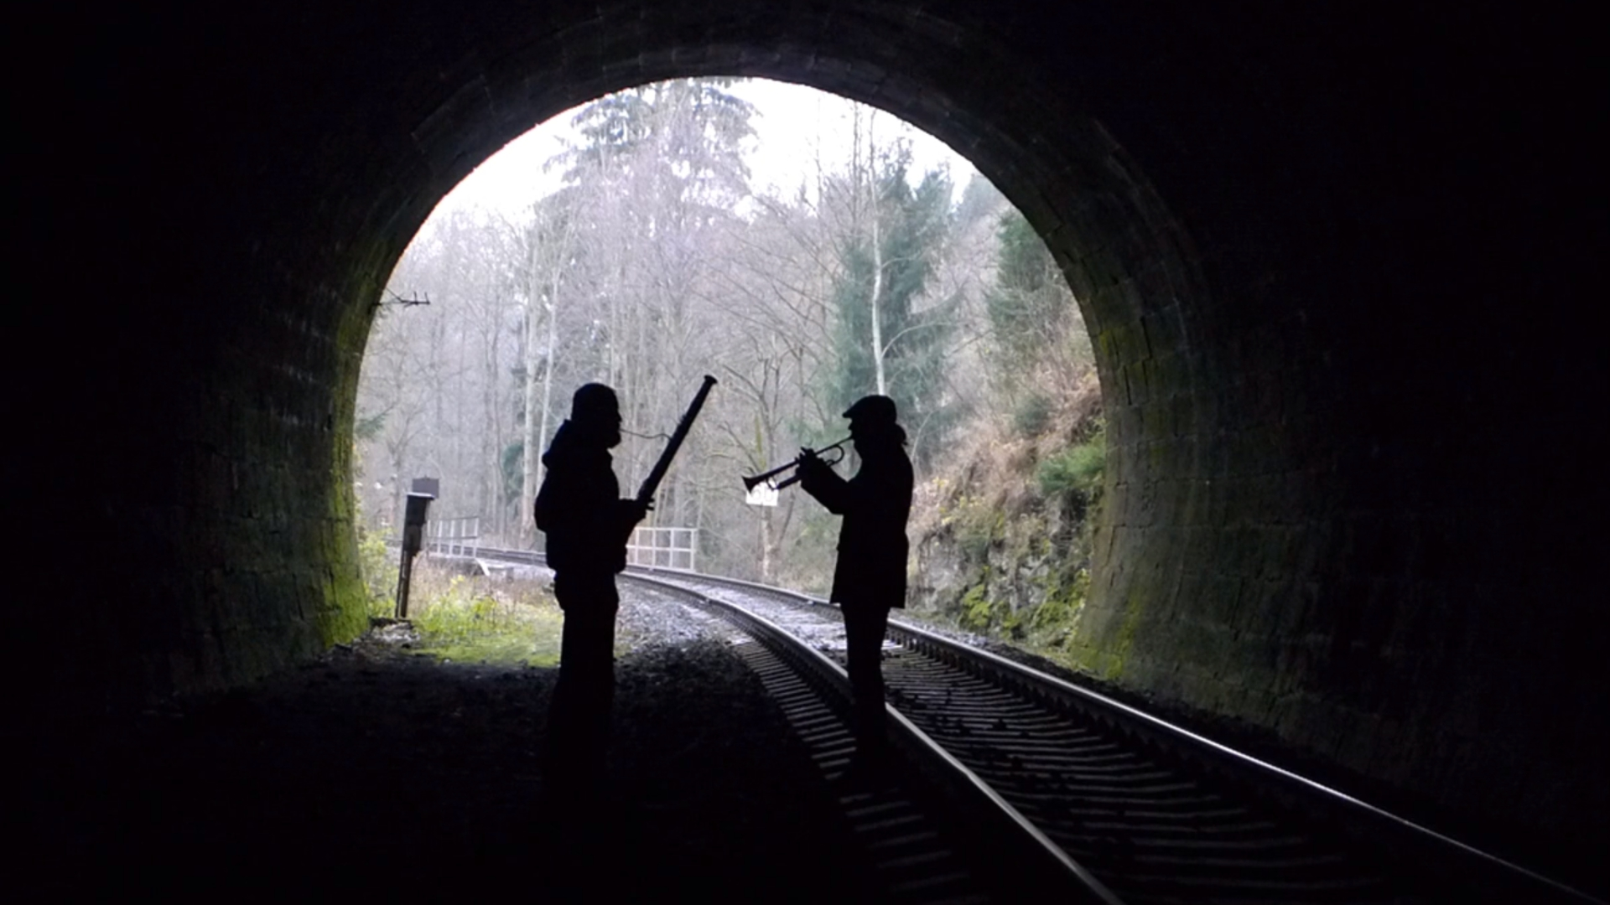


Complex time and Critical effects
in
Quantum tunnelling
Pavel Stránský
Institute of Particle and Nuclear Physics, Charles University, Czech Republic
Supported by:
Collaborators:
Pavel Cejnar (IPNP)
Milan Šindelka (IPP CAS)
Michal Kloc (IPNP, Uni Basel)
Publications:
Physical Review Letters 125, 020401 (2020)
Physical Review A 103, 062207 (2021)
ITP Seminar
8 March 2022

Slide 2
Outline
Motivation
Theory
  Continuum level density
  Complex scaling method
  Complex time shift
  ESQPT-like singularities in the continuum LD
Numerical results
Summary and conclusions

Slide 3
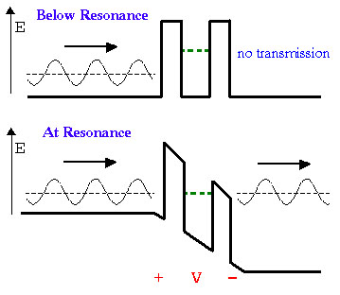
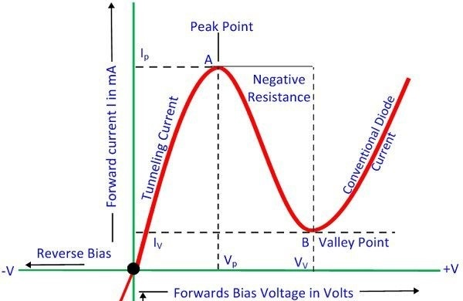
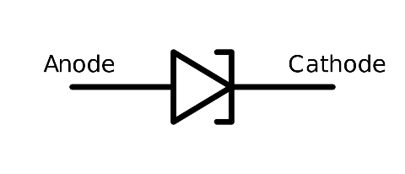
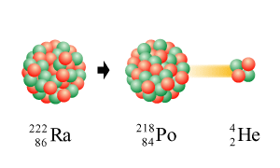

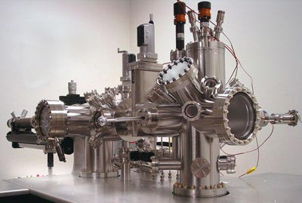
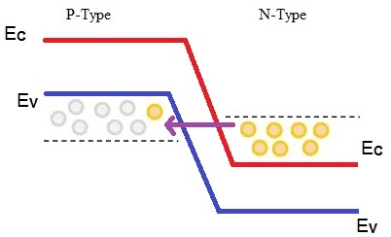
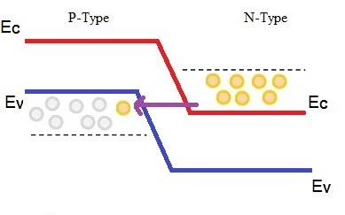
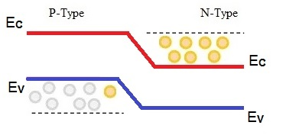





Experimental Motivation
https://www.electronicshub.org/tunnel-diode-working-characteristics-applications/
Resonant-tunnelling diode
Scanning tunnelling microscope
https://www.electronicshub.org/tunnel-diode-working-characteristics-applications/
Tunnel diode
Radioactive $α$-decay
STM tip
Tunnelling current
A
$$I∝e^{−Kd}$$
Sample surface
Leo Esaki (Sony)
Nobel Prize 1973
Radioactive $α$-decay
IBM research
laboratory Zurich
Electrons cross the barrier
$$V_{α}$$
Gerd Binnig
Heinrich Rohrer
Nobel prize 1986
$$V_{α}$$
No tunnel current
https://www.electronicshub.org/tunnel-diode-working-characteristics-applications/

Slide 4
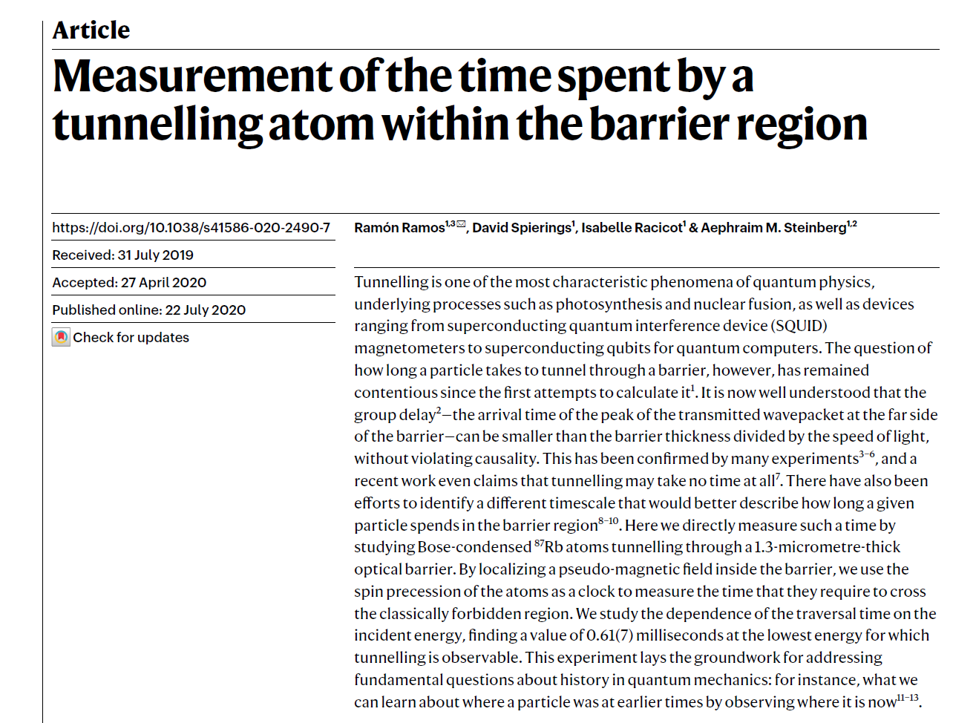
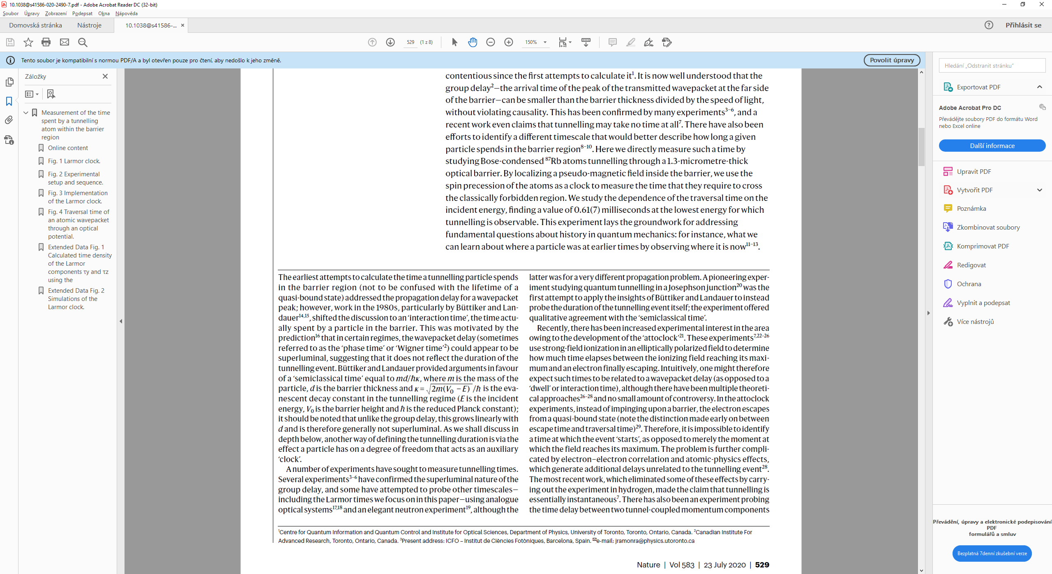
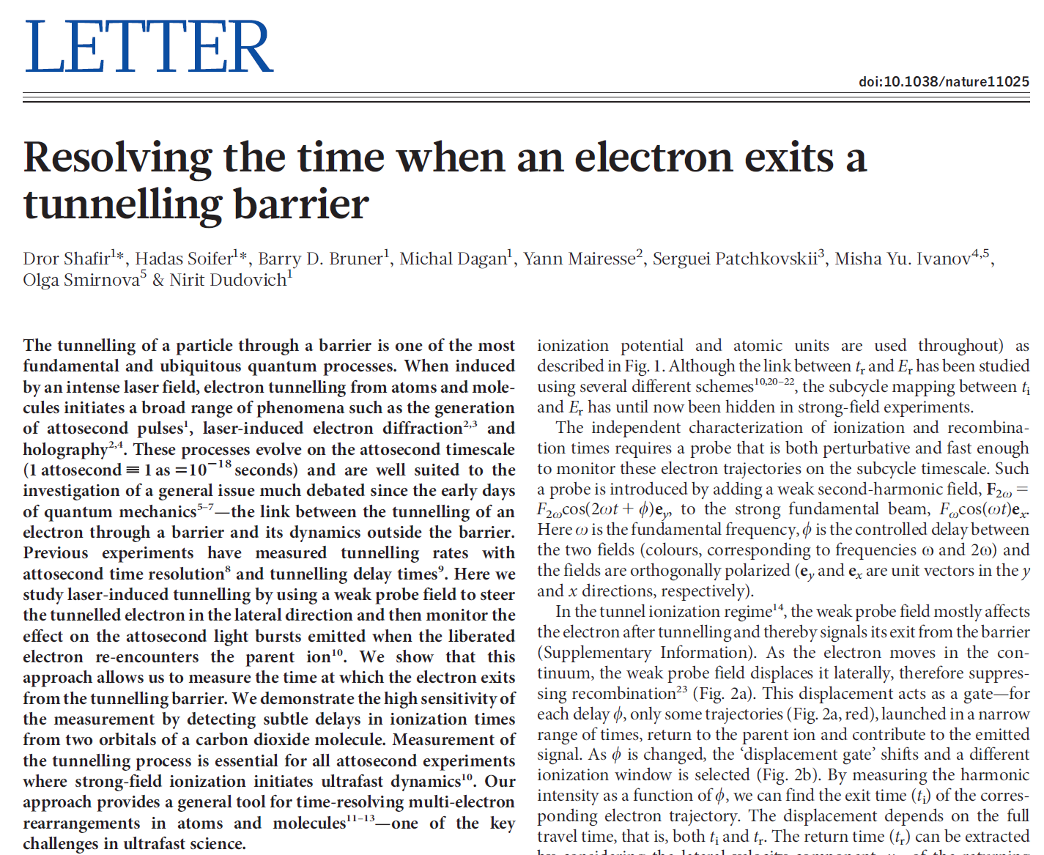
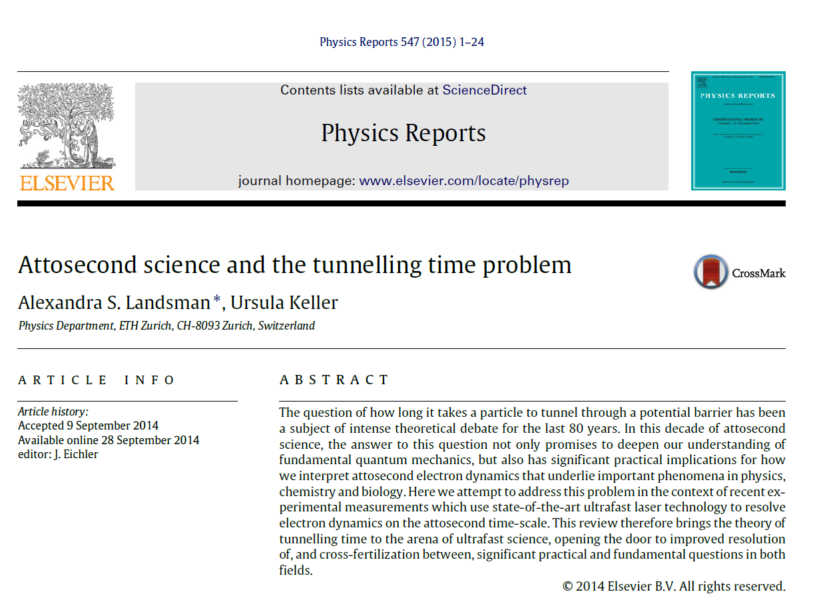
Experimental Motivation: Tunnelling time

Slide 5
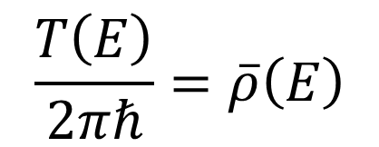

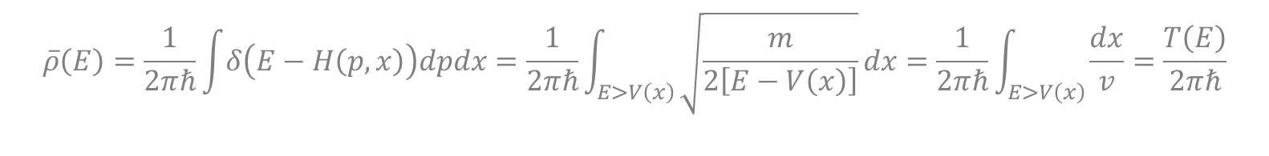
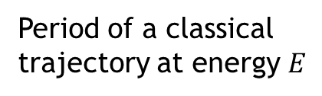
Theoretical Motivation
A 1DoF bound system with discrete spectrum:
Period of a classical trajectory at energy $E$
$$\frac{T\left(E\right)}{2πℏ}=\overline{ρ}\left(E\right)$$
Smooth quantum level density
Weyl formula
$$\overline{ρ}\left(E\right)=\frac{1}{2πℏ}\int{δ\left(E−H\left(p,x\right)\right)dpdx}=\frac{1}{2πℏ}\int_{E>V\left(x\right)}{\sqrt{\frac{m}{2\left[E−V\left(x\right)\right]}}dx}=\frac{1}{2πℏ}\int_{E>V\left(x\right)}{\frac{dx}{v}}=\frac{T\left(E\right)}{2πℏ}$$
Proof:
$$H=\frac{p^{2}}{2m}+V\left(x\right)$$

Slide 6
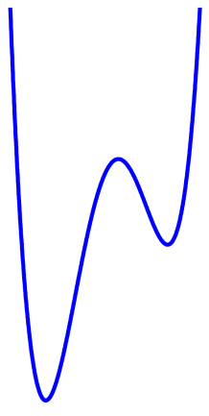
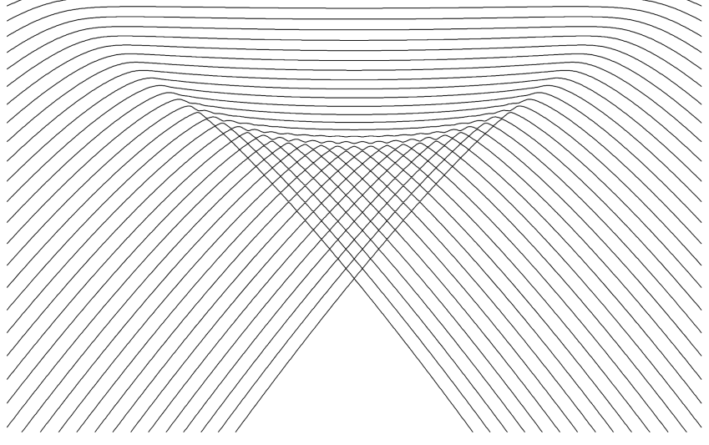
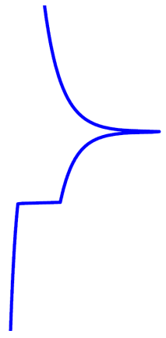
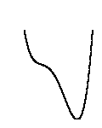
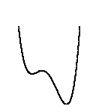
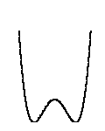
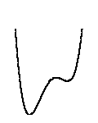
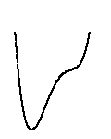







Theoretical Motivation
A 1DoF bound system with discrete spectrum:
Period of a classical trajectory at energy $E$
$$\frac{T\left(E\right)}{2πℏ}=\overline{ρ}\left(E\right)$$
Smooth quantum level density
Example: CUSP system $V_{λ}(x)=x^{4}−x^{2}+λx$
Potential
Quantum level dynamics
$$E$$
$r=1 →$ log divergence
$r=0 →$ jump up
$$x$$
$$\overline{ρ}$$
λ
Critical phenomena
Quantum Phase Transition
Excited-state quantum phase transitions (ESQPT)
$$V(x)$$
P. Cejnar, P. Stránský, M. Macek, M. Kloc, J. Phys. A: Math. Theor. 54, 133001 (2021)
$$x$$

Slide 7





Theoretical Motivation
A 1DoF bound system with discrete spectrum:
Period of a classical trajectory at energy $E$
$$\frac{T\left(E\right)}{2πℏ}=\overline{ρ}\left(E\right)$$
Smooth quantum level density
To what extent is this formula valid for “continuum states” (resonances) in unbound systems?
$$E$$
$$ψ\left(x\right)=e^{+\frac{ipx}{ℏ}}+α\left(E\right)e^{−\frac{ipx}{ℏ}}$$
$$ψ\left(x\right)=β\left(E\right)e^{+\frac{ipx}{ℏ}}$$
$$V(x)$$
Multibarrier tunnelling potential
$$x$$

Slide 8
Theory

Slide 9

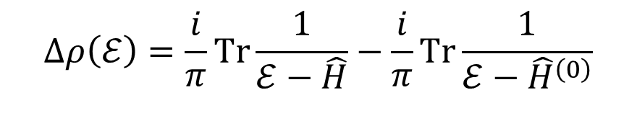
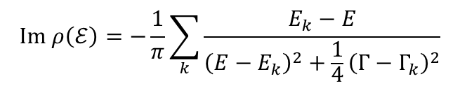
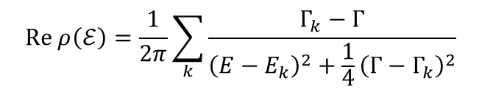
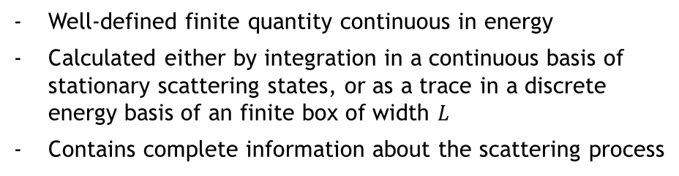

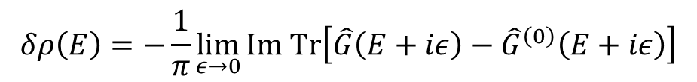

Level density
Green operator
$$ρ\left(E\right)=\sum_{k}{δ\left(E−E_{k}\right)}=\lim_{ε→0+}\sum_{k}{\frac{1}{π}\frac{ε}{{\left(E−E_{k}\right)}^{2}+ε^{2}}}=−\frac{1}{π}\lim_{ε→0+}{Im Tr }\hat{G}\left(E+iε\right)$$
Continuum level density
Well-defined finite quantity continuous in energy
Calculated either by integration in a continuous basis of stationary scattering states, or as a trace in a discrete energy basis of an finite box of width $L$
Contains complete information about the scattering process
$$δρ\left(E\right)=−\frac{1}{π}\lim_{ε→0}{Im Tr\left[\hat{G}\left(E+iε\right)−{\hat{G}}^{\left(0\right)}\left(E+iε\right)\right]}$$
System with interaction
Free particle
A.T. Kruppa, Phys. Lett. B 431, 237 (1998)
A.T. Kruppa, K. Arai, Phys. Rev. A 59, 3556 (1999)
Complex extension
$$ℰ=E−\frac{i}{2}Γ$$
$$Re ρ\left(ℰ\right)=\frac{1}{2π}\sum_{k}{\frac{Γ_{k}−Γ}{{\left(E−E_{k}\right)}^{2}+\frac{1}{4}{\left(Γ−Γ_{k}\right)}^{2}}}$$
$$Δρ\left(ℰ\right)=\frac{i}{π}Tr\frac{1}{ℰ−\hat{H}}−\frac{i}{π}Tr\frac{1}{ℰ−{\hat{H}}^{\left(0\right)}}$$
2D dipole structure
$$Im ρ\left(ℰ\right)=−\frac{1}{π}\sum_{k}{\frac{E_{k}−E}{{\left(E−E_{k}\right)}^{2}+\frac{1}{4}{\left(Γ−Γ_{k}\right)}^{2}}}$$
$$ρ\left(ℰ\right)$$
$$ρ^{\left(0\right)}\left(ℰ\right)$$
Some of the states interpreted as resonances.

Slide 10






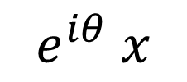

Complex scaling method
N. Moiseyev, Phys. Rep. 302, 211 (1998)
Rotation of the real coordinate into the complex plane
Similarity nonunitary transformation
$${\hat{S}}_{θ}=e^{i\frac{θ}{2}} e^{−θ \frac{\hat{x}\hat{p}}{ℏ}}$$
$$x$$
$$e^{iθ} x$$
$$0≤θ<\frac{π}{4}$$
$${\hat{S}}_{θ}\hat{x}{\hat{S}}_{θ}^{−1}=e^{iθ}\hat{x}$$
$${\hat{S}}_{θ}\hat{p}{\hat{S}}_{θ}^{−1}=e^{−iθ}\hat{p}$$
… reveals all the resonances living in the sector $2E\tan{2θ}≥Γ$, while the rest of the resonances stay hidden in the rotated continuum
$${\hat{S}}_{θ}\hat{H}{\hat{S}}_{θ}^{−1}=e^{−2iθ}\frac{\hat{p}}{2m}+V\left(e^{iθ} \hat{x}\right)$$
Example: Gaussian barrier
$$V\left(x\right)=e^{−x^{2}}$$
Bounded in an infinite potential well of width $L→∞$

Slide 11
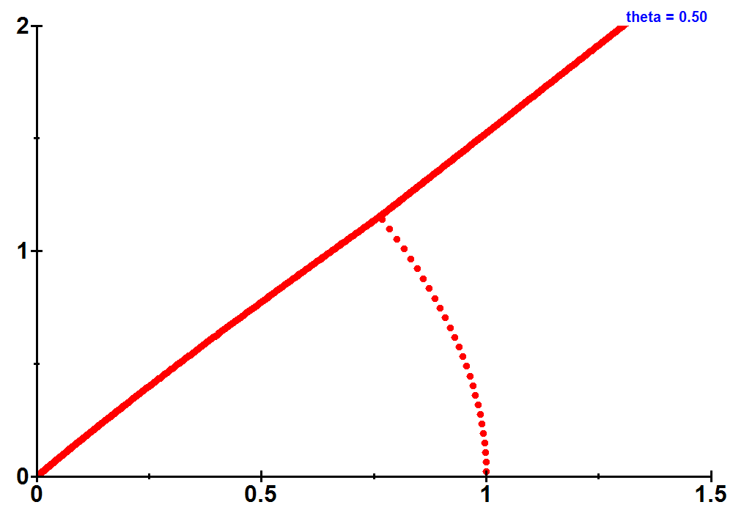
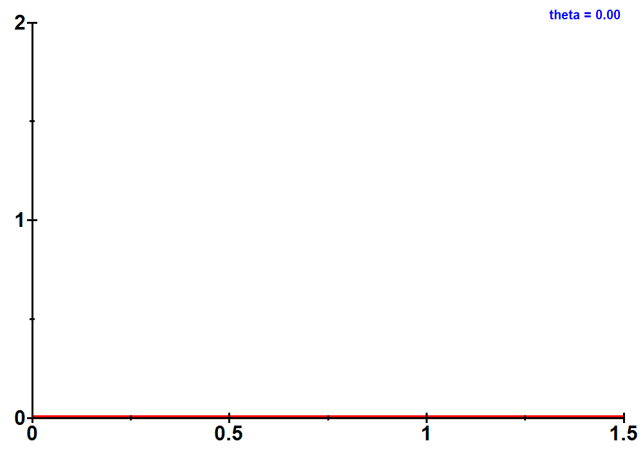


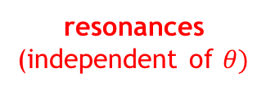

Complex scaling method
N. Moiseyev, Phys. Rep. 302, 211 (1998)
Rotation of the real coordinate into the complex plane
Similarity nonunitary transformation
$${\hat{S}}_{θ}=e^{i\frac{θ}{2}} e^{−θ \frac{\hat{x}\hat{p}}{ℏ}}$$
$$x$$
$$e^{iθ} x$$
$$0≤θ<\frac{π}{4}$$
$${\hat{S}}_{θ}\hat{x}{\hat{S}}_{θ}^{−1}=e^{iθ}\hat{x}$$
$${\hat{S}}_{θ}\hat{p}{\hat{S}}_{θ}^{−1}=e^{iθ}\hat{p}$$
… reveals all the resonances living in the sector $2E\tan{2θ}≥Γ$, while the rest of the resonances stay hidden in the rotated continuum
$${\hat{S}}_{θ}\hat{H}{\hat{S}}_{θ}^{−1}=e^{−2iθ}\frac{\hat{p}}{2m}+V\left(e^{iθ} \hat{x}\right)$$
Example: Gaussian barrier
rotated continuum
$$V\left(x\right)=e^{−x^{2}}$$
$$Γ$$
resonances
(independent of $θ)$
Bounded in an infinite potential well of width $L→∞$
$$E$$

Slide 12
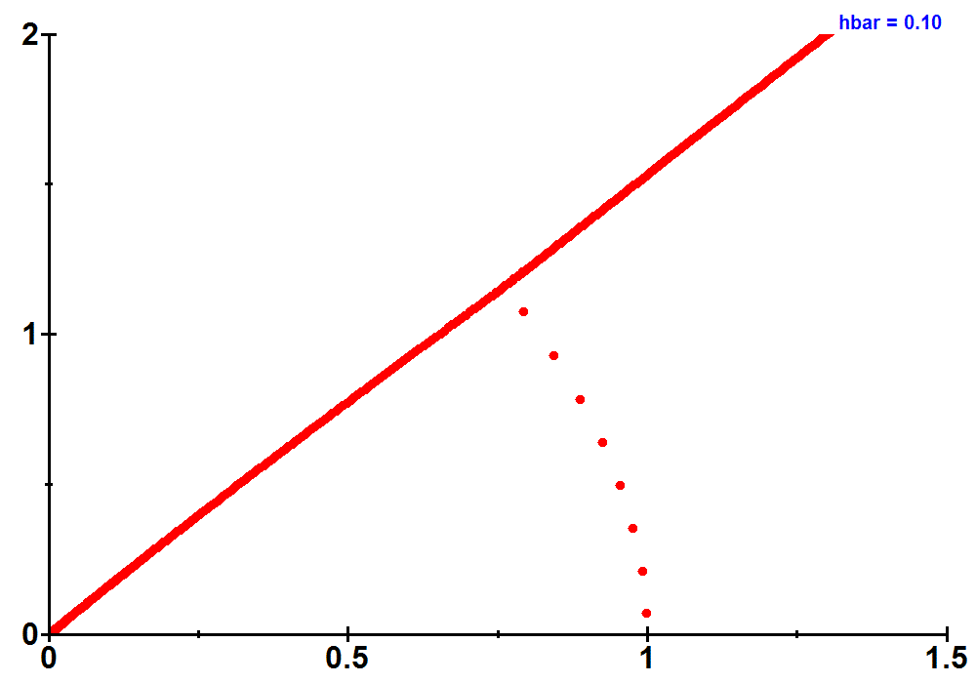
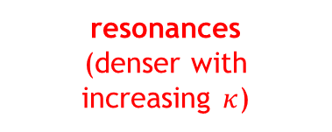

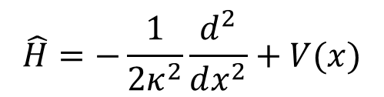
System size and semiclassical limit
$$\hat{H}=−\frac{1}{2κ^{2}}\frac{d^{2}}{dx^{2}}+V(x)$$
$κ^{2}≡\frac{m}{ℏ^{2}}$ - size parameter
Semiclassical limit approached when $κ→∞.$
Example: Gaussian barrier
$$V\left(x\right)=e^{−x^{2}}$$
$$Γ$$
resonances
(denser with increasing $κ$)
Bounded in an infinite potential well of width $L→∞$
$$E$$

Slide 13
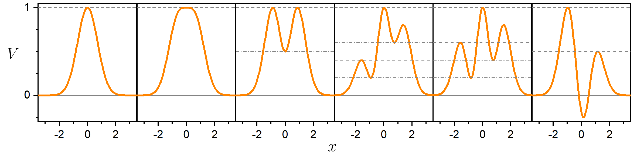
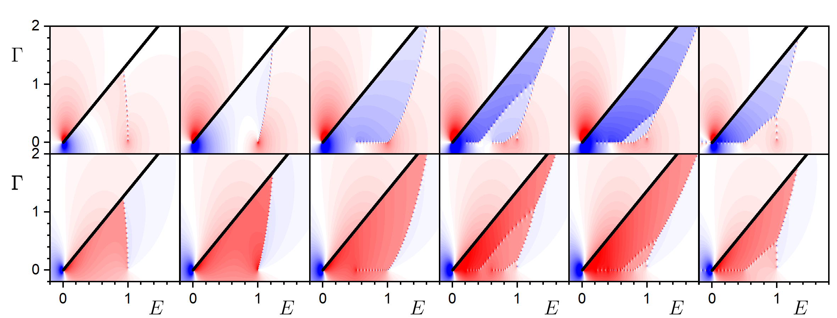
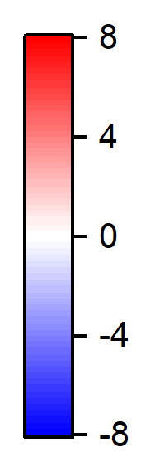




Results
Gauss
Supergauss
Symmetric
Bound states
$$πℏ Re Δρ(ℰ)$$
$$θ=0.3$$
$$ℏ=0.03$$
$$πℏ Im Δρ(ℰ)$$
$$𝓔=E+i0$$

Slide 14




But why should be the level density so interesting?
$$ψ\left(x\right)=e^{+\frac{ipx}{ℏ}}+α\left(E\right)e^{−\frac{ipx}{ℏ}}$$
$$ψ\left(x\right)=β\left(E\right)e^{+\frac{ipx}{ℏ}}$$
$$V(x)$$
$$=\left|β\left(E\right)\right|e^{+\frac{ipx}{ℏ}+iφ\left(E\right)}$$
… It contains complete information about the behaviour of the transmitted wave.

Slide 15

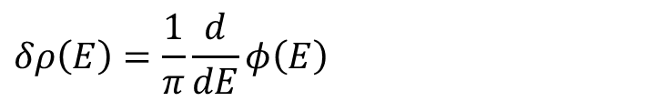




Continuum phase shift
$$φ=Re Φ$$
$$V$$
$$δρ\left(E\right)=\frac{1}{π}\frac{d}{dE}φ\left(E\right)$$
R.D. Levin, Quantum Mechanics of Molecular Rate Processes (Clarendon Press, Oxford, 1969)
N. Moiseyev, Non-Hermitian Quantum Mechanics (Cambridge University Press, Cambridge UK, 2011)
$$x$$
Complex extension
$$Δρ\left(E\right)=\frac{1}{π}\frac{d}{dE}Φ\left(E\right)=\frac{1}{π}\frac{d}{dE}φ\left(E\right)−\frac{i}{π}\frac{d}{dE}\ln\left|β\left(E\right)\right|$$
$$\ln{β=Im Φ}$$
Transmission probability and phase shift can be obtained by integrating the complex continuum level density.
$$E$$

Slide 16
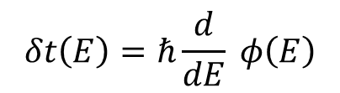
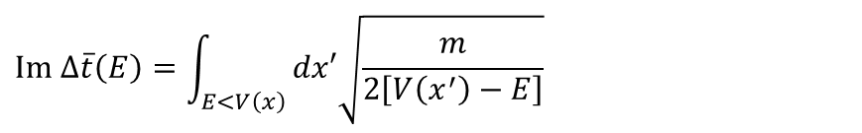
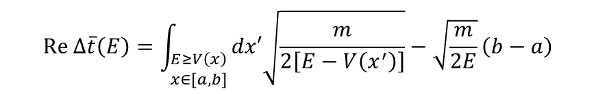
Eisenbud-Wigner Time shift
- The simplest definition of time delay of the transmitted particle during quantum tunnelling
$$δt\left(E\right)=ℏ\frac{d}{dE} φ\left(E\right)$$
E.P. Wigner, Phys. Rev. 98, 145 (1955)
D. McLaughlin, J. Math. Phys. 13, 1099 (1972)
Complex extension
Time shift of a single resonance: $δt\left(E_{1}\right)=2ℏ/Γ_{1}$
$$Δt\left(E\right)=ℏ\frac{d}{dE} Φ\left(E\right)=πℏ Δρ\left(E\right)=δt\left(E\right)−i\frac{ℏ}{2}\frac{d}{dE}{\left|\ln{β\left(E\right)}\right|}^{2}$$
Semiclassical WKB approximation
$$Re Δ\overline{t}\left(E\right)=\int_{\begin{aligned}E≥V\left(x\right) \\ x∈[a,b]\end{aligned}}{dx′\sqrt{\frac{m}{2\left[E−V\left(x^{′}\right)\right]}}}−\sqrt{\frac{m}{2E}}\left(b−a\right)$$
Periods of trajectories in the allowed / forbidden regions
$$Im Δ\overline{t}\left(E\right)=\int_{E<V\left(x\right)}{dx′\sqrt{\frac{m}{2\left[V\left(x^{′}\right)−E\right]}}}$$
- Solution of the classical equations of motion inside the potential barrier (instanton-like approach to the tunnelling problem, Wick rotation $t→−iτ$)
S. Coleman, contribution to the 1977 “Ettore Majorana: International School of Subnuclear Physics; reprinted in S. Coleman, Aspects of Symmetry (Cambridge University Press 1985)

Slide 17

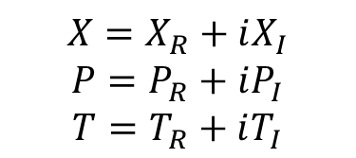
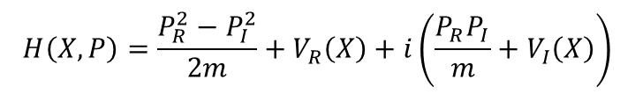



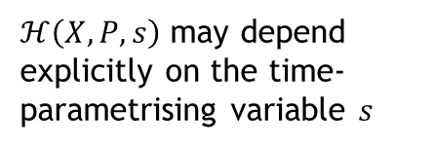
Complex classical dynamics
$$X=X_{R}+iX_{I}$$
$$P=P_{R}+iP_{I}$$
$$T=T_{R}+iT_{I}$$
Dynamics given by a solution of complex Hamilton equations of motion
An orbit parametrised by $s∈ℝ$
No unique prescription for $T\left(s\right),X\left(s\right),P\left(s\right)∈ℂ$
$$T_{I}$$
$$H\left(X,P\right)=\frac{P_{R}^{2}−P_{I}^{2}}{2m}+V_{R}\left(X\right)+i\left(\frac{P_{R}P_{I}}{m}+V_{I}\left(X\right)\right)$$
?
$$\left(\frac{dX}{ds},\frac{dP}{ds}\right)=\left(\frac{∂}{∂P},−\frac{∂}{∂X}\right)H\left(X,P\right)\frac{dT}{ds}$$
$ℋ\left(X,P,s\right)$ may depend explicitly on the time-parametrising variable $s$
$$T_{R}$$

Slide 18


Complex classical dynamics
Complex $X$ in WKB connecting formulae
Imaginary time in the beginning phase
of our Universe (The Big Bang)
$$X=X_{R}+iX_{I}$$
$$P=P_{R}+iP_{I}$$
$$T=T_{R}+iT_{I}$$
Study of $𝓟𝓣$-symmetry in classical dynamics
Singularity in ordinary time
It can be removed when modelled with imaginary time (Harle-Hawking state)
The Big Bang behaves then like any other point in four-dimensional spacetime (S. Hawking: “The boundary condition to the Universe is that it has no boundary”)
Decay of false vacuum
Dynamics given by a solution of complex Hamilton equations of motion
- Instanton solution
An orbit parametrised by $s∈ℝ$
No unique prescription for $T\left(s\right),X\left(s\right),P\left(s\right)∈ℂ$
$$T_{I}$$
$$H\left(X,P\right)=\frac{P_{R}^{2}−P_{I}^{2}}{2m}+V_{R}\left(X\right)+i\left(\frac{P_{R}P_{I}}{m}+V_{I}\left(X\right)\right)$$
?
$$\left(\frac{dX}{ds},\frac{dP}{ds}\right)=\left(\frac{∂}{∂P},−\frac{∂}{∂X}\right)H\left(X,P\right)\frac{dT}{ds}$$
S. Coleman, Phys. Rev. D 15, 2929 (1977)
M.V. Berry, K.E. Mount, Rep. Prog. Phys. 35, 315 (1972)
$ℋ\left(X,P,s\right)$ may depend explicitly on the time-parametrising variable $s$
S.W. Hawking, T. Hertog, JHEP04, 147 (2018)
$$T_{R}$$
C.M. Bender, D.D. Holm, D.W. Hook, J. Phys. A: Math. Theor. 40, F793 (2007)
A.G. Anderson, C.M. Bender, U.I. Morone, Phys. Lett. A 375, 3399 (2011)

Slide 19

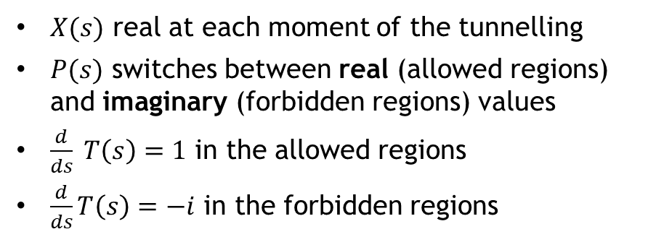


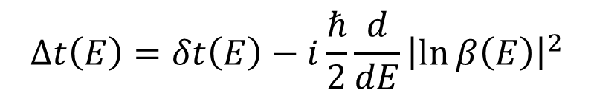


Complex time shift
$$Δt\left(E\right)=δt\left(E\right)−i\frac{ℏ}{2}\frac{d}{dE}{\left|\ln{β\left(E\right)}\right|}^{2}$$
$X(s)$ real at each moment of the tunnelling
$P(s)$ switches between real (allowed regions) and imaginary (forbidden regions) values
$\frac{d}{ds} T\left(s\right)=1$ in the allowed regions
$\frac{d}{ds}T\left(s\right)=−i$ in the forbidden regions
J. Le Deunff, A. Mouchet, Phys. Rev. E 81, 046205 (2010)
S.F. Bramberger, G. Lavrelashvili, J.-L. Lehners, Phys. Rev. D 94, 064032 (2016)
$$T_{I}$$
$$E$$
real motion
$$T_{R}$$
tunnelling
$$V(x)$$
$$x, s$$

Slide 20

Complex time shift
$$Δt\left(E\right)=δt\left(E\right)−i\frac{ℏ}{2}\frac{d}{dE}{\left|\ln{β\left(E\right)}\right|}^{2}$$
$X(s)$ real at each moment of the tunnelling
$P(s)$ switches between real (allowed regions) and imaginary (forbidden regions) values
$\frac{d}{ds} T\left(s\right)=1$ in the allowed regions
$\frac{d}{ds}T\left(s\right)=−i$ in the forbidden regions
J. Le Deunff, A. Mouchet, Phys. Rev. E 81, 046205 (2010)
S.F. Bramberger, G. Lavrelashvili, J.-L. Lehners, Phys. Rev. D 94, 064032 (2016)
$$E$$
$$V(x)$$
$$x, s$$
…And what happens at energies of the stationary points?

Slide 21
















ESQPT-type singularities ($f=1)$
- Calculated via a local expansion around a stationary point of the potential $V\left(x_{0}\right)=E_{0}$
logarithmic divergence
Nondegenerate stationary points
Quadratic minimum
jump up
$$Im Δ\overline{ρ}\left(E\right)∼−\ln\left|E−E_{0}\right|$$
$$Re Δ\overline{ρ}\left(E\right)∼Θ\left(E−E_{0}\right)$$
$$E_{0}$$
$$E$$
$$E_{0}$$
$$E$$
logarithmic divergence
Quadratic maximum
jump down
$$Re Δ\overline{ρ}\left(E\right)∼−\ln\left|E−E_{0}\right|$$
$$Im Δ\overline{ρ}\left(E\right)∼−Θ\left(E−E_{0}\right)$$
$$E_{0}$$
$$E$$
$$E_{0}$$
$$E$$
Degenerate stationary points
$n$-order minimum
$$Re Δ\overline{ρ}\left(E\right)∼\frac{Θ\left(E−E_{0}\right)}{{\left|E−E_{0}\right|}^{\frac{n−2}{2n}}}$$
$$Im Δ\overline{ρ}\left(E\right)∼\frac{1}{{\left|E−E_{0}\right|}^{\frac{n−2}{2n}}}$$
$$E_{0}$$
$$E$$
$$E_{0}$$
$$E$$
$n$-order maximum
$$Re Δ\overline{ρ}\left(E\right)∼\frac{1}{{\left|E−E_{0}\right|}^{\frac{n−2}{2n}}}$$
$$Im Δ\overline{ρ}\left(E\right)∼\frac{Θ\left(E−E_{0}\right)}{{\left|E−E_{0}\right|}^{\frac{n−2}{2n}}}$$
$$E_{0}$$
$$E$$
$$E_{0}$$
$$E$$

Slide 22
Gauss
Supergauss
Symmetric
With bound states

Slide 23











Quantum resonances
Summary
$$ℰ=E−\frac{i}{2}Γ$$
$$Re Δρ\left(ℰ\right)$$
$$Γ$$
Tunnelling 1D system
Complex phase shift
Complex scaling
Phase shift $φ$
$$Im Δρ\left(ℰ\right)$$
Transmission probability $β$
Complex level density
$$Γ$$
Smoothening (semiclassical limit)
$$E$$
Classical orbits
Allowed region $Re Δ\overline{t}$
ESQPT-like analysis of critical effects
Forbidden region $Im Δ\overline{t}$ (inverted potential)
Complex tunnelling time
$$E$$

Slide 24

Conclusions
Quantum level density in the continuum can be extended into the complex domain and related with the phase shift and transmission probability of a scattering problem.
Its smooth part along the real energy axis can be calculated semiclassically from the time the classical trajectory spends in the allowed regions (real components) and in the forbidden regions (imaginary component).
This allows for a semiclassical formulation of the tunnelling problem.
Singularities in the smooth continuum level density can be classified by a straightforward extension of the ESQPT classification for the bound states, and can be explained by the existence of classical stationary points in the potential.
The dual structure in the real and imaginary parts of the continuum density is based on potentials $V\left(x\right)$ and $−V(x)$ and on the existence of classically allowed and forbidden regions.
Based on the analogy with ESQPT, one can anticipate the properties of systems with higher numbers of DoF $f$ (singularities appearing in the $\left(f−1\right)$th derivative of the level density etc.)
ESQPT singularities can be detected by tunnelling experiments (e.g. resonant tunnelling semiconductors).

Slide 25
Thanks
for your attention

