Slide 1
Quantum quench dynamics
in the extended Dicke model
Michal Kloc, Pavel Stránský, Pavel Cejnar
Institute of Particle and Nuclear Physics
Charles University, Prague
Czech Republic
arXiv:1805.06285 [quant.ph] (2018)
Sumbmitted to: Physical Review A
CSIC, Madrid 2018

Slide 2
Outline
Excited-State Quantum Phase Transitions (ESQPT)
Extended Dicke Model
Quantum quenches: backward and forward protocols

Slide 3
Brief introduction to the ESQPTs

Slide 4
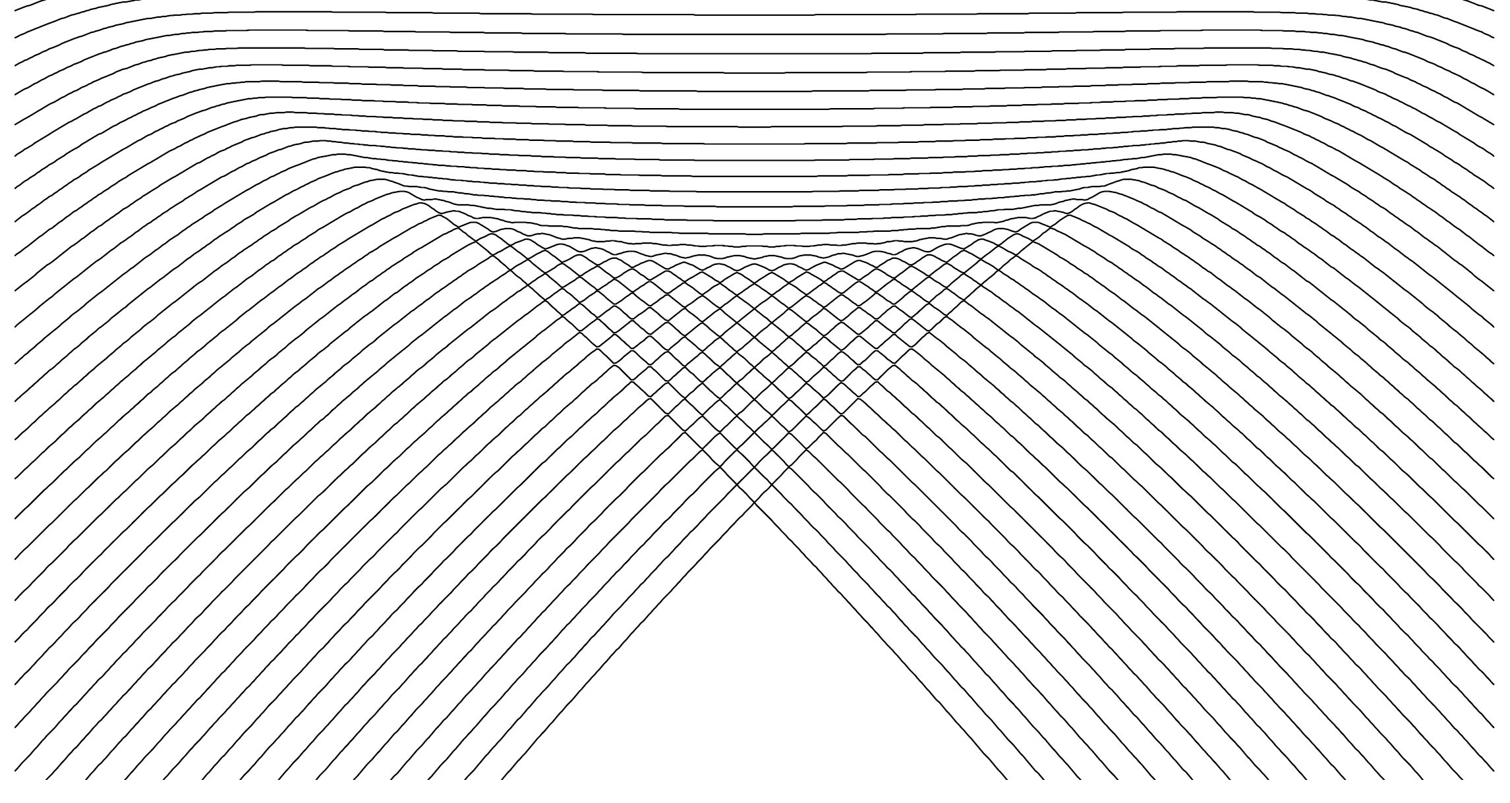
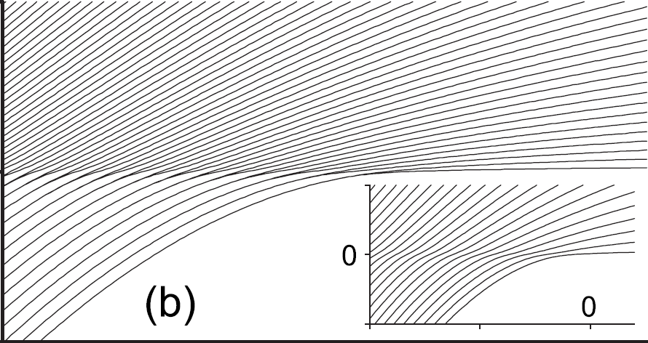
ESQPT
$$H\left(λ\right)=H_{0}+λV$$
Generalization of the QPTs for the excited spectra
a) discontinuity in the smooth level density ρ
critical borderlines
E
b) discontinuity in the average level flow rate φ
a)
b)
λ
ESQPT’s effect is best visible in averaged quantities characterizing bundles of energy levels in individual level themselves
M.A. Caprio, P. Cejnar, F. Iachello, Ann. Phys. 323, 1106 (2008)
P. Cejnar, P. Stránský, Phys. Rev. E 78, 031130 (2008)
Notes:
general Hamiltonian – PES of algebraic models
critical borderlines
configurational state density in the framework of statistical mechanics

Slide 5
a) Level density
oscillatory component
(semiclassically given by the Gutzwiller trace formula; not relevant here in the infinite-size limit)
smooth component
(Weyl formula)
volume function
of the classical phase space
Numerical approximation
I. Hoveijn, J. Math. Anal. Appl. 348, 530 (2008)
M. Kastner, Rev. Mod. Phys. 80, 167 (2008)
Notes:
volume integral – flooding of the Hamiltonian function

Slide 6
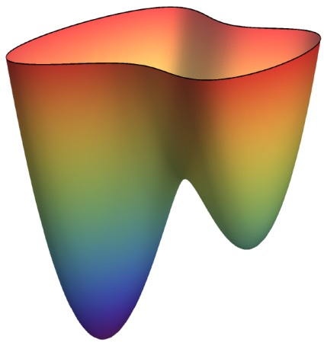
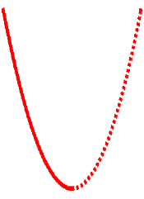
Level density: Nondegenerate stationary point w
Morse lemma
energy surface
Approximation of the Hamiltonian with a quadratic function in the vicinity of w
index r of the stationary point
E
ε
w
local volume integral
y₂
x₂
x₁
y₁
local coordinates
r = 0
r > 0
P. Stránský, P. Cejnar, Phys. Lett. A380, 2637 (2016)

Slide 7
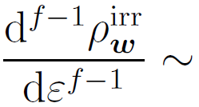
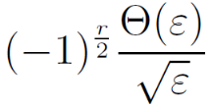
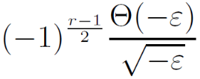
Nondegenerate stationary point: singularities
f integer
f half-integer
(relevant for lattices and time-dependent Hamiltonian systems)
r even
r odd
r even
r odd
[f-1]-th derivative
logarithmic divergence
inverse sqrt
jump
E_{w}
E
E_{w}
E
E_{w}
E
E_{w}
E
Each singularity of the level density at a nondegenerate stationary point is uniquely classified by the two numbers (f,r)
P. Stránský, P. Cejnar, Phys. Lett. A380, 2637 (2016)

Slide 8
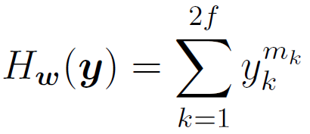
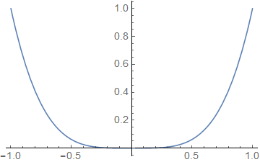
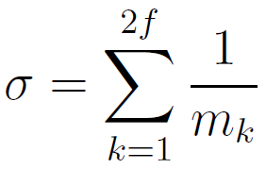
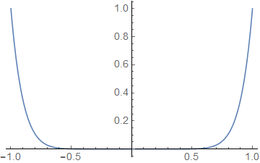
Level density: Degenerate stationary point
Special class of separable Hamiltonians (flat minimum):
(analytic only for m_{k} even integer)
- discontinuity in the$\left\lceil σ−1\right\rceil$-th derivative
Example: We require discontinuity of the t-th derivative
- satisfied when
even in the thermodynamic limit
the level density can be discontinuous
Higher flatness of the stationary point enhances its signatures in the spectrum (it shifts the singularity towards lower derivatives).

Slide 9
Level density: Degenerate stationary point
Special class of separable Hamiltonians (flat minimum):
(analytic only for m_{k} even integer)
Structural stability
- an arbitrarily small perturbation converts any function into a Morse function:
- discontinuity of the -th derivative
Example 1: We require discontinuity of the t-th derivative
- satisfied when
flat minimum
quadratic minimum
even in the thermodynamic limit
the level density can be discontinuous
M. Kastner, Rev. Mod. Phys. 80, 167 (2008)
Higher flatness of the stationary point enhances its signatures in the spectrum (it shifts the singularity towards lower derivatives).
Notes:
Structural stability

Slide 10
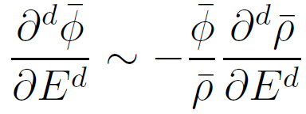
b) Level flow rate
E
($≡$position)
trajectories of individual levels – flow lines
Continuity equation
derivatives
λ ($≡$time)
Using Hellmann-Feynman formula, the flow rate can be expressed as
We expect the same nonanalyticity in the flow rate as in the level density
- weighted average of the quantum expectation value of $H_{I}(x)$ in the eigenstates around energy $E$
- experimentally more important than the level density itself
P. Stránský, M. Macek, P. Cejnar, Ann. Phys. 345, 73 (2014)
P. Stránský, P. Cejnar, Phys. Lett. A380, 2637 (2016)
Notes:
regular – analytic
irregular - nonanalytic

Slide 11
Extended Dicke Model

Slide 12
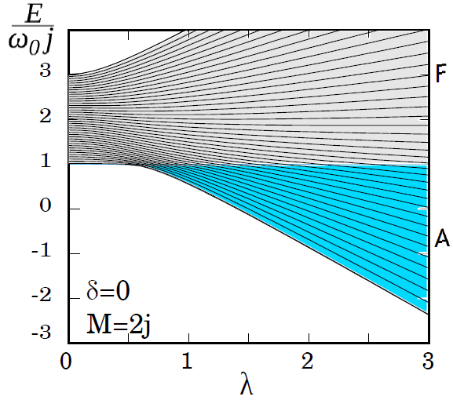
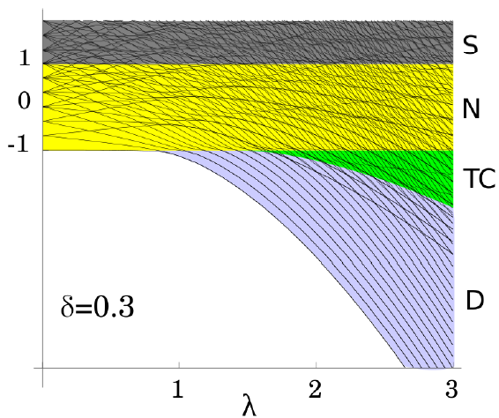
Extended Dicke Model
- interaction of a single-mode bosonic field with a chain of two-level atoms
$$H\left(λ;δ\right)=ωb^{+}b+ω_{0}J_{z}+\frac{λ}{\sqrt{2j}}\left[b^{+}J_{−}+bJ_{+}+δ\left(b^{+}J_{+}+bJ_{−}\right)\right]$$
R.H, Dicke, Phys. Rev. 93, 99 (1954)
K. Hepp, E. Lieb, Ann. Phys. 76, 360 (1973)
δ = 0: integrable (Tavis-Cummings) regime
δ = 1: nonintegrable (Dicke) regime
$M=b^{+}b+J_{z}+j$ conserved
effectively $f=1$
$M=2j$ subspace with an ESQPT (provided $ω≠ω_{0}$)
partially chaotic (degree of chaoticity grows with $δ$)
$f=2$
various ESQPTs
$$λ_{c}=\frac{ω−ω_{0}}{2}$$
$$λ_{c}=\frac{\sqrt{ωω_{0}}}{1+δ}$$
$$λ_{0}=\frac{\sqrt{ωω_{0}}}{1−δ}$$

Slide 13
Quantum quenches
in the Extended Dicke Model

Slide 14
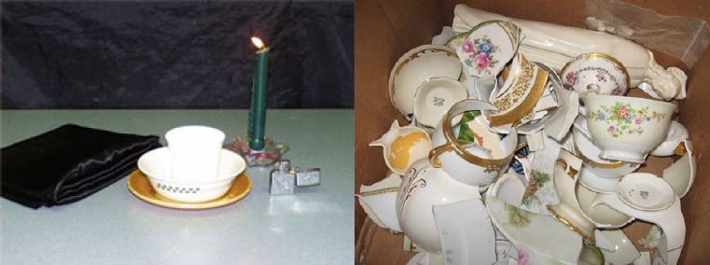
$$H_{i}≡H\left(λ_{i}\right)$$
$$H_{f}≡H\left(λ_{f}\right)$$
Quantum quench
- abrupt change of the initial Hamiltonian to a new final Hamiltonian $H_{i}→H_{f}$
Survival probability
$$P\left(t\right)={\left|\left\langle ψ_{i} | e^{−iH_{f}t} | ψ_{i}\right\rangle \right|}^{2}$$
$$={\left|\sum_{l=1}^{d}{\underset{{\left|s_{l}\right|}^{2}}{\underbrace{{\left|\left\langle ψ_{i} | φ_{fl}\right\rangle \right|}^{2}}}e^{−iE_{fl}t}}\right|}^{2}$$
$$=\sum_{l}{{\left|s_{l}\right|}^{4}+2\sum_{l^{′}<l}{{\left|s_{l}\right|}^{2}{\left|s_{l^{′}}\right|}^{2}\cos\left(E_{l}−E_{l^{′}}\right)t}}$$
$$={\left|ℱ\left[S\left(E\right)\right]\right|}^{2}$$
Strength function (LDS)
quantum tablecloth experiment
$$S\left(E\right)=\sum_{l=1}^{d}{{\left|s_{l}\right|}^{2}}δ\left(E−E_{fl}\right)$$
$$P\left(t\right)≈1$$
$$P\left(t\right)≪1$$

Slide 15
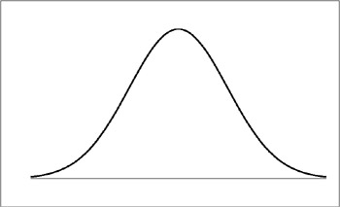
Quantum quench
Mean value of the LDS distribution:
$${\left\langle E_{f}\right\rangle }_{i}=E_{i}+Δλ{\left\langle V\right\rangle }_{i}=E_{i}+Δλ\frac{dE_{i}}{dλ}$$
$$E$$
$$λ_{f}$$
Variance of the LDS distribution:
$$var_{i}E_{f}={\left(Δλ\right)}^{2} var_{i}V$$
$$λ_{i}$$
(important for the resolution of the procedure)
$$λ$$

Slide 16
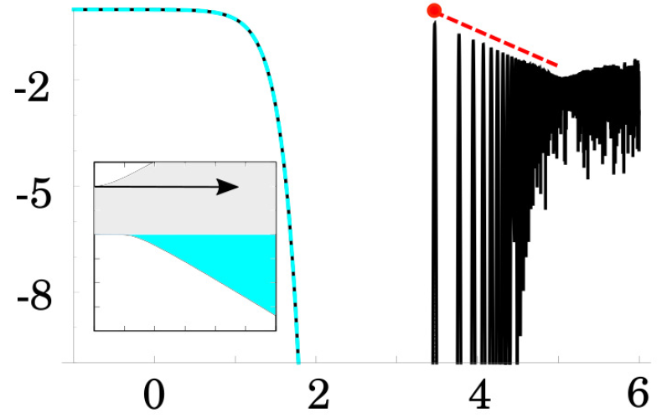
Various stages after the quench
$$t_{H}=\frac{2π}{\sum_{l}{\frac{{\left|s_{l+1}\right|}^{2}+{\left|s_{l}\right|}^{2}}{2}\left(E_{f\left(l+1\right)}−E_{fl}\right)}}=\frac{2π}{{\left\langle {ΔE}_{f}\right\rangle }_{i}}$$
$$\log_{10}{P}$$
Heisenberg time
Ultra-short time regime
2. Short time regime
$$t≪t_{s}=\frac{1}{{var}_{i} E_{f}}$$
$$t_{s}<t<t_{h}$$
4. Ultra-long time regime
$$\overline{P(t)}=IPR$$
$$var P\left(t\right)=IPR^{2}−\sum_{l}{{\left|s_{l}\right|}^{8}}$$
saturation + quantum revivals
Gaussian decay
(decay given by the width of the strength function)
$$P\left(t\right)≈1−{\left(\frac{t}{t_{s}}\right)}^{2}$$
3. Long time regime
(power-law modulated oscillations of different origin can appear)
survival collapse
$$\log_{10}{\frac{t}{j}}$$

Slide 17
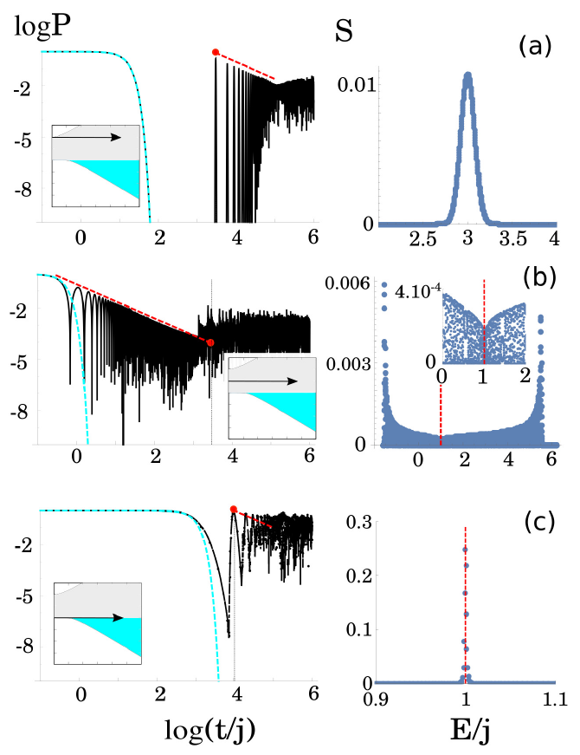
Forward quench protocol
$$λ_{i}=0<λ_{f}$$
$$δ=0$$
$$λ_{f}=2.5$$
Heisenberg time $t_{H}=\frac{2π}{{\left\langle ΔE_{f}\right\rangle }_{i}}$
power-law $\frac{1}{t}$ dependence
S. Lerma-Hernández et al.,
arXiv:1710.05937 [quant-ph] (2017)
ESQPT $\left(f,r\right)∼(1,1)$
$$j=2000, M=2j$$

Slide 18
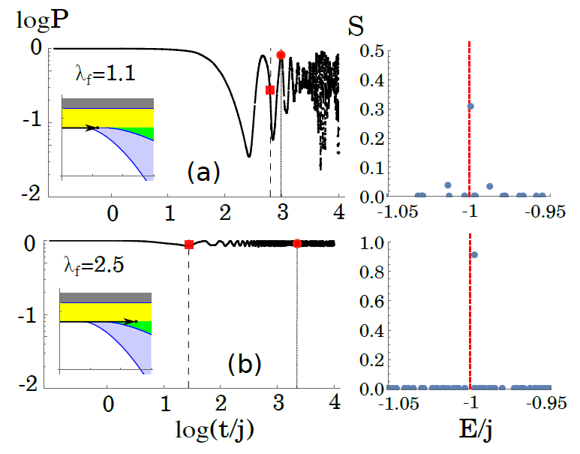
Forward quench protocol
$$λ_{i}=0<λ_{f}$$
$$δ=0$$
$$λ_{f}=2.5$$
$$δ=0.3$$
ESQPT $\left(f,r\right)=(2,1)$
ESQPT $\left(f,r\right)∼(1,1)$
ESQPT $\left(f,r\right)∼(2,2)$
$$j=2000, M=2j$$
$$j=20$$

Slide 19
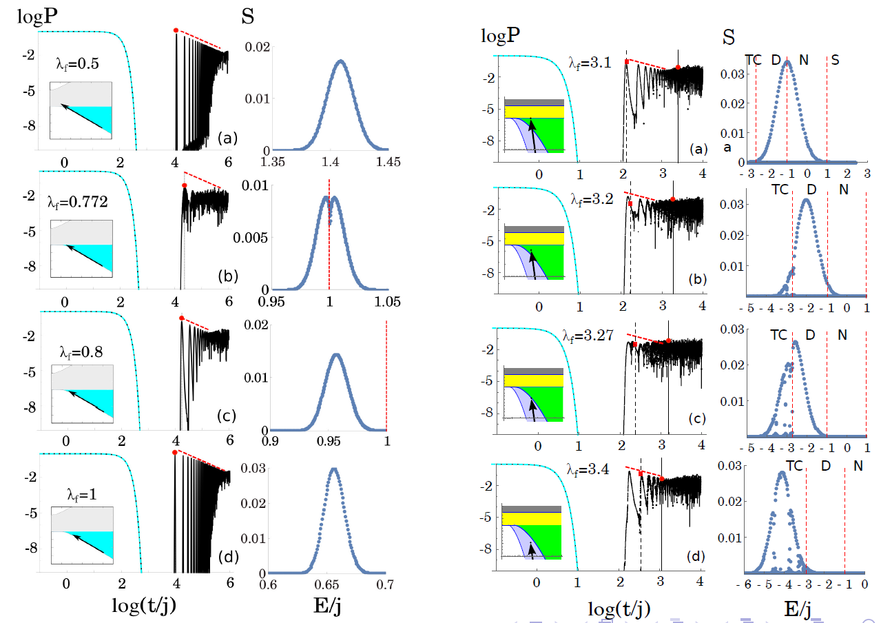
Backward quench protocol
$$δ=0$$
$$λ_{i}=2.5$$
$$δ=0.3$$
$$λ_{i}=6$$
$$(2,2)$$
∼$(1,1)$
$$(2,1)$$

Slide 20
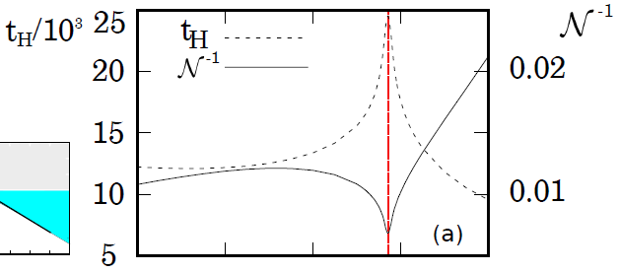
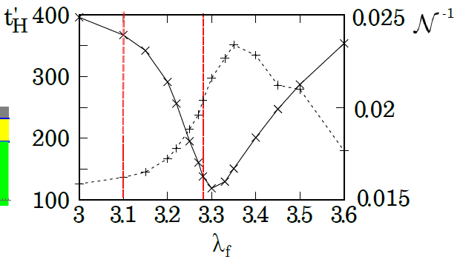
Heisenberg time
$$δ=0$$
$$λ_{i}=2.5$$
$$δ=0.3$$
$$λ_{i}=6$$
$$(2,2)$$
∼$(1,1)$

Slide 21
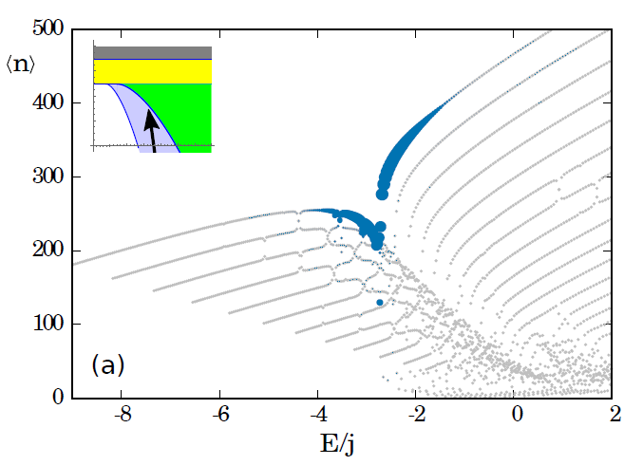
Influence of chaos
Peres latttice: quantum expectation value $\left\langle φ_{fl} | n | φ_{fl}\right\rangle$ vs. energy $l$
$$δ=0.3$$
$$λ_{i}=6$$
$$(2,2)$$
$$(2,1)$$
LDS encoded in the size of the blue dots

Slide 22
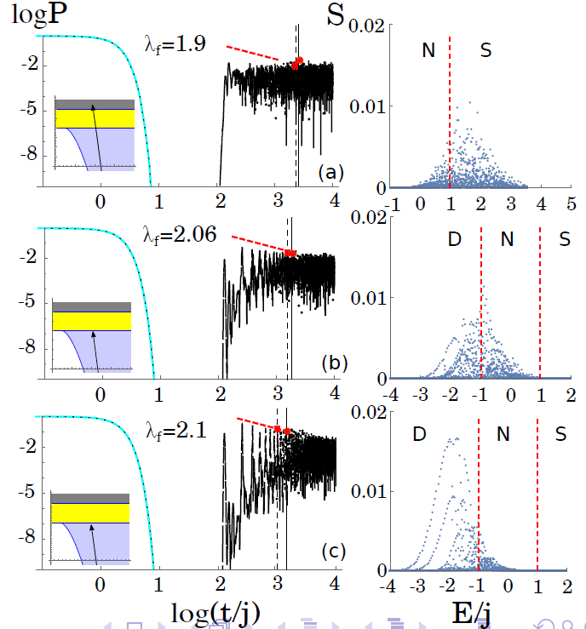
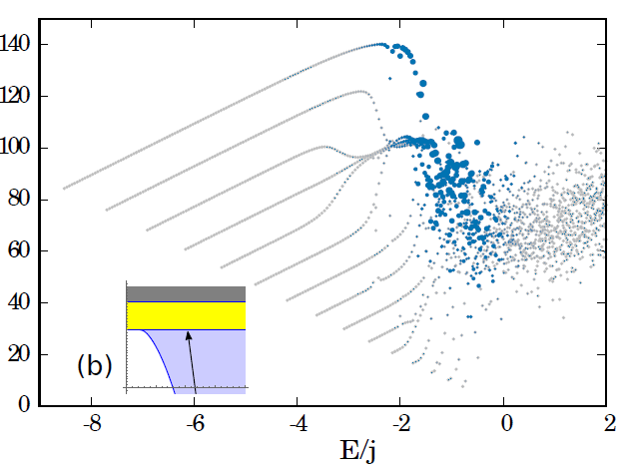
Dicke limit
Peres latttice: quantum expectation value $\left\langle φ_{fl} | n | φ_{fl}\right\rangle$ vs. energy $l$
$$δ=1$$
$$λ_{i}=4$$
$$(2,1)$$
Chaos suppresses the effect of ESQPT

Slide 23
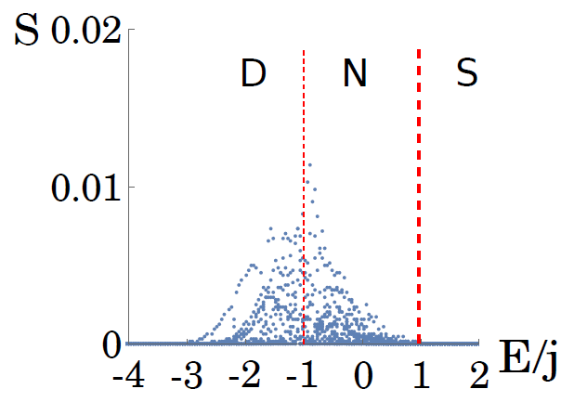
Dicke limit
However, if one searches thoroughly...

Slide 24
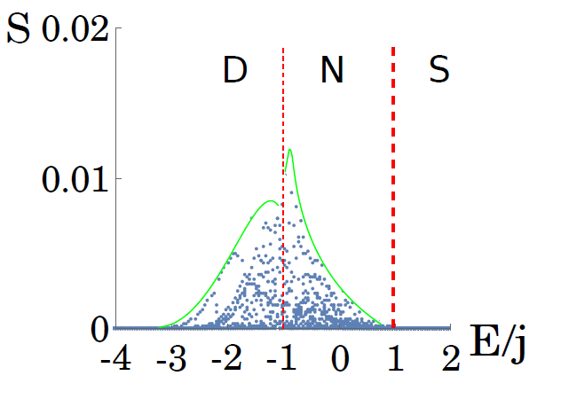
Dicke limit
However, if one searches thoroughly...
... the fingerprints are hidden in the splitting of the LDS

Slide 25
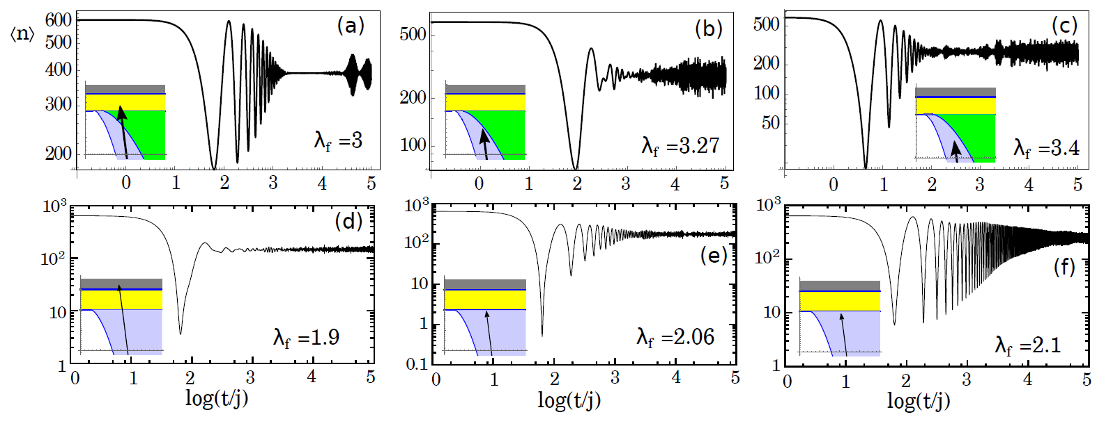
Observables
- average number of photons in the cavity $\left\langle n\right\rangle$
$$\left(f,r\right)=(2,1)$$

Slide 26
Summary
Thanks for your attention
1. ESQPT stabilizes the initial state
forward quenches across the QPT to the ESQPT regions
in the non-integrable case the stabilization is stronger for longer quenches to the ESQPT between TC and N phase
2. ESQPT speeds up the onset of the saturation
backward quenches from the ground state to the ESQPT regions
in non-integrable systems strongly disturbed by chaos
Selected bibliography
http://pavelstransky.cz/quench_dicke.php
Extended Dicke Model
R.H. Dicke, Phys. Rev. 93, 99 (1954)
T. Brandes, Phys. Rev. E 88, 032133 (2013)
M. Kloc, P. Stránský, P. Cejnar, Ann. Phys. 382, 85 (2017)
Quantum quenches and ESQPT
P. Pérez-Fernández et al., Phys. Rev. A 83, 033802 (2011)
L.F. Santos, F. Pérez-Bernal, Phys. Rev. A 92, 050101(R) (2015)
L.F. Santos, M. Távora, F. Pérez-Bernal, Phys. Rev. A 94, 012113 (2016)
Experimental relevance
K. Baumann et al., Phys. Rev. Lett. 107, 140402 (2011)
Z. Zhiqiang et al., Optica 4, 424 (2017)

