Slide 1
Excited-state quantum phase transitions,
monodromy, and non-equilibrium dynamics
in the Extended Dicke Model
Pavel Stránský
www.pavelstransky.cz
Institute of Particle and Nuclear Physics
Charles University in Prague
Czech Republic
In collaboration with: Pavel Cejnar, Michal Kloc, Michal Macek
IPNP, Charles Univeristy in Prague, Czech Republic
Seminario del departamento de Estructura de la Materia, ICN UNAM
6 December 2017

Slide 2
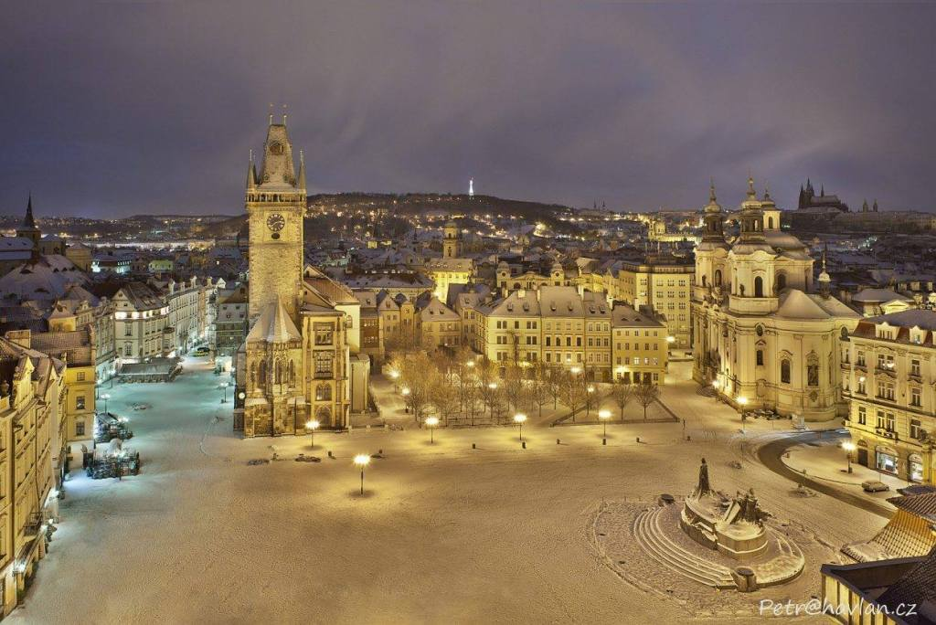
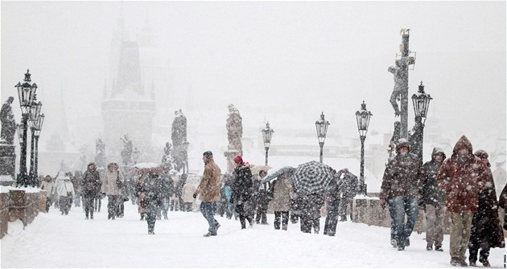

Slide 3
Outline
ESQPT: Definition, evidence in the literature
ESQPT: Theory (level density, flow rate)
ESQPT in the Dicke model
ESQPT: Monodromy
ESQPT: Quantum quenches
(ESQPT: Thermodynamical consequences)
Summary

Slide 4
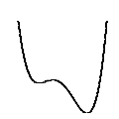
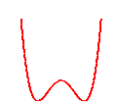
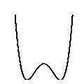
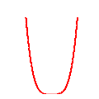
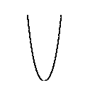
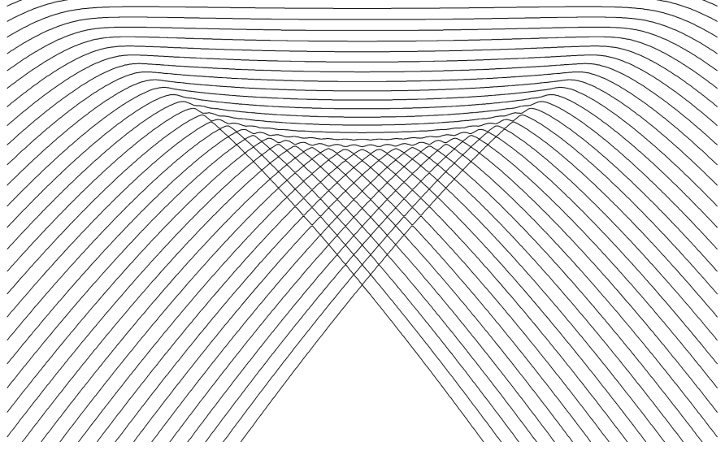
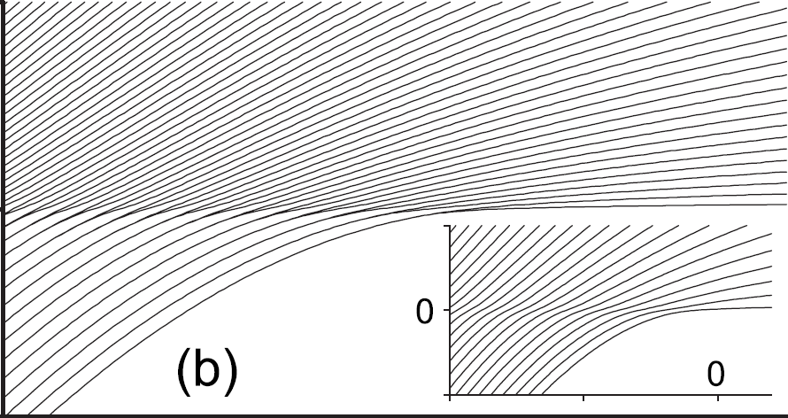
Quantum phase transition (QPT)
A nonanalytic change (in the infinite-size limit) of ground-state properties of a system by varying an external control parameter λ at absolute zero temperature (only quantum fluctuations present)
potential-wells evolutions in a quantum CUSP model
(details later)
E
first-order
continuous(n^{th} order)
λ
λ
Examples:
ferromagnet-paramegnet transitions
insulator-superfluid transitions
superradiant phase transitions
...
S. Sachdev, Quantum Phase Transitions (2011)
L.D. Carr, Understanding Quantum Phase Transitions (2011)

Slide 5
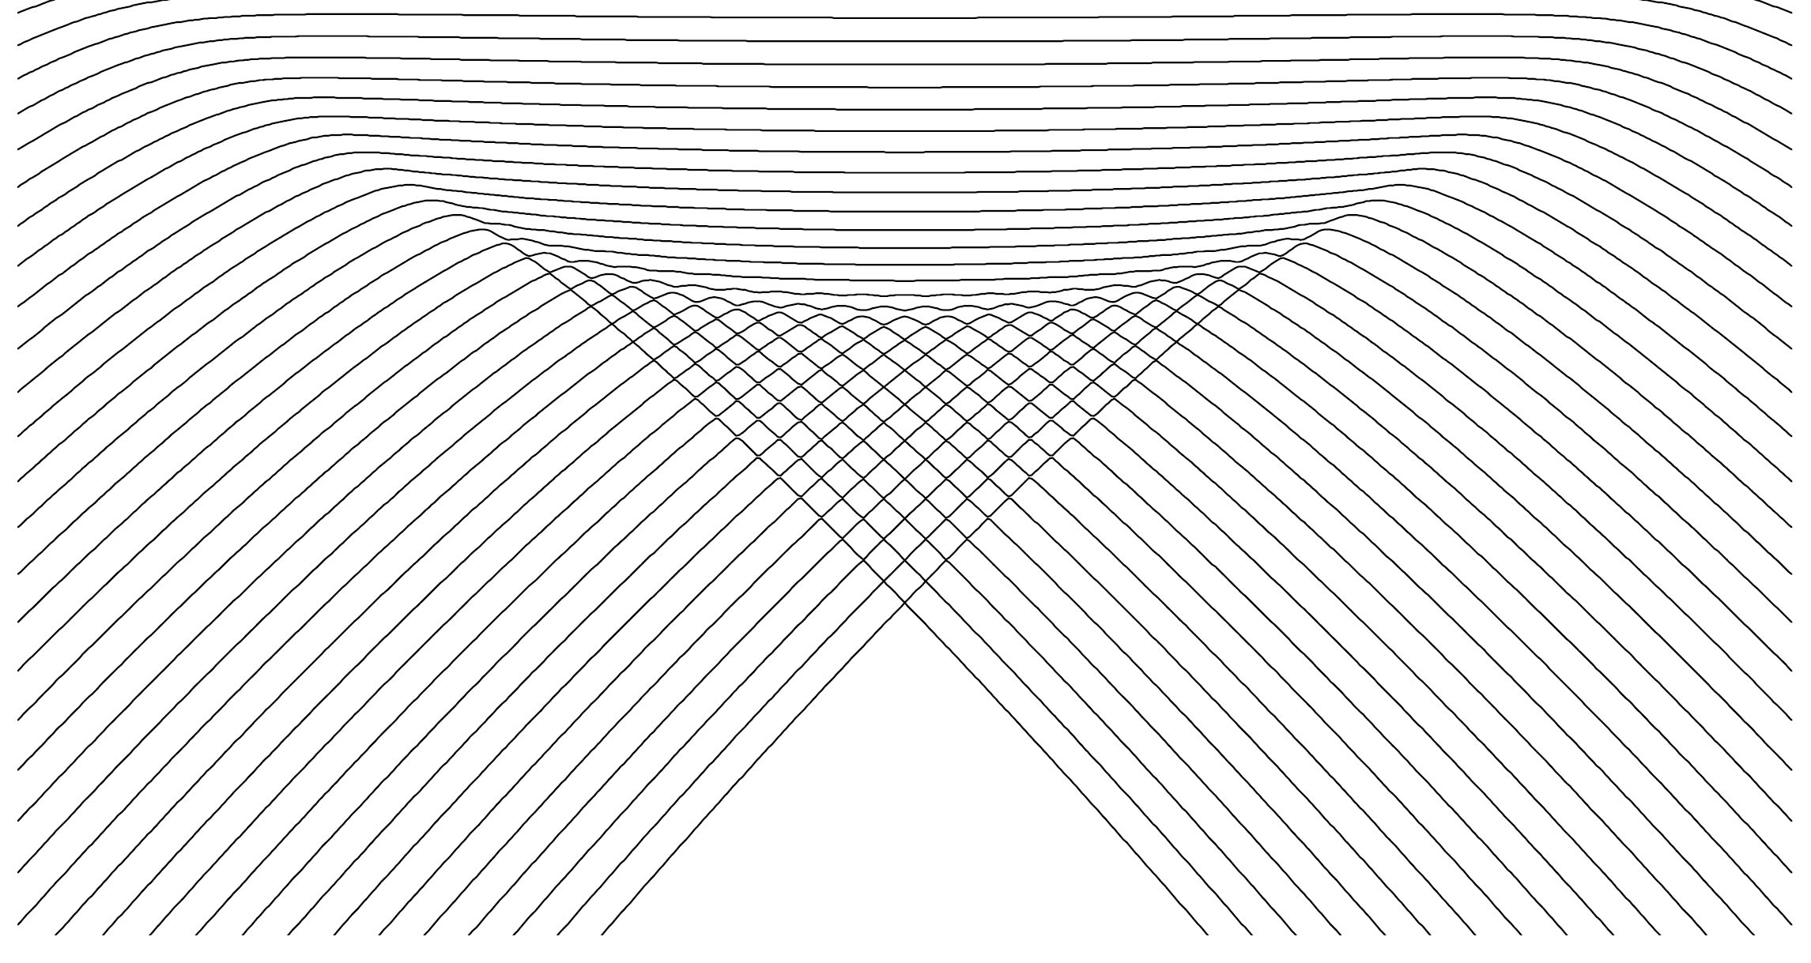
Excited-state quantum phase transition
Generalization of the QPTs for the excited spectra
(ESQPT)
a) discontinuity in the smooth level density ρ
critical borderlines
E
b) discontinuity in the average level flow rate φ
a)
b)
λ
ESQPT’s effect is best visible in averaged quantities characterizing bundles of energy levels in individual level themselves
M.A. Caprio, P. Cejnar, F. Iachello, Ann. Phys. 323, 1106 (2008)
P. Cejnar, P. Stránský, Phys. Rev. E 78, 031130 (2008)

Slide 6
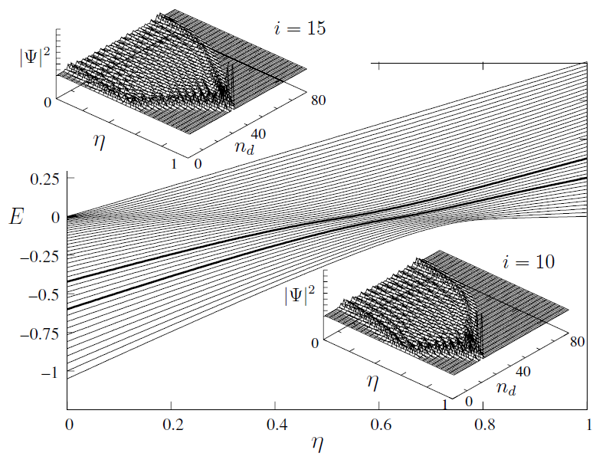
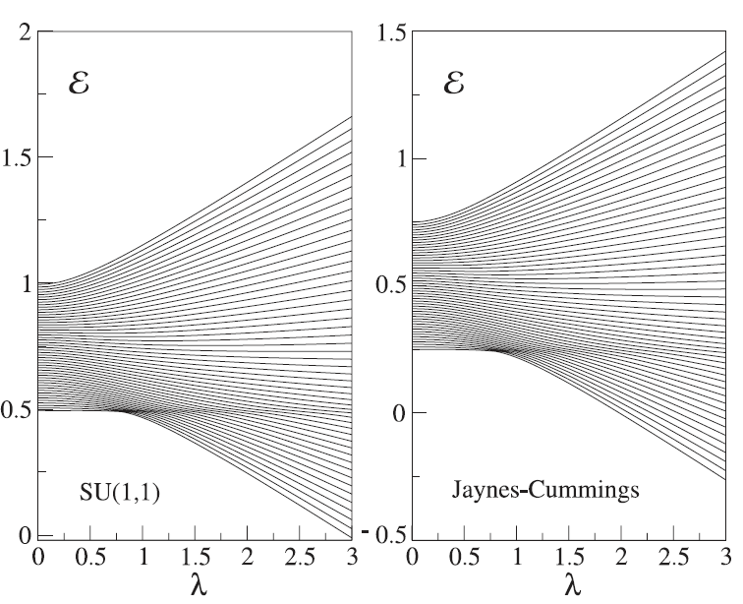
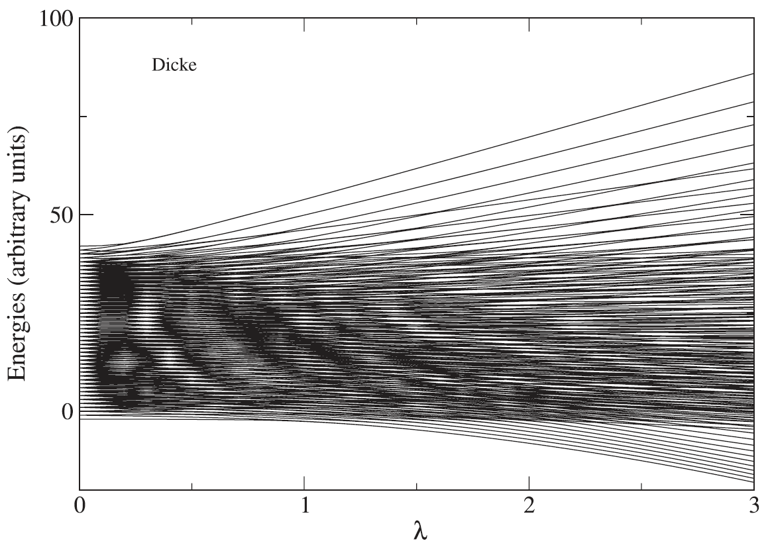
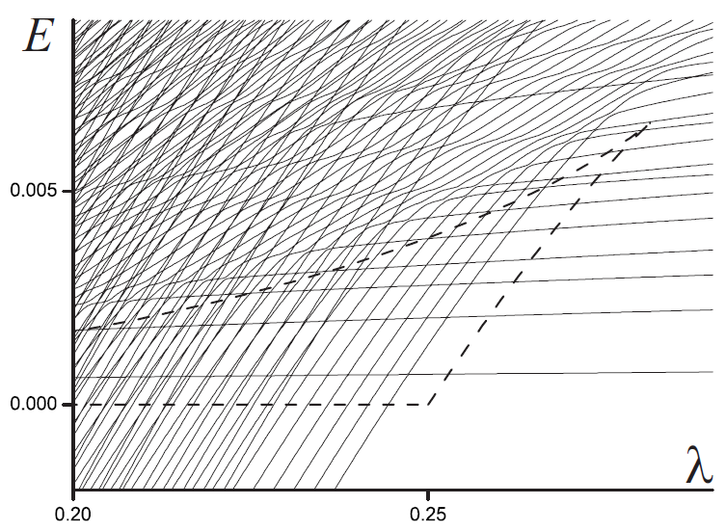
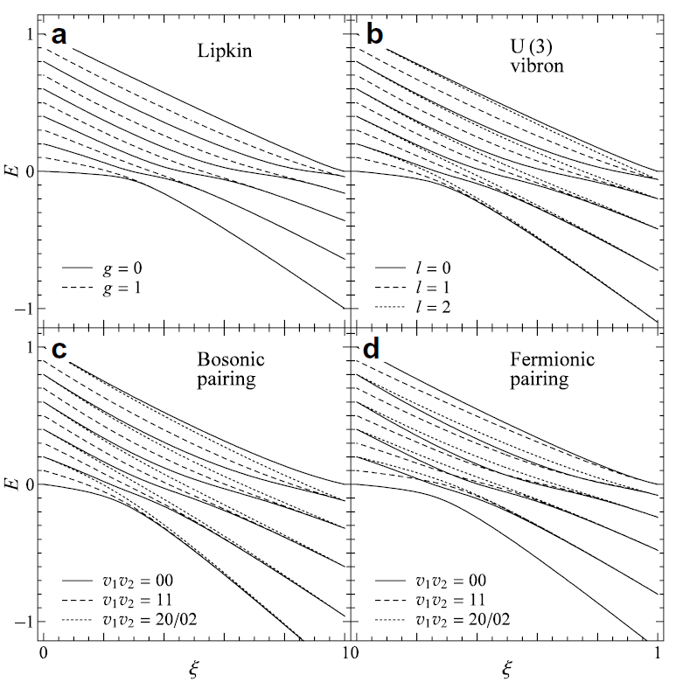
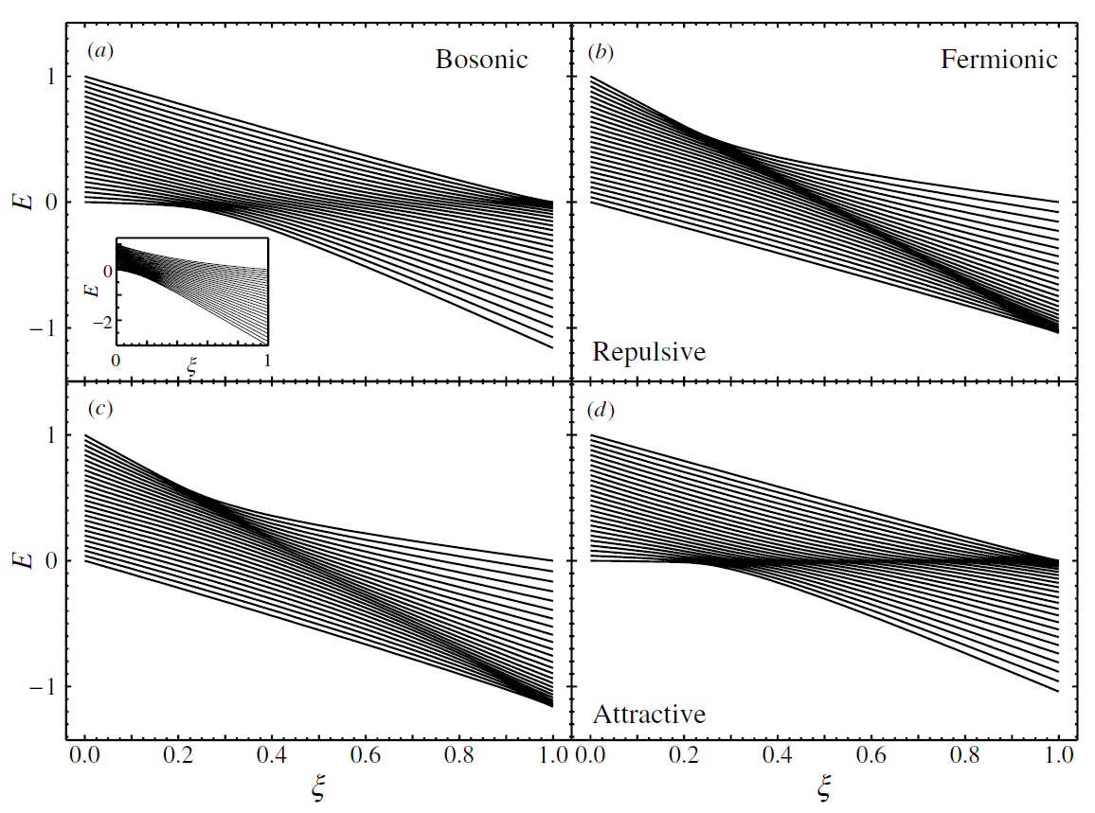
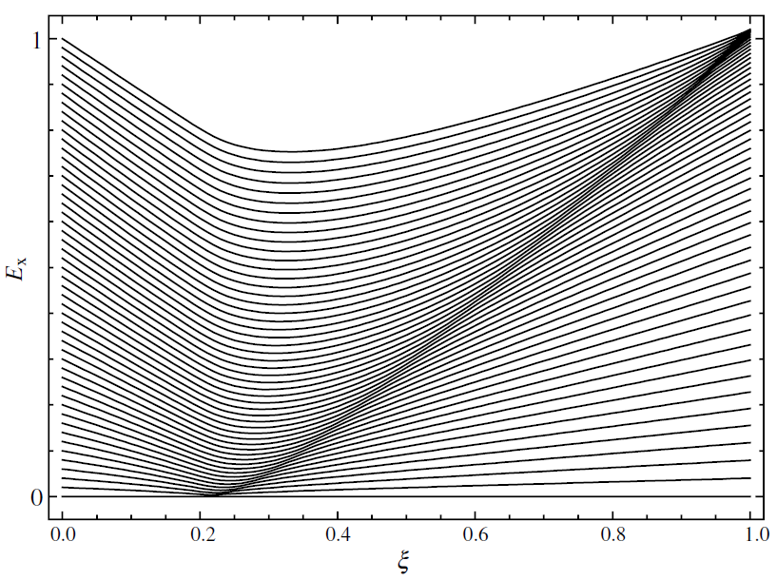
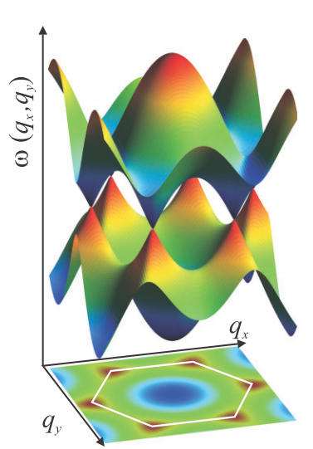
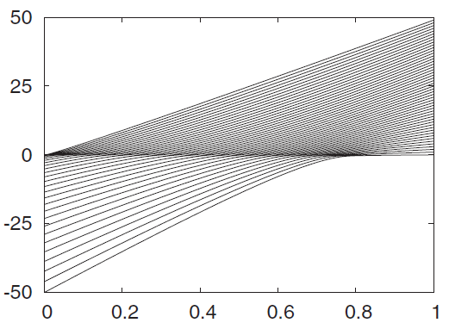
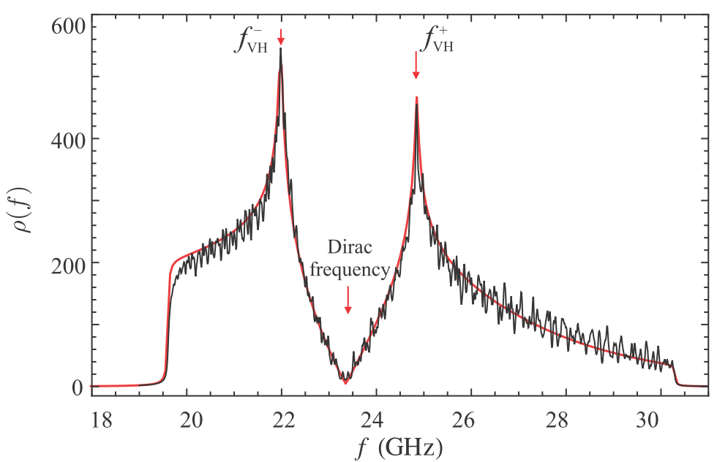
Evidence of ESQPTs in the literature
O(6)-U(5) transition in the Interacting Boson Model
2-level fermionic pairing model
Geometric collective model of atomic nuclei
Graphene
(ESQPT experimentally observed)
Lipkin model
2-level pairing models
s-boson condensate
M.A. Caprio, P. Cejnar, F. Iachello,
Annals of Physics 323, 1106 (2008)
P. Pérez-Fernández, A. Relaño, J.M. Arias, J. Dukelsky, J.E. García-Ramos, Phys. Rev. A 80, 032111 (2009)
s+d-bosons condensate
B. Dietz, F. Iachello, M. Miski-Oglu, N. Pietralla, A. Richter, L. von Smekal, and J. Wambach, Phys. Rev. B 88, 104101 (2013)
P. Pérez-Fernández, P. Cejnar, J.M. Arias, J. Dukelsky,
J.E. García-Ramos, A. Relaño, Phys. Rev. A 83, 033802 (2009)
P. Cejnar, P. Stránský, Phys. Rev. E 78, 031130 (2008)
M.A. Caprio, J.H. Skrabacz, F. Iachello, J. Phys. A 44, 075303 (2011)
P. Cejnar, M. Macek, S. Heinze, J. Jolie, J. Dobeš, J. Phys. A: Math. Gen. 39, L515 (2006)

Slide 7
ESQPT
Theory

Slide 8
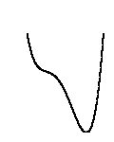
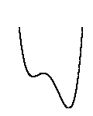
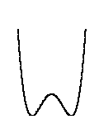
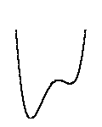
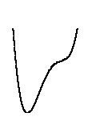
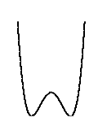
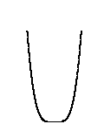
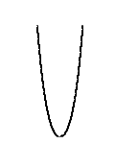
Manifestations of ESQPTs
Hamiltonian
analytic function on the phase space $x=\left(p,q\right)$
f degrees of freedom
energy surfaces
E
x
E
λ
λ
Interesting behaviour expected at energies of the Hamiltonian stationary points
Critical borderlines correspond with the positions of local extremes in the constant-energy surfaces

Slide 9
a) Level density
oscillatory component
(semiclassically given by the Gutzwiller trace formula; not relevant here in the infinite-size limit)
smooth component
(Weyl formula)
volume function
of the classical phase space
Numerical approximation
I. Hoveijn, J. Math. Anal. Appl. 348, 530 (2008)
M. Kastner, Rev. Mod. Phys. 80, 167 (2008)

Slide 10
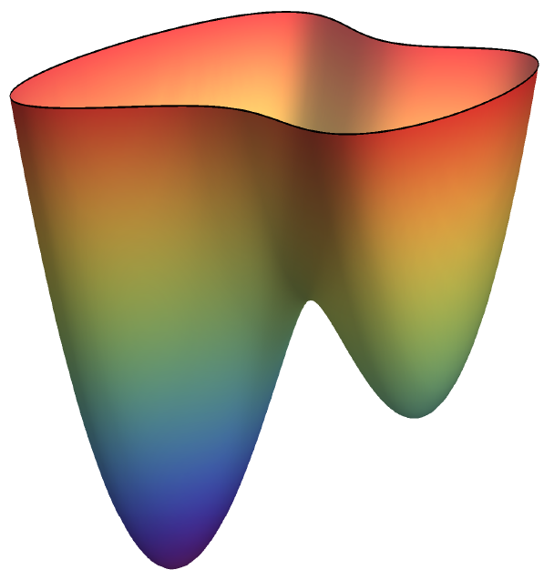
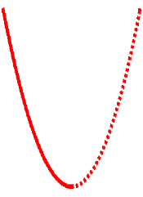
Level density: Nondegenerate stationary point w
Morse lemma
energy surface
Approximation of the Hamiltonian with a quadratic function in the vicinity of w
index r of the stationary point
E
ε
w
local volume integral
y₂
x₂
x₁
y₁
local coordinates
r = 0
r > 0
P. Stránský, P. Cejnar, Phys. Lett. A380, 2637 (2016)

Slide 11
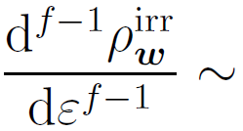
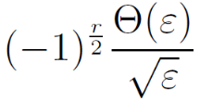
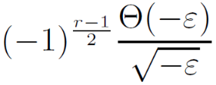
Nondegenerate stationary point: singularities
f integer
f half-integer
(relevant for lattices and time-dependent Hamiltonian systems)
r even
r odd
r even
r odd
[f-1]-th derivative
logarithmic divergence
inverse sqrt
jump
E_{w}
E
E_{w}
E
E_{w}
E
E_{w}
E
Each singularity of the level density at a nondegenerate stationary point is uniquely classified by the two numbers (f,r)
P. Stránský, P. Cejnar, Phys. Lett. A380, 2637 (2016)

Slide 12
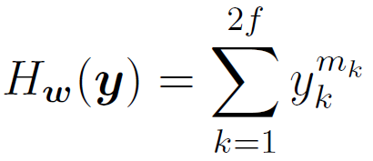
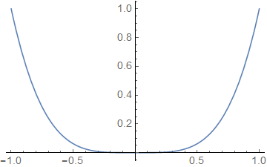
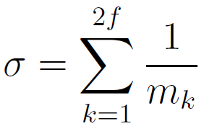
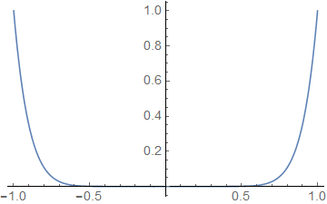
Level density: Degenerate stationary point
Special class of separable Hamiltonians (flat minimum):
(analytic only for m_{k} even integer)
- discontinuity in the$\left\lceil σ−1\right\rceil$-th derivative
Example: We require discontinuity of the t-th derivative
- satisfied when
even in the thermodynamic limit
the level density can be discontinuous
Higher flatness of the stationary point enhances its signatures in the spectrum (it shifts the singularity towards lower derivatives).

Slide 13
Level density: Degenerate stationary point
Special class of separable Hamiltonians (flat minimum):
(analytic only for m_{k} even integer)
Structural stability
- an arbitrarily small perturbation converts any function into a Morse function:
- discontinuity of the -th derivative
Example 1: We require discontinuity of the t-th derivative
- satisfied when
flat minimum
quadratic minimum
even in the thermodynamic limit
the level density can be discontinuous
M. Kastner, Rev. Mod. Phys. 80, 167 (2008)
Higher flatness of the stationary point enhances its signatures in the spectrum (it shifts the singularity towards lower derivatives).

Slide 14
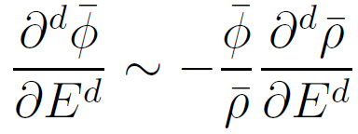
b) Level flow rate
E
($≡$position)
trajectories of individual levels – flow lines
Continuity equation
derivatives
λ ($≡$time)
Using Hellmann-Feynman formula, the flow rate can be expressed as
We expect the same nonanalyticity in the flow rate as in the level density
- weighted average of the quantum expectation value of $H_{I}(x)$ in the eigenstates around energy $E$
- experimentally more important than the level density itself
P. Stránský, M. Macek, P. Cejnar, Ann. Phys. 345, 73 (2014)
P. Stránský, P. Cejnar, Phys. Lett. A380, 2637 (2016)

Slide 15
ESQPTs
in the Extended Dicke Model

Slide 16
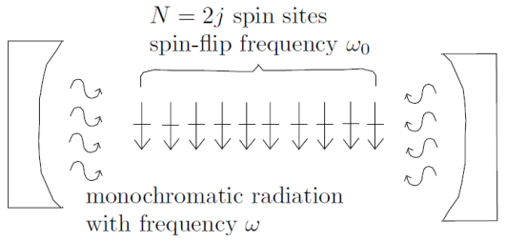
Dicke model of superradiance
interaction of a single-mode bosonic field with a chain of two-level atoms
$f=2$ degrees of freedom
$SU\left(2\right)×HW(1)$ algebra
R.H, Dicke, Phys. Rev. 93, 99 (1954)
K. Hepp, E. Lieb, Ann. Phys. 76, 360 (1973)
$$\hat{J}=\sum_{i=1}^{N}{\frac{σ^{i}}{2}}$$
Semiclassical Hamiltonian
M.A. Bastarrachea-Magnani et al., Phys. Rev. A 89, 032101 (2014)

Slide 17
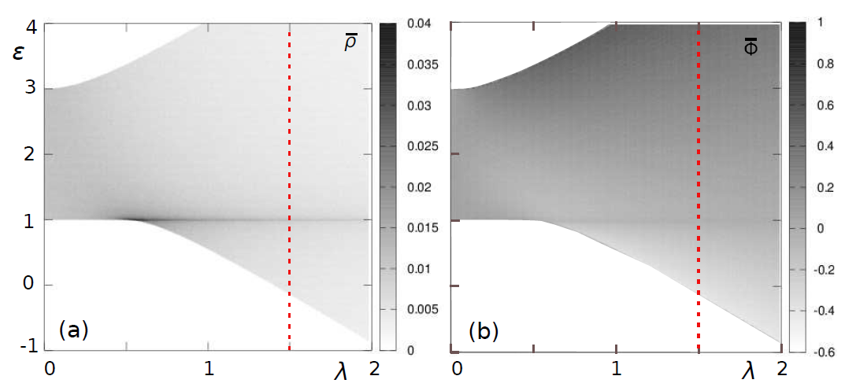
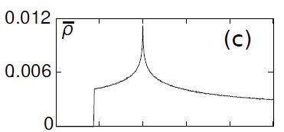
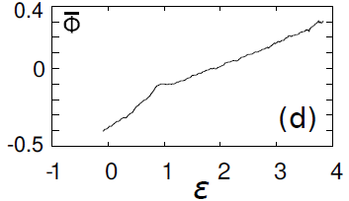
$δ=0$ integrable regime
another integral of motion $\hat{M}={\hat{b}}^{+}\hat{b}+{\hat{J}}_{z}+j$
For fixed $M$ effectively 1 degree of freedom
ESQPT appears in the critical irrep $M=N=\frac{j}{2}$
$$H_{TC}^{λ}\left(p^{′},x^{′};M\right)=\left(ω−ω_{0}\right)\frac{{p^{′}}^{2}+{x^{′}}^{2}}{2}+ω_{0}M+λx^{′}\sqrt{j}\sqrt{1−\frac{1}{j^{2}}{\left(M−\frac{{p^{′}}^{2}+{x^{′}}^{2}}{2}\right)}^{2}}$$
level density
(semiclassical calculation)
flow rate
ESQPT
$ω>ω_{0}$ detuned
M. Kloc, P. Stránský, P. Cejnar, Ann. Phys. 382, 85 (2017)

Slide 18
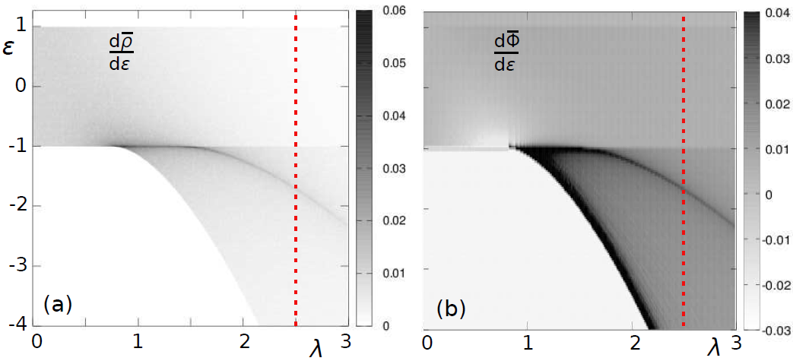
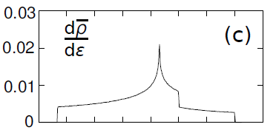
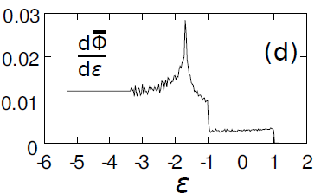
$δ≠0$ nonintegrable regime
$f=2$ degrees of freedom
nonanalyticities appear in the first derivative of ρ
level density
$$δ=0.3$$
flow rate
(2,2)
QPT
2nd order
ESQPTs
(2,2)
(2,1)
M. Kloc, P. Stránský, P. Cejnar, Ann. Phys. 382, 85 (2017)

Slide 19
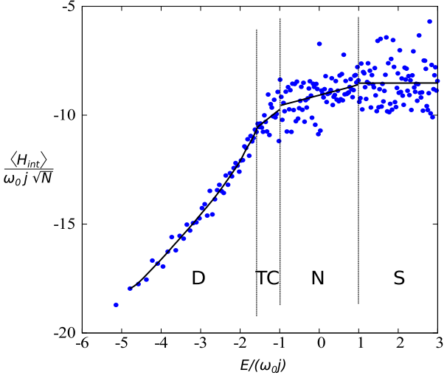
Flow rate from quantum spectrum
flow rate
Superradiant
(2,2)
Normal
QPT
2nd order
ESQPTs
(2,2)
TavisCummings
(2,1)
Hellmann-Feynman formula:
$$\frac{dE_{i}}{dλ}={\left\langle \frac{dH}{dλ}\right\rangle }_{i}=\frac{{\left\langle V\right\rangle }_{i}}{\sqrt{N}}$$
Dicke
M. Kloc, P. Stránský, P. Cejnar, Ann. Phys. 382, 85 (2017)

Slide 20
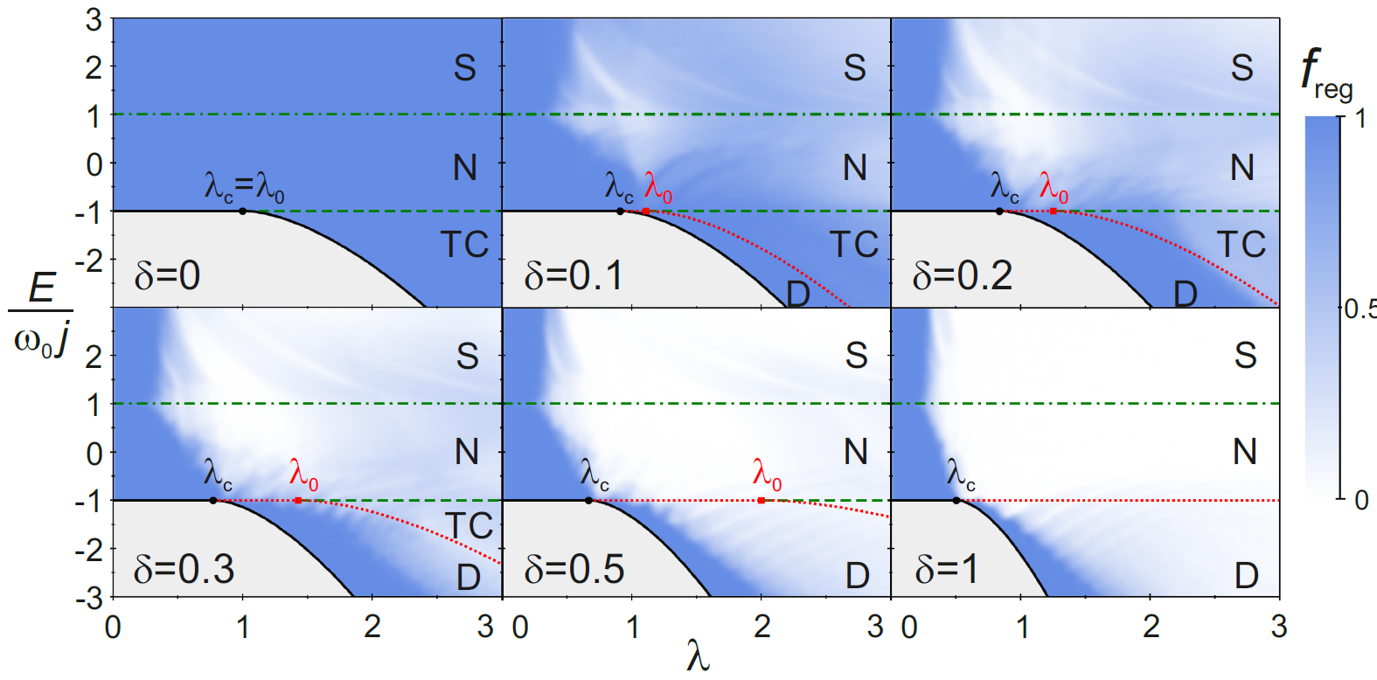
Chaos in the Dicke model
Nonintegrability – allows one to study connection between the ESQPTs and chaos
$$λ_{c}=\frac{\sqrt{ωω_{0}}}{1+δ}$$
$$λ_{0}=\frac{\sqrt{ωω_{0}}}{1−δ}$$
M. Kloc, P. Stránský, P. Cejnar, Ann. Phys. 382, 85 (2017)

Slide 21
ESQPT
and Monodromy

Slide 22
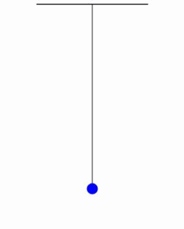
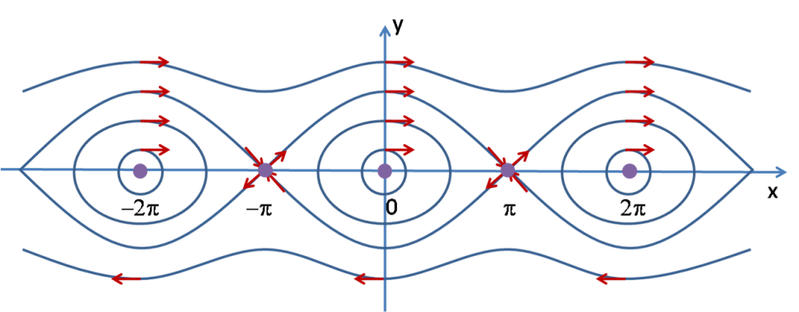
Monodromy
existence of singular tori splitting the phase space into two parts with analytically non-connectable types of motion
induced by unstable equilibrium points of integrable Hamiltonian
Example: spherical pendulum $f=2$
Phase portrait for a trajectory with angular momentum $M=0$
p
pinched torus
- prevents introducing global action-angle variables in the whole phase space
x

Slide 23
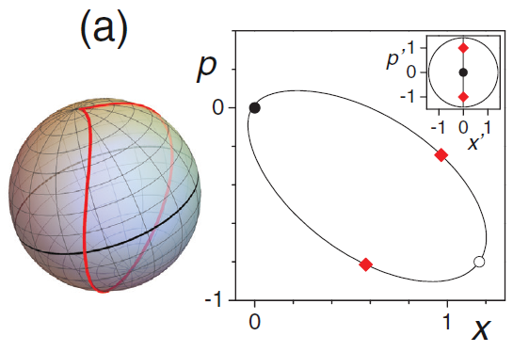
Monodromy in the Dicke model
$$H_{TC}^{λ}\left(p^{′},x^{′};M\right)=\left(ω−ω_{0}\right)\frac{{p^{′}}^{2}+{x^{′}}^{2}}{2}+ω_{0}M+λx^{′}\sqrt{j}\sqrt{1−\frac{1}{j^{2}}{\left(M−\frac{{p^{′}}^{2}+{x^{′}}^{2}}{2}\right)}^{2}}$$
$$δ=0$$
energy surfaces
critical trajectory on the pinched torus $M=N$
fully excited atomic ensemble
$$M=0.9N$$
$$M=N$$
$$M=1.1N$$
$ω=ω_{0}$ tuned
$ω>ω_{0}$ detuned
O. Babelon, L. Cantini, B. Doucot, J. Stat. Mech. 2009, P07011 (2009)
M. Kloc, P. Stránský, P. Cejnar, J. Phys. A: Math. Theor. 50, 315205 (2017)

Slide 24
Decay of monodromy
$ω=ω_{0}$ tuned
Poincaré sections of a perturbed system at the energy of the monodromy point
Each color marks a passage of a trajectory through plane $φ′=0$
Each trajectory has different value of $\left\langle M\right\rangle$
$\left\langle M\right\rangle =N$ orbit plotted in black. This orbit is destroyed first.
M. Kloc, P. Stránský, P. Cejnar, J. Phys. A: Math. Theor. 50, 315205 (2017)

Slide 25
Quantum monodromy
$ω=ω_{0}$ tuned
defect in a lattice (energy x momentum) of eigenvalues at the point of classical pinched torus
encircling this point
Elementary cell given by basis vectors
$$M=\left(1,E_{k}\left(M+1\right)−E_{k}\left(M\right)\right)$$
$$k=\left(0,E_{k+1}\left(M\right)−E_{k}\left(M\right)\right)$$
transforms as
$$\left(\begin{matrix}M′ \\ k′\end{matrix}\right)=\left(\begin{matrix}1 & 1 \\ 0 & 1\end{matrix}\right)\left(\begin{matrix}M \\ k\end{matrix}\right)$$
monodromy matrix
Experimentally identified in excited spectra of some molecules, eg. H₂O, CO₂.

Slide 26
Quantum monodromy
$ω=ω_{0}$ tuned
defect in a lattice (energy x momentum) of eigenvalues at the point of classical pinched torus
The defect appears also in lattices for expectation values of arbitrary operators – indicator of monodromy if the second integral of motion is not known
M. Kloc, P. Stránský, P. Cejnar, J. Phys. A: Math. Theor. 50, 315205 (2017)

Slide 27
Decay of quantum monodromy
The lattice defect is destroyed already with the weakest perturbation (due to the high energy level density near the monodromy point)
M. Kloc, P. Stránský, P. Cejnar, J. Phys. A: Math. Theor. 50, 315205 (2017)

Slide 28
ESQPT
and quantum quenches
(work in progress)

Slide 29
Quantum quench
Abrupt diabatic change $λ^{\left(i\right)}→λ^{\left(f\right)}$ of the control parameter in a system $H\left(λ\right)=H_{0}+λV$ followed by unitary quantum evolution at $λ^{\left(f\right)}$
Evolution depends on the fragmentation of the initial state $|\left.ψ^{\left(i\right)}\right\rangle$ in the eigenstates $|\left.φ_{n}^{\left(f\right)}\right\rangle$ of the final state
Due to singularities in the energy level density, a response of a quench onto a ESQPT or across a critical borderline should differ from the quench ending on the same side
Survival amplitude
(Loschmidt amplitude, fidelity)
$$a\left(t\right)≡\left\langle ψ^{\left(i\right)} | e^{−\frac{i}{ℏ}{\hat{H}}^{\left(f\right)}t} | ψ^{\left(i\right)}\right\rangle$$
$$=\sum_{n}{{\left|\left\langle ψ^{\left(i\right)} | φ_{n}^{\left(f\right)}\right\rangle \right|}^{2}}e^{−\frac{i}{ℏ}E_{n}^{\left(f\right)}t}=\sum_{n}{{\left|c_{n}\right|}^{2}}e^{−\frac{i}{ℏ}E_{n}^{\left(f\right)}t}$$
Survival probability
(Loschmidt echo)
$$p\left(t\right)≡{\left|a\left(t\right)\right|}^{2}=\sum_{n}{{\left|c_{n}\right|}^{4}}+2\sum_{n<m}{{\left|c_{n}\right|}^{2}{\left|c_{m}\right|}^{2}\cos\left[\frac{E_{m}^{\left(f\right)}−E_{n}^{\left(f\right)}}{ℏ}t\right]}$$
P. Pérez-Fernández et al., Phys. Rev. A 83, 033802 (2011)

Slide 30
Quantum quench in the $δ=0$Dicke model
critical irrep
Center of the energy distribution after quench:
$${\left\langle {\hat{H}}^{\left(f\right)}\right\rangle }_{i}=E_{i}+Δλ{\left\langle \hat{V}\right\rangle }_{i}=E_{i}+Δλ\frac{dE_{i}}{dλ}$$
Dispersion after quench:
$${\left(Δ_{i}\hat{O}\right)}^{2}={\left\langle {\hat{O}}^{2}\right\rangle }_{i}−{\left\langle \hat{O}\right\rangle }_{i}^{2}$$
$$Δ_{i}{\hat{H}}^{\left(f\right)}=Δλ Δ_{i}\hat{V}$$
$${\left\langle \hat{O}\right\rangle }_{i}≡\left\langle ψ^{\left(i\right)} | \hat{O} | ψ^{\left(i\right)}\right\rangle$$
Forward quench: Short time decay
- from the theory of the Loschmidt echo
$$p\left(t\right)≈1−{\left(\frac{t}{τ}\right)}^{2}$$
$$τ=\frac{1}{Δ_{i}{\hat{H}}_{f}}$$
- given by the dispersion of the initial state
For the ground-state $Δ_{0}\hat{V}=δ$.

Slide 31
Quantum quench in the $δ=0$Dicke model
critical irrep
Center of the energy distribution after quench:
$${\left\langle {\hat{H}}^{\left(f\right)}\right\rangle }_{i}=E_{i}+Δλ{\left\langle \hat{V}\right\rangle }_{i}=E_{i}+Δλ\frac{dE_{i}}{dλ}$$
Dispersion after quench:
$${\left(Δ_{i}\hat{O}\right)}^{2}={\left\langle {\hat{O}}^{2}\right\rangle }_{i}−{\left\langle \hat{O}\right\rangle }_{i}^{2}$$
$$Δ_{i}{\hat{H}}^{\left(f\right)}=Δλ Δ_{i}\hat{V}$$
$${\left\langle \hat{O}\right\rangle }_{i}≡\left\langle ψ^{\left(i\right)} | \hat{O} | ψ^{\left(i\right)}\right\rangle$$
Forward quench: Long time behavior
recurences
1/t power law

Slide 32
Quantum quench in the $δ=0$Dicke model
critical irrep
Center of the energy distribution after quench:
$${\left\langle {\hat{H}}^{\left(f\right)}\right\rangle }_{i}=E_{i}+Δλ{\left\langle \hat{V}\right\rangle }_{i}=E_{i}+Δλ\frac{dE_{i}}{dλ}$$
Dispersion after quench:
$${\left(Δ_{i}\hat{O}\right)}^{2}={\left\langle {\hat{O}}^{2}\right\rangle }_{i}−{\left\langle \hat{O}\right\rangle }_{i}^{2}$$
$$Δ_{i}{\hat{H}}^{\left(f\right)}=Δλ Δ_{i}\hat{V}$$
$${\left\langle \hat{O}\right\rangle }_{i}≡\left\langle ψ^{\left(i\right)} | \hat{O} | ψ^{\left(i\right)}\right\rangle$$
Backward quench
$$λ^{\left(f\right)}=0.3$$
$$λ^{\left(f\right)}=0.77$$
ESQPT
$$λ^{\left(f\right)}=1$$

Slide 33
Quantum quench in the $δ≠0$Dicke model
$$δ=0.3$$
Forward quench
Short-time behavior
for the ground-state:
$$p\left(t\right)=1−Δλ^{2}δ^{2}t^{2}$$
(ground state)

Slide 34
Quantum quench in the $δ≠0$Dicke model
$$δ=0.3$$
$$N=12$$
survival of eigenstates
Forward quench
Short-time behavior
for the ground-state:
$$p\left(t\right)=1−Δλ^{2}δ^{2}t^{2}$$
(ground state)

Slide 35
Quantum quench in the $δ≠0$Dicke model
Backward quenchs
$$δ=0.3$$
$$λ^{\left(f\right)}=0.8$$
$$λ^{\left(f\right)}=1.1$$
In this full $f=2$ system the ESQPT-related phenomena are expected to be smoother than in the restricted integrable system
Chaoticity can obscure the analysis
$$λ^{\left(f\right)}=1.475$$
ESQPT
$$λ^{\left(f\right)}=1.5$$

Slide 36
Summary
ESQPTs originate in stationary points of the Hamiltonian and manifest themselves as singularities in the smooth level density and in the average flow rate.
Nondegenerate stationary points
Singularities classified uniquely and completely by two numbers $(f,r)$
Singularities occur in the $\left\lceil f−1\right\rceil$-th derivative of the smooth level density or flow rate and are always of a jump / logarithmic divergence type
Degenerate stationary points
Higher flatness of the stationary point shifts the discontinuity towards lower derivatives
Phenomena connected with the existence ESQPTs
Monodromy, changes in the nonequilibrium dynamics
Thank you for attention

