Slide 1


Spontaneous stabilization of product states
in the RABI MODEL
Pavel Stránský
Institute of Particle and Nuclear Physics, Charles University, Czech Republic
In collaboration with:
Pavel Cejnar (IPNP CUNI)
Radim Filip (Department of Optics, Faculty of Science, Palacký University, Olomouc, Czech Republic)
Supported by:
Recently published in:
Physical Review A 104, 053722 (2021)
arXiv:2108.08210
Caos y localización en sistemas cuánticos de muchos cuerpos 2022
24 January 2022

Slide 2
Outline
Extended Rabi model and its classical limit
QPTs and ESQPTs
Stability of the noninteracting ground state
Parity violation

Slide 3
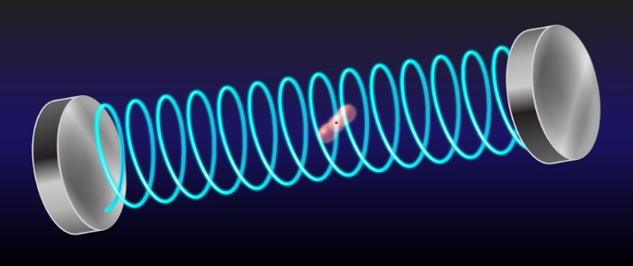

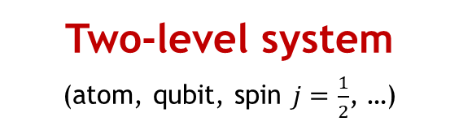
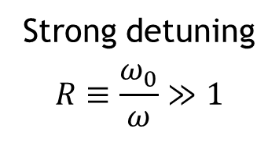





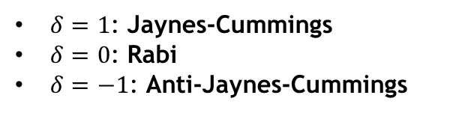



Experiments:
Rabi model
F. Yoshihara et al., Nat. Phys. 13, 44 (2017)
N.K. Langford et al., Nat. Commun. 8, 1715 (2017)
M.-L. Cai et al., Nat. Commun. 12, 1126 (2021)
Two-level system
(atom, qubit, spin $j=\frac{1}{2}$, …)
Harmonic oscillator
(EM field,…)
Strong detuning
$$R≡\frac{ω_{0}}{ω}≫1$$
$${\hat{H}}_{spin}=ω_{0}{\hat{J}}_{z}$$
$$H_{osc}=ω{\hat{b}}^{+}\hat{b}$$
$$\hat{b}=\sqrt{\frac{R}{2}}\left(\hat{q}+i\hat{p}\right)$$
$$\hat{J}=\frac{1}{2}\left(σ_{x},σ_{y},σ_{z}\right)$$
Interaction
Conserving parity:
$$H_{int}=λ\sqrt{R}\left[\left(1+δ\right)\left({\hat{b}}^{+}{\hat{J}}_{−}+\hat{b}{\hat{J}}_{+}\right)+\left(1−δ\right)\left({\hat{b}}^{+}{\hat{J}}_{+}+\hat{b}{\hat{J}}_{−}\right)\right]$$
$$λ∈\left[0,∞\right), δ∈[−1,1]$$
$$\hat{Π}≡{\left(−1\right)}^{\hat{n}+{\hat{n}}_{∗}}$$
$$\hat{n}≡{\hat{b}}^{+}\hat{b}$$
$δ=1$: Jaynes-Cummings
$δ=0$: Rabi
$δ=−1$: Anti-Jaynes-Cummings
$${\hat{n}}_{∗}≡{\hat{J}}_{z}+j$$
Violating parity:
$$+μ\sqrt{R}\left({\hat{b}}^{+}+\hat{b}\right)\left({\hat{J}}_{z}+j\right)$$

Slide 4



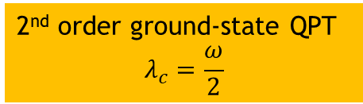

Quantum critical effects
0
Energy level dynamics
$$λ_{0}=\frac{λ_{c}}{\left|δ\right|}$$
$$ε≡\frac{E}{Rω}$$
-0.5
2nd order ground-state QPT
$$λ_{c}=\frac{ω}{2}$$
ESQPTs
-1
$$R=20, δ=0.5$$
-1.5
$μ=0$ – parity conserving case

Slide 5

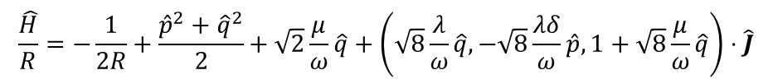

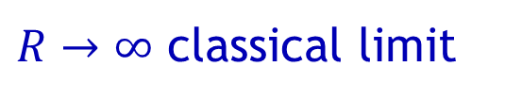
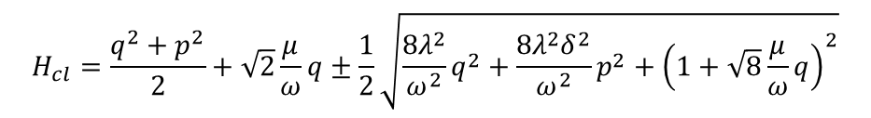

Quantum critical effects
$R→∞$ classical limit
$$\left[\hat{q},\hat{p}\right]=\frac{i}{R}$$
0
$$\frac{\hat{H}}{R}=−\frac{1}{2R}+\frac{{\hat{p}}^{2}+{\hat{q}}^{2}}{2}+\sqrt{2}\frac{μ}{ω}\hat{q}+\left(\sqrt{8}\frac{λ}{ω}\hat{q},−\sqrt{8}\frac{λδ}{ω}\hat{p},1+\sqrt{8}\frac{μ}{ω}\hat{q}\right)⋅\hat{J}$$
Smooth level density
$$λ_{0}=\frac{λ_{c}}{\left|δ\right|}$$
$$ε≡\frac{E}{Rω}$$
Magnetic dipole in an external field
$$\hat{B}\left(\hat{q},\hat{p}\right)$$
In the $R→∞$ limit the field becomes classical
(adiabatic separation of the field and qubit subsystems)
-0.5
$$H_{cl}=\frac{q^{2}+p^{2}}{2}+\sqrt{2}\frac{μ}{ω}q±\frac{1}{2}\sqrt{\frac{8λ^{2}}{ω^{2}}q^{2}+\frac{8λ^{2}δ^{2}}{ω^{2}}p^{2}+{\left(1+\sqrt{8}\frac{μ}{ω}q\right)}^{2}}$$
2nd order ground-state QPT
$$λ_{c}=\frac{ω}{2}$$
ESQPTs
Stationary points at $ε=−\frac{1}{2}$
maximum
Hessian
-1
saddle
minimum
$$R=20, δ=0.5$$
-1.5
$μ=0$ – parity conserving case

Slide 6
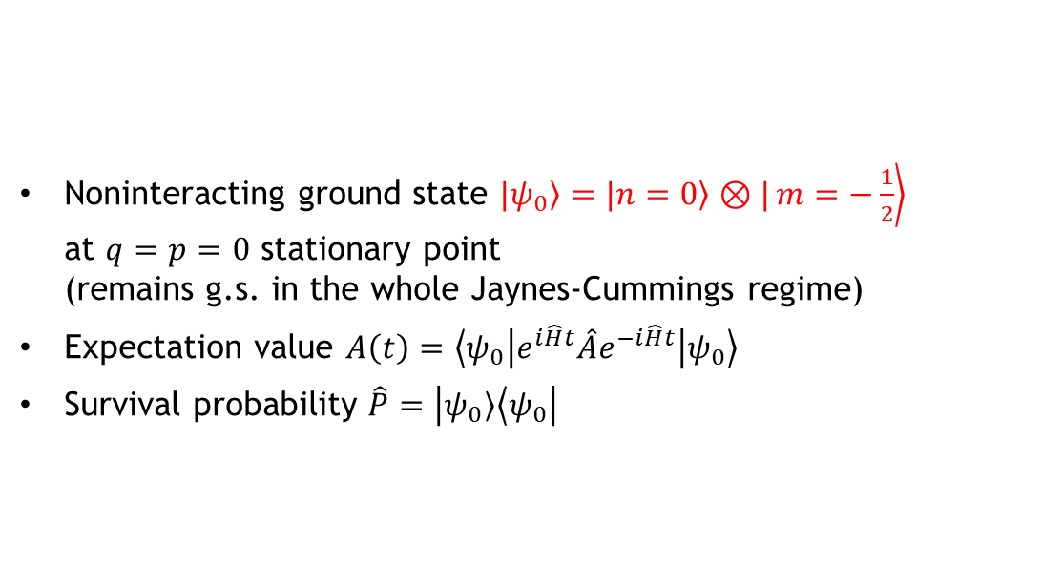
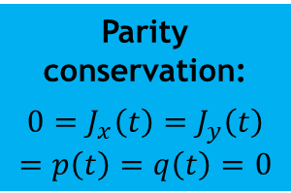

Quench of the noninteracting state
Noninteracting ground state $|\left.ψ_{0}\right\rangle =|\left.n=0\right\rangle ⊗|\left.m=−\frac{1}{2}\right\rangle$ at $q=p=0$ stationary point
(remains g.s. in the whole Jaynes-Cummings regime)
Expectation value $A\left(t\right)=\left\langle ψ_{0} | e^{i\hat{H}t}\hat{A}e^{−i\hat{H}t} | ψ_{0}\right\rangle$
Survival probability $\hat{P}=\left|\left.ψ_{0}\right\rangle \left\langle ψ_{0}\right.\right|$
$$R=100, δ=0.5$$
Parity conservation:
$${0=J}_{x}\left(t\right)=J_{y}\left(t\right)=p\left(t\right)=q\left(t\right)=0$$

Slide 7
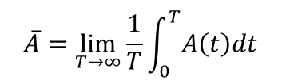
Quench of the noninteracting state
Noninteracting ground state $|\left.ψ_{0}\right\rangle =|\left.n=0\right\rangle ⊗|\left.m=−\frac{1}{2}\right\rangle$ at $q=p=0$ stationary point
(remains g.s. in the whole Jaynes-Cummings regime)
Expectation value $A\left(t\right)=\left\langle ψ_{0} | e^{i\hat{H}t}\hat{A}e^{−i\hat{H}t} | ψ_{0}\right\rangle$
Survival probability $\hat{P}=\left|\left.ψ_{0}\right\rangle \left\langle ψ_{0}\right.\right|$
Infinite-time average
$$\overline{A}=\lim_{T→∞}{\frac{1}{T}\int_{0}^{T}{A\left(t\right)dt}}$$
Parity conservation:
$${0=J}_{x}\left(t\right)=J_{y}\left(t\right)=p\left(t\right)=q\left(t\right)=0$$

Slide 8
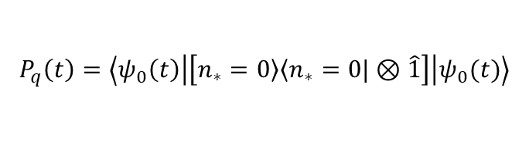
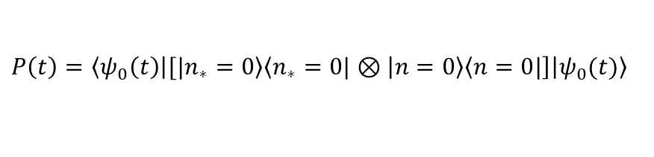


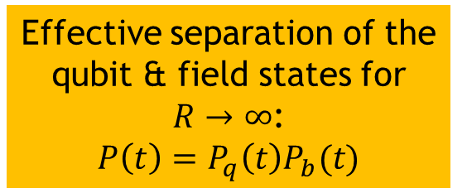


Subsystem survival probabilities
$$P\left(t\right)=\left\langle ψ_{0}\left(t\right) | [|\left.n_{∗}=0\right\rangle \left\langle n_{∗}=0|\right.⊗\left|\left.n=0\right\rangle \left\langle n=0|\right.\right] | ψ_{0}(t)\right\rangle$$
Phase S₁
Phase S₂
$$P_{q}\left(t\right)=\left\langle ψ_{0}\left(t\right) | \left[\left.n_{∗}=0\right\rangle \left\langle n_{∗}=0|\right.⊗\hat{1}\right] | ψ_{0}(t)\right\rangle$$
$$=\frac{1}{2}−J_{z}(t)$$
overall
overall
$$\overline{P}→0$$
$$\overline{P}→1−?$$
qubit
qubit
Effective separation of the qubit & field states for $R→∞$:
$$P\left(t\right)=P_{q}\left(t\right)P_{b}(t)$$
$${\overline{P}}_{q}→1$$
$${\overline{P}}_{q}→1$$

Slide 9
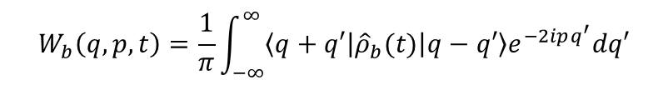
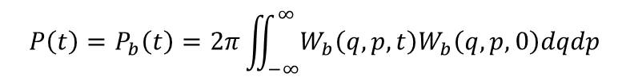
Minimum (N)
Saddle (S₁)
Maximum (S₂)
Wigner function
Phase-space evolution of the bosonic degree of freedom
$$W_{b}\left(q,p,t\right)=\frac{1}{π}\int_{−∞}^{∞}{\left\langle q+q′ | {\hat{ρ}}_{b}(t) | q−q′\right\rangle e^{−2ipq^{′}}dq′}$$
$$P\left(t\right)=P_{b}\left(t\right)=2π\iint_{−∞}^{∞}{W_{b}\left(q,p,t\right)W_{b}\left(q,p,0\right)dqdp}$$
Animations available at
http://pavelstransky.cz/wigner_rabi.php

Slide 10
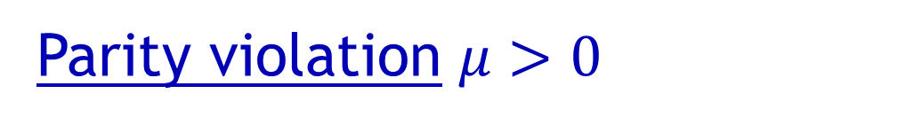



Parity violation $μ>0$
Infinite-time average
Smooth level density
$$μ=0.4, δ=0.5$$
Additional ESQPT structures
1st order ground-state QPT
? Sudden parity violation ?
$$μ=0.55, δ=0.5$$
NO ground-state QPT
$${\overline{J}}_{y}=\overline{p}=0$$

Slide 11
References:
ESQPT-related stabilization
L.F. Santos, F. Pérez-Bernal, Phys. Rev. A 92, 050101(R) (2015)
L.F. Santos, M. Távora, F. Pérez-Bernal, Phys. Rev. A 94, 012113 (2016)
M.A. Bastarrachea-Magnani et al., J. Phys. A: Math. Theor. 50, 144002 (2017)
M. Kloc, P. Stránský, P. Cejnar, Phys. Rev. A 98, 013836 (2018)
… and destabilization (depending od the quench protocol)
P. Pérez-Fernández et al., Phys. Rev. A 83, 033802 (2011)
M. Kloc et al., Phys Rev. A 103, 032213 (2021)
Integrability and solvability of the Rabi model
D. Braak, Phys. Rev. Lett. 107, 100401 (2011)
R. Puebla, Equilibrium and Nonequilibrium Aspects of Phase Transitions in Quantum Physics (Springer 2018)

Slide 12
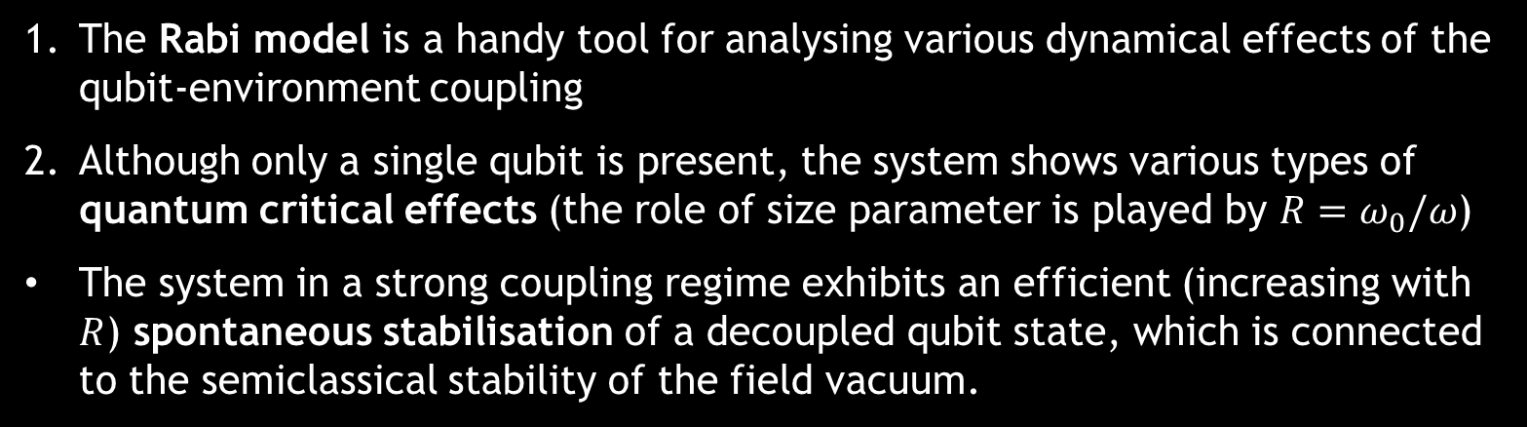
Conclusions
The Rabi model is a handy tool for analysing various dynamical effects of the qubit-environment coupling
Although only a single qubit is present, the system shows various types of quantum critical effects (the role of size parameter is played by $R=ω_{0}/ω$)
The system in a strong coupling regime exhibits an efficient (increasing with $R$) spontaneous stabilisation of a decoupled qubit state, which is connected to the semiclassical stability of the field vacuum.
Presented material based on:
Physical Review A 104, 053722 (2021)
arXiv:2108.08210
Thank you for listening

