Slide 1
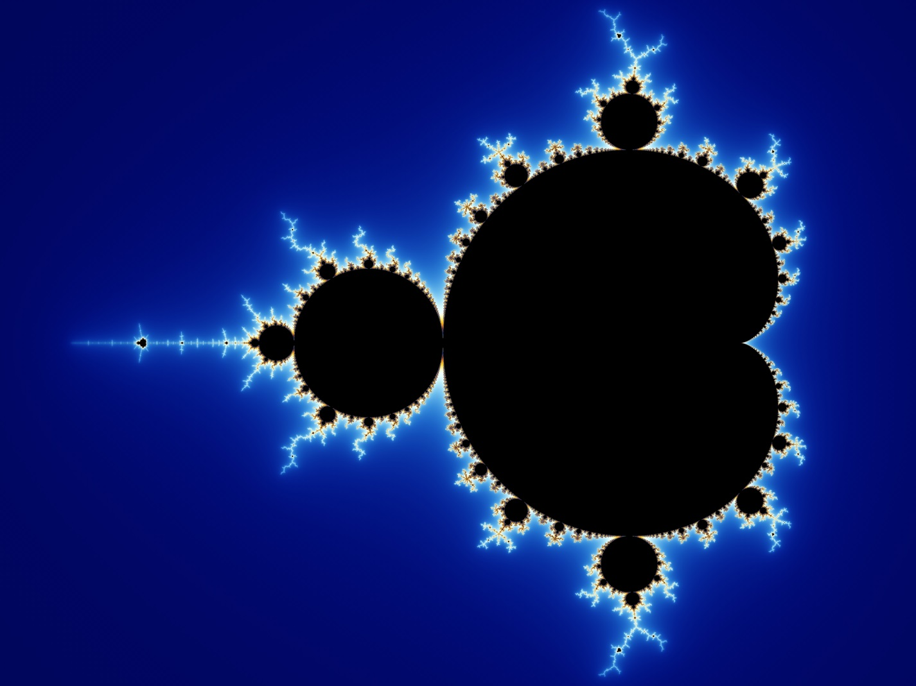
FRACTALS
Pavel Stránský
The peculiar geometry
of Nature
Masters of Puppets 2018

Slide 2
Why is geometry often described as “cold” and “dry”? One reason lies in its inability to describe the shape of a cloud, a mountain, a coastline, or a tree...
Benoît Mandelbrot, 1983

Slide 3
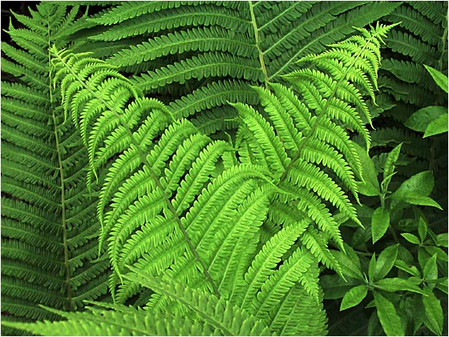
Fern

Slide 4
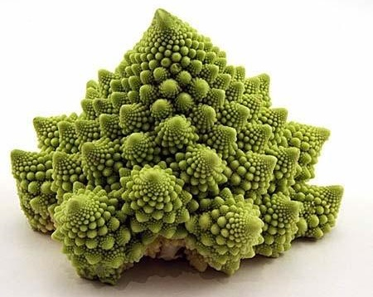
Romanesco broccoli

Slide 5
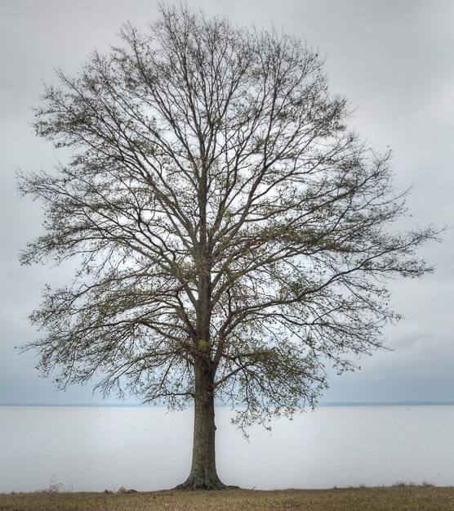
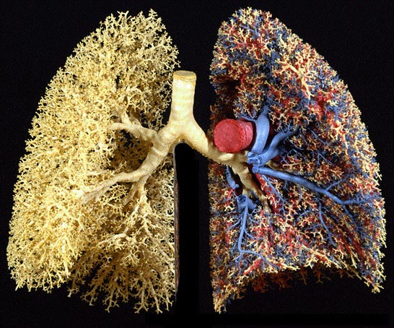
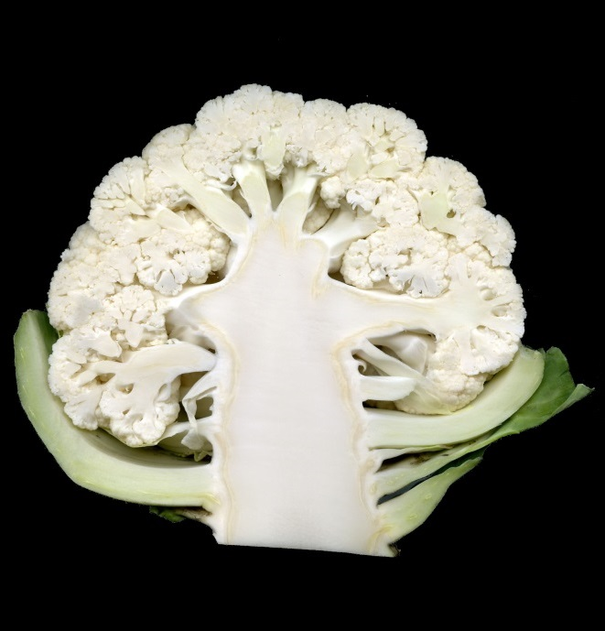

Slide 6
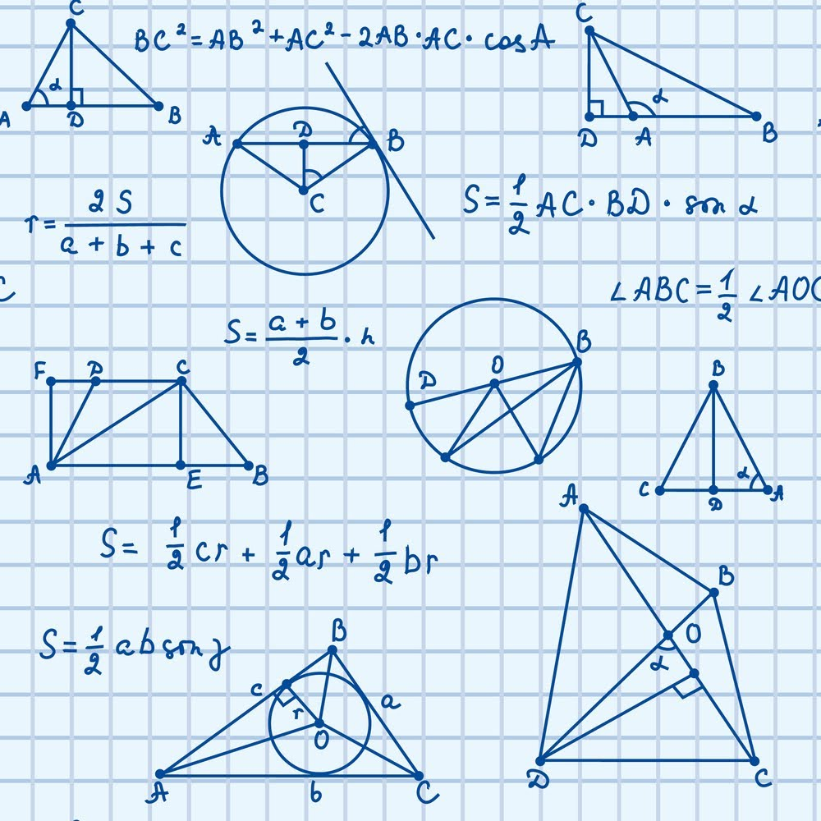
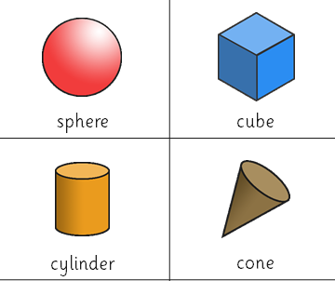
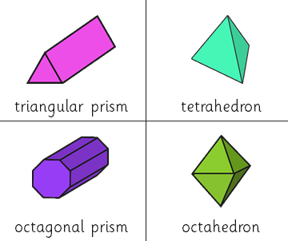
Eukleidean geometry
Nature described by a FINITE number of simple geometrical objects
(lines, circles, triangles...),
each with its own SCALE

Slide 7
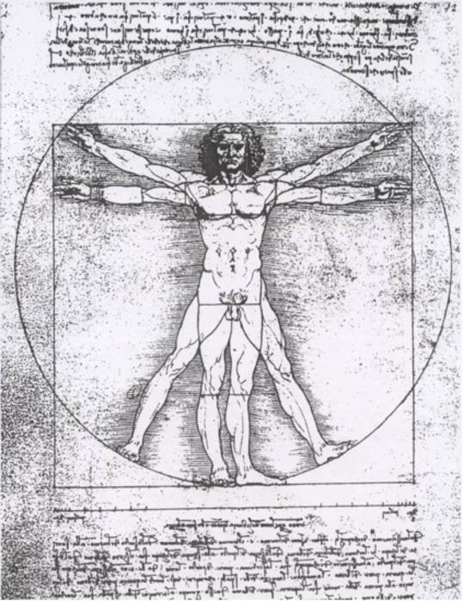
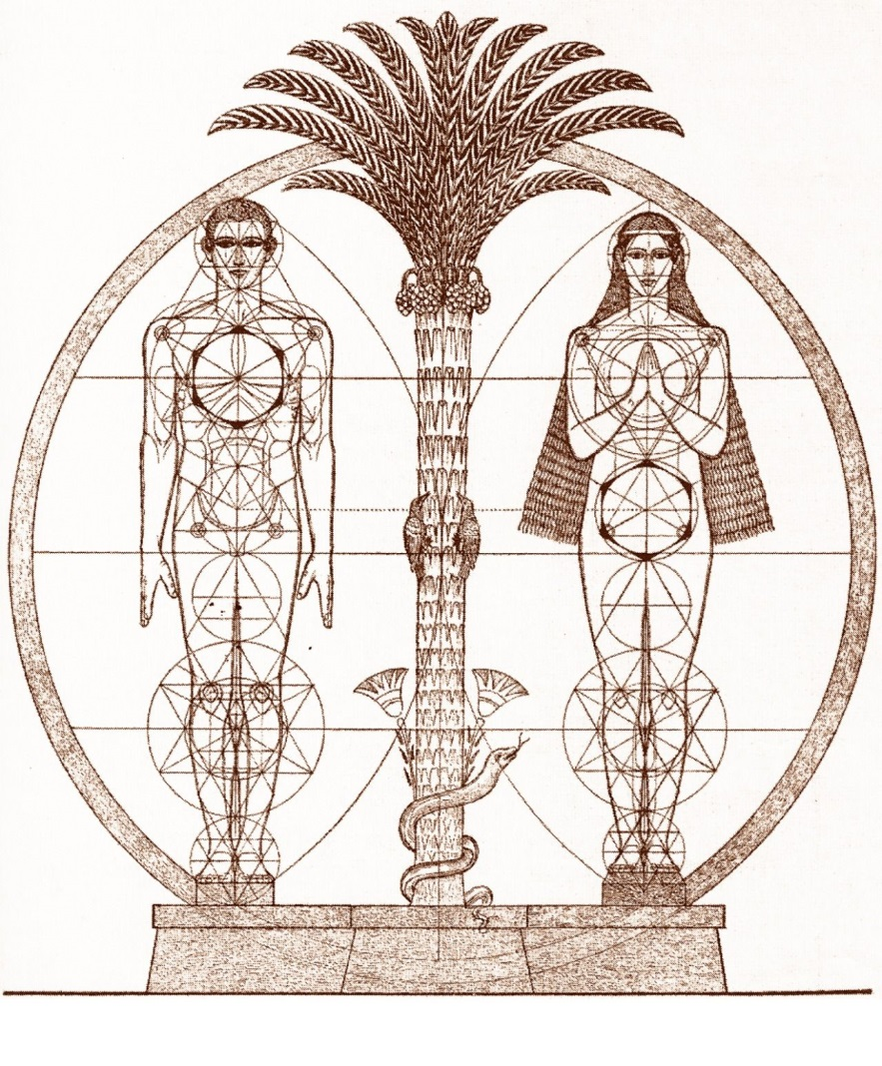
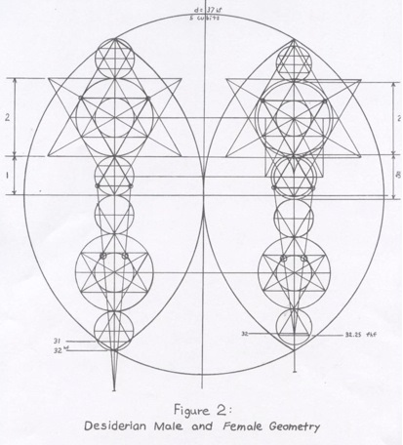
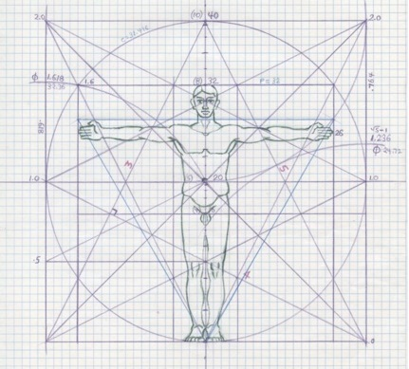
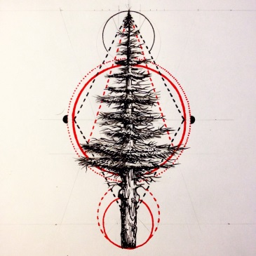
Vitruvian man
(Leonardo da Vinci, 1490)
Desiderian canon
(Beuron Art School, Desiderius Lenz, 1920)

Slide 8
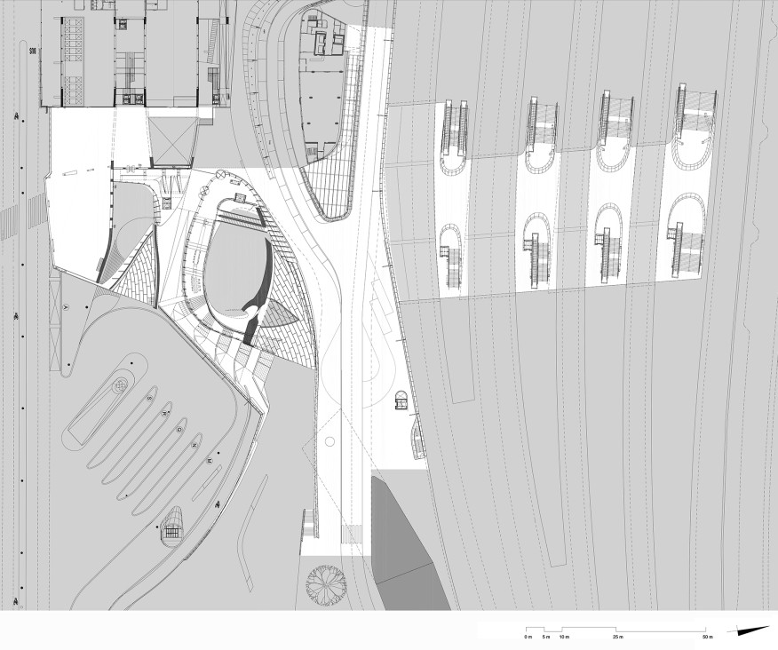
Arnhem train station, Netherlands (UNStudio)

Slide 9
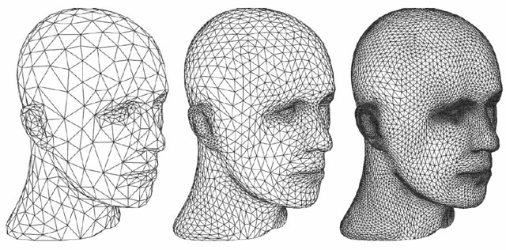
Tessellation (computer graphics)
Every curve (surface) can be approximated with broken lines (triangles)
The smaller measure we take, the better approximation of the length (surface) we get

Slide 10
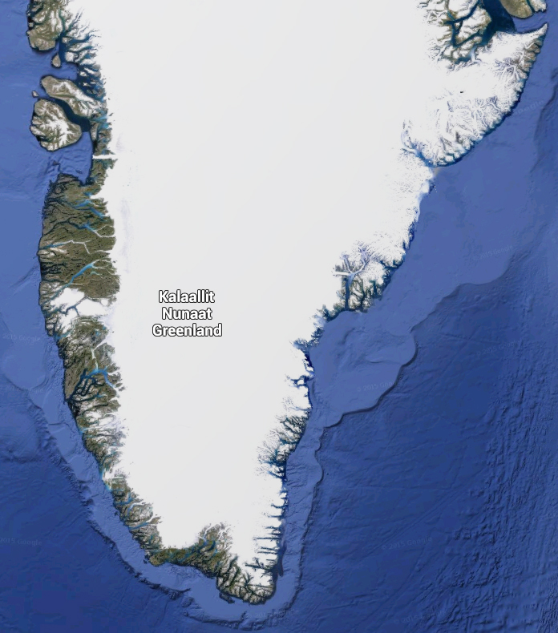
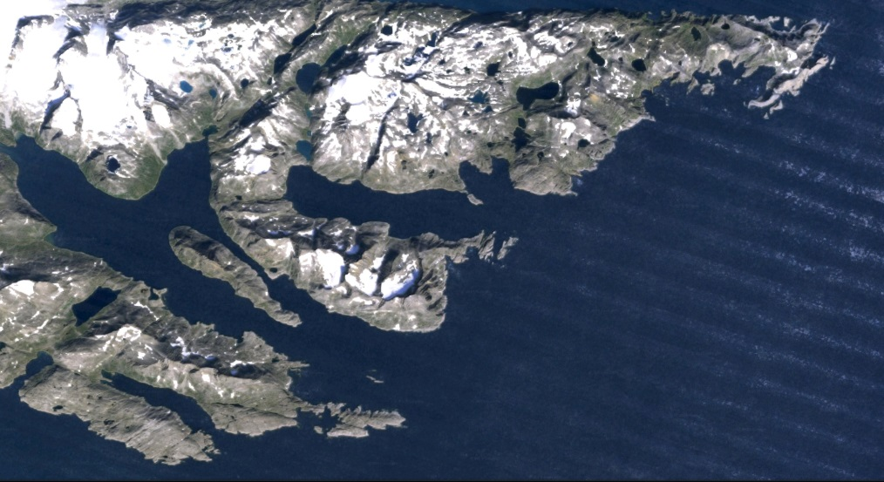
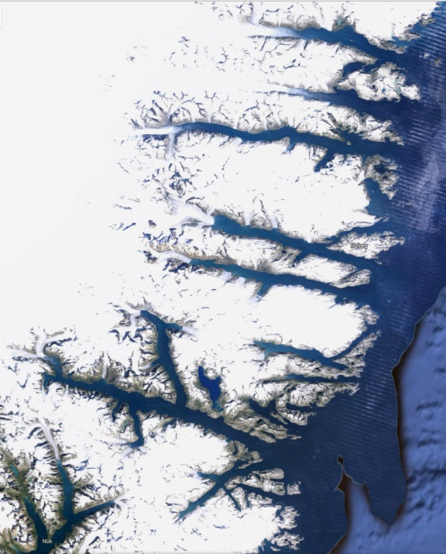
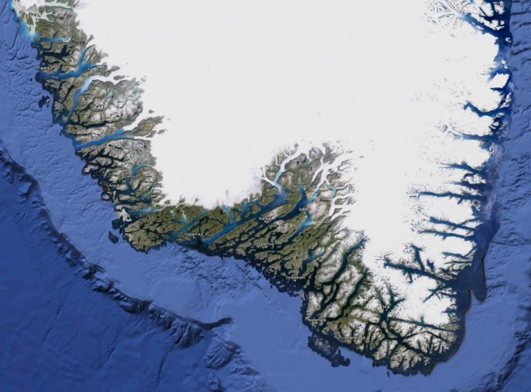
Length of the sea coastline
1 km
100 km

Slide 11
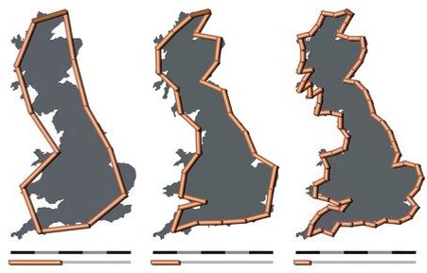
Length of the sea coastline
(Great Britain)
1950 – Lewis Fry Richardson studies the correlation between the tendency of countries to declare a war and the length of their common border
He finds out that the border lengths taken from different sources vary extremely. Today’s values for the GB:
Ordance Survey: 17 820 km
Coastal Guide Europe: 18 838 km
CIA World Factbook: 12 429 km (includes Northern Ireland)
Measured coastline length depends strongly on the ruler length.
Ruler length l:
Number of mesurements N:
Length of the coastline:
200 km
12
2400 km
100 km
28
2800 km
50 km
68
3400 km

Slide 12
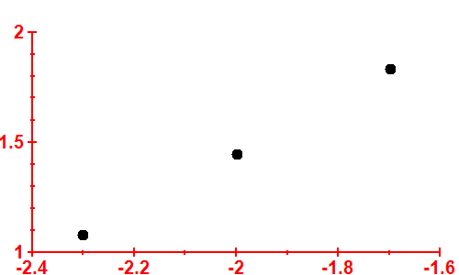
Fractal (fractional) dimension
$$log⁡N$$
extrapolation
$$N=\frac{1}{l^{d}}$$
line slope: fractal dimension $d≈1.25$
(for ordinary smooth curves $d=1)$
$$\log{\frac{1}{l}}$$
Measured coastline length depends strongly on the ruler length.
For very small rulers, the coastline length goes to $∞!$
Measured coastline length depends strongly on the ruler length.
Great Britain’s coastline
=
fractal curve
Ruler length l:
Number of mesurements N:
Length of the coastline:
200 km
12
2400 km
100 km
28
2800 km
50 km
68
3400 km

Slide 13
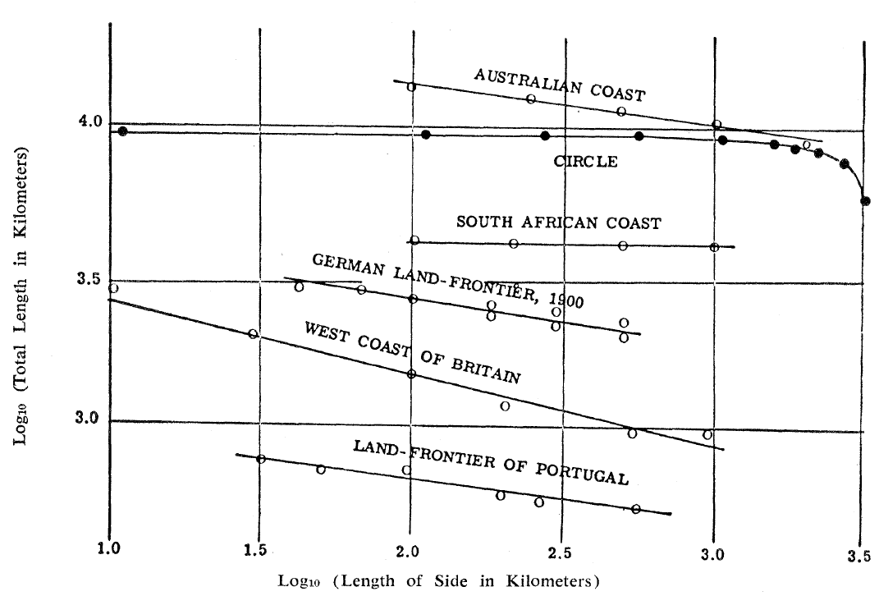
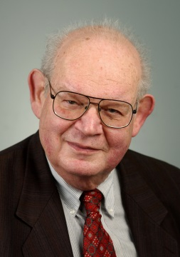
Fractal (fractional) dimension
$$log⁡N$$
extrapolation
$$N=\frac{1}{l^{d}}$$
line slope: fractal dimension $d≈1.25$
Benoît Mandelbrot: How long is the coast of Britain? Statistical self-similarity and fractional dimension, Science 156, 636 (1967)
(for ordinary smooth curves $d=1)$
$$\log{\frac{1}{l}}$$
Measured coastline length depends strongly on the ruler length.
For very small rulers, the coastline length goes to $∞!$
Measured coastline length depends strongly on the ruler length.
Great Britain’s coastline
=
fractal curve
$$1.15$$
Ruler length l:
Number of mesurements N:
Length of the coastline:
200 km
12
2400 km
100 km
28
2800 km
50 km
68
3400 km
$$1.25$$

Slide 14
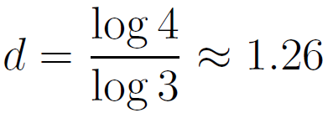
Koch curve
(Helge von Koch, 1904)
initiator
fractal
(teragon)
...
+
generator
- fractal dimension
Infinite length, finite surface
No tangent anywhere
Simple algorithm to get a complicated structure

Slide 15
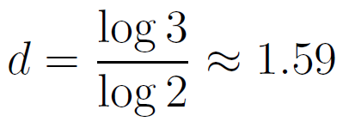
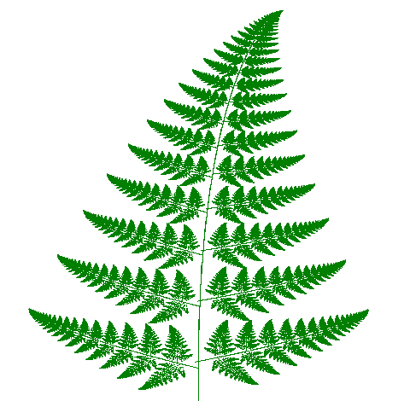
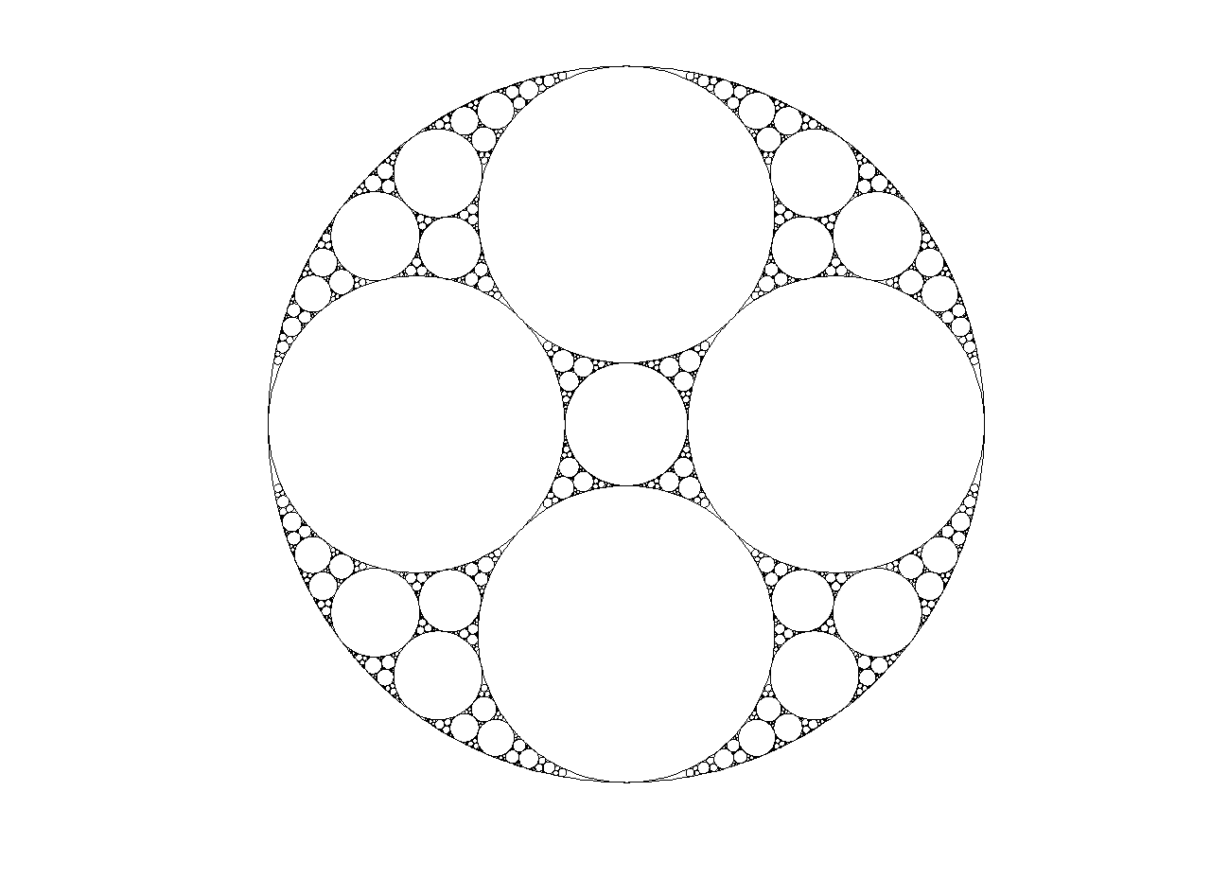
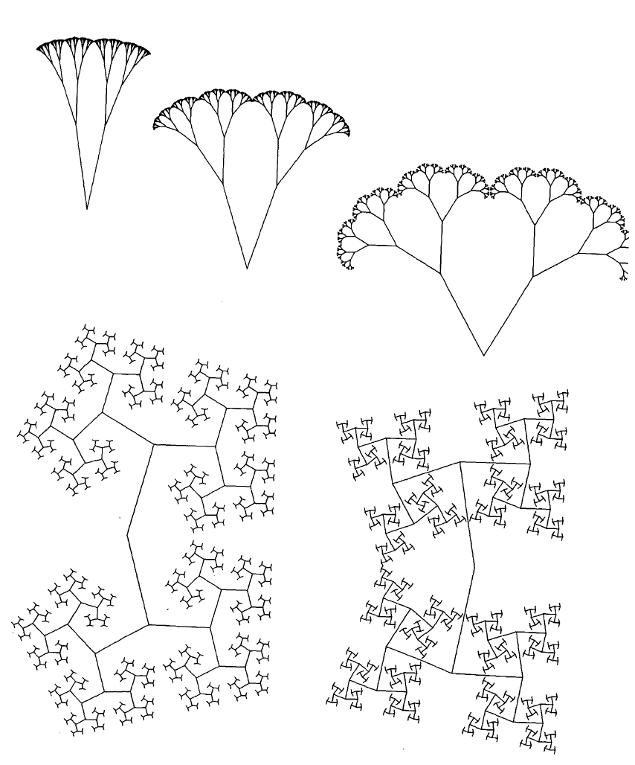
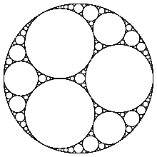
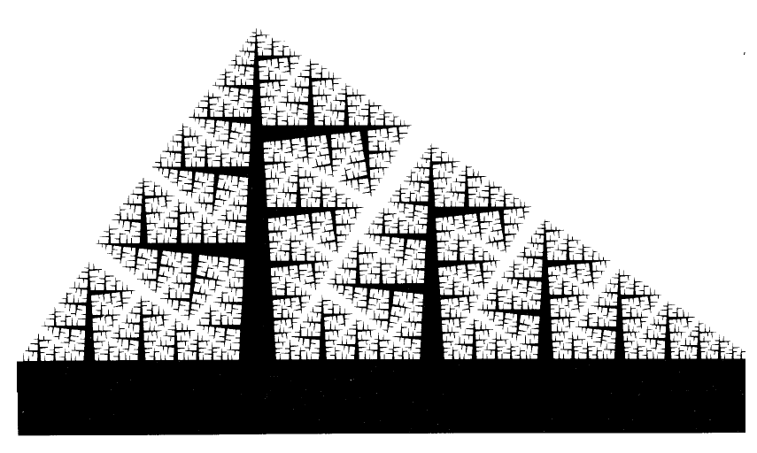
Sierpińsky triangle
(Wacław Sierpińsky, 1915)
...
Apollonian circles
$$d≈1.3$$
(depends on the type)
Trees, branches
... and more and more

Slide 16
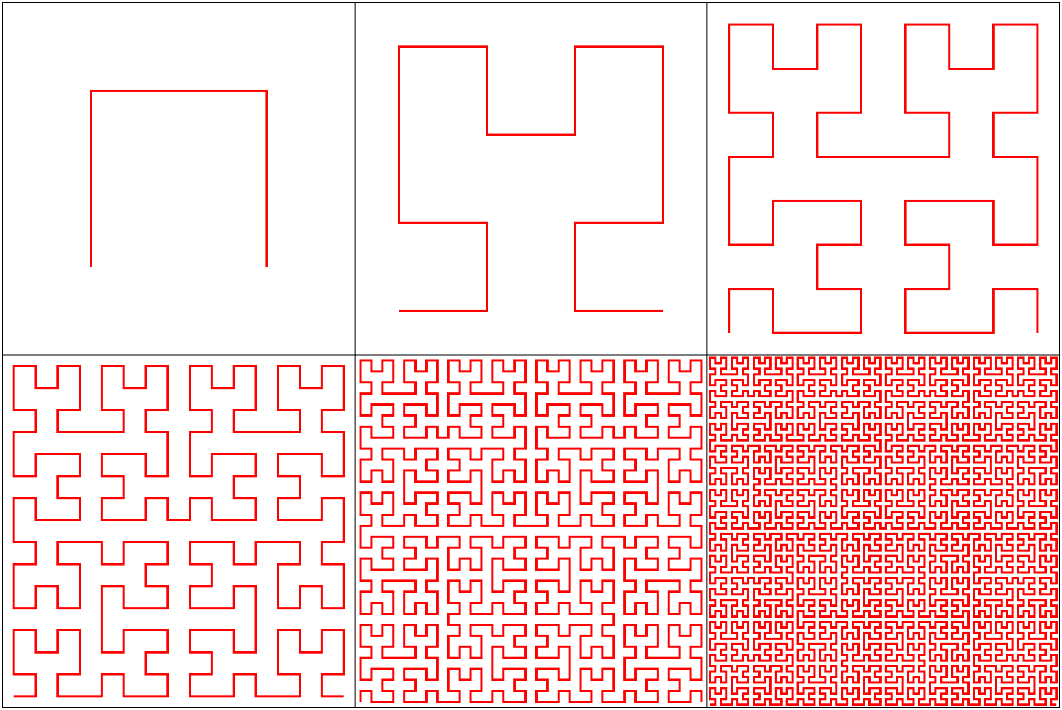
Space-filling curve (Peano curve)
Fills the whole surface $d=2$

Slide 17
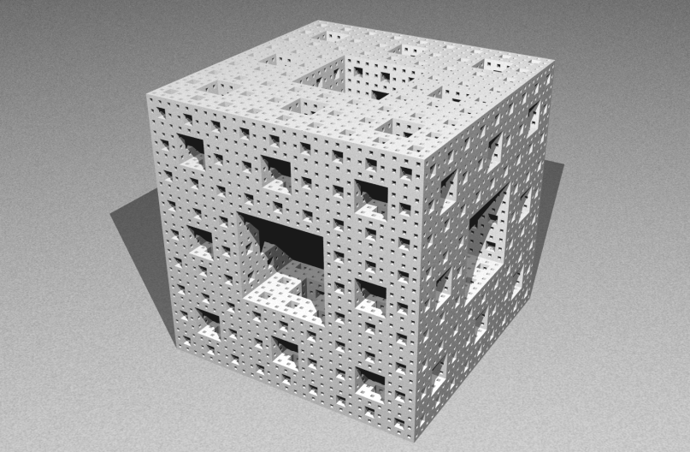
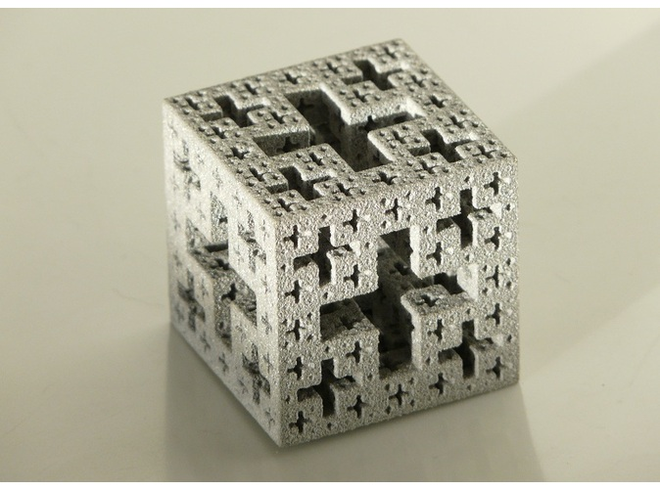
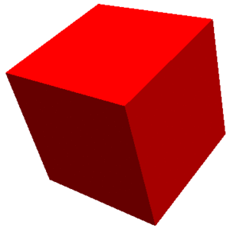
Spacial fractals
Menger sponge
Jerusalem dice
$$2.73$$
$$2.53$$
Mosely snowflake
$1≤d≤2$ – curves
$2≤d≤3$ – surfaces
$$2.63$$

Slide 18
Sierpińsky carpet

Slide 19
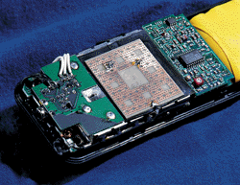
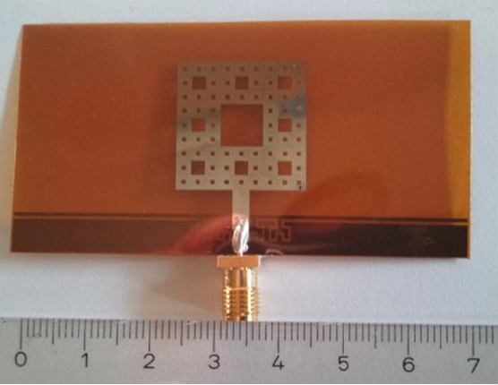
Sierpińsky carpet
Antenna

Slide 20
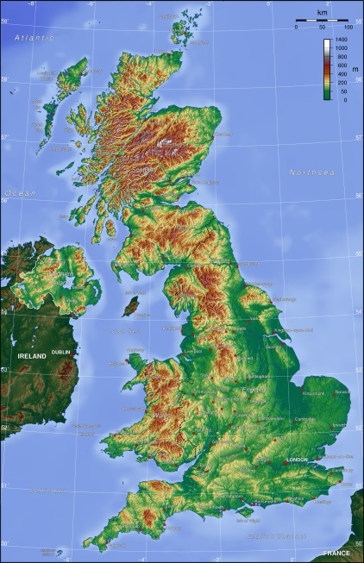
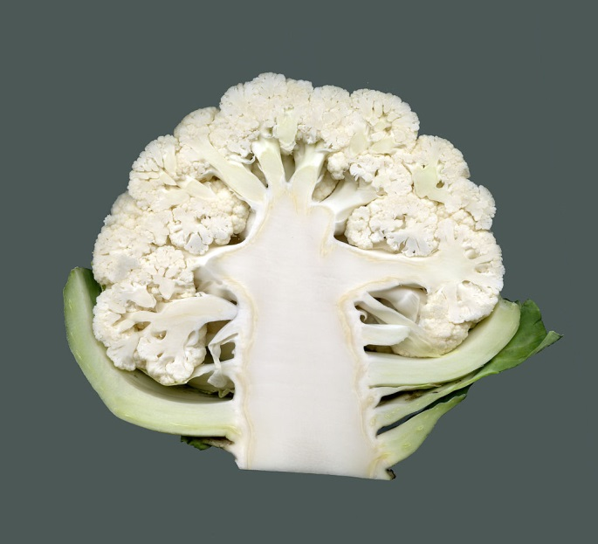
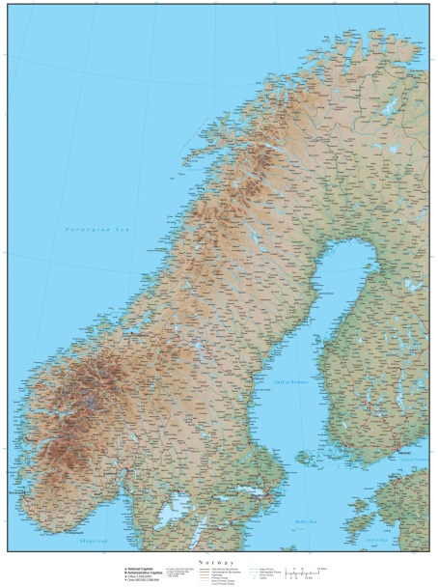
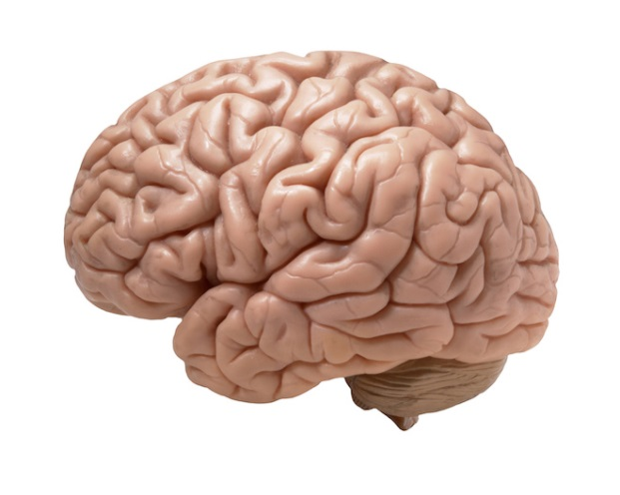
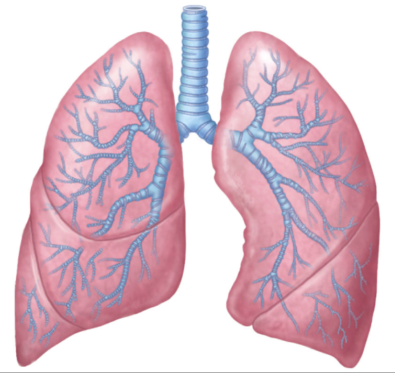
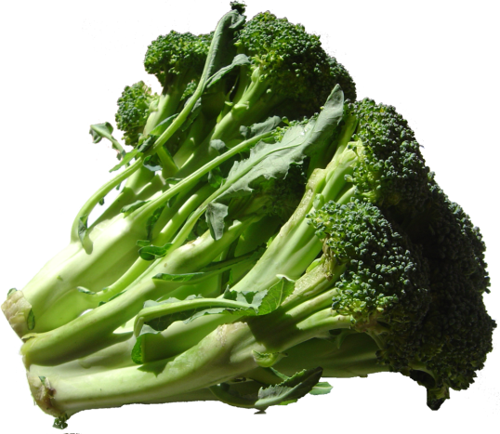
Natural fractals
Great Britain
fern
cauliflower
$$1.6$$
Norway
$\frac{\log{13}}{\log{3}}$≈2.33
$$1.25$$
brain
lungs
$$1.52$$
broccoli
$$2.66$$
$$2.79$$
$$2.98$$

Slide 21
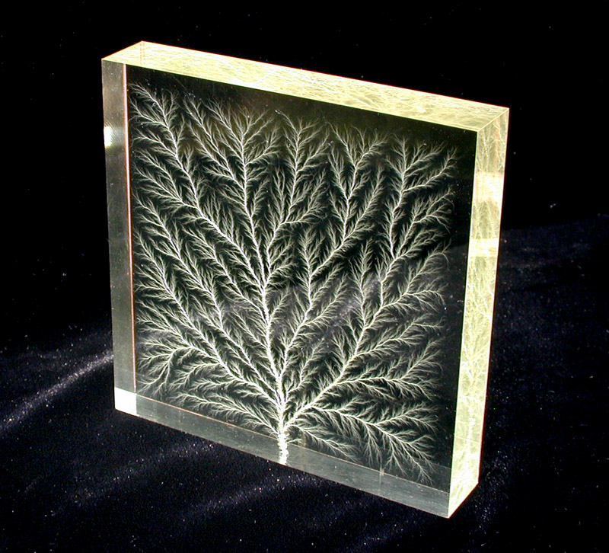
Lichtenberg figure
Branching electric discharges that sometimes appear on the surface or in the interior of insulating materials
High voltage breakdown within a 4” (100 mm) block of acrylic

Slide 22
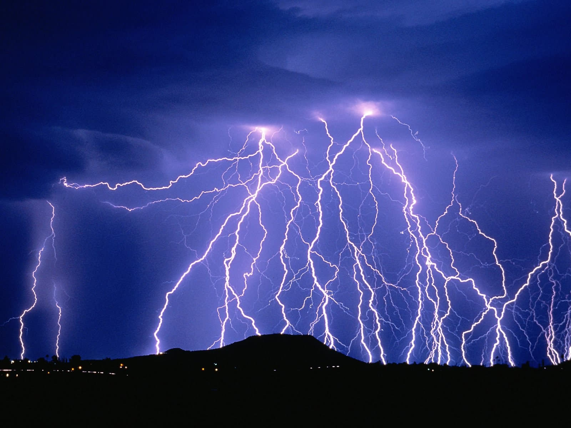
Lichtenberg figure

Slide 23
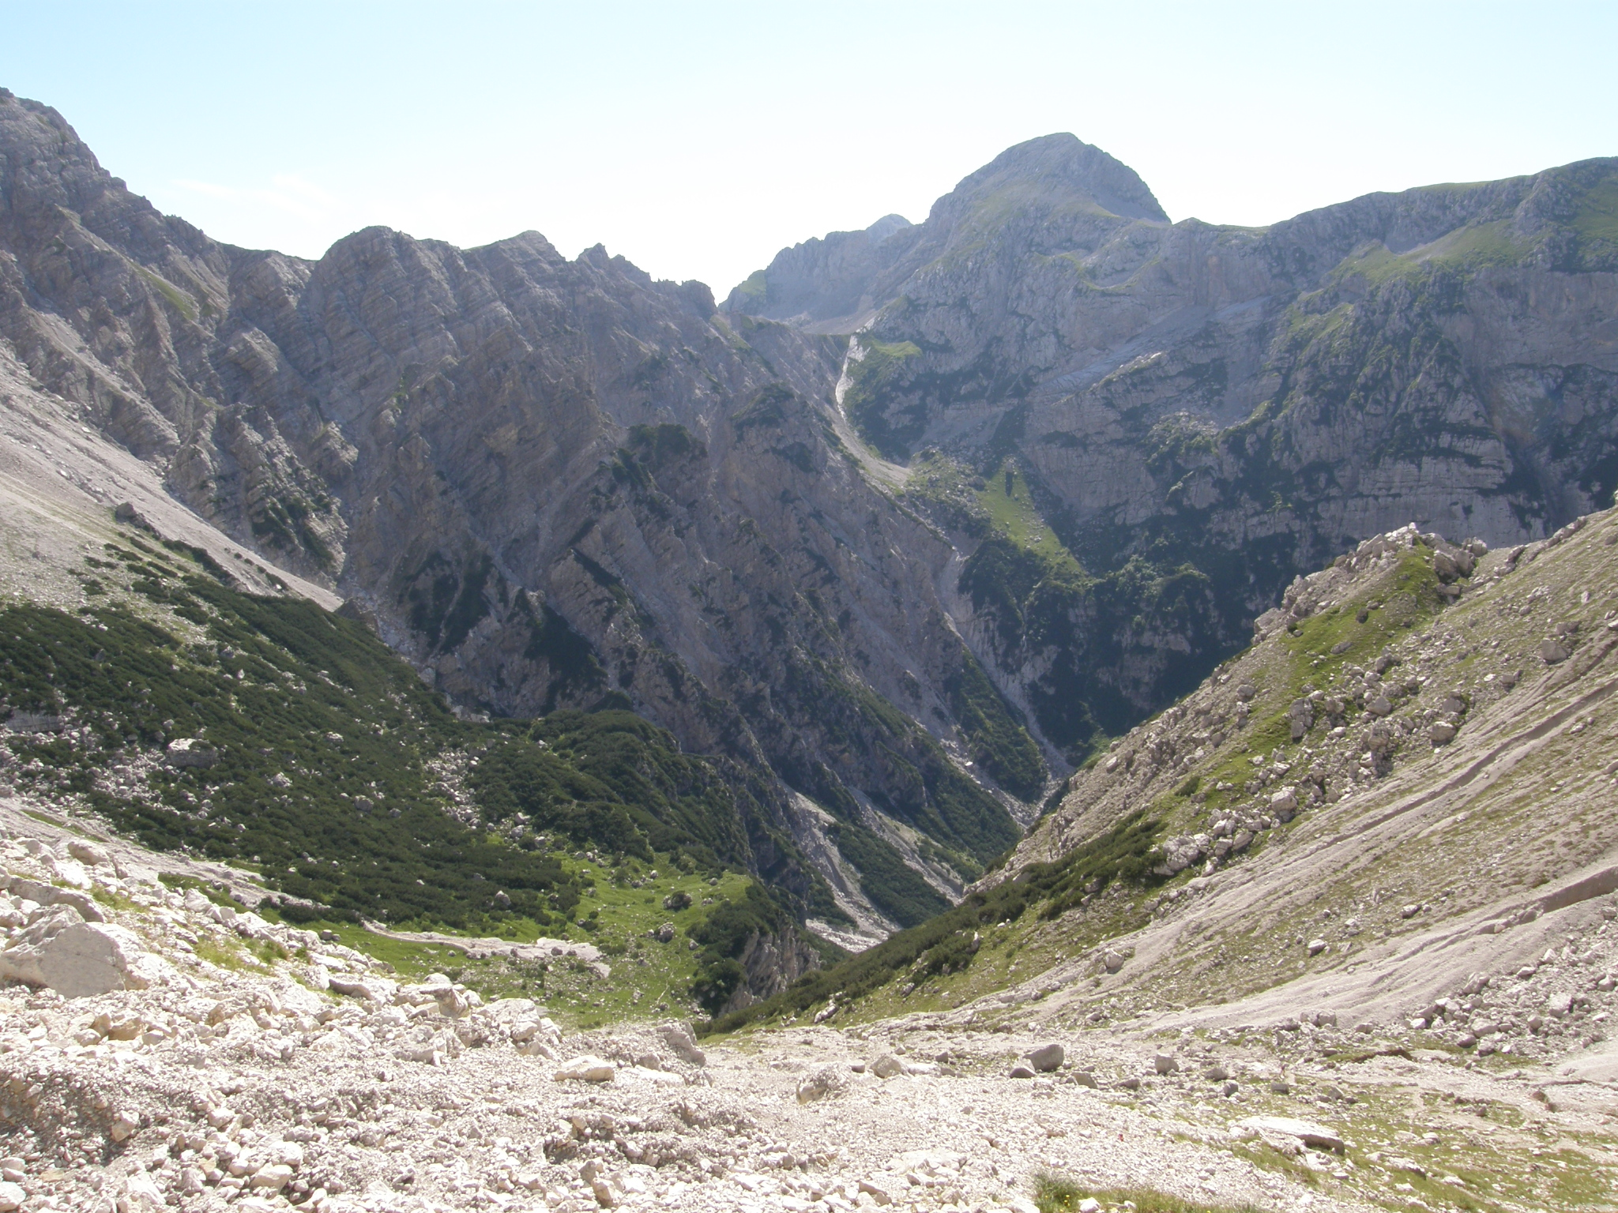
Mountains

Slide 24
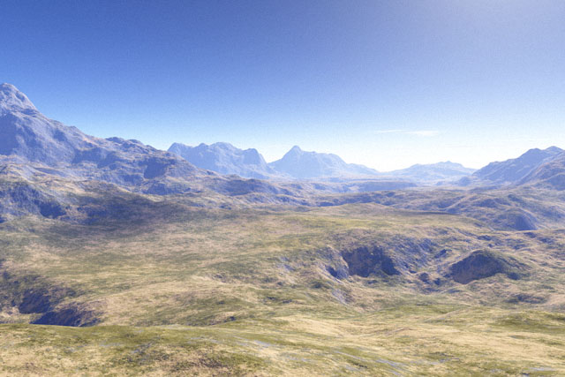
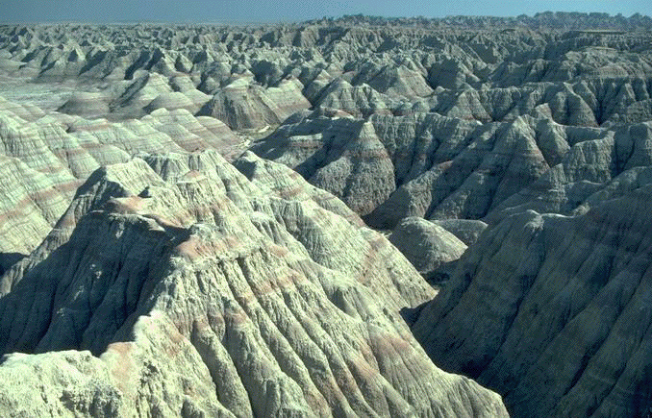
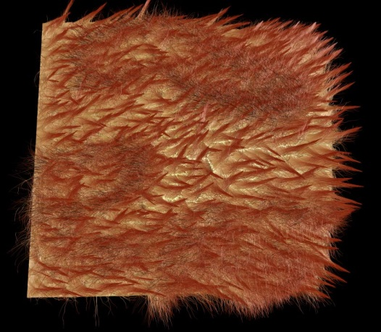
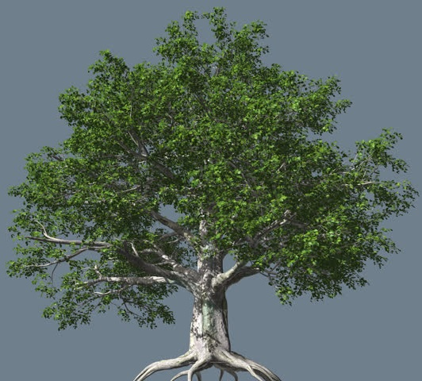
Computer graphics
generating of structures with given fractal dimension
computer games, movies (Star Trek II: The Wrath of Khan - 1982)

Slide 25
Mandelbrot set
A set of all complex numbers c,
for which the series
is bounded
$$z_{n+1}=z_{n}^{2}+c$$

Slide 26
Mandelbrot set
1978 – defined by Robert W. Brooks and Peter Matelski, giving the first sketch of its shape
fractal dimension of the border d=2
Benoît Mandelbrot
1980 - uses the computer to draw the set for the first time

Slide 27
Self-similarity: A part looks like the whole

Slide 32
Fractals and Chaos
$$x_{n+1}=rx_{n}(1−x_{n})$$
population (at time $n+1$)
dying due to overpopulation
growth rate
Logistic equation

Slide 33
Logistic map
bifurcation
oscillation (period 2)
atractor
self-similar (fractal) structure
$$1+\sqrt{6}≈3.45$$
3.57 - chaos

Slide 34
Maurits Cornelis Escher
Angels and Daemons

Slide 35
Maurits Cornelis Escher
Smaller and smaller

Slide 36
Summary
Fractal
Pattern that repeats at all (at many) scales, characterized by non-integer fractal dimension
Generated by a simple algorithm (initiator, generator) that can be easily encoded (in the genetic information)
Very efficient structure (high surface)
Live everywhere around us
...Clouds are not spheres, mountains are not cones, coastlines are not circles, and bark is not smooth, nor does lightning travel in a straight line.
Benoît Mandelbrot, 1983
Thanks for your attention

