Slide 1
Excited-state
quantum phase transitions:
Classification and thermal properties
Pavel Stránský
www.pavelstransky.cz
Institute of Particle and Nuclear Physics
Charles University in Prague
Czech Republic
In collaboration with: Pavel Cejnar, Michal Kloc, Michal Macek
IPNP, Charles Univeristy in Prague, Czech Republic
NMP17, East Lansing, Michigan, USA
7 March 2017

Slide 2
Outline
ESQPT: Definition and evidence in the literature
ESQPT: Theory (level density, flow rate)
ESQPT: numerical examples (Dicke model, CUSPs)
ESQPT: Thermodynamical consequences
Conclusions

Slide 3
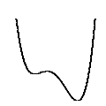
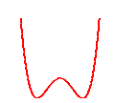
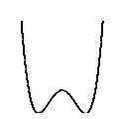
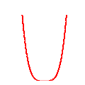
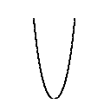
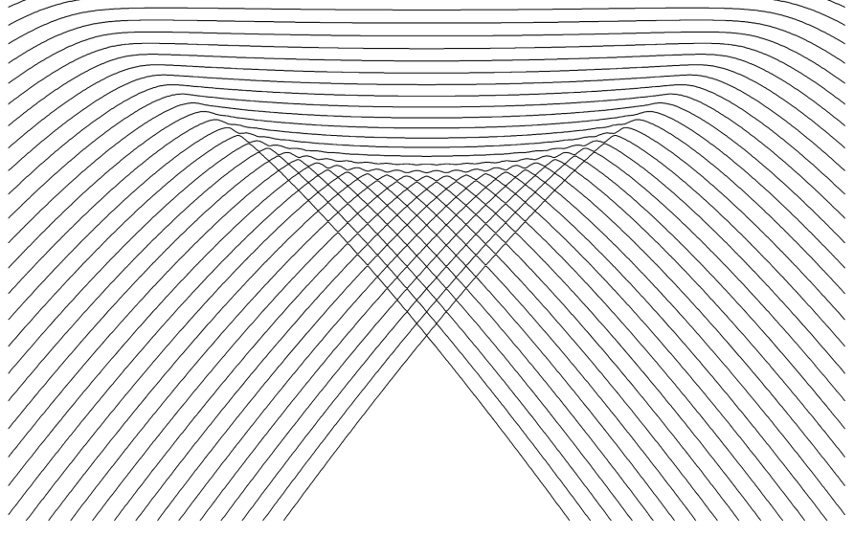
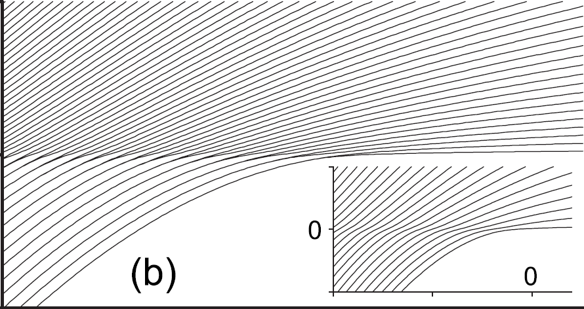
Quantum phase transition (QPT)
A nonanalytic change (in the infinite-size limit) of ground-state properties of a system by varying an external control parameter λ at absolute zero temperature (only quantum fluctuations present)
potential-wells evolutions in a quantum CUSP model
(details later)
E
first-order
continuous(n^{th} order)
λ
λ
Examples:
ferromagnet-paramegnet transitions
insulator-superfluid transitions
superradiant phase transitions
...
S. Sachdev, Quantum Phase Transitions (2011)
L.D. Carr, Understanding Quantum Phase Transitions (2011)

Slide 4
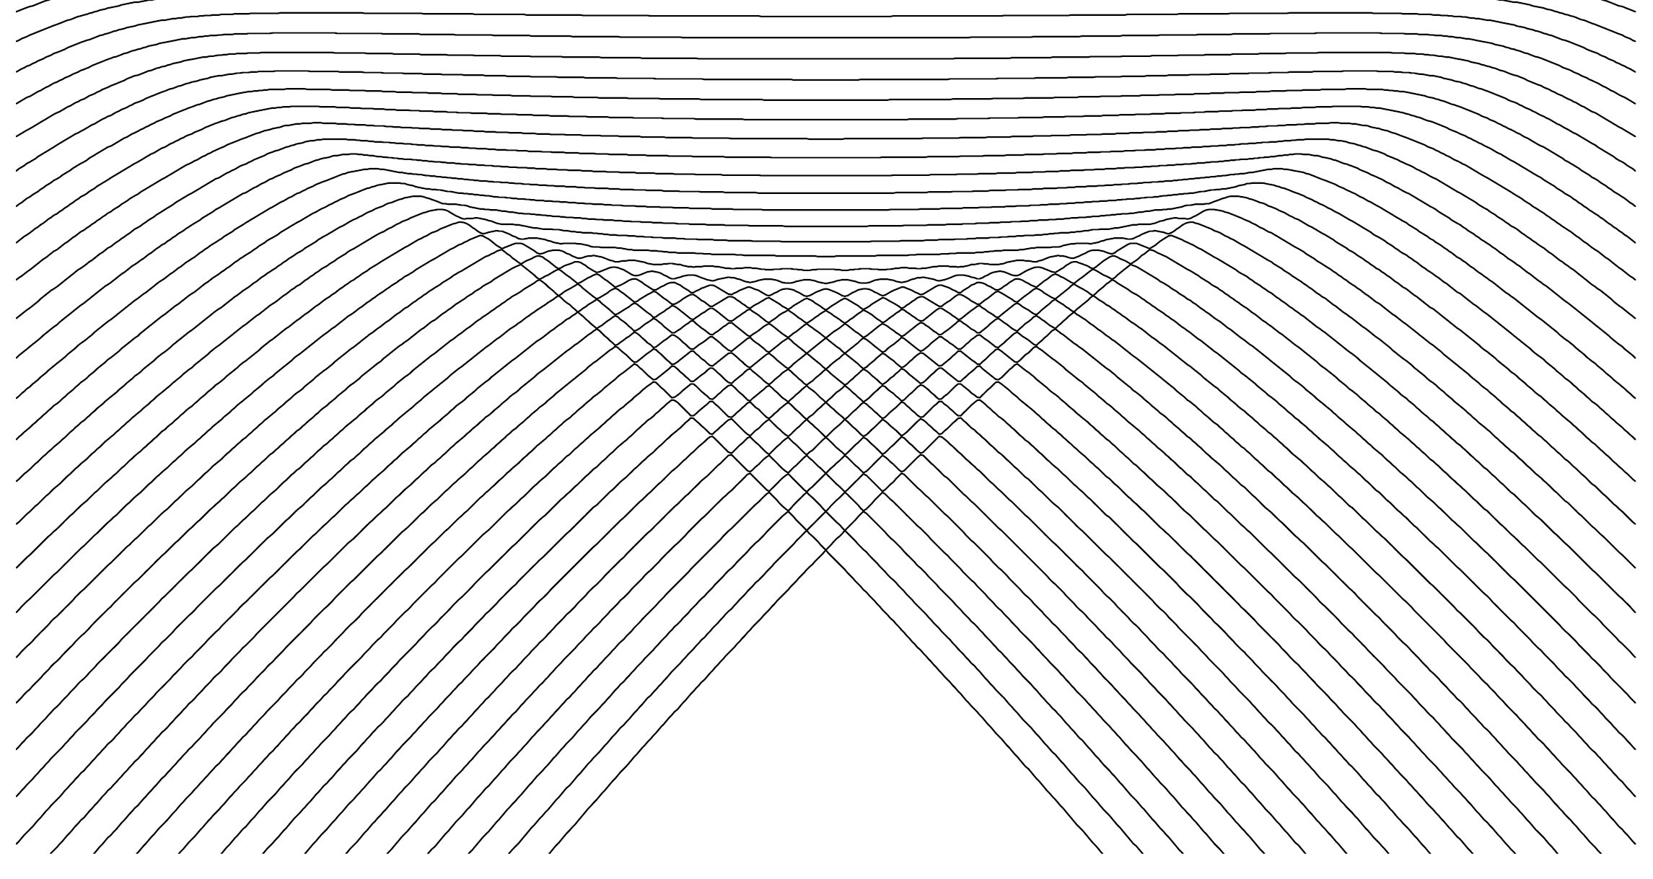
Excited-state quantum phase transition
Generalization of the QPTs for the excited spectra
(ESQPT)
a) discontinuity in the smooth level density ρ
critical borderlines
E
b) discontinuity in the average level flow rate φ
a)
b)
λ
ESQPT’s effect is best visible in averaged quantities characterizing bundles of energy levels in individual level themselves
M.A. Caprio, P. Cejnar, F. Iachello, Ann. Phys. 323, 1106 (2008)
P. Cejnar, P. Stránský, Phys. Rev. E 78, 031130 (2008)

Slide 5
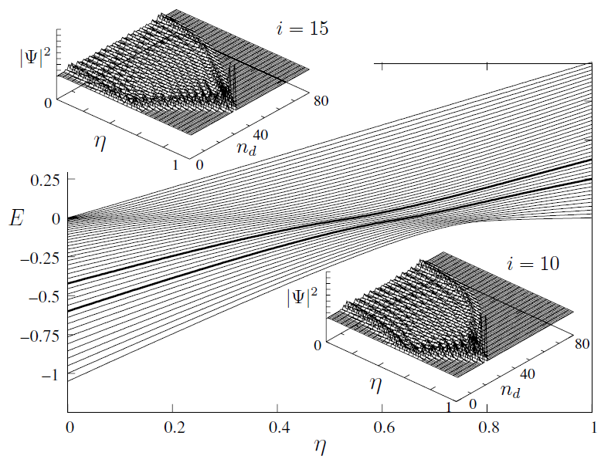
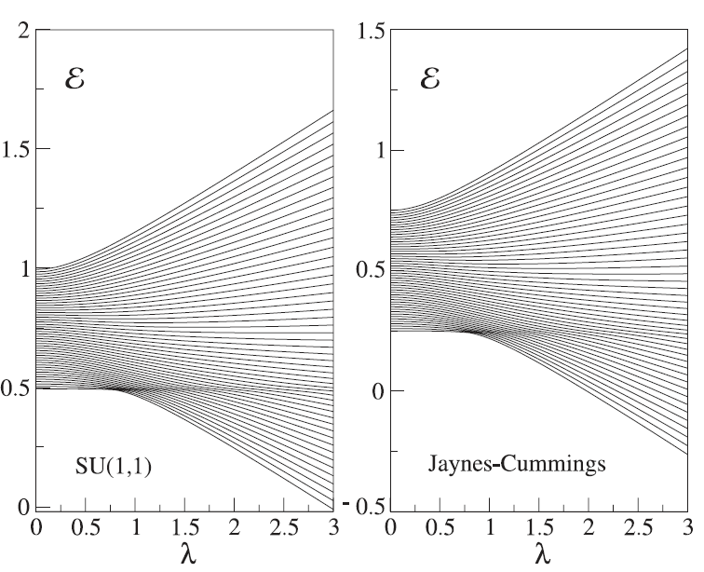
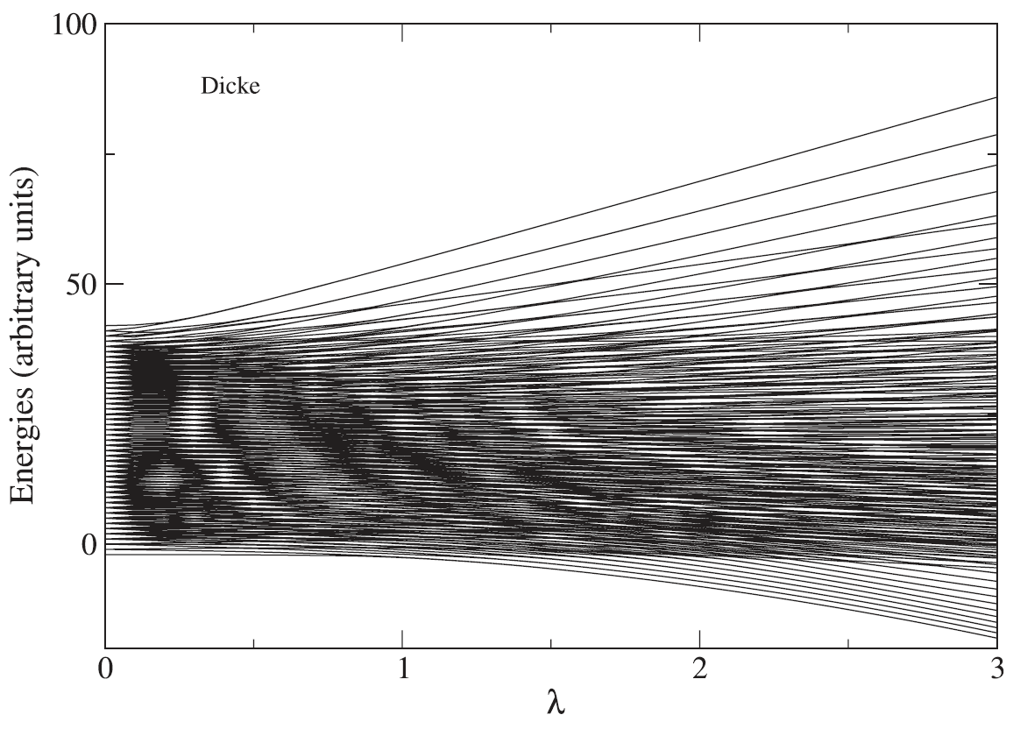
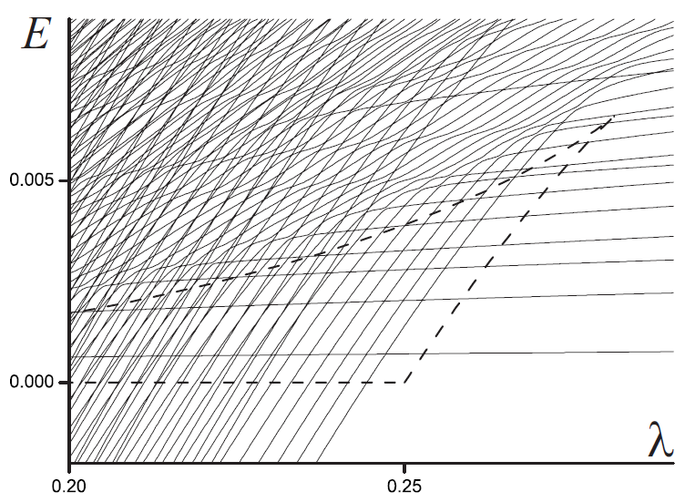
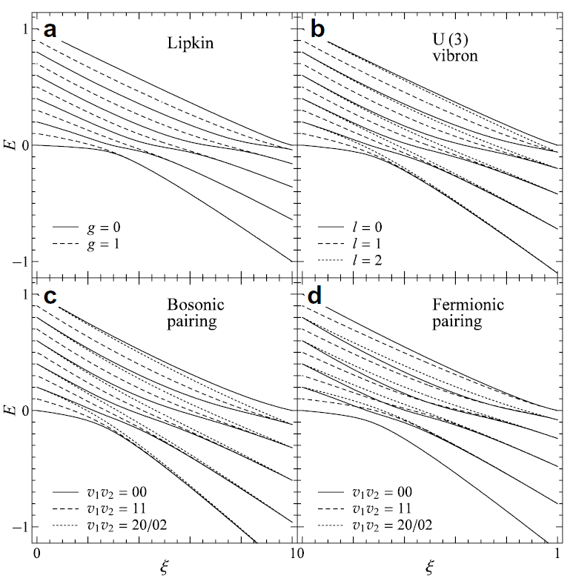
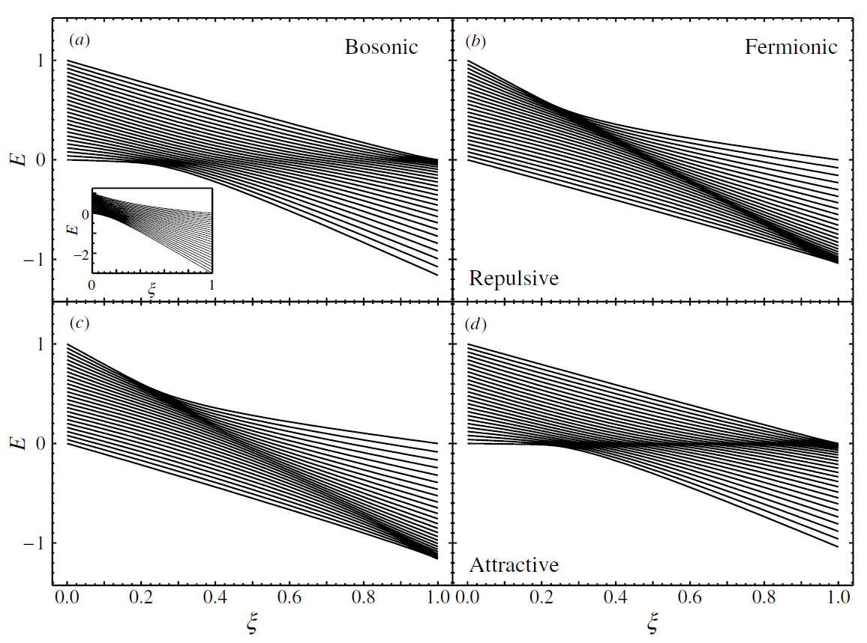
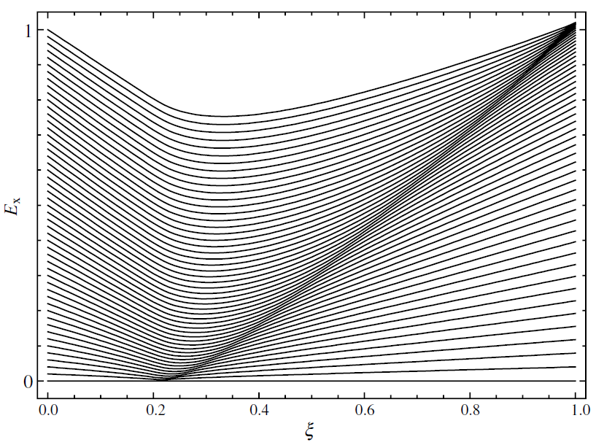
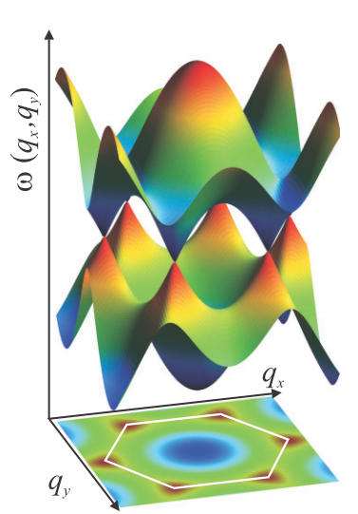
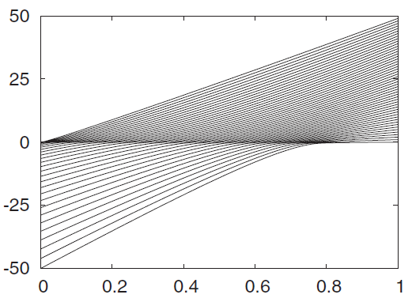
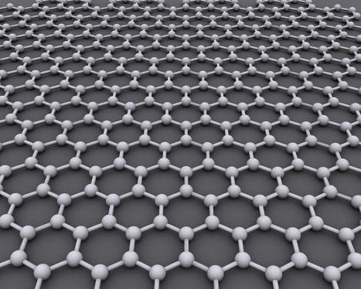
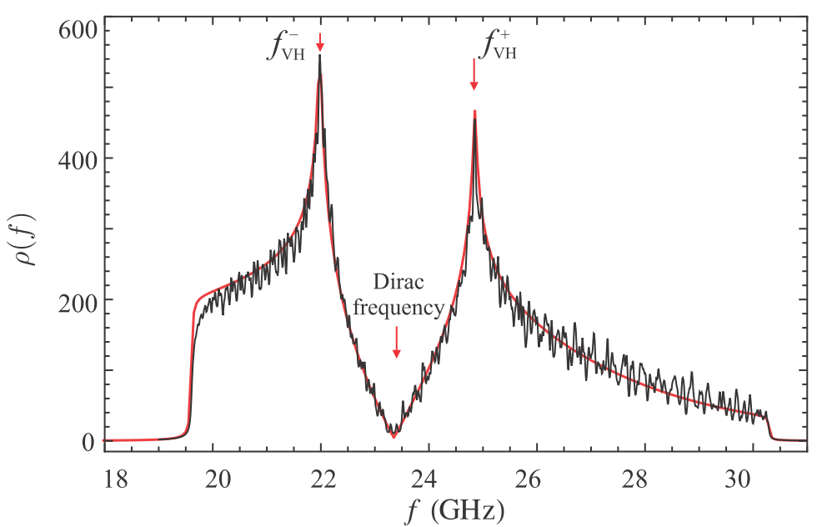
Evidence of ESQPTs in the literature
O(6)-U(5) transition in the Interacting Boson Model
2-level fermionic pairing model
Geometric collective model of atomic nuclei
Graphene
(ESQPT experimentally observed)
Lipkin model
2-level pairing models
s-boson condensate
M.A. Caprio, P. Cejnar, F. Iachello,
Annals of Physics 323, 1106 (2008)
P. Pérez-Fernández, A. Relaño, J.M. Arias, J. Dukelsky, J.E. García-Ramos, Phys. Rev. A 80, 032111 (2009)
s+d-bosons condensate
B. Dietz, F. Iachello, M. Miski-Oglu, N. Pietralla, A. Richter, L. von Smekal, and J. Wambach, Phys. Rev. B 88, 104101 (2013)
P. Pérez-Fernández, P. Cejnar, J.M. Arias, J. Dukelsky,
J.E. García-Ramos, A. Relaño, Phys. Rev. A 83, 033802 (2009)
P. Cejnar, P. Stránský, Phys. Rev. E 78, 031130 (2008)
M.A. Caprio, J.H. Skrabacz, F. Iachello, J. Phys. A 44, 075303 (2011)
P. Cejnar, M. Macek, S. Heinze, J. Jolie, J. Dobeš, J. Phys. A: Math. Gen. 39, L515 (2006)

Slide 6
ESQPT
Theory

Slide 7
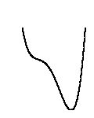
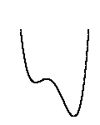
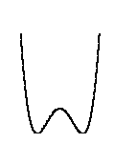
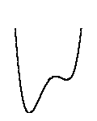
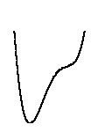
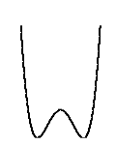
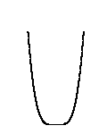
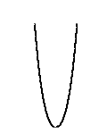
Manifestations of ESQPTs
Hamiltonian
analytic function on the phase space $x=\left(p,q\right)$
f degrees of freedom
energy surfaces
E
x
E
λ
λ
Interesting behaviour expected at energies of the Hamiltonian stationary points
Critical borderlines correspond with the positions of local extremes in the constant-energy surfaces

Slide 8
a) Level density
oscillatory component
(semiclassically given by the Gutzwiller trace formula; not relevant here in the infinite-size limit)
smooth component
(Weyl formula)
volume function
of the classical phase space
Numerical approximation
I. Hoveijn, J. Math. Anal. Appl. 348, 530 (2008)
M. Kastner, Rev. Mod. Phys. 80, 167 (2008)

Slide 9
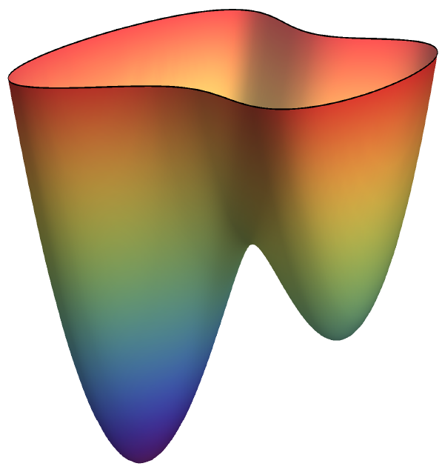
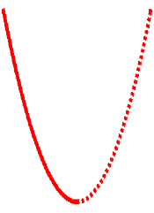
Level density: Nondegenerate stationary point w
Morse lemma
energy surface
Approximation of the Hamiltonian with a quadratic function in the vicinity of w
index r of the stationary point
E
ε
w
local volume integral
y₂
x₂
x₁
y₁
local coordinates
r = 0
r > 0
P. Stránský, P. Cejnar, Phys. Lett. A380, 2637 (2016)

Slide 10
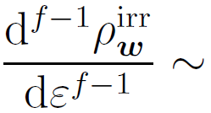
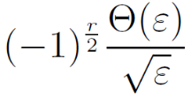
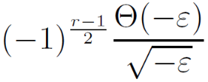
Nondegenerate stationary point: singularities
f integer
f half-integer
(relevant for lattices and time-dependent Hamiltonian systems)
r even
r odd
r even
r odd
[f-1]-th derivative
logarithmic divergence
inverse sqrt
jump
E_{w}
E
E_{w}
E
E_{w}
E
E_{w}
E
Each singularity of the level density at a nondegenerate stationary point is uniquely classified by the two numbers (f,r)
P. Stránský, P. Cejnar, Phys. Lett. A380, 2637 (2016)

Slide 11
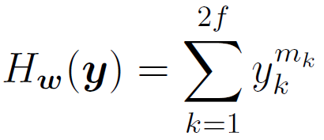
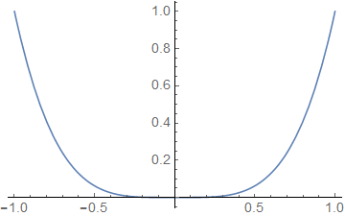
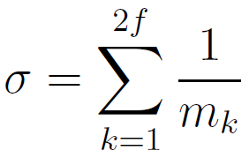
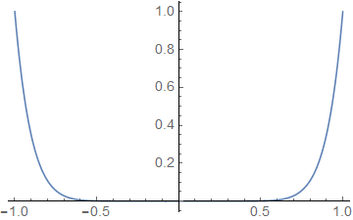
Level density: Degenerate stationary point
Special class of separable Hamiltonians (flat minimum):
(analytic only for m_{k} even integer)
- discontinuity in the$\left\lceil σ−1\right\rceil$-th derivative
Example: We require discontinuity of the t-th derivative
- satisfied when
even in the thermodynamic limit
the level density can be discontinuous
Higher flatness of the stationary point enhances its signatures in the spectrum (it shifts the singularity towards lower derivatives).

Slide 12
Level density: Degenerate stationary point
Special class of separable Hamiltonians (flat minimum):
(analytic only for m_{k} even integer)
Structural stability
- an arbitrarily small perturbation converts any function into a Morse function:
- discontinuity of the -th derivative
Example 1: We require discontinuity of the t-th derivative
- satisfied when
flat minimum
quadratic minimum
even in the thermodynamic limit
the level density can be discontinuous
M. Kastner, Rev. Mod. Phys. 80, 167 (2008)
Higher flatness of the stationary point enhances its signatures in the spectrum (it shifts the singularity towards lower derivatives).

Slide 13
ESQPT
Numerical examples

Slide 14
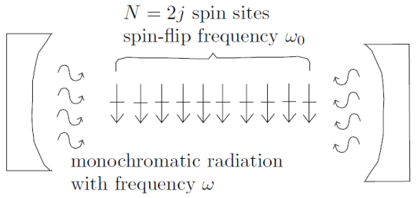
Example 1: Dicke model of superradiance
- interaction of a single-mode bosonic field with a chain of two-level atoms
δ = 0: integrable (Tavis-Cummings) regime
δ = 1: nonintegrable (Dicke) regime
R.H, Dicke, Phys. Rev. 93, 99 (1954)
K. Hepp, E. Lieb, Ann. Phys. 76, 360 (1973)
Michal Kloc
(Thursday afternoon)
Semiclassical Hamiltonian
M. Kloc, P. Stránský, P. Cejnar, submitted to Ann. Phys.

Slide 15
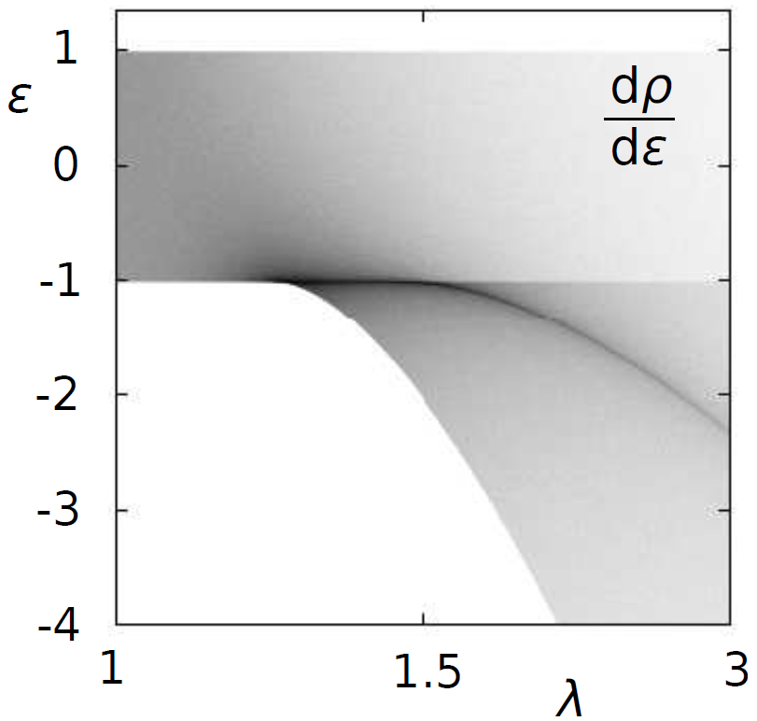
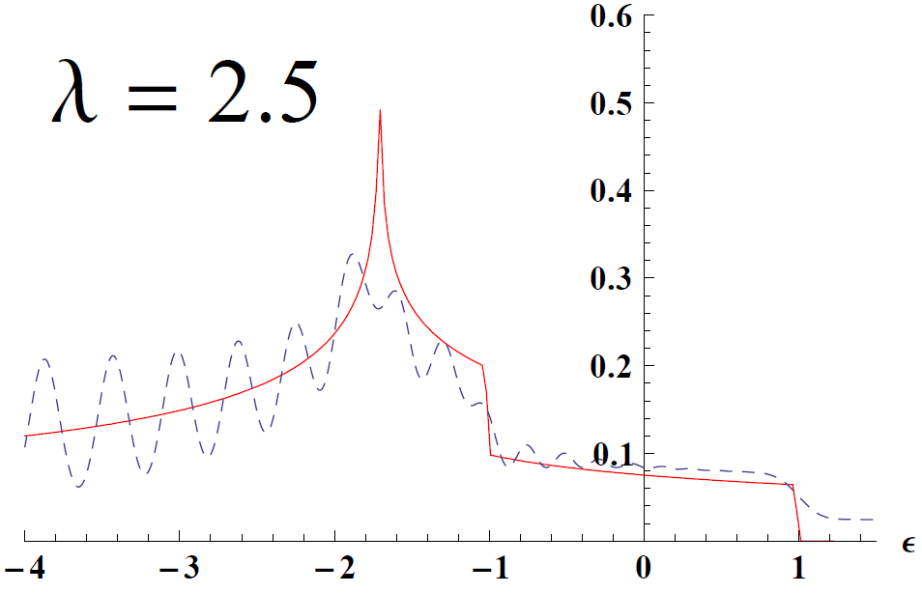
Example 1: Dicke model of superradiance
- interaction of a single-mode bosonic field with a chain of two-level atoms
δ = 0: integrable (Tavis-Cummings) regime
δ = 1: nonintegrable (Dicke) regime
R.H, Dicke, Phys. Rev. 93, 99 (1954)
K. Hepp, E. Lieb, Ann. Phys. 76, 360 (1973)
f = 2 degrees of freedom
nonanalyticities appear in the first derivative of ρ
ESQPTs
dρ/dε
normal phase
QPT
2nd order
superradiant phase
M. Kloc, P. Stránský, P. Cejnar, submitted to Ann. Phys.

Slide 16
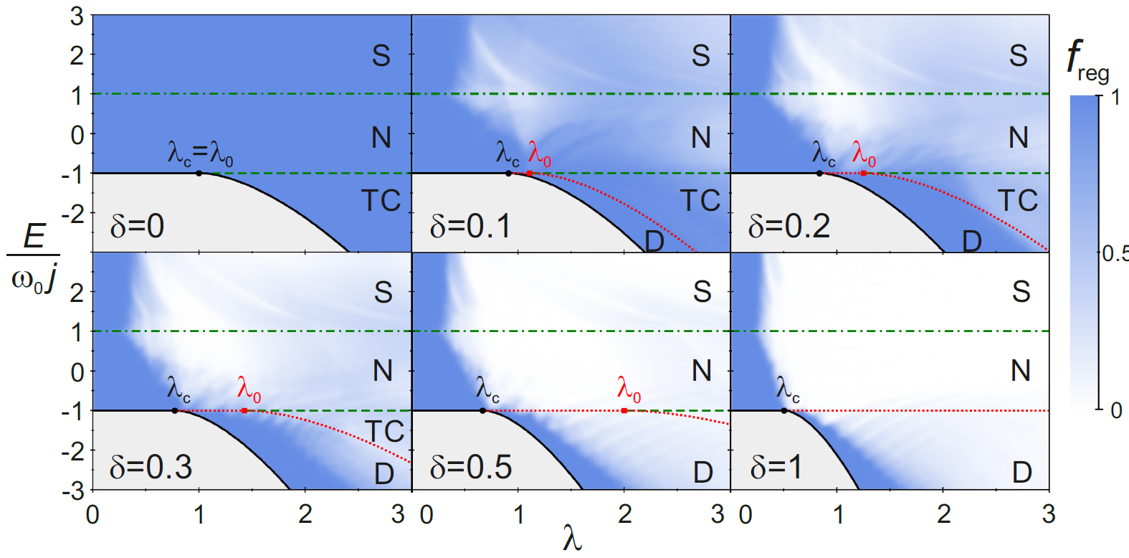
Example 1: Dicke model of superradiance
- interaction of a single-mode bosonic field with a chain of two-level atoms
δ = 0: integrable (Tavis-Cummings) regime
δ = 1: nonintegrable (Dicke) regime
R.H, Dicke, Phys. Rev. 93, 99 (1954)
K. Hepp, E. Lieb, Ann. Phys. 76, 360 (1973)
Nonintegrability – allows one to study connection between the ESQPTs and chaos
regular
chaotic
M. Kloc, P. Stránský, P. Cejnar, submitted to Ann. Phys.

Slide 17
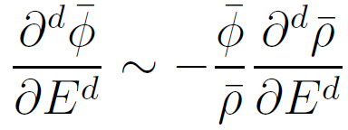
b) Level flow rate
E
($≡$position)
trajectories of individual levels – flow lines
Continuity equation
derivatives
λ ($≡$time)
Using Hellmann-Feynman formula, the flow rate can be expressed as
We expect the same nonanalyticity in the flow rate as in the level density
- weighted average of the quantum expectation value of $H_{I}(x)$ in the eigenstates around energy $E$
- experimentally more important than the level density itself
P. Stránský, M. Macek, P. Cejnar, Ann. Phys. 345, 73 (2014)
P. Stránský, P. Cejnar, Phys. Lett. A380, 2637 (2016)

Slide 18
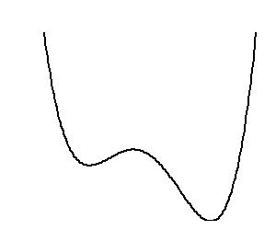
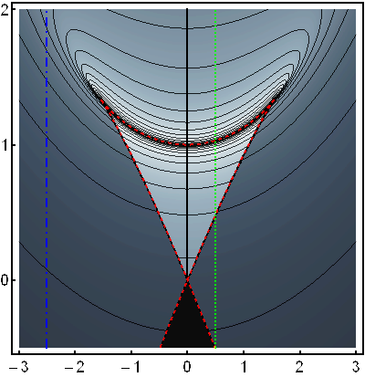
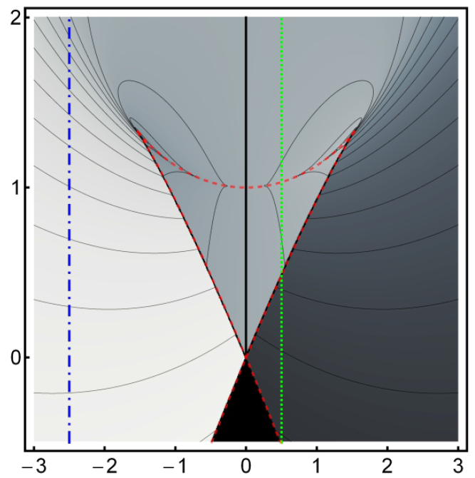
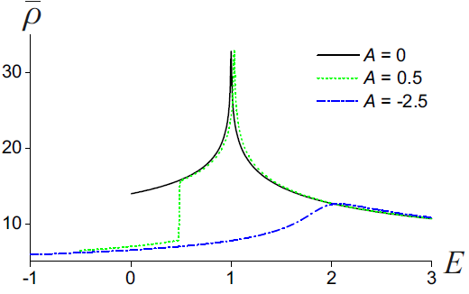
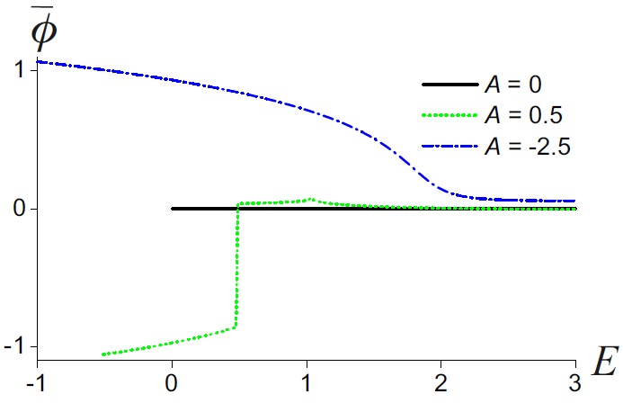
Example 2: CUSP and related systems
2 ESQPTs (if )
E
(1,1)
(1,0)
Level density
P. Cejnar, P. Stránský, Phys. Rev. E 78, 031130 (2008)
P. Stránský, M. Macek, P. Cejnar, Ann. Phys. 345, 73 (2014)
E
x
Flow rate
approximately 0
positive (levels rise)
negative (levels fall)
Singularly localized wave function at the top of the local maximum with
λ
(1,1)
Both minima accessible – the wave function is a mixture of states localized around and
(1,0)
The wave function localized around the global minimum
(1,0)

Slide 19
Example 2: CUSP and related systems
2 ESQPTs (if )
E
(1,1)
(1,0)
P. Cejnar, P. Stránský, Phys. Rev. E 78, 031130 (2008)
P. Stránský, M. Macek, P. Cejnar, Ann. Phys. 345, 73 (2014)
x
Creagh-Whelan 2D model
E
(2,1)
nonintegrable (if $B≠0≠C$)
phase structure identical with a single CUSP
y
(2,0)
x
P. Stránský, M. Macek, P. Cejnar, Ann. Phys. 345, 73 (2014)
P. Stránský, M. Macek, A. Leviatan, P. Cejnar, Ann. Phys. 356, 52 (2015)
Triple CUSP model
3
Separable combination of three CUSP systems
P. Stránský, P. Cejnar, Phys. Lett. A380, 2637 (2016)

Slide 20
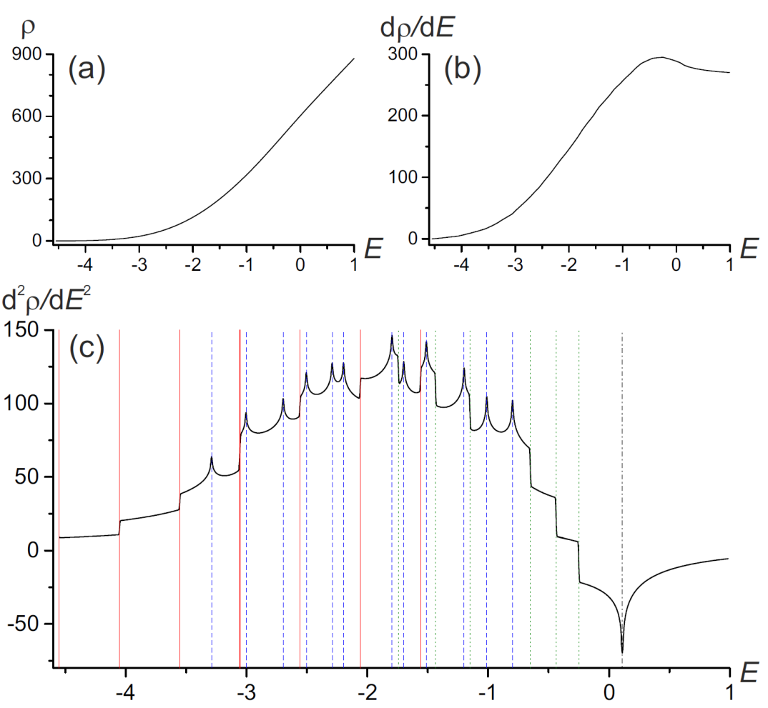
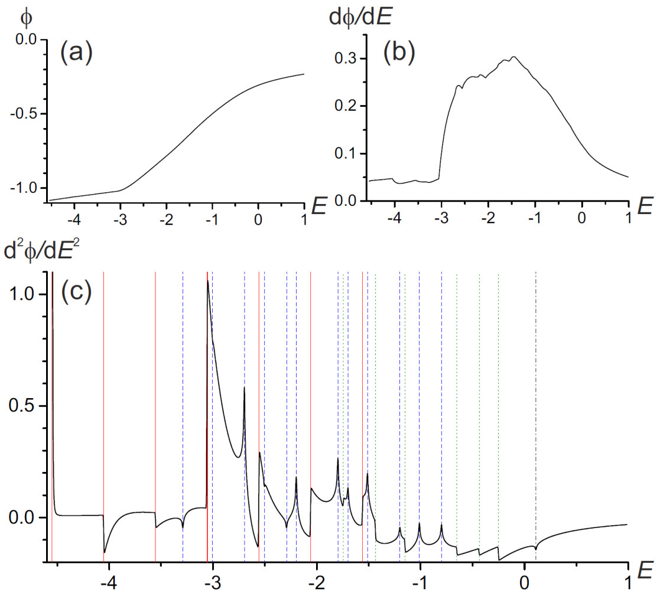
Triple CUSP model
Level density
Flow rate
f=3 degrees of freedom
Due to the continuity equation
27 stationary points:
8x
12x
6x
1x
(3,0) minimum
(3,1) saddle 1
(3,2) saddle 2
(3,3) maximum
↑ jump
↑ log div
↓ jump
↓ log div
Singularities expected in the 2nd derivative of the level density and flow rate
singularities in φ of the same type as in ρ (except for the sign)

Slide 21
ESQPT
Thermal properties

Slide 22
Infinite-size limit of systems with finite f
Illustrative example: Array of trapped spin$=\frac{1}{2}$ sites
...
$N_{a}$ atoms in each site
$N_{s}$ sites
Size parameter: $N=N_{a}N_{s}$
Assumption:
The interaction is such that the total spin of each site is conserved in its maximum value $\frac{N_{a}}{2}⟶$ strong collective behaviour
Limits:
Classical limit $N_{a}→∞$
Thermodynamic limit $f=N_{s}→∞$
Interacting Boson Model of atomic nuclei
- b bosons (of the type s or d) – quasiparticles, generating a U(6) algebra (f = 5)
- 3 degrees of freedom are always separated (conserving angular momentum)
- $N_{a}=b$ (dimension of the irreducible representation of the U(6) algebra)

Slide 23
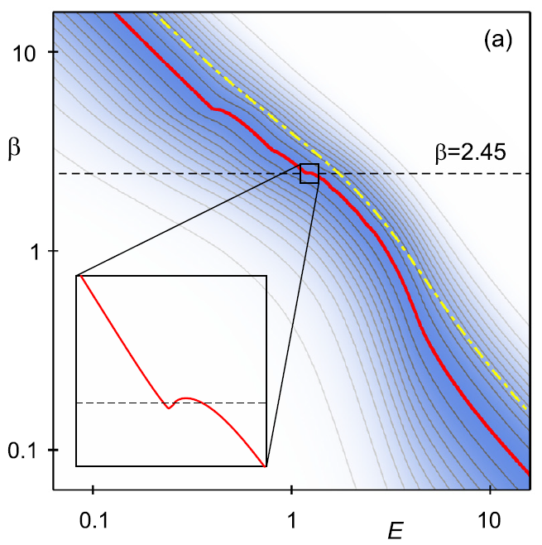
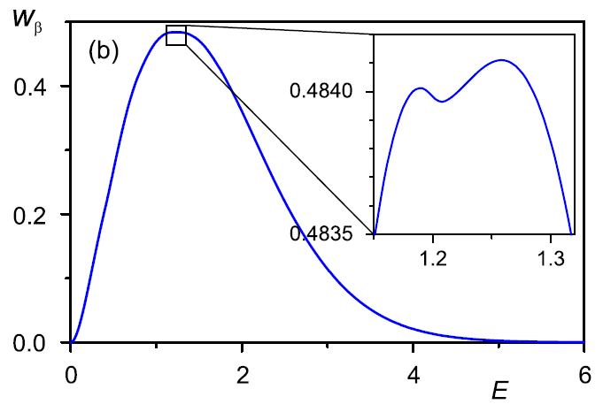
Microcanonical thermodynamics
- inverse temperature
partition function
- thermal distribution
Tripple CUSP system
$β_{mic}$ - maximum of the thermal distribution $⟶$ microcanonical caloric curve
In systems with nondegenerate SP not defined for $f≤3$
- heat capacity
- nonanalytic behavior again
P. Cejnar, P. Stránský, Phys. Lett. A381, 984 (2017)

Slide 24
Heat capacity
separable system
Microcanonical
Canonical
- smooth regular function of $β$ irrespective of ESQPT
CUSP + (f-1) x HO
(3 stationary points)
f x CUSP
(3^{f} stationary points)
f=3
f=4
f=3
f=4
f=5
f=15
f=5
f=15
canonical
microcanonical

Slide 25
Conclusions
ESQPTs originate in stationary points of the Hamiltonian and manifest themselves as singularities in the smooth level density and in the average flow rate.
Nondegenerate stationary points
Singularities classified uniquely and completely by two numbers $(f,r)$
Singularities occur in the $\left\lceil f−1\right\rceil$-th derivative of the smooth level density or flow rate and are always of a jump / logarithmic divergence type
Degenerate stationary points
Higher flatness of the stationary point shifts the discontinuity towards lower derivatives
Thermodynamics
Low-$f$ systems exhibit considerable differences between the canonical and microcanonical heat capacities even in the limit $N→∞$.
$C_{mic}$ cannot be properly defined for $f≤3;$ for higher $f$ exhibit singularities originated in the ESQPT nonanalyticity of the level density.
ESQPTs and thermal phase transitions are complementary form of criticality, existing in different asymptotic regimes of $N$ and $f$, respectively.
Thank you for attention

