Slide 1
EXCEPTIONAL POINTS
AND
QUANTUM CRITICALITY
Pavel Stránský
^{Martin Dvořák, Pavel Cejnar}
Institute of Particle and Nuclear Physics
Charles University in Prague
Czech Republic
Non-Hermitian Hamiltonians in Physics: Theory and Experiment 2017
18 May 2017

Slide 2
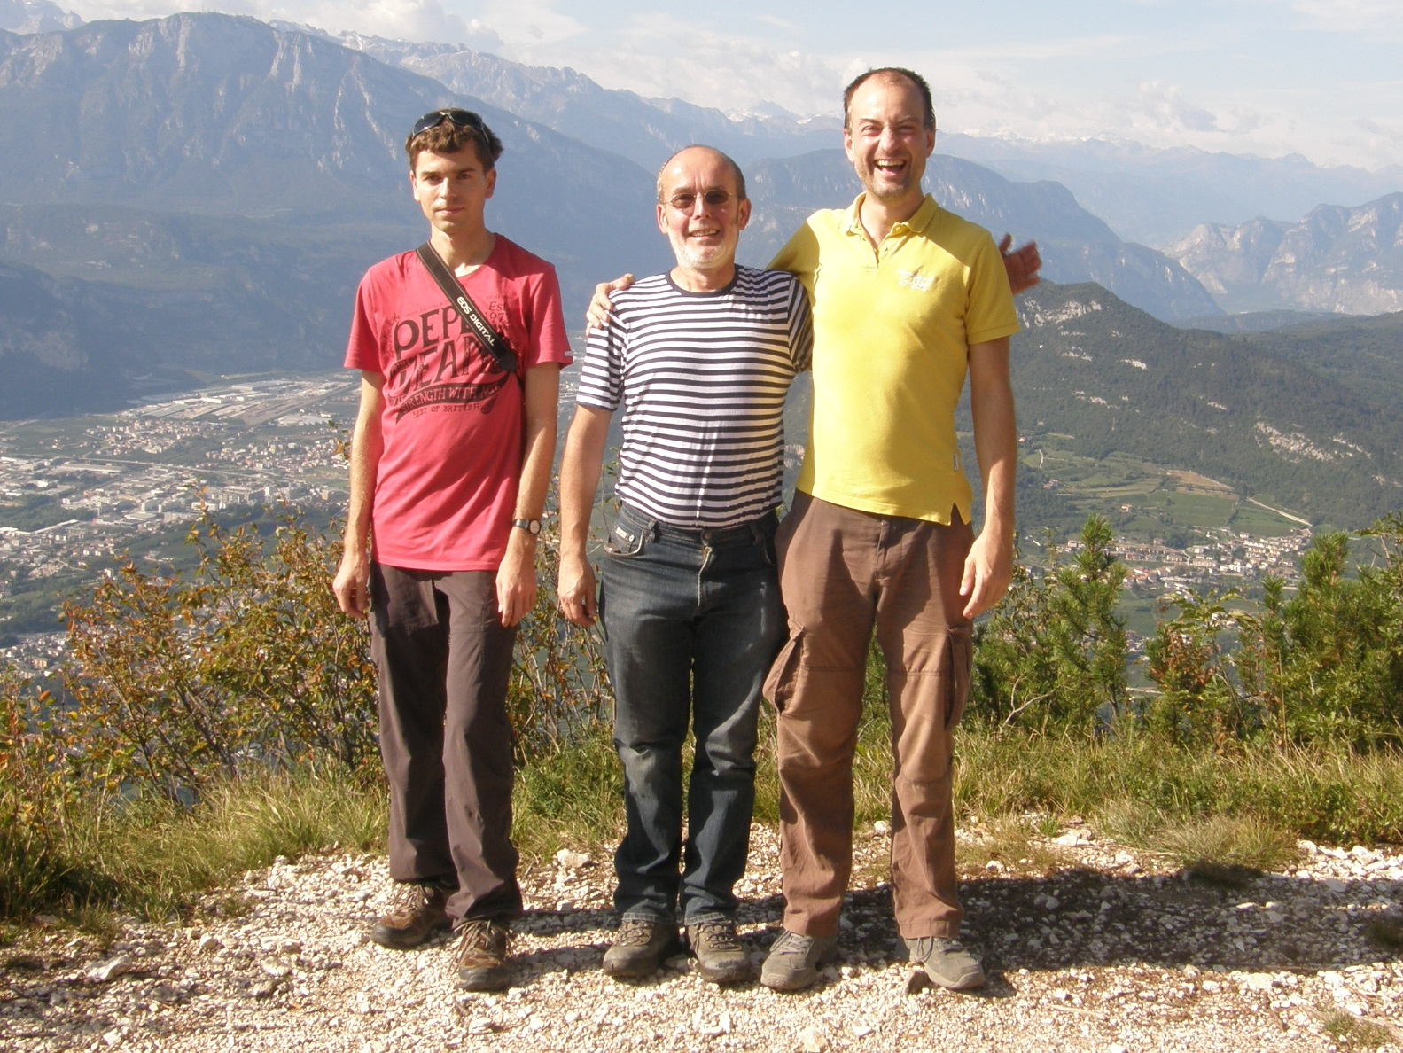

Slide 3
Outline
Quantum $↔$ Thermal phase transitions
Exceptional points as charges in a plane
Lipkin model (1st and 2nd order QPT)
Random perturbation of a critical Hamiltonian
Summary

Slide 4
Quantum phase transition (QPT)
$$H\left(λ\right)=H_{0}+λH_{I}$$
$$\left[H_{0},H_{I}\right]≠0$$
QPT: nonanalytic change of the ground state energy $E_{0}\left(λ\right)$ under a continuous change of a control parameter.
Assumptions:
Zero thermodynamic temperature
Infinite size of the system
thermal fluctuations $\sim k_{B}T$
quantum fluctuations $\sim ℏω_{c}$
Literature:
M. Vojta, Rep. Prog. Phys. 66, 2069 (2003)
S. Sachdev, Quantum Phase Transitions (2011)
L.D. Carr, Understanding Quantum Phase Transitions (2011)

Slide 5
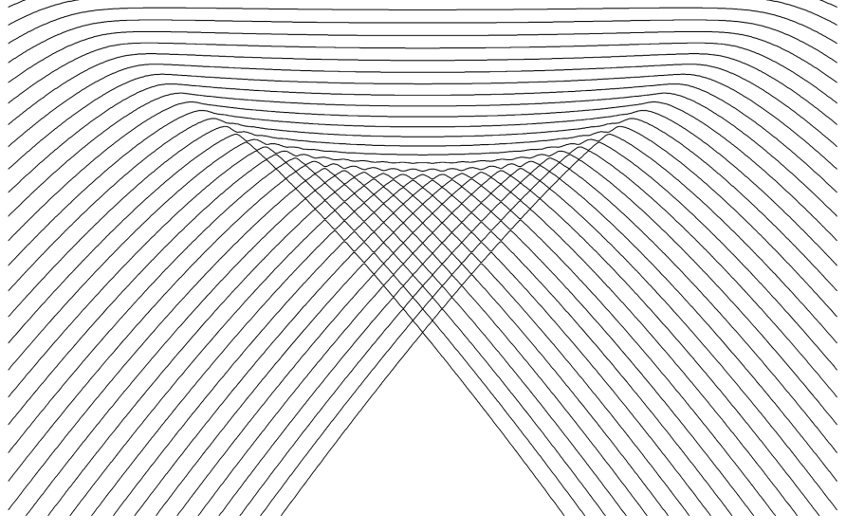
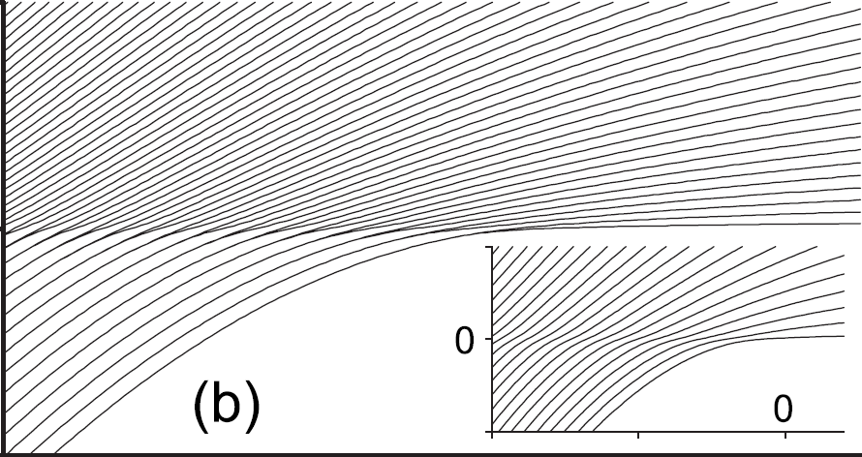
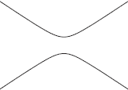
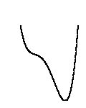
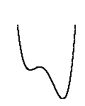
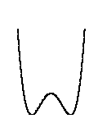
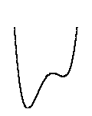
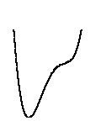
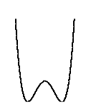
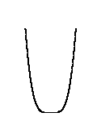
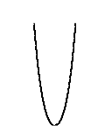
Quantum phase transition (QPT)
1st order QPT
Continuous QPT (2nd order)
Energy level dynamics
E
λ
λ
$$V(q)$$
double-well form of the energy surface
quartic minimum in the energy surface

Slide 6
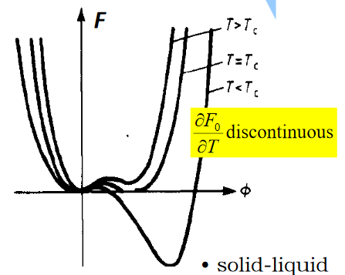
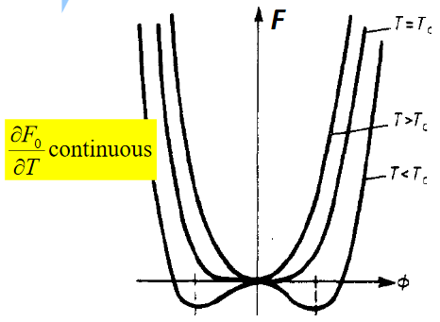
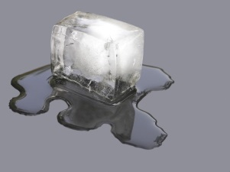
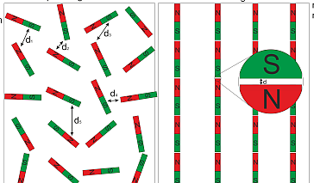
$$F_{0}(T)↔E_{0}\left(λ\right)$$
Canonical partition function:
$$Z\left(T\right)=\sum_{k}{e^{−\frac{E_{k}}{T}}}$$
... in analogy
(smooth nonzero function of T)
Thermal phase transitions
Free energy:
$$F(T)=−T ln{Z(T)}$$
1st order PT
2nd order PT
$$\frac{∂F_{0}}{∂T}$$
$$\frac{∂F_{0}}{∂T}$$
order parameter
latent heat
$$T$$
$$T$$
liquid-gas $p=p_{crit}$
ferromagnet
superfluid
etc.
solid-liquid
liquid-gas $p<p_{crit}$
etc.

Slide 7
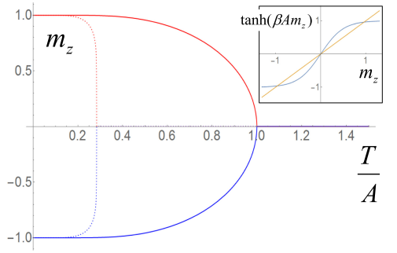
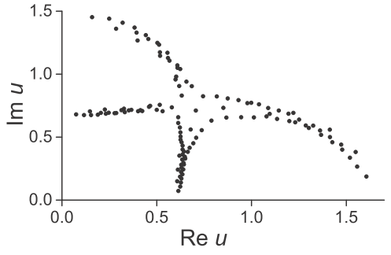
Thermal phase transitions
$$H=−\frac{A}{2}\sum_{\{ij\}}{σ_{i}^{z}σ_{j}^{z}}$$
Example: 2D Ising model
$$=\left\langle σ_{i}^{z}\right\rangle$$
(order parameter)
Extended into the complex plane $Z\left(T\right)$ can vanish – Yang-Lee zeros
12 x 12 lattice
Their approaching the real axis in the TD limit indicates a TD phase transition.
$$u=e^{−\frac{1}{T}}$$
T.D. Lee, C.N. Yang, Phys. Rev. 87, 410 (1952)
M.E. Fischer, Lecture Notes in Theoretical Physics 7C, 1 (1965)

Slide 8
Surmise:
There exists an analogy between the distribution of Yang-Lee zeros of the canonical partition function and the distribution of exceptional points of the QPT Hamiltonian.
P. Cejnar, S. Heinze, J. Dobeš, Phys. Rev. C 71, 011304(R) (2005)

Slide 9
Exceptional points
$$H\left(λ\right)=H_{0}+λH_{I}$$
$$\left[H_{0},H_{I}\right]≠0$$
In a generic situation: no real crossings
$$E_{i}\left(λ\right)≠E_{i+1}\left(λ\right)$$
(energies from the same symmetry subspace)
E
λ
But energy levels cross at exceptional points$λ^{EP}∈ℂ$
$$P\left(E,λ\right)=\det\left[E−H\left(λ\right)\right]=0$$
Resultant $R\left(λ\right)$
$$Q\left(E,λ\right)=\frac{∂P\left(E,λ\right)}{∂E}=0$$
polynomial of degree $N\left(N−1\right)$
pairs of complex conjugate roots
no roots on the real axis

Slide 10
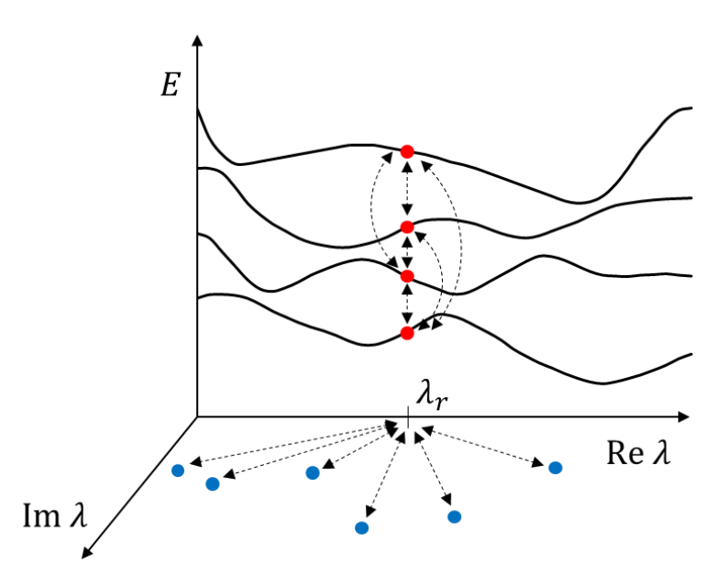
2D electrostatics of EPs
$$R\left(λ\right)=\prod_{i<j}{{\left[E_{i}\left(λ\right)−E_{j}\left(λ\right)\right]}^{2}=a\prod_{k=1}^{\frac{N\left(N−1\right)}{2}}{\left(λ−λ_{k}^{EP}\right)\left(λ−{\overline{λ}}_{k}^{EP}\right)}}$$
Resultant
$$U_{EP}\left(λ_{R}\right)=−\frac{\ln{a}}{2\left(N−1\right)}−\frac{1}{N−1}\sum_{k=1}^{\frac{N\left(N−1\right)}{2}}{\ln{R_{k}(λ_{R})}}$$
$$U_{SP}\left(λ_{R}\right)=−\frac{1}{N−1}\sum_{i<j}{\ln\left|E_{i}\left(λ_{R}\right)−E_{j}\left(λ_{R}\right)\right|}$$
Coulomb energy of charges placed on energy levels at a given $λ_{R}$ on the real axis
(Shifted) Coulomb potential at the point $λ_{R}$ from charges placed in the EPs
Partial resultant
$$R_{j}^{a}\left(λ\right)=\prod_{i≠j}{[E_{i}\left(λ\right)−E_{j}\left(λ\right)]}$$
$$R_{j}^{b}\left(λ\right)=a\prod_{k≠j}{\left(λ−λ_{k,j}^{EP}\right)\left(λ−{\overline{λ}}_{k,j}^{EP}\right)}$$
(Product over EPs on $k$-th Riemann sheet)
Open question: Relation between $R_{j}^{a}\left(λ\right)$ and $R_{j}^{b}\left(λ\right)$?

Slide 11
Thermal PT
Quantum PT
Yang-Lee zeros of the partition function
Zeros of the resultant
(non-Hermitian degeneracies)
$$Z\left(T\right)=\sum_{i}{e^{−\frac{E_{i}}{T}}}$$
Partial resultant
$$R_{j}\left(λ\right)=\prod_{i≠j}{{\left[E_{i}\left(λ\right)−E_{j}\left(λ\right)\right]}^{2}}$$
Partition function
Free energy
$$F\left(T\right)=−T\ln{Z(T)}$$
$$U_{j}\left(λ\right)=−\frac{1}{Ω}\ln{R_{j}(λ)}$$
Coulomb energy
$$C\left(T\right)=−T\frac{∂^{2}F\left(T\right)}{∂T^{2}}$$
$$C_{j}\left(λ\right)=−\frac{∂^{2}U_{j}\left(λ\right)}{∂λ^{2}}$$
Specific heat
$$Q\left(λ\right)=\lim_{ε→0+}{\int_{λ−ε}^{λ+ε}{C\left(λ′\right)dλ′}}$$
$$Q\left(T\right)=\lim_{ε→0+}{\int_{T−ε}^{T+ε}{C\left(T′\right)dT′}}$$
Latent heat
Order of the PT is given by the density of zeros in the vicinity of the real axis:
$$λ_{PT}$$
$$ρ^{EP}∝{\left(Im λ\right)}^{α}$$
$α=0$ – 1st order
$0<α<1$ – 2nd order
$$Re λ$$
P. Cejnar, S. Heinze, J. Dobeš, Phys. Rev. C 71, 011304(R) (2005)
P. Cejnar, S. Heinze, M. Macek, Phys. Rev. Lett. 99, 100601 (2007)

Slide 12
Lipkin(-Meshkov-Glick) model
H.J. Lipkin, N. Meshkov, A.J. Glick, Nucl. Phys. 62, 188 (1965)
N. Meshkov, A.J. Glick, H.J. Lipkin, Nucl. Phys. 62, 199 (1965)
A.J. Glick, H.J. Lipkin, N. Meshkov, Nucl. Phys. 62, 211 (1965)
2 levels with capacity $N$
$N$ interacting fermions
$$J_{z}=\frac{1}{2}\sum_{i=1}^{N}{a_{i+}^{+}a_{i+}−a_{i−}^{+}a_{i−}}$$
SU(2) algebra
$$J_{+}=\sum_{i=1}^{N}{a_{i+}^{+}a_{i−}}$$
$$J_{−}={\left(J_{+}\right)}^{+}$$
Quasispin $J$ is conserved
$$H\left(η,χ\right)=η\left(\frac{N}{2}+J_{z}\right)−\frac{1−η}{N}\left[J_{+}+J_{−}+χ{\left(\frac{N}{2}+J_{z}\right)}^{2}\right]$$
We shall consider only $J=\frac{N}{2}$ subspace – 1 degree of freedom
J. Vidal, J.M. Arias, J. Dukelsky, J.E. García-Ramos, Phys. Rev. C 73, 054305 (2006)

Slide 13
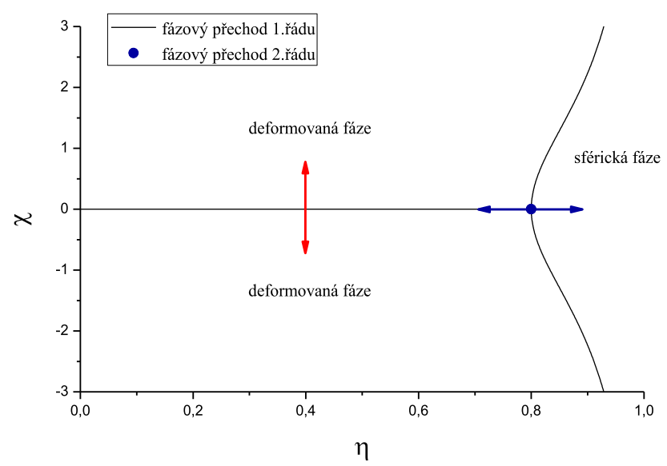
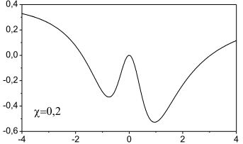
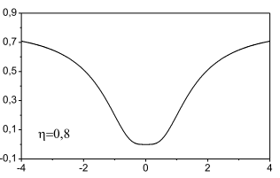
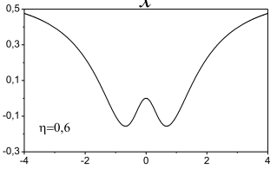
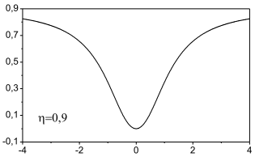
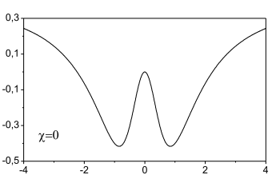
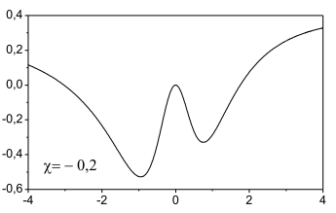
Phase structure
$$\frac{4+χ^{2}}{5+χ^{2}}$$
P
DEFORMED phase
$$V$$
$$x$$
$$V$$
1st order QPT
2nd order QPT
SPHERICAL phase
$$x$$
DEFORMED phase

Slide 14
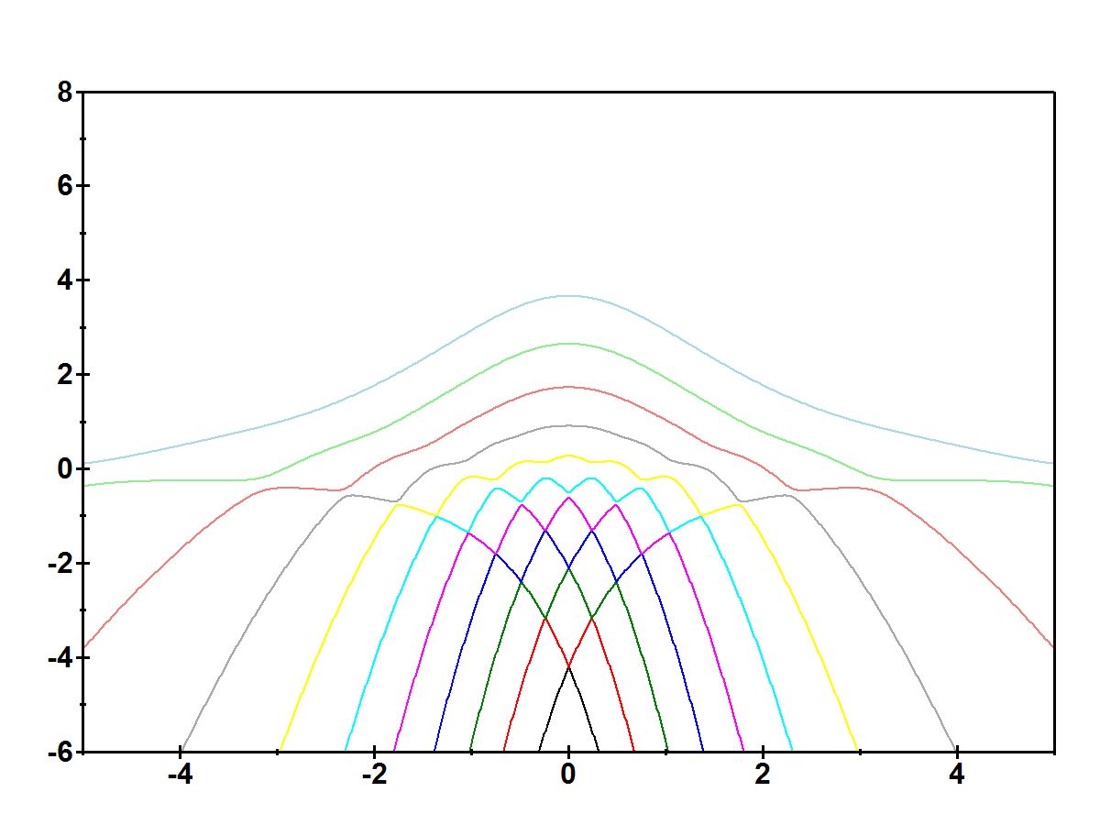
1st order QPT
$$E$$
Level dynamics
$$N=10$$
$$η=0.4$$
$$χ$$
P. Cejnar, P. Stránský, Phys. Scr. 91, 083006 (2016)

Slide 15
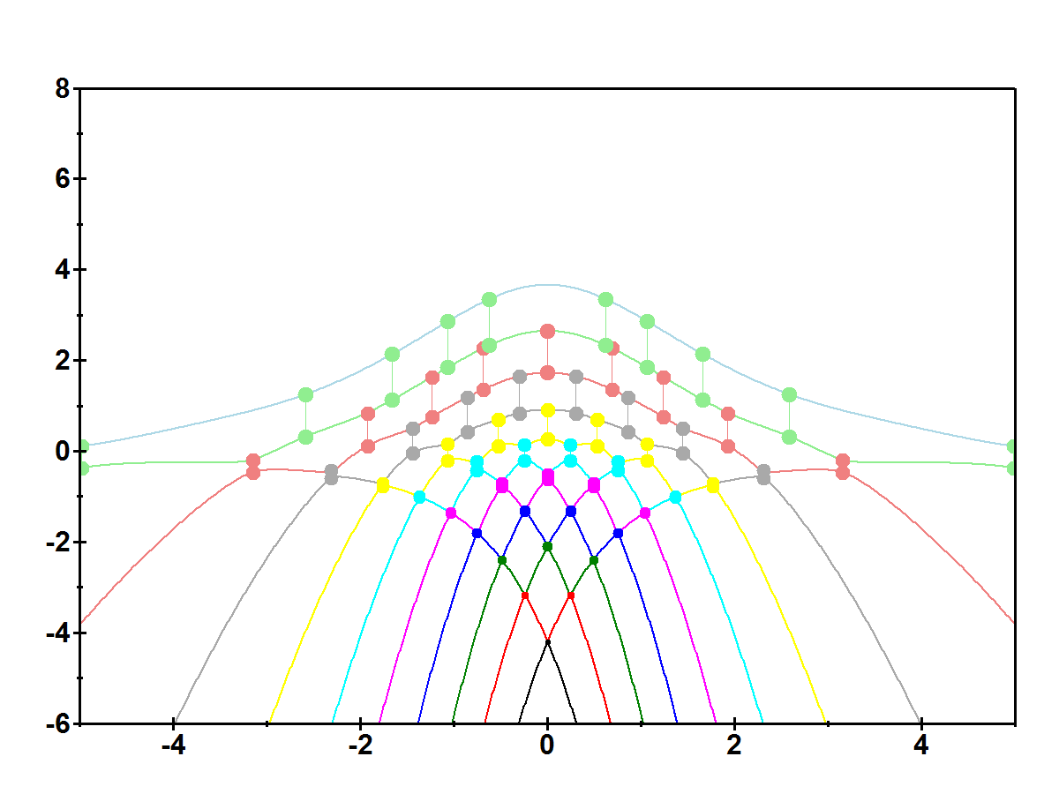
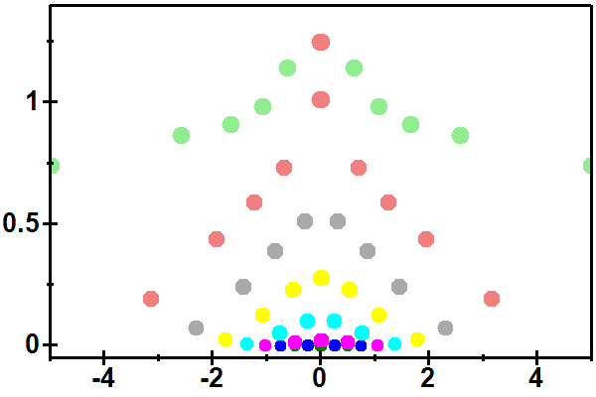
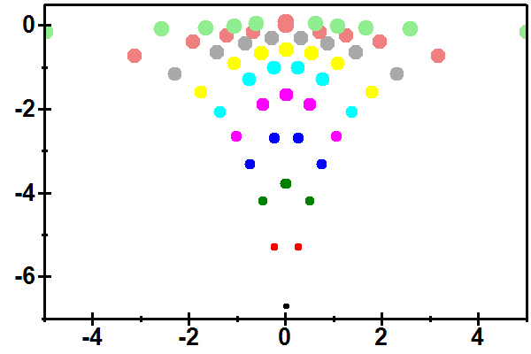
1st order QPT
$$E$$
Exceptional points
$$Imχ$$
- tight connection between neighbouring levels
$$Reχ$$
$$\log{Imχ}$$
$$Reχ$$
$$N=10$$
$$η=0.4$$
$$χ$$

Slide 16
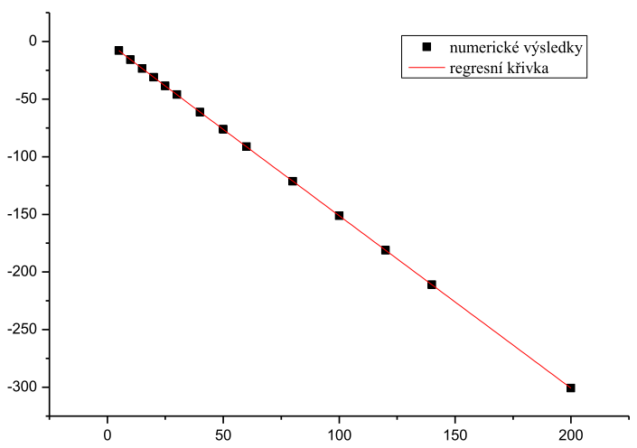
1st order QPT
$$E$$
Exceptional points
$$Imχ$$
- tight connection between neighbouring levels
$$\ln{Imχ_{0,1}^{EP} }$$
EPs approach real axis exponentially fast
$$Reχ$$
$$\log{Imχ}$$
$$N$$
$$Reχ$$
$$N=10$$
$$η=0.4$$
$$χ$$

Slide 17
1st order QPT
$$E$$
$$Imχ$$
M. Caprio, P. Cejnar, F. Iachello, Ann. Phys. 323, 1106 (2008)
P. Stránský, P. Cejnar, Phys. Lett. A 380, 2637 (2016)
$$Reχ$$
Excited-state quantum phase transitions
Spinodal region
$$N=10$$
$$η=0.4$$
$$χ$$

Slide 18
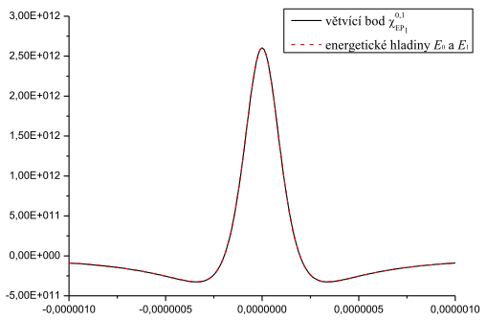
Specific heat analogy
$$C_{0}(χ)$$
$$C_{max}=\frac{1}{N−1}\frac{1}{{\left(Im χ_{0,1}^{EP}\right)}^{2}}$$
$$C_{EP,0}\left(χ\right)≈\frac{1}{N−1}\frac{d^{2}}{dχ^{2}}\ln{\sqrt{{\left(χ−Re χ_{0,1}^{EP}\right)}^{2}+{\left(Im χ_{0,1}^{EP}\right)}^{2}}}$$
$$C_{SP,0}\left(χ\right)≈\frac{1}{N−1}\frac{d^{2}}{dχ^{2}}\ln\left|E_{1}\left(χ\right)−E_{0}\left(χ\right)\right|$$
$$χ_{min}=\frac{\sqrt{3}}{2}Im χ_{0,1}^{EP}$$
EPs are well separated, therefore there is just one EP connected with the ground state
$$χ$$
We can neglect the influence of other EPs
Latent heat analogy
- approximated by $Q≈χ_{min}∗C_{max}=\frac{\sqrt{3}}{2\left(N−1\right)}\frac{1}{Im χ_{0,1}^{EP}}∼\frac{e^{N}}{N}→∞$

Slide 19
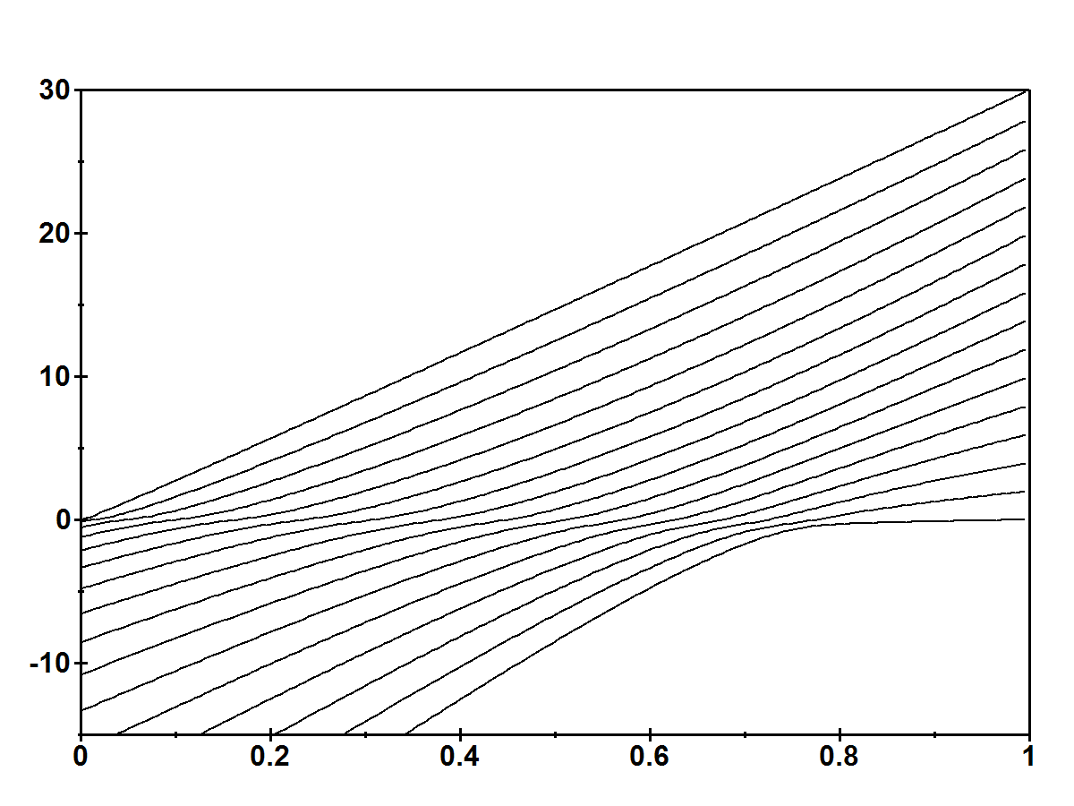
2nd order QPT
Already discussed in the literature, see for example
$$E$$
W.D. Heiss, F.G. Scholtz and H.B. Geyer, J. Phys. A: Math. Gen. 38, 1843 (2005)
W.D. Heiss, J. Phys. A: Math. Theor. 45, 444016 (2012)
...
$$N=30$$
$π^{+}$ states
$$η$$

Slide 20
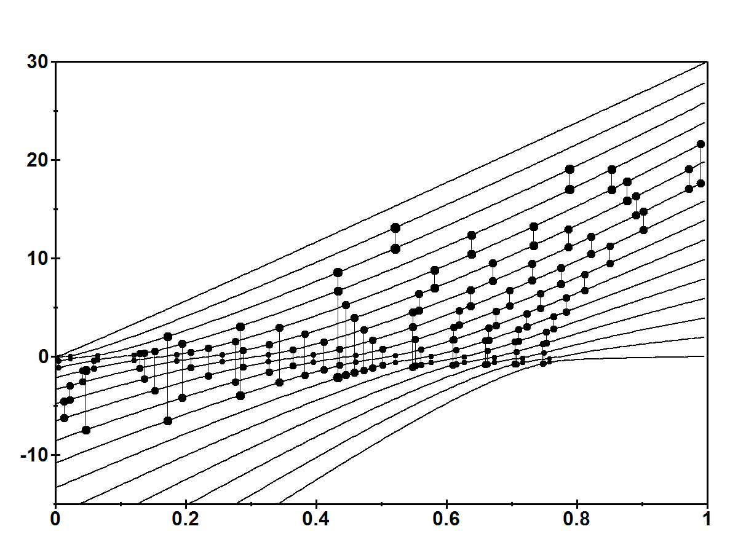
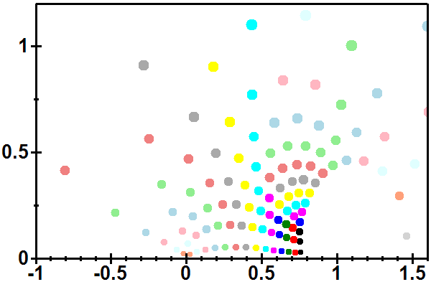
2nd order QPT
Exceptional points
$$E$$
$$Im η$$
$$Re η$$
$$N=30$$
$π^{+}$ states
$$η$$

Slide 21
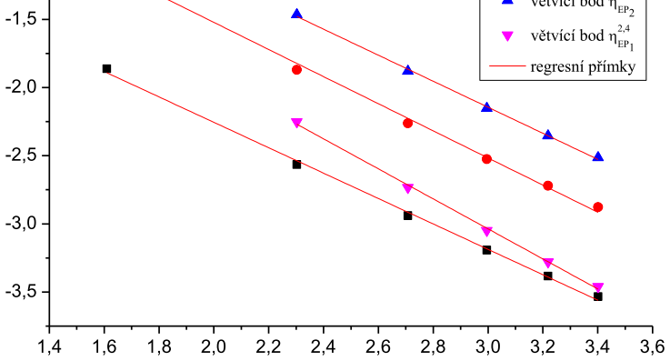
2nd order QPT
Exceptional points
$$E$$
$$Im η$$
$$\ln{Imχ_{0,1}^{EP} }$$
EPs approach real axis polynomially fast
slope $∼−0.4$
$$Re η$$
$$\ln{N}$$
$$N=30$$
$π^{+}$ states
$$η$$

Slide 22
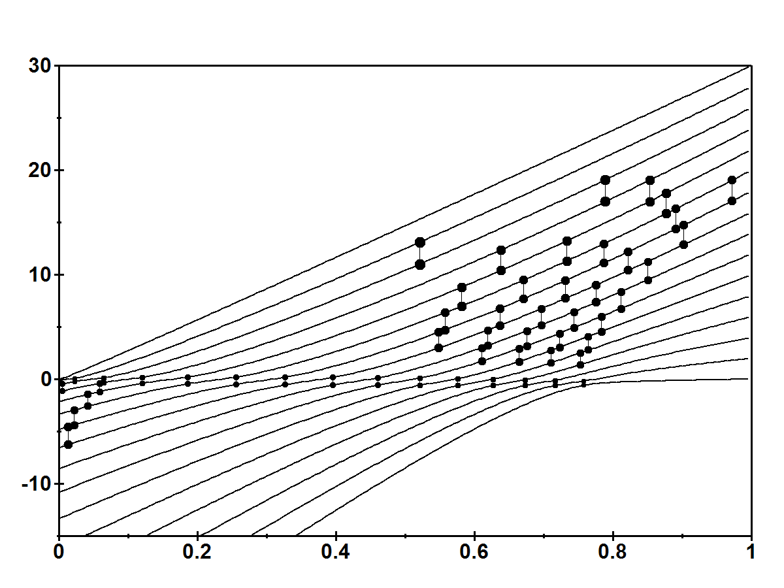
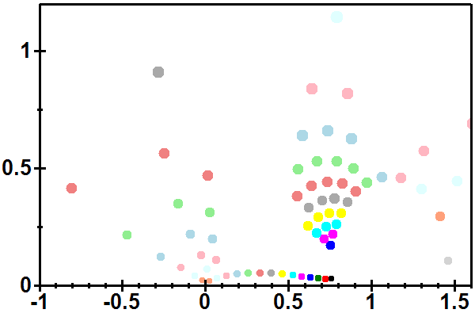
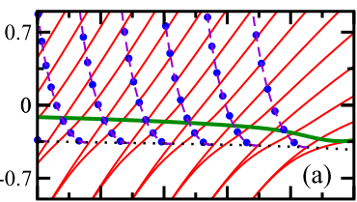
2nd order QPT
Exceptional points
$$E$$
$$Im η$$
- only the interaction of neigbouring levels shown
$$Re η$$
Excited-state quantum phase transition
M. Šindelka, L. Santos, N. Moiseyev, Phys. Rev. A 95, 010103(R) (2017)
$$η$$

Slide 23
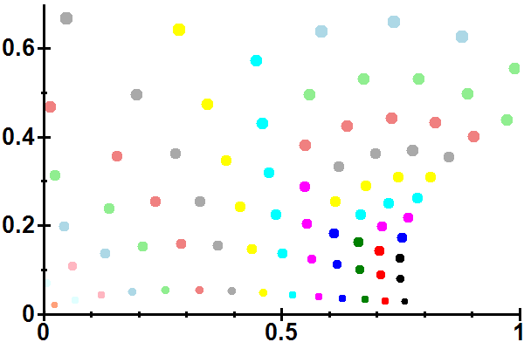
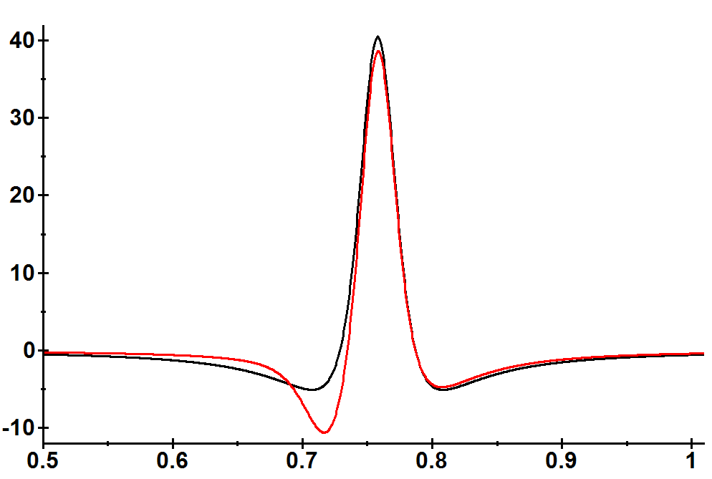
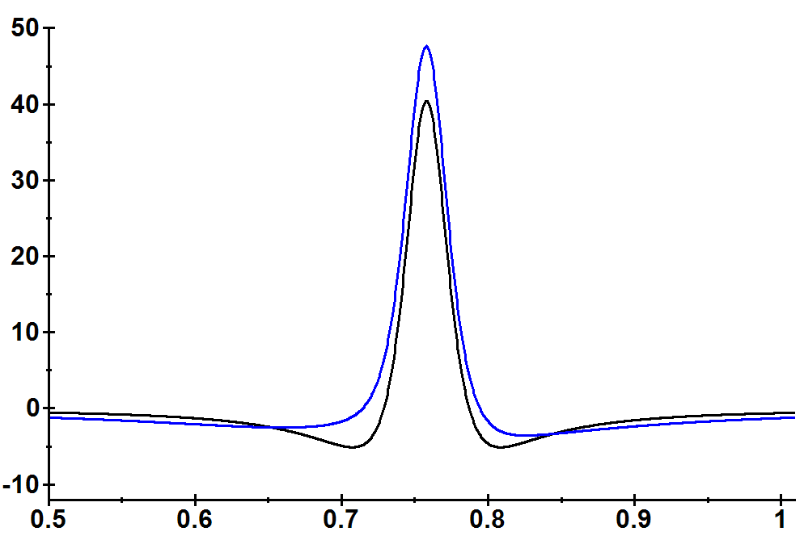
Specific heat analogy
$$Im η$$
$$C_{0}(η)$$
$$Re η$$
$$C_{EP,0}$$
Other EPs connected with the ground state included
$$C_{SP,0}$$
$$C_{EP,0}^{All}$$
$$η$$
$$η$$
Latent heat analogy
- approximated by $Q≈χ_{min}∗C_{max}=\frac{\sqrt{3}}{2\left(N−1\right)}\frac{1}{Im χ_{0,1}^{EP}}∼\frac{N^{0.4}}{N}→0$

Slide 24
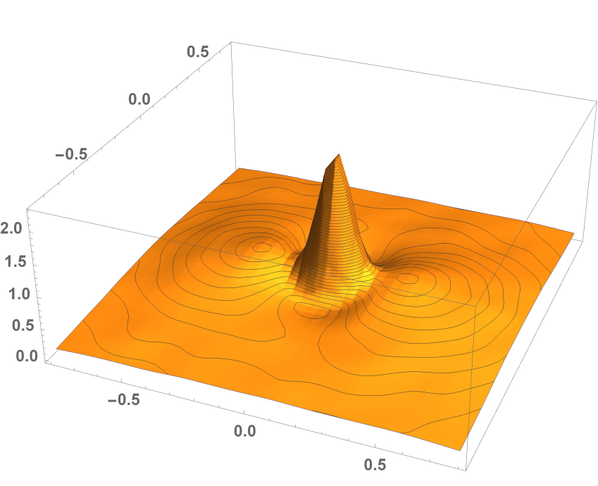
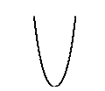
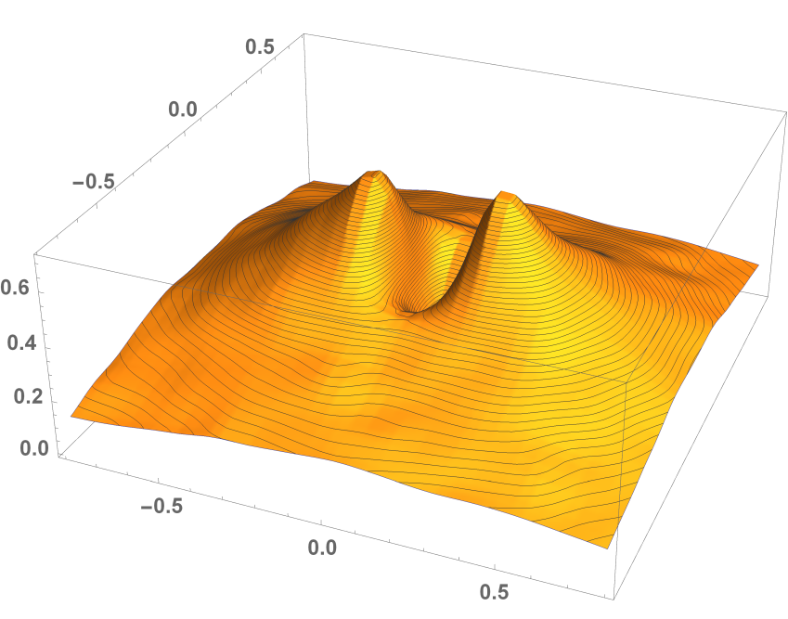
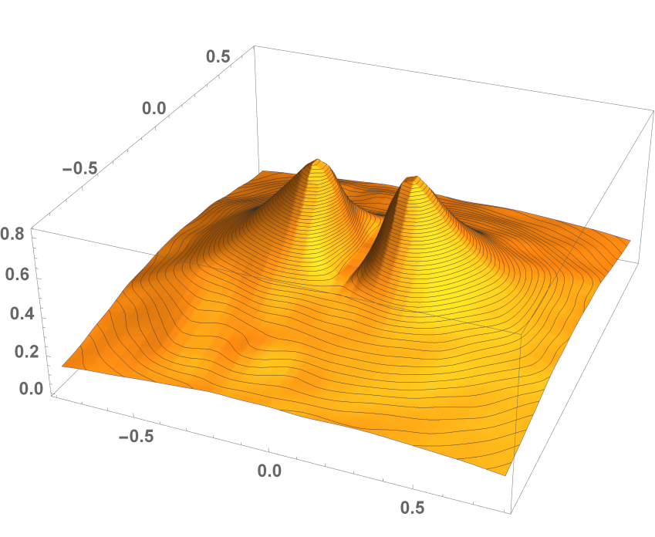
Random perturbation at a critical point
$$H=H_{c}+λH_{GOE}$$
Double-well potential
1st order QPT
$$P(λ)$$
$$Im λ$$
Harmonic oscillator
$$Im λ$$
$$P(λ)$$
$$Re λ$$
Quartic potential
2nd order QPT
$$P(λ)$$
$$Im λ$$
$$Re λ$$
M.R. Zirnbauer, J.J.M. Verbaarschot, H.A. Weidenmüller, Nucl. Phys. A411, 161 (1983)
$$Re λ$$
Preliminary results

Slide 25
Conclusions
Quantum analog of Yang-Lee zeros are exceptional points (= zeros of the resultant)
EPs can be considered as charges in a plane, forming electrostatic potential for a test particle on the real axis of the control parameter; This potential equals the energy of Coulomb gas built up by identical charges lying on real eigenenergies.
At a 1st order QPT modelled by a double-well potential, only those EPs belonging to neighbouring pairs of levels give a significant contribution to the potential (and derived quantities). EPs approaches the real axis exponentially fast in the infinite-size limit.
In a 2nd order QPT modelled by a quartic oscillator, EPs approaches the real axis polynomially fast in the infinite-size limit.
Thanks for your attention

