Slide 1
CLASSIFICATION OF ESQPTS
Pavel Stránský
www.pavelstransky.cz
Institute of Particle and Nuclear Physics
Charles University in Prague
Czech Republic
In collaboration with: Pavel Cejnar, Michal Macek, Michal Kloc
IPNP, Charles Univeristy in Prague, Czech Republic
QPTN-8, Prague, Czech Republic
9 June 2016

Slide 2
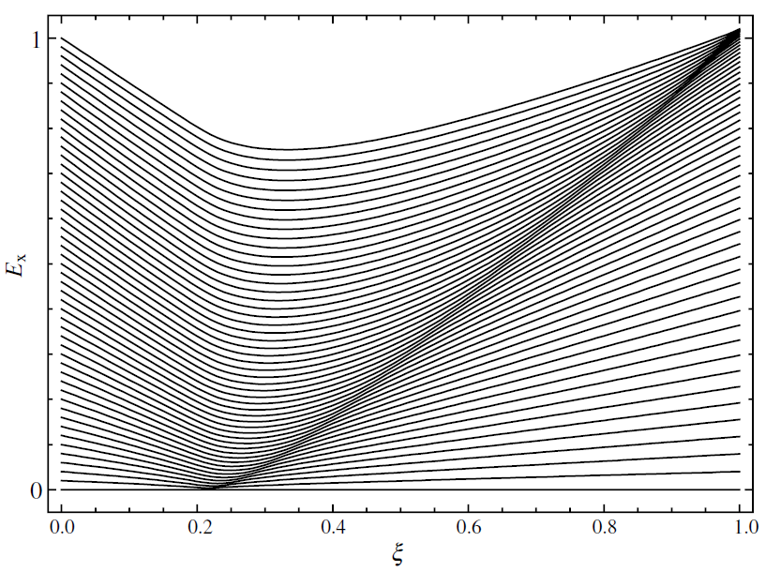
2-level pairing model
M.A. Caprio, P. Cejnar, F. Iachello, Annals of Physics 323, 1106 (2008)
in talks of Franco Iachello, Lea Santos, Michal Macek and others...

Slide 3
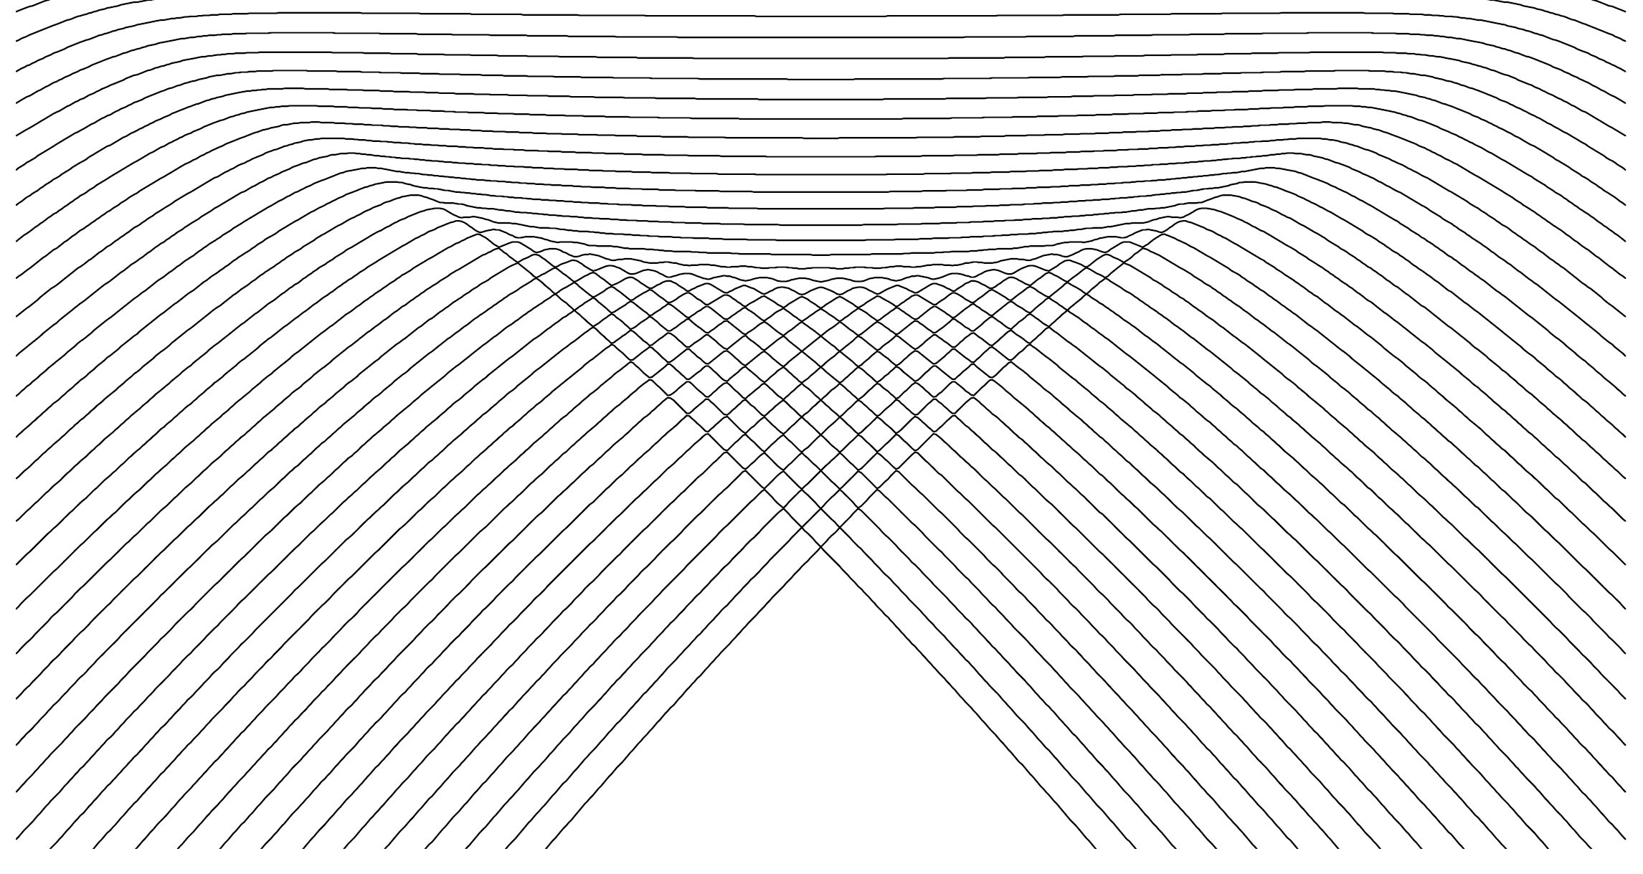
Manifestations of ESQPTs
arbitrary analytic function of p, q
f degrees of freedom
Level density
discontinuity in the level density ρ
smooth component
(Weyl formula)
E
discontinuity in the level flow rate φ
volume function
of the classical phase space
control parameter λ
I. Hoveijn, J. Math. Anal. Appl. 348, 530 (2008)
M. Kastner, Rev. Mod. Phys. 80, 167 (2008)
Flow rate
role of velocity
given from the continuity equation
(time)
(coordinate)
P. Stránský, M. Macek, P. Cejnar, Annals of Physics 345, 73 (2014)
P. Stránský, M. Macek, A. Leviatan, P. Cejnar, Annals of Physics 356, 57 (2015)

Slide 4
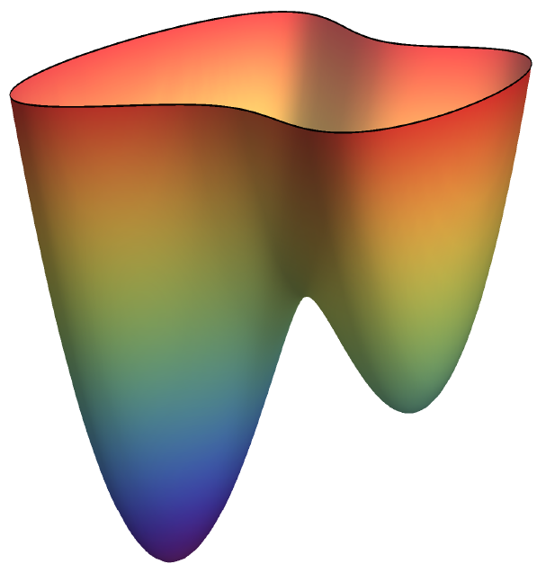
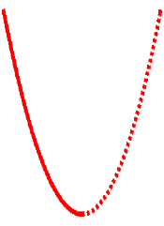
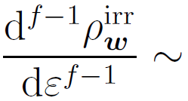
Level density: Nondegenerate stationary point
Morse lemma
Approximation of the Hamiltonian
E
with quadratic function:
ε
w
index of the stationary point
y₂
x₂
volume
integral
x₁
y₁
r even
r odd
[f-1]-th derivative
logarithmic divergence
jump
E_{w}
E
E_{w}
E

Slide 5
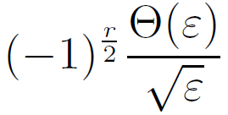
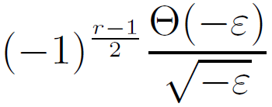
Level density: Nondegenerate stationary point
Morse lemma
Approximation of the Hamiltonian
E
with quadratic function:
ε
w
index of the stationary point
y₂
x₂
volume
integral
x₁
y₁
f integer
f half-integer
r even
r odd
r even
r odd
[f-1]-th derivative
logarithmic divergence
inverse sqrt
jump
E_{w}
E
E_{w}
E
E_{w}
E
E_{w}
E

Slide 6
Level density: Nondegenerate stationary point
Relevant for:
Michal Macek
Morse lemma
lattices
time-dependent Hamiltonian systems
Approximation of the Hamiltonian
with quadratic function:
Each singularity of the level density at a nondegenerate stationary point is uniquely classified by two numbers (f,r)
index of the stationary point
f integer
f half-integer
r even
r odd
r even
r odd
[f-1]-th derivative
logarithmic divergence
inverse sqrt
jump
E_{w}
E
E_{w}
E
E_{w}
E
E_{w}
E

Slide 7
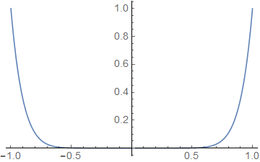
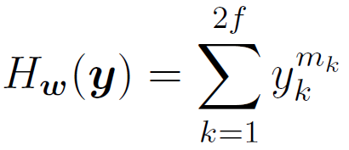
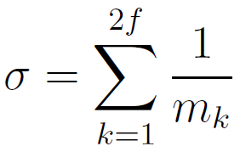
Level density: Degenerate stationary point
Structural stability
- an arbitrarily small perturbation converts any function into a Morse function:
M. Kastner, Rev. Mod. Phys. 80, 167 (2008)
x
flat minimum
quadratic minimum
Flat minimum – level density
(analytic only for m_{k} even integer)
- discontinuity in the -th derivative

Slide 8
Example: 3 noninteracting CUSP systems
f=3 degrees of freedom
- special choice of the parameters
λ₁ = 0.25
λ₂ = 0.5
λ₃ = 0.75
27 stationary points:
(singularities in the 2nd derivative)
8 local minima (3,0)
- upward jump
Singularities expected in the 2nd derivative of the level density and flow rate
12 saddle points (3,1)
- upward log divergence
6 saddle points (3,2)
- downward jump
local maximum (3,3)
- downward log divergence

Slide 9
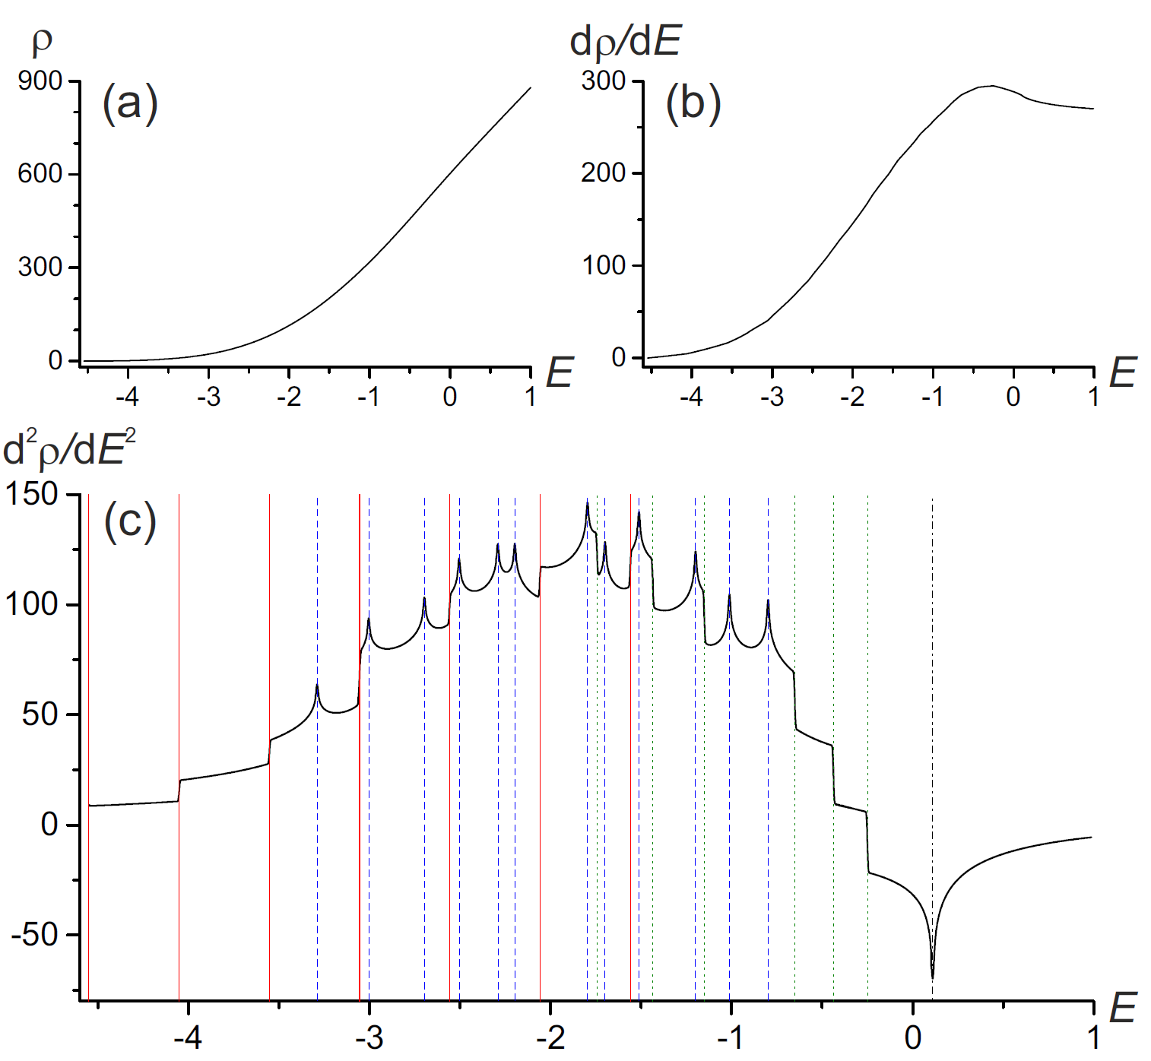
Example: 3 noninteracting CUSP systems
Level density
- special choice of the parameters
λ₁ = 0.25
λ₂ = 0.5
λ₃ = 0.75
27 stationary points:
(singularities in the 2nd derivative)
8 local minima (3,0)
- upward jump
12 saddle points (3,1)
- upward log divergence
6 saddle points (3,2)
- downward jump
local maximum (3,3)
- downward log divergence

Slide 10
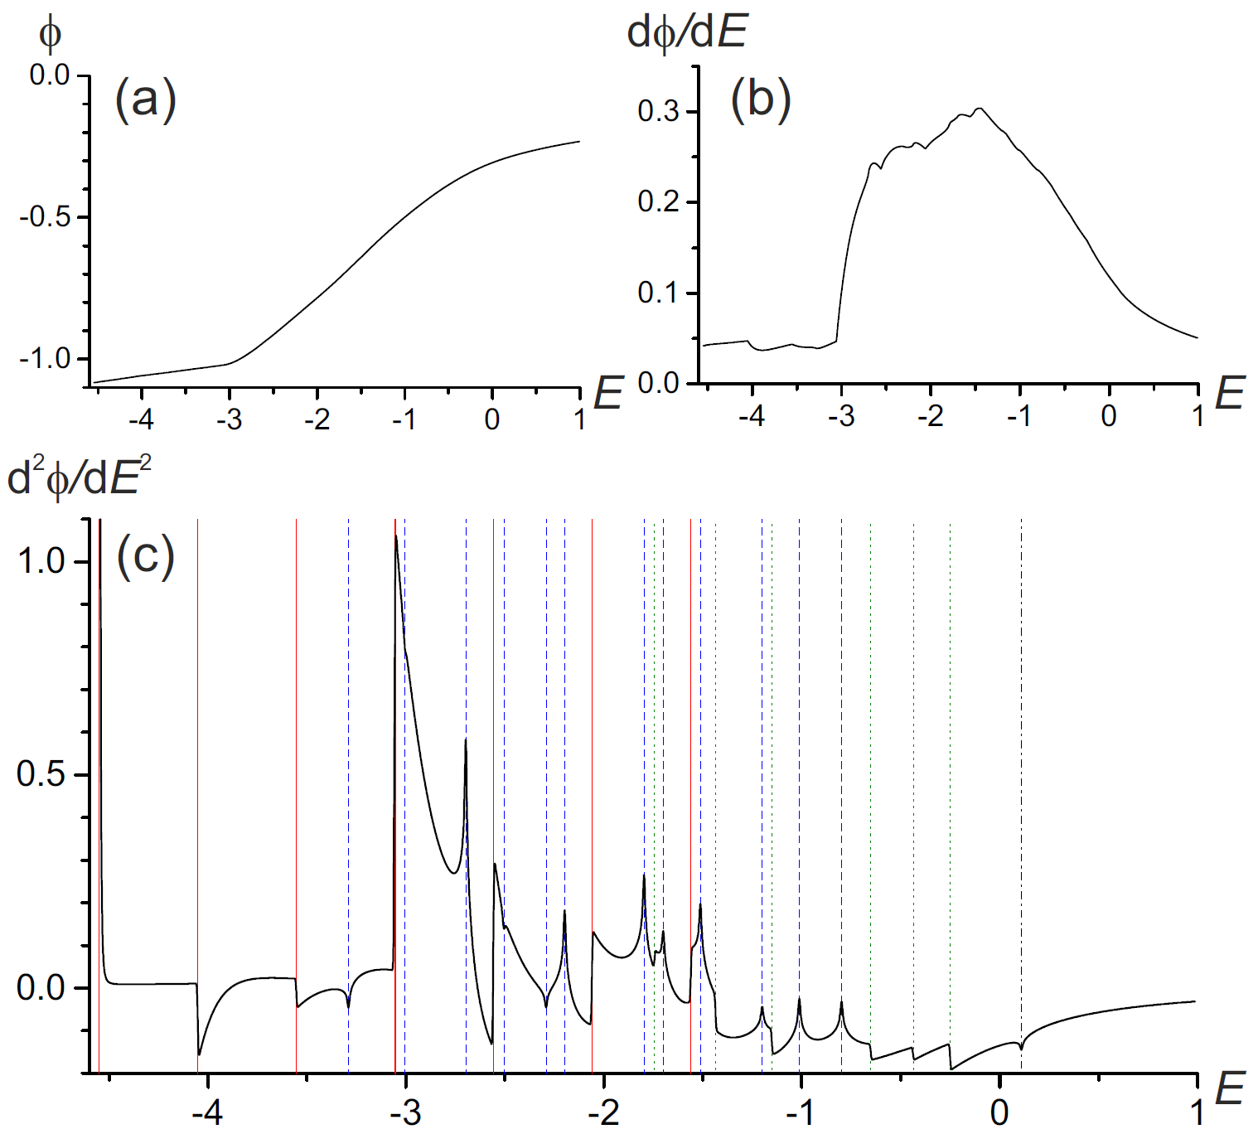
Example: 3 noninteracting CUSP systems
Flow rate
Due to the continuity equation
singularities in φ of the same type as in ρ (except for the sign)
8 local minima (3,0)
- jump
12 saddle points (3,1)
- log divergence
6 saddle points (3,2)
- jump
local maximum (3,3)
- log divergence

Slide 11
Conclusions
ESQPTs originate in stationary points of the Hamiltonian function
Nondegenerate stationary points: singularities classified uniquely and completely by two numbers:
(f – number of degrees of freedom, r – index of the stationary point)
Singularities occur in the ┌f-1┐- th derivative of the smooth level density or flow rate and are always of a jump / logarithmic divergence type
Degenerate stationary points: higher flatness of the stationary point shifts the discontinuity towards lower derivatives
References
P. Stránský, P. Cejnar, submitted to Physics Letters A (2016)
P. Stránský, M. Macek, P. Cejnar, Annals of Physics 345, 73 (2014)
P. Stránský, M. Macek, A. Leviatan, P. Cejnar, Annals of Physics 356, 57 (2015)
Thank you for your stationary points

