Slide 1
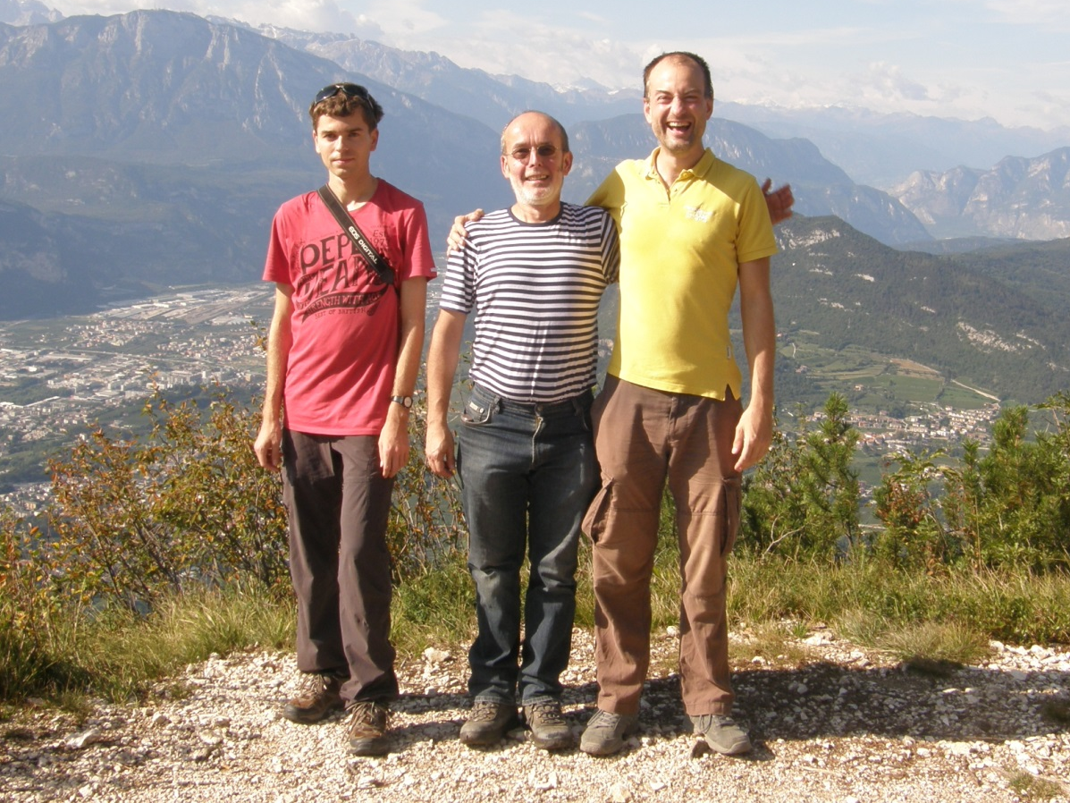
EXCEPTIONAL POINTS
FOR RANDOMLY PERTURBED
CRITICAL HAMILTONIAN
Published in:
Physical Review E 97, 012112 (2018)
Pavel Stránský
Martin Dvořák, Pavel Cejnar
Institute of Particle and Nuclear Physics
Charles University, Prague
Czech Republic
QPTn 9, Padova, Italy
25 May 2018

Slide 2
Outline
Exceptional points (EP)
Lipkin model: A simple critical system with both 1st and 2nd order QPTs
EP distribution of randomly perturbed Hamiltonians

Slide 3
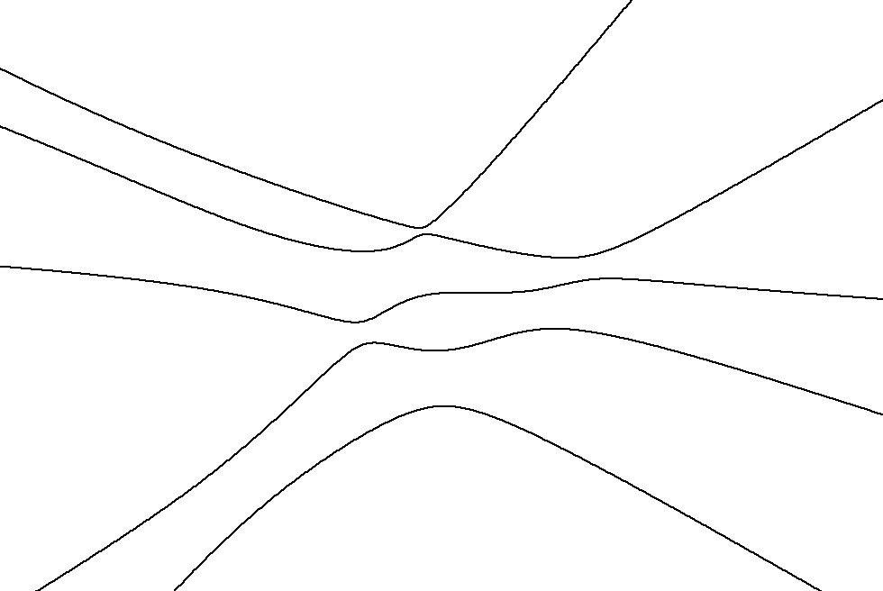
Exceptional points
$$H\left(λ\right)=H_{0}+λV$$
$$\left[H_{0},V\right]≠0$$
$$E$$
In a generic situation: no real crossings
$$E_{i}\left(λ\right)≠E_{i+1}\left(λ\right)$$
(energies from the same symmetry subspace)
λ
1
Notes:
external field strength
all operators Hermitian

Slide 4
Exceptional points
$$H\left(λ\right)=H_{0}+λV$$
$$\left[H_{0},V\right]≠0$$
$$E$$
In a generic situation: no real crossings
$$E_{i}\left(λ\right)≠E_{i+1}\left(λ\right)$$
(energies from the same symmetry subspace)
$$Reλ$$
Nonhermitian extension of the Hamiltonian
$$Im λ$$
Energy levels cross at $\frac{1}{2}n\left(n−1\right)$ complex conjugate pairs of exceptional points$λ^{EP},λ^{EP∗}∈ℂ$
1
Notes:
Complex energy
EP – square-root type of branch points connecting two Riemann sheets
EP distribution symmetric under the complex conjugation

Slide 5
Lipkin(-Meshkov-Glick) model
H.J. Lipkin, N. Meshkov, A.J. Glick, Nucl. Phys. 62, 188 (1965)
N. Meshkov, A.J. Glick, H.J. Lipkin, Nucl. Phys. 62, 199 (1965)
A.J. Glick, H.J. Lipkin, N. Meshkov, Nucl. Phys. 62, 211 (1965)
2 levels with capacity $N$
$N$ interacting fermions
$$J_{z}=\frac{1}{2}\sum_{i=1}^{N}{a_{i+}^{+}a_{i+}−a_{i−}^{+}a_{i−}}$$
SU(2) algebra
$$J_{+}=\sum_{i=1}^{N}{a_{i+}^{+}a_{i−}}$$
Quasispin $j$ is conserved
$$J_{−}={\left(J_{+}\right)}^{+}$$
Only $j=\frac{N}{2}$ subspace considered – 1 degree of freedom
2
Notes:
Dicke without the photonic field

Slide 6
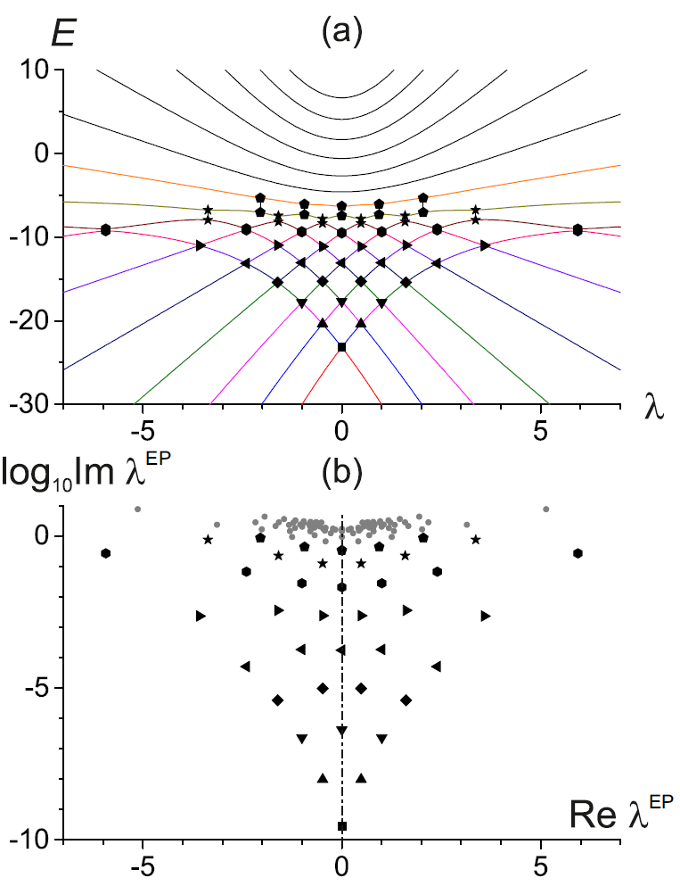
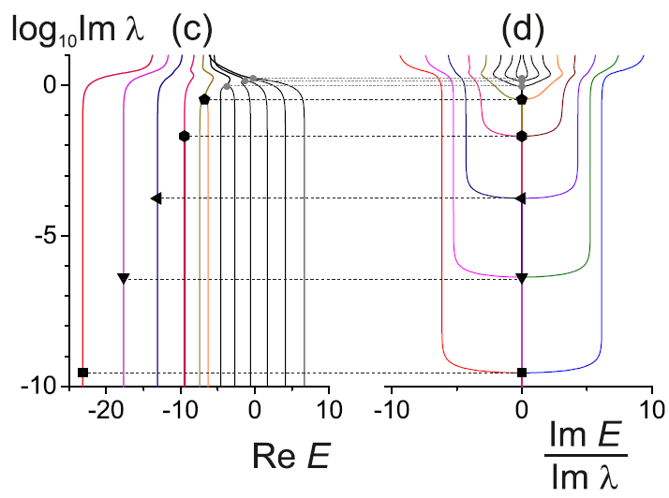
1st order QPT
$$H_{0}=J_{3}−\frac{6}{N}J_{1}^{2}$$
$$V=−J_{1}−\frac{1}{N}\left(J_{1}J_{3}+J_{3}J_{1}\right)$$
potential
$$E$$
$Re E$ merges
$Im E$ diverges
at an individual EP when $Im λ$ increased
deformed$↔$ deformed
3
$$N=15$$

Slide 7
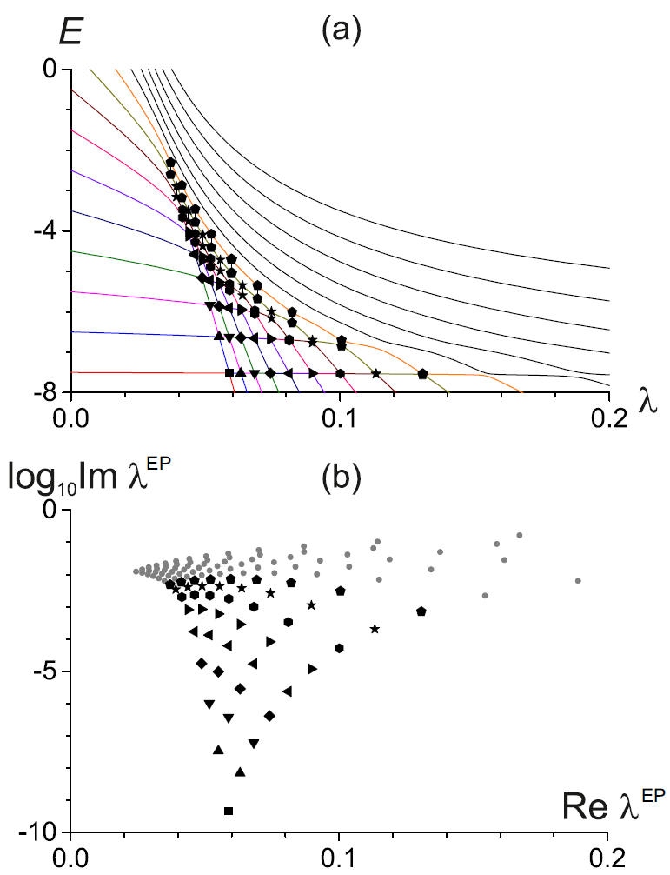
1st order QPT
$$H_{0}=J_{3}−\frac{6}{N}J_{1}^{2}$$
$$V=−J_{1}−\frac{1}{N}\left(J_{1}J_{3}+J_{3}J_{1}\right)$$
$$V=−\frac{1}{N}{\left[J_{1}+4\left(J_{3}+\frac{N}{2}\right)\right]}^{2}$$
$$H_{0}=J_{3}$$
potential
$$E$$
$$E$$
deformed$↔$ deformed
spherical$⟷$ deformed
3
$$N=15$$

Slide 8
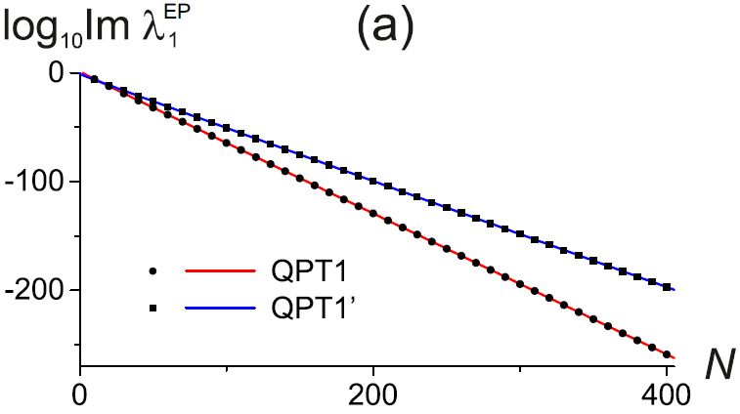
1st order QPT
$$H_{0}=J_{3}−\frac{6}{N}J_{1}^{2}$$
$$V=−J_{1}−\frac{1}{N}\left(J_{1}J_{3}+J_{3}J_{1}\right)$$
$$V=−\frac{1}{N}{\left[J_{1}+4\left(J_{3}+\frac{N}{2}\right)\right]}^{2}$$
$$H_{0}=J_{3}$$
potential
exponential convergence towards the real axis
$$E$$
$$E$$
deformed$↔$ deformed
spherical$⟷$ deformed
3
$$N=15$$
Notes:
Closest EP to the real axis

Slide 9
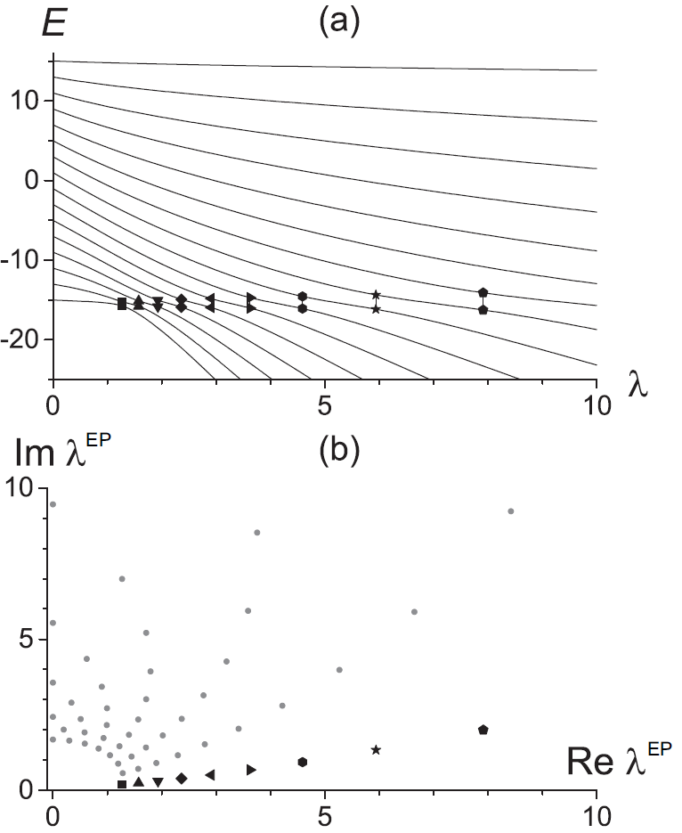
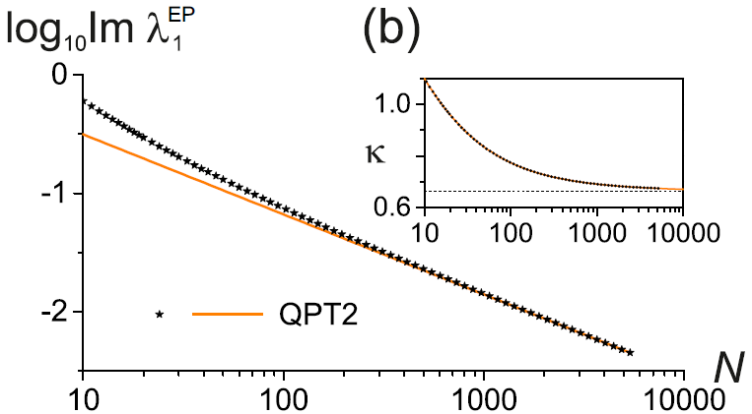
2nd order QPT
$$H_{0}=J_{3}$$
$$V=−\frac{1}{N}J_{1}^{2}$$
algebraic convergence towards the real axis
$$Im λ_{1}^{EP}∼N^{−κ}$$
4
$N=15$ even parity
W.D. Heiss, F.G. Scholz, H.B. Geyer, J. Phys. A: Math. Gen. 38, 1843 (2005)
M. Šindelka, L.F. Santos, N. Moiseyev, Phys. Rev. A 95, 010103 (2017)
Notes:
citace Šindelka

Slide 10
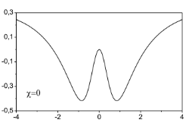
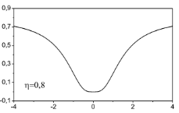
Critical Hamiltonians $H_{0}$
C1
C2
... to be compared with the Harmonic Oscillator
$$E$$
+ random perturbation $V$
(averaged over the whole ensemble of interactions $V$)
5

Slide 11
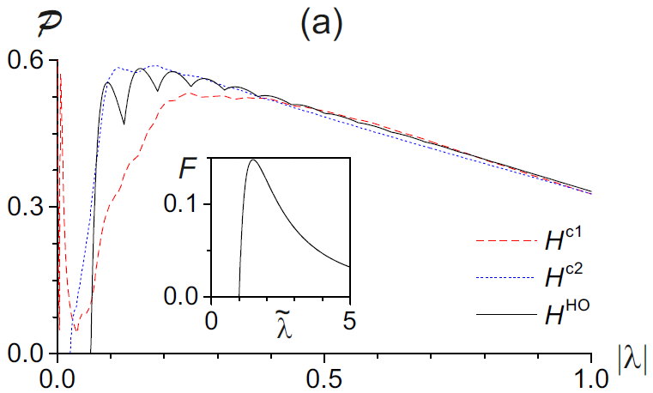
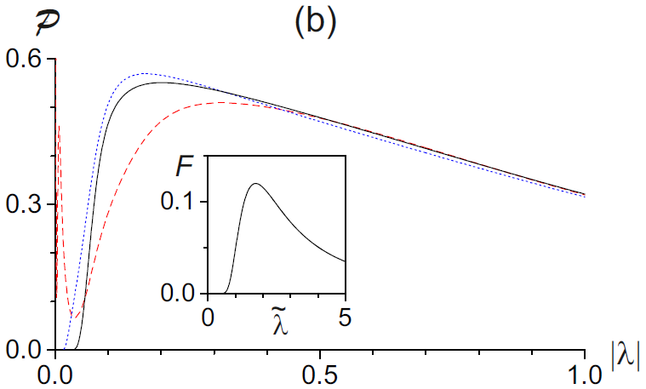
Diagonal perturbation
- corresponds to perturbations preserving all the symmetries of the original Hamiltonian
$$E$$
real crossings
λ
$$V=\left(\begin{matrix}R\left(0,σ^{2}\right) & ⋯ & 0 \\ ⋮ & ⋱ & ⋮ \\ 0 & ⋯ & R\left(0,σ^{2}\right)\end{matrix}\right)$$
$$V=\left(\begin{matrix}N\left(0,σ^{2}\right) & ⋯ & 0 \\ ⋮ & ⋱ & ⋮ \\ 0 & ⋯ & N\left(0,σ^{2}\right)\end{matrix}\right)$$
EP distribution can be calculated analytically
$σ^{2}$ fixed so that it is comparable with the variance of $H_{0}$ spectrum
Sharp peak at small $\left|λ\right|$
EPs shifted towards smaller $|λ|$
6
$$d=16$$
Notes:
R(0,sigma^2) – a number with uniform distribution on [-sqrt(3)*sigma, +sqrt(3)*sigma]

Slide 12
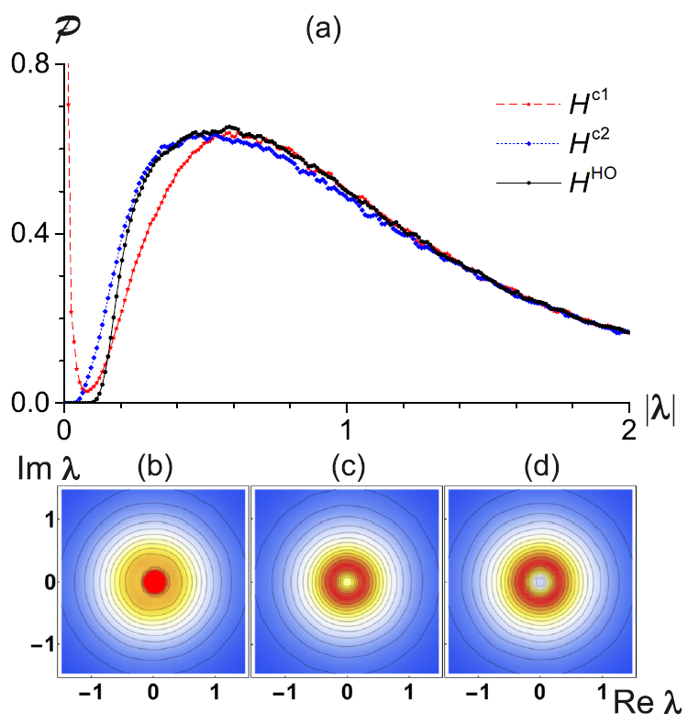
GOE perturbation
$$V=\left(\begin{matrix}N\left(0,{2σ}^{2}\right) & ⋯ & N\left(0,σ^{2}\right) \\ ⋮ & ⋱ & ⋮ \\ N\left(0,σ^{2}\right) & ⋯ & N\left(0,2σ^{2}\right)\end{matrix}\right)∈GOE$$
eigenbasis = random rotation of the unperturbed basis
C1
C2
HO
EP distribution in the complex $λ$ plane is rotationally symmetric around the origin $λ=0$
B. Shapiro, K. Zarembo,
J. Phys. A: Math. Theor. 50, 045201 (2017)
7
$d=16$, $∼{10}^{6}$ EPs

Slide 13
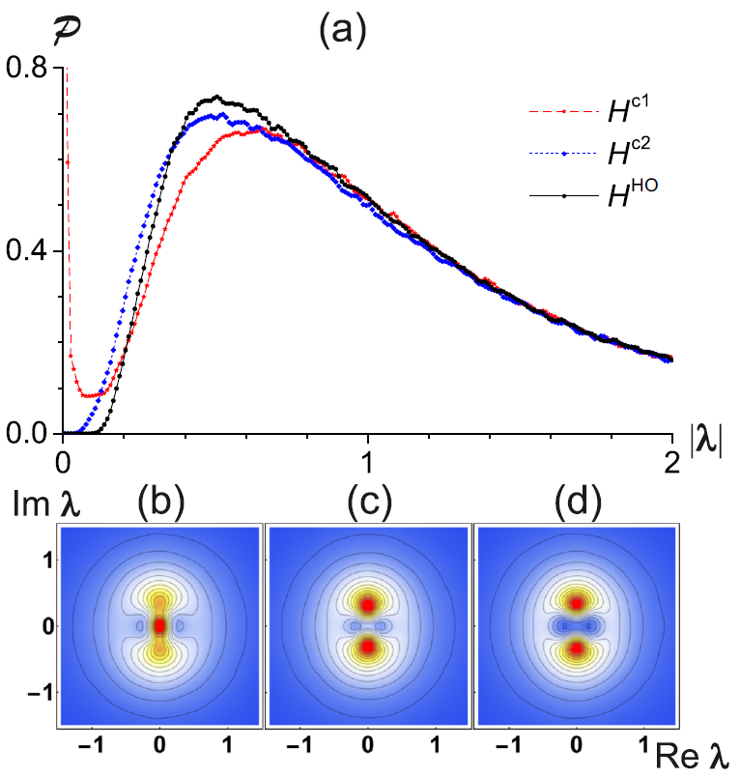
Off-diagonal perturbation
$$V=\left(\begin{matrix}0 & ⋯ & N\left(0,σ^{2}\right) \\ ⋮ & ⋱ & ⋮ \\ N\left(0,σ^{2}\right) & ⋯ & 0\end{matrix}\right)$$
iInitial symmetries are violated in a maximal way
Expected results partly similar to the matrices from $GUE$
Small $\left|λ\right|$ behaviour similar with the diagonal and GOE perturbation
C1
C2
HO
EPs the furthest from the real axis
8
$d=16$, $∼{10}^{6}$ EPs
Notes:
probability of conserving the unperturbed basis is zero

Slide 14
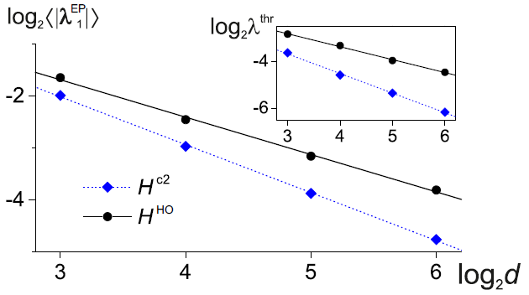
Scaling with matrix dimension $d$
Ensemble average of the distance of the closest EP from the origin
Distance of the closest EP from the origin in an ensemble of ${10}^{6}$ generated EPs
Power-law behaviour $d^{−c}$, where $c$ is higher for the critical Hamiltonian
9

Slide 15
Conclusions
1st order QPT
2nd order QPT
Ground-state affected by several EPs located at comparable distances from the real axis.
Connected with a single pair of EPs.
Exponential
Algebraic
convergence of the EPs to the real axis when the system’s size grows
accumulation of the EPs near $λ=0$ when the system is arbitrarily perturbed
EP distribution represents a strong signature of quantum criticality allowing us to discriminate between the first- and higher-order critical Hamiltonians
EP distribution may have consequences for the superradiance phenomenon in open quantum systems (work in progress)
P. Stránský, M. Dvořák, P. Cejnar, Physical Review E 97, 012112 (2018)
Thanks for your attention
Notes:
Open question: relation between thermal phase transitions and ESQPT in EPs
Open systems

Slide 17
Resultant $R\left(λ\right)$
$$P\left(E,λ\right)=\det\left[E−H\left(λ\right)\right]=0$$
polynomial of degree $N\left(N−1\right)$
pairs of complex conjugate roots
no roots on the real axis
$$Q\left(E,λ\right)=\frac{∂P\left(E,λ\right)}{∂E}=0$$
Notes:
Open question: relation between thermal phase transitions and ESQPT in EPs
Open systems

Slide 18
$σ^{2}$ adjustment
$$D_{H}=\frac{1}{d−1}\sum_{n=1}^{d}{{\left|E_{n}−M_{E}\right|}^{2}}=\frac{Tr HH^{+}}{d−1}−\frac{Tr H Tr H^{+}}{d\left(d−1\right)}$$
quadratic spread of the spectrum $E_{n}$
characterizes an average diameter of the cloud of complex eigenvalues
$$M_{H}=\frac{1}{d}\sum_{n=1}^{d}{E_{n}}=\frac{Tr H}{d}$$
- center of mass of the spectrum
HO: $\sqrt{D_{E}}≈\frac{ωd}{\sqrt{12}}$, $E_{n}=ωn$
C2: $\sqrt{D_{E}}≈\frac{ωd}{\sqrt{11.23}}$, $E_{n}=ωn^{\frac{4}{3}}d^{−\frac{1}{3}}$
$σ^{2}=D_{H(0)}$ for the diagonal perturbation
$σ^{2}=\frac{D_{H\left(0\right)}}{d+2}$ for the GOE perturbation
$σ^{2}=\frac{D_{H\left(0\right)}}{d}$ for the offdiagonal perturbation
$$\left\langle D_{V}\right\rangle =D_{H(0)}$$
Notes:
Open question: relation between thermal phase transitions and ESQPT in EPs
Open systems

Slide 19
Global properties of the spectrum
$$M_{H\left(λ\right)}=M_{H\left(0\right)}+λM_{V}$$
- spectral mean value
$$D_{H\left(λ\right)}=D_{H\left(0\right)}+Reλ\underset{K}{\underbrace{\frac{2d}{d−1}\left[M_{H\left(0\right)V}−M_{H\left(0\right)}M_{V}\right]}}+{\left|λ\right|}^{2}D_{V}$$
- quadratic spread (quadratic dependence on $λ$)
$$Imλ=0$$
parabola with a minimum at $λ_{0}=−\frac{K}{2D_{V}}$
(at this point the spectrum is maximally compressed)
Main structural changes expected for $Δλ≈\sqrt{\frac{D_{H\left(λ_{0}\right)}}{D_{V}}}$ vicinity of $λ_{0}$
Expectation values
$$\left\langle M_{V}\right\rangle =\left\langle K\right\rangle =0$$
$$\left\langle D_{V}\right\rangle =D_{H\left(0\right)}$$
$$\left\langle K\right\rangle =0$$
Notes:
Open question: relation between thermal phase transitions and ESQPT in EPs
Open systems

