Slide 1
Excited-State Quantum Phase Transitions
in nuclei and beyond
Pavel Stránský
Institute of Particle and Nuclear Physics
Charles University in Prague
Czech Republic
Institute of Nuclear Physics, Tashkent
21th September 2018

Slide 2
Outline
What is QPT and ESQPT
ESQPT: Theory
QPT: Evidence in Nuclei
ESQPT: Nuclear models
ESQPT: Numerical study on schematic models
(ESQPT: Thermodynamical consequences)
Summary

Slide 3
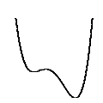
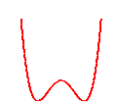
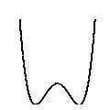
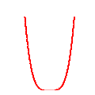
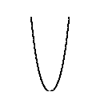
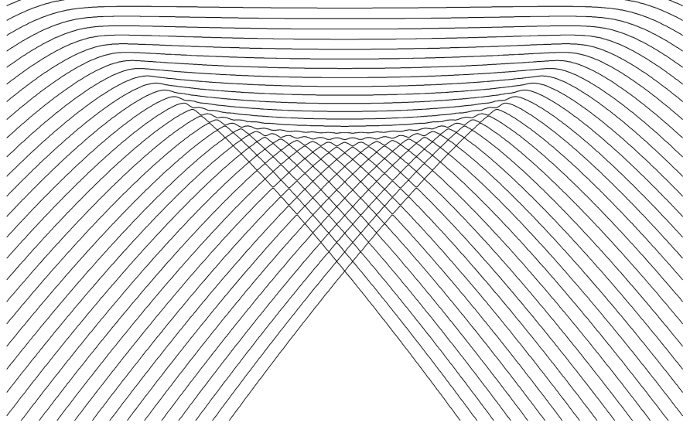
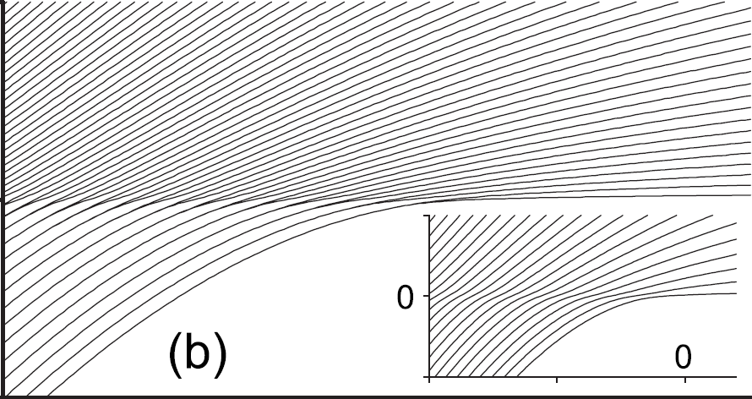
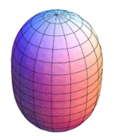
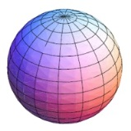
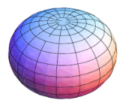
Quantum phase transition (QPT)
A nonanalytic change (in the infinite-size limit) of ground-state properties of a system by varying an external control parameter λ at absolute zero temperature (only quantum fluctuations present)
Schematic example
evolution of the potential-wells
E
first-order
continuous(n^{th} order)
λ
λ
Systems with QPT:
shape-phase transition in nuclei
ferromagnet-paramegnet transitions
insulator-superfluid transitions
...
S. Sachdev, Quantum Phase Transitions (2011)
L.D. Carr, Understanding Quantum Phase Transitions (2011)

Slide 4
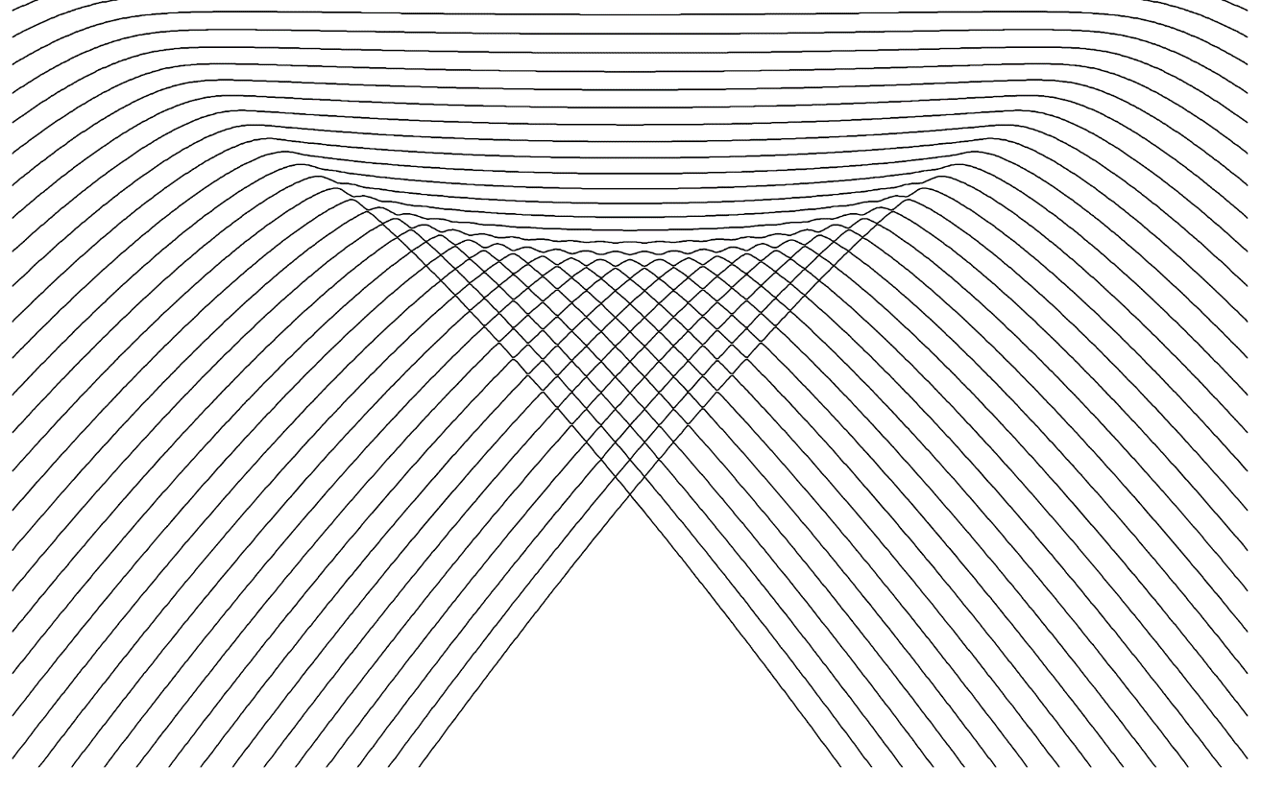
Excited-state quantum phase transition
Generalization of the QPTs for the excited spectra
(ESQPT)
a) discontinuity in the smooth level density ρ
critical borderlines
E
b) discontinuity in the average level flow rate φ
a)
b)
λ
ESQPT’s effect is best visible in averaged quantities characterizing bundles of energy levels in individual level themselves
M.A. Caprio, P. Cejnar, F. Iachello, Ann. Phys. 323, 1106 (2008)
P. Cejnar, P. Stránský, Phys. Rev. E 78, 031130 (2008)

Slide 5
ESQPT
Theory

Slide 6
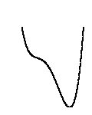
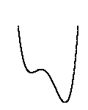
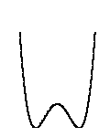
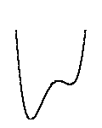
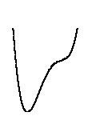
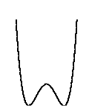
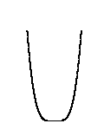
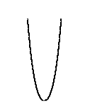
Manifestations of ESQPTs
Hamiltonian
analytic function on the phase space $x=\left(p,q\right)$
f degrees of freedom
energy surfaces
E
x
E
λ
λ
Interesting behaviour expected at energies of the Hamiltonian stationary points
Critical borderlines correspond with the positions of local extremes in the constant-energy surfaces

Slide 7
a) Level density
oscillatory component
(semiclassically given by the Gutzwiller trace formula; not relevant here in the infinite-size limit)
smooth component
(Weyl formula)
volume function
of the classical phase space
Numerical approximation
I. Hoveijn, J. Math. Anal. Appl. 348, 530 (2008)
M. Kastner, Rev. Mod. Phys. 80, 167 (2008)

Slide 8
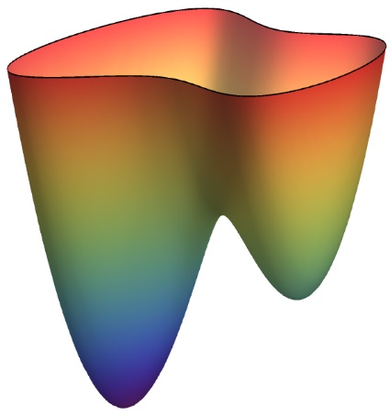
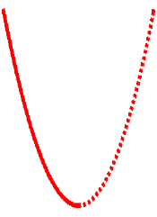
Level density: Nondegenerate stationary point w
Morse lemma
energy surface
Approximation of the Hamiltonian with a quadratic function in the vicinity of w
index r of the stationary point
E
ε
w
local volume integral
y₂
x₂
x₁
y₁
local coordinates
r = 0
r > 0
P. Stránský, P. Cejnar, Phys. Lett. A380, 2637 (2016)

Slide 9
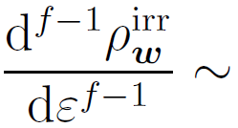
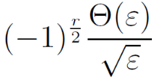
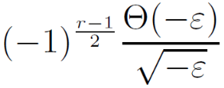
Nondegenerate stationary point: singularities
f integer
f half-integer
(relevant for lattices and time-dependent Hamiltonian systems)
r even
r odd
r even
r odd
[f-1]-th derivative
logarithmic divergence
inverse sqrt
jump
E_{w}
E
E_{w}
E
E_{w}
E
E_{w}
E
Each singularity of the level density at a nondegenerate stationary point is uniquely classified by the two numbers (f,r)
P. Stránský, P. Cejnar, Phys. Lett. A380, 2637 (2016)

Slide 10
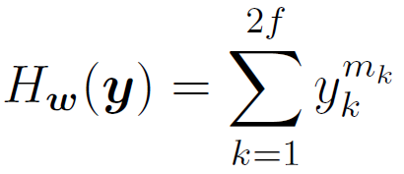
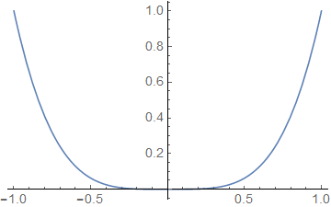
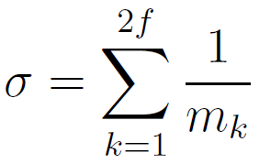
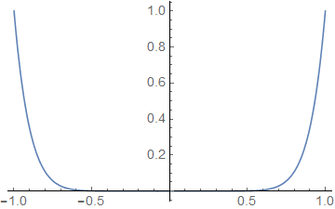
Level density: Degenerate stationary point
Special class of separable Hamiltonians (flat minimum):
(analytic only for m_{k} even integer)
- discontinuity in the$\left\lceil σ−1\right\rceil$-th derivative
Example: We require discontinuity of the t-th derivative
- satisfied when
even in the thermodynamic limit
the level density can be discontinuous
Higher flatness of the stationary point enhances its signatures in the spectrum (it shifts the singularity towards lower derivatives).

Slide 11
Level density: Degenerate stationary point
Special class of separable Hamiltonians (flat minimum):
(analytic only for m_{k} even integer)
Structural stability
- an arbitrarily small perturbation converts any function into a Morse function:
- discontinuity of the -th derivative
Example 1: We require discontinuity of the t-th derivative
- satisfied when
flat minimum
quadratic minimum
even in the thermodynamic limit
the level density can be discontinuous
M. Kastner, Rev. Mod. Phys. 80, 167 (2008)
Higher flatness of the stationary point enhances its signatures in the spectrum (it shifts the singularity towards lower derivatives).

Slide 12
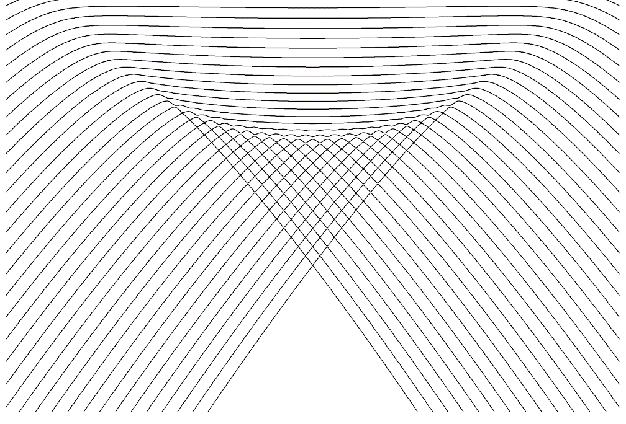
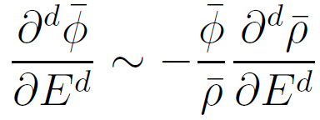
b) Level flow rate
E
($≡$position)
trajectories of individual levels – flow lines
Continuity equation
derivatives
λ ($≡$time)
Using Hellmann-Feynman formula, the flow rate can be expressed as
We expect the same nonanalyticity in the flow rate as in the level density
- weighted average of the quantum expectation value of $H_{I}(x)$ in the eigenstates around energy $E$
- experimentally more important than the level density itself
P. Stránský, M. Macek, P. Cejnar, Ann. Phys. 345, 73 (2014)
P. Stránský, P. Cejnar, Phys. Lett. A380, 2637 (2016)

Slide 13
QPT:
Experimental evidence in nuclei

Slide 14
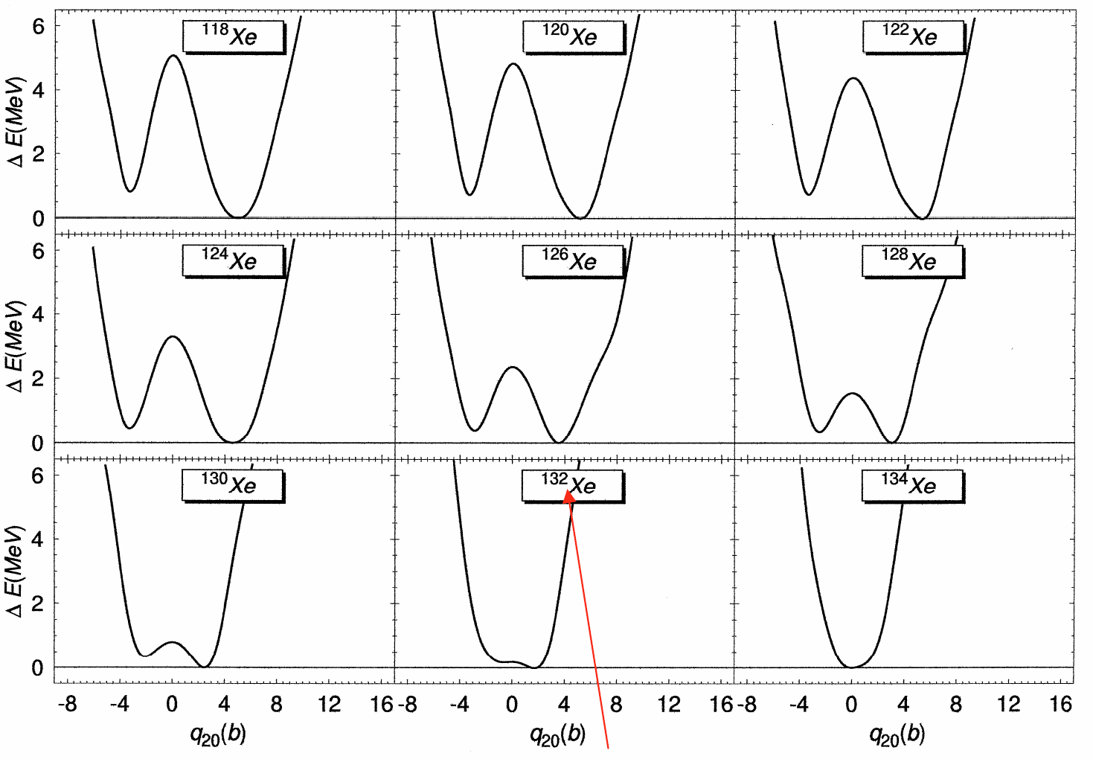
Potential energy curves (surfaces)
- self-consistent Hartree-Fock-Bogoliubov approximation based on Gogny interaction (D1S)
$$β$$
$$β$$
$$β$$
critical nucleus
L.M. Robledo, R.R. Rodríguez-Guzmán, P. Sarrigueren, Phys. Rev. C 78, 034314 (2008)

Slide 15
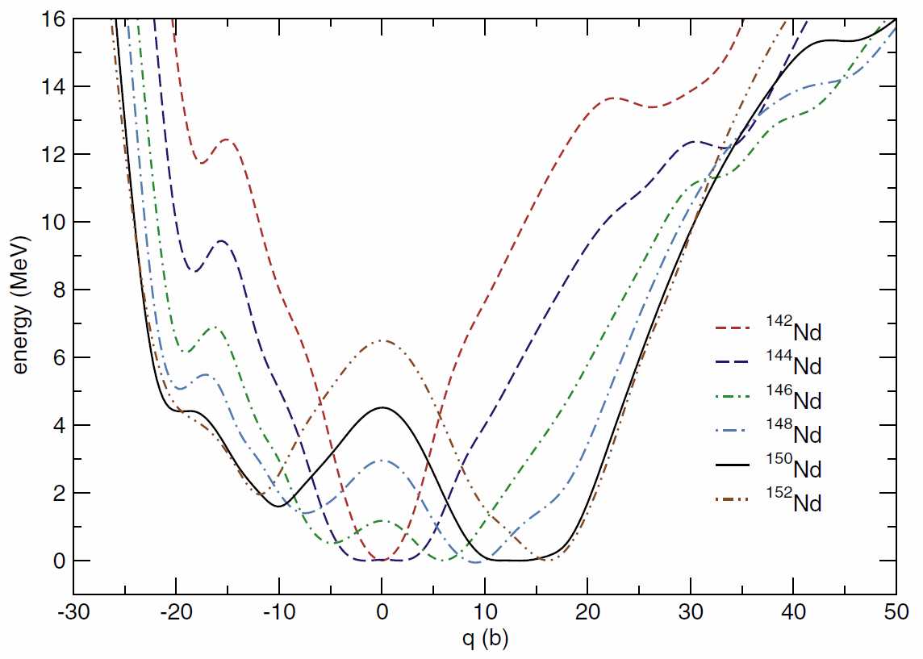
Potential energy curves (surfaces)
- self-consistent Relativistic Mean Field
T. Nikšić, D. Vretenar, G.A. Lalazissis, P. Ring, Phys. Rev. Lett. 99, 092502 (2007)

Slide 16
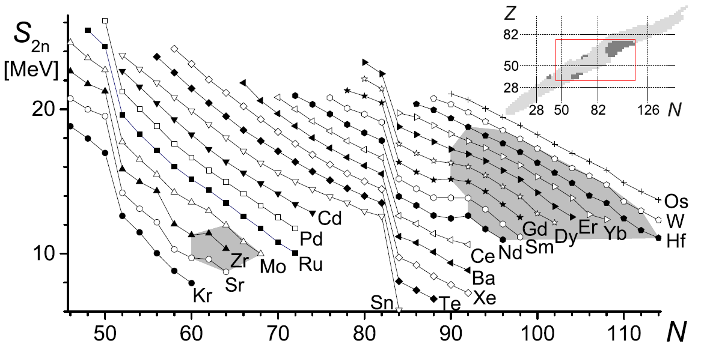
Two-neutron separation energies
$$S_{2n}\left(N,Z\right)=E\left(N−2,Z\right)−E\left(N,Z\right)+2M_{n}$$
spherical nuclei
deformed nuclei
Semi-empirical condition for the onset of deformation: $\frac{NZ}{5}−N−Z≥0$
P. Cejnar, J. Jolie, R.F. Casten, Rev. Mod. Phys. 82, 2155 (2010)
P. Cejnar, P. Stránský, Phys. Scr. 91, 083006 (2016)

Slide 17
ESQPT:
Models and numerical evidence

Slide 18
1. Lipkin(-Meshkov-Glick) model
H.J. Lipkin, N. Meshkov, A.J. Glick, Nucl. Phys. 62, 188 (1965)
N. Meshkov, A.J. Glick, H.J. Lipkin, Nucl. Phys. 62, 199 (1965)
A.J. Glick, H.J. Lipkin, N. Meshkov, Nucl. Phys. 62, 211 (1965)
2 levels with capacity $N$
$N$ interacting fermions
$$J_{z}=\frac{1}{2}\sum_{i=1}^{N}{a_{i+}^{+}a_{i+}−a_{i−}^{+}a_{i−}}$$
SU(2) algebra
$$J_{+}=\sum_{i=1}^{N}{a_{i+}^{+}a_{i−}}$$
$$J_{−}={\left(J_{+}\right)}^{+}$$
Quasispin $J$ is conserved
$$H\left(η,χ\right)=η\left(\frac{N}{2}+J_{z}\right)−\frac{1−η}{N}\left[J_{+}+J_{−}+χ{\left(\frac{N}{2}+J_{z}\right)}^{2}\right]$$
We shall consider only $J=\frac{N}{2}$ subspace – 1 degree of freedom
J. Vidal, J.M. Arias, J. Dukelsky, J.E. García-Ramos, Phys. Rev. C 73, 054305 (2006)

Slide 19
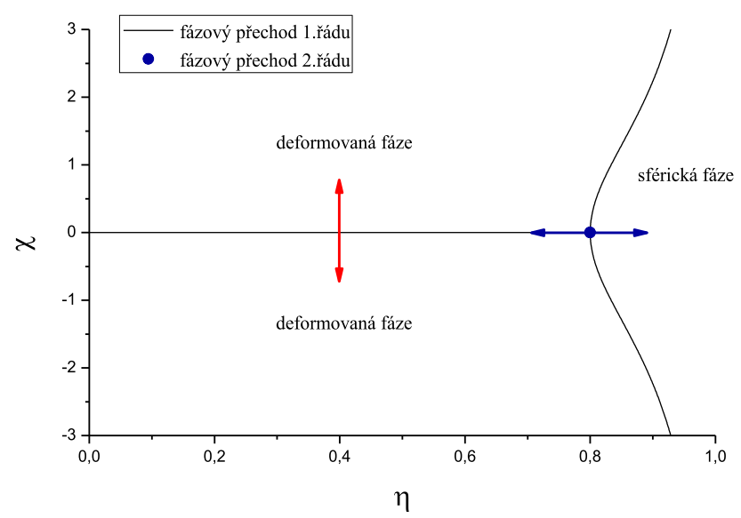
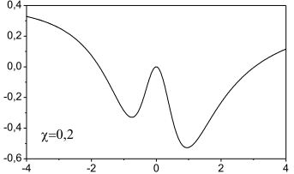
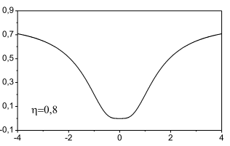
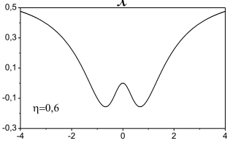
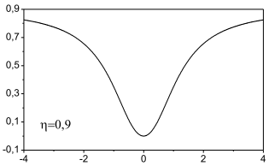
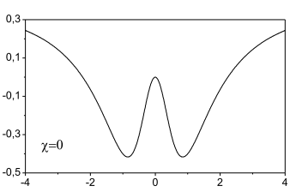
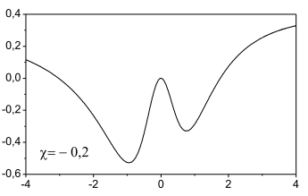
Phase structure
$$\frac{4+χ^{2}}{5+χ^{2}}$$
P
DEFORMED phase
(1,1)
$$V$$
(1,0)
$$x$$
$$V$$
1st order QPT
2nd order QPT
SPHERICAL phase
$$x$$
DEFORMED phase

Slide 20
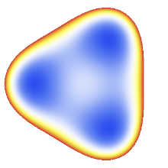
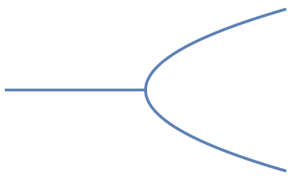
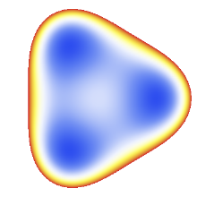
2. Geometric Collective Model (GCM)
$$R\left(t\right)=R_{0}\left(1+\sum_{λ=0}^{∞}{α_{λμ}^{∗}\left(t\right)Y_{λμ}}\right)$$
- multipole expansion of nuclear surface
Quadrupole deformations $λ=2$
- Bohr Hamiltonian with
Gneuss-Mosel-Greiner potential
$$H=T+V=\frac{K}{2}\sqrt{5}{\left[π×π\right]}^{\left(0\right)}+…+A\sqrt{5}{\left[α×α\right]}^{\left(0\right)}−B\sqrt{\frac{35}{2}}{\left[{\left[α×α\right]}^{\left(2\right)}×α\right]}^{\left(0\right)}+5C{\left({\left[α×α\right]}^{\left(0\right)}\right)}^{2}+…$$
$(α,π)$: Canonically conjugated quadrupole tensors
collective coordinates (2 shape parameters, 3 Euler angles) momenta
$K, A,B,C$: adjustable parameters
Principal Axes System (PAS)
Phase structure
$$T=T_{rot}+T_{vib}$$
(2,1)
(2,2)
$$B$$
Focus on the nonrotating case J = 0!
$$V=Aβ^{2}+Bβ^{3}\cos{3γ}+Cβ^{4}$$
0
$x=β\cos{γ=Re α_{0}{\left.​\right|}_{PAS}}$
$y=β\sin{γ=\sqrt{2} Re α_{±2}{\left.​\right|}_{PAS}}$
$f=2$ degrees of freedom
$$A$$
G. Gneuss, U. Mosel, W. Greiner, Phys. Lett. 30B, 397 (1969)

Slide 21
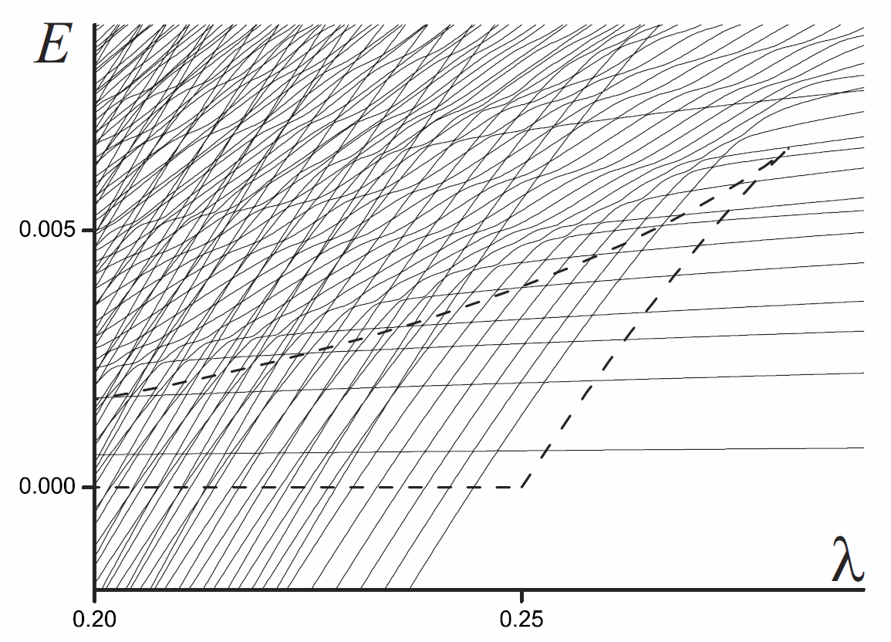
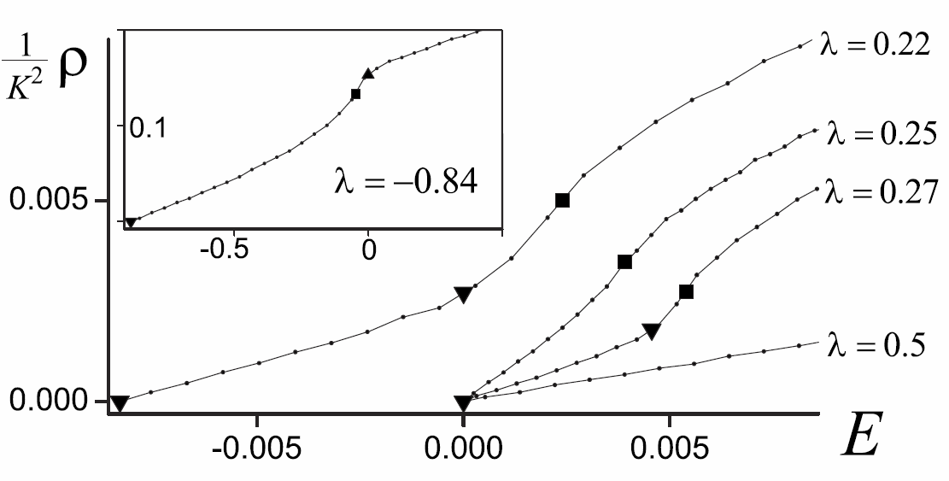
GCM:
Level dynamics
$$λ≡A$$
$$B=1$$
$$λ=0.22$$
$$λ=0.25$$
(2,0) minimum
$$λ=0.27$$
(2,1) saddle
(2,2) local maximum
P. Cejnar, P. Stránský, Phys. Rev. E 78, 031130 (2008)

Slide 22
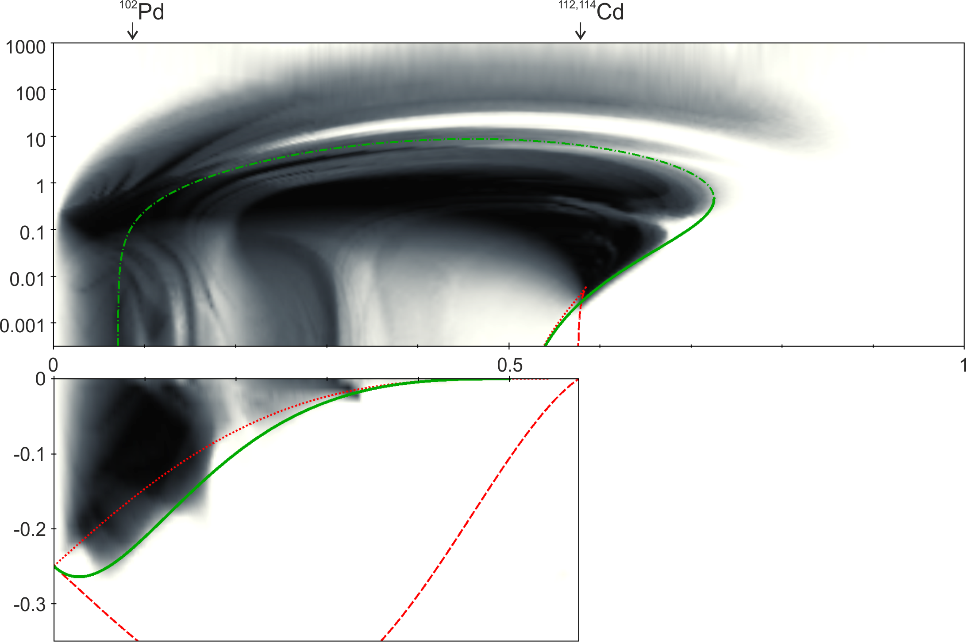
Digression: chaos in the GCM
integrable
deformed spherical
integrable
(mexican hat)
regular “veins”
chaos
phase transition
valley of stability
regularity
$$λ$$
global / local potential minimum (2,0)
saddle point (2,1)
border of stability E_{c}
Very rich dynamics encoded in a simple Hamiltonian
regularity
P. Stránský, P. Hruška, P. Cejnar, Phys. Rev. C 79, 046202 (2009)
P. Stránský, P. Cejnar, J. Phys. A: Math. Theor. 48, 125102 (2015)

Slide 23
3. Interacting Boson Model (IBM)
$$H=\sum_{ij}{u_{ij}b_{i}^{+}b_{j}+\sum_{ijkl}{v_{ijkl}b_{i}^{+}b_{j}^{+}b_{k}b_{l}}}$$
$$b_{i}^{+}=\left\{\begin{matrix}s^{+} \\ d_{μ}^{+} \end{matrix}\right.$$
s-boson $\left(l=0\right)$
d-bosons $\left(l=2\right)$
nucleon pairs with l=0,2
quanta of collective excitations
Dynamical symmetry group
$U(6)$with 36 generators $G_{ij}=b_{i}^{+}b_{j}$
$SO(3)$ invariance of the Hamiltonian (angular momentum conservation)
total number of bosons is conserved: $\left[N,H\right]=0$, $N=\sum_{i=1}^{6}{G_{ii}}$
Group chains
$$U\left(6\right)⊃\left\{\begin{matrix}U(5)⊃O(5) \\ O(6)⊃O(5) \\ SU(3)\end{matrix}\right\}⊃SO\left(3\right)$$
vibrational
γ-unstable
nuclei
rotational
$SO\left(3\right)$-invariant Hamiltonian constructed from Casimir invariants of the subgroups
F. Iachello, A. Arima, The Interacting Boson Model (Cambridge University Press, Cambridge, 1987)

Slide 24
Consistent-Q Hamiltonian
$$H=\frac{η}{N}n_{d}−\frac{1−η}{N^{2}}Q\left(χ\right)⋅Q(χ)$$
$$n_{d}=d^{+}⋅\tilde{d}$$
- d-boson number operator
$$Q_{μ}\left(χ\right)=s^{+}{\tilde{d}}_{μ}+d_{μ}^{+}s+χ{\left[d^{+}×d\right]}^{\left(2\right)}$$
- quadrupole operator
Phase structure
Semiclassical Hamiltonian
(using coherent states)
$$O(6)$$
$$H\left(η,χ\right)=\frac{1}{2}\left[η+2\left(1−η\right)β^{2}\right]\left(β^{2}+T\right)−2\left(1−η\right)β^{2}−\frac{2χ\left(1−η\right)}{\sqrt{7}}\sqrt{1−\frac{β^{2}+T}{2}}\left[\left(\frac{p_{γ}^{2}}{β}−βp_{β}^{2}−β^{3}\right)cos 3γ+2p_{β}p_{γ}\sin{3γ}\right]−\frac{{4χ}^{2}\left(1−η\right)}{7}\left[\frac{{\left(β^{2}+T\right)}^{2}}{8}−\frac{p_{γ}^{2}}{2}\right]$$
$$0$$
$$0$$
$$χ$$
$$η$$
$$−\frac{\sqrt{7}}{2}$$
QPT
$$1$$
$$T=p_{β}^{2}+\frac{p_{γ}^{2}}{β^{2}}$$
$f=2$ degrees of freedom
$$SU(3)$$
$$U(5)$$
Casten triangle

Slide 25
ESQPT behaviour is universal:
Let’s study it in simpler models with the same $(f,r)$

Slide 26
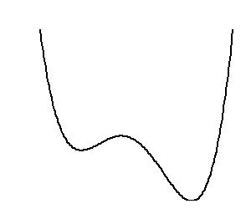
CUSP and related systems
2 ESQPTs (if )
E
(1,1)
(1,0)
P. Cejnar, P. Stránský, Phys. Rev. E 78, 031130 (2008)
P. Stránský, M. Macek, P. Cejnar, Ann. Phys. 345, 73 (2014)
x
Creagh-Whelan 2D model
E
(2,1)
nonintegrable (if $B≠0≠C$)
phase structure identical with a single CUSP
y
(2,0)
x
P. Stránský, M. Macek, P. Cejnar, Ann. Phys. 345, 73 (2014)
P. Stránský, M. Macek, A. Leviatan, P. Cejnar, Ann. Phys. 356, 52 (2015)
Triple CUSP model
3
Separable combination of three CUSP systems
P. Stránský, P. Cejnar, Phys. Lett. A380, 2637 (2016)

Slide 27
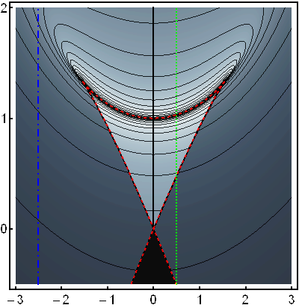
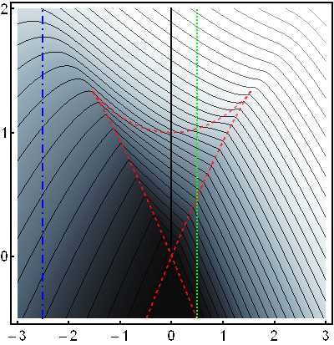
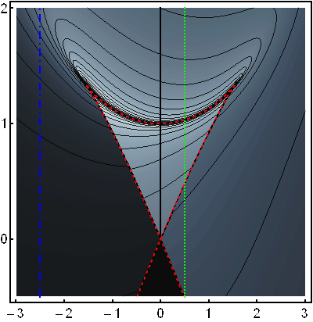
Level density
CUSP model
Creagh-Whelan model
E
level density
B = 30, C=D=20
1st derivative
E
E
λ
0
0.5
-2.5
λ
λ
λ
(1,1)
(2,1)
(1,0)
(2,0)

Slide 28
Flow rate (CUSP system)
vanishes due to the potential symmetry
(1,1)
approximately 0
(1,0)
positive (levels rise)
negative (levels fall)
Singularly localized wave function at the top of the local maximum with
Both minima accessible – the wave function is a mixture of states localized around and
Hellmann-Feynman formula
The wave function localized around the global minimum

Slide 29
Flow rate (Creagh-Whelan system)
flow rate
energy derivative of the flow rate
(2,1)
The singularities of the flow rate are of the same type as for the level density
(2,0)

Slide 30
3. Triple CUSP model
Level density
Flow rate
f=3 degrees of freedom
Due to the continuity equation
27 stationary points:
8x
12x
6x
1x
(3,0) minimum
(3,1) saddle 1
(3,2) saddle 2
(3,3) maximum
↑ jump
↑ log div
↓ jump
↓ log div
Singularities expected in the 2nd derivative of the level density and flow rate
singularities in φ of the same type as in ρ (except for the sign)

Slide 31
ESQPT
Thermal properties

Slide 32
Infinite-size limit of systems with finite f
Illustrative example: Array of trapped spin$=\frac{1}{2}$ sites
...
$N_{a}$ atoms in each site
$N_{s}$ sites
Size parameter: $N=N_{a}N_{s}$
Assumption:
The interaction is such that the total spin of each site is conserved in its maximum value $\frac{N_{a}}{2}⟶$ strong collective behaviour
Limits:
Classical limit $N_{a}→∞$
Thermodynamic limit $f=N_{s}→∞$
Interacting Boson Model of atomic nuclei
- b bosons (of the type s or d) – quasiparticles, generating a U(6) algebra (f = 5)
- 3 degrees of freedom are always separated (conserving angular momentum)
- $N_{a}=b$ (dimension of the irreducible representation of the U(6) algebra)

Slide 33
Microcanonical thermodynamics
- inverse temperature
partition function
- thermal distribution
Tripple CUSP system
$β_{mic}$ - maximum of the thermal distribution $⟶$ microcanonical caloric curve
In systems with nondegenerate SP not defined for $f≤3$
- heat capacity
- nonanalytic behavior again
P. Cejnar, P. Stránský, Phys. Lett. A381, 984 (2017)

Slide 34
Heat capacity
separable system
Microcanonical
Canonical
- smooth regular function of $β$ irrespective of ESQPT
CUSP + (f-1) x HO
(3 stationary points)
f x CUSP
(3^{f} stationary points)
f=3
f=4
f=3
f=4
f=5
f=15
f=5
f=15
canonical
microcanonical

Slide 35
Evidence of ESQPTs in the literature
O(6)-U(5) transition in the Interacting Boson Model
2-level fermionic pairing model
Geometric collective model of atomic nuclei
Graphene
(ESQPT experimentally observed)
Lipkin model
2-level pairing models
s-boson condensate
M.A. Caprio, P. Cejnar, F. Iachello,
Annals of Physics 323, 1106 (2008)
P. Pérez-Fernández, A. Relaño, J.M. Arias, J. Dukelsky, J.E. García-Ramos, Phys. Rev. A 80, 032111 (2009)
s+d-bosons condensate
B. Dietz, F. Iachello, M. Miski-Oglu, N. Pietralla, A. Richter, L. von Smekal, and J. Wambach, Phys. Rev. B 88, 104101 (2013)
P. Pérez-Fernández, P. Cejnar, J.M. Arias, J. Dukelsky,
J.E. García-Ramos, A. Relaño, Phys. Rev. A 83, 033802 (2009)
P. Cejnar, P. Stránský, Phys. Rev. E 78, 031130 (2008)
M.A. Caprio, J.H. Skrabacz, F. Iachello, J. Phys. A 44, 075303 (2011)
P. Cejnar, M. Macek, S. Heinze, J. Jolie, J. Dobeš, J. Phys. A: Math. Gen. 39, L515 (2006)

Slide 36
Summary
ESQPTs originate in stationary points of the Hamiltonian and manifest themselves as singularities in the smooth level density and in the average flow rate.
Nondegenerate stationary points
Singularities classified uniquely and completely by two numbers $(f,r)$
Singularities occur in the $\left\lceil f−1\right\rceil$-th derivative of the smooth level density or flow rate and are always of a jump / logarithmic divergence type
Degenerate stationary points
Higher flatness of the stationary point shifts the discontinuity towards lower derivatives
Thermodynamics
Low-$f$ systems exhibit considerable differences between the canonical and microcanonical heat capacities even in the limit $N→∞$.
$C_{mic}$ cannot be properly defined for $f≤3;$ for higher $f$ exhibit singularities originated in the ESQPT nonanalyticity of the level density.
ESQPTs and thermal phase transitions are complementary form of criticality, existing in different asymptotic regimes of $N$ and $f$, respectively.
Thank you for attention

Slide 37
3. Finite-size effects
P. Stránský, M. Macek, A. Leviatan, P. Cejnar, Annals of Physics 356, 57 (2015)
Notes:
Přidat referenci ESQPT2

Slide 38
Separable system
Level density given by a convolution
Model
Creagh-Whelan with B=C=0:
Harmonic oscillator
E_{x}
ρ_{x}(E_{x})ρ_{y}(E_{y})

Slide 39
The level dynamics is a superposition of shifted 1D CUSP-like critical triangles
Imbalanced system
D = 40
the time scale significantly differs in each degree of freedom
E
Rigidity
(ratio of the mean level spacing in each direction) much bigger or smaller that one
Smoothing
σ can be chosen in such a way that it is big enough
to smooth the level density in one degree of freedom and keep the oscillatory part in the other
λ
E
finite-size effect
λ

Slide 40
Nonintegrable system – Partial separability
Classical dynamics
fraction of regularity
E
- Creagh-Whelan system
B=0
C=30
D=10
rigidity similar with the separable case
λ

Slide 41
Nonintegrable system – Partial separability
Classical dynamics
fraction of regularity
Poincaré sections
E
p_{x}
p_{x}
x
λ
x
Partially smoothed level density
corresponding patterns
E
λ

Slide 42
Nonintegrable system – Partial separability
Classical dynamics
fraction of regularity
Poincaré sections
E
p_{x}
p_{x}
Level dynamics
x
λ
x
Partially smoothed level density
corresponding patterns
E
λ

Slide 43
Nonintegrable system – Chaos
E
f_{reg}
symmetric case
B=0, C=39, D=1
level dynamics
λ
E
asymmetric case
B=39, 20, D=20
λ
Notes:
Level dynamics

