Slide 1
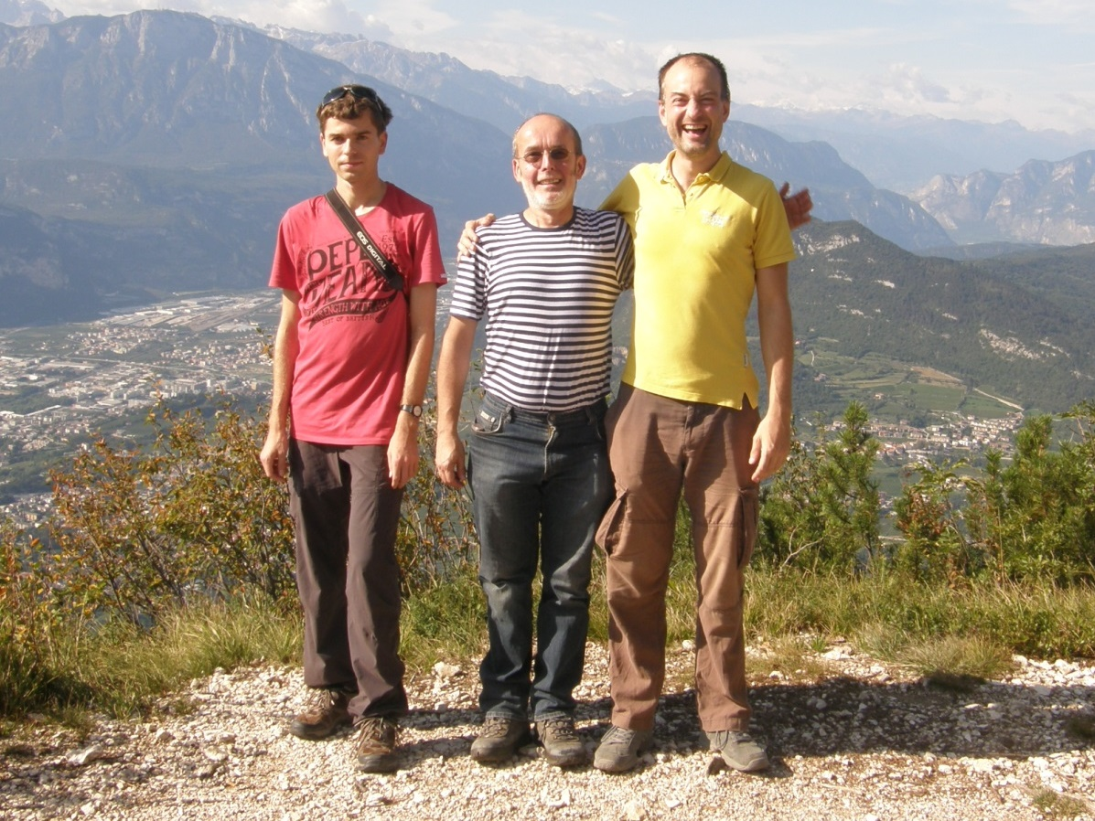
Nonhermitian approach
TO QUANTUM PHASE TRANSITIONS
Published in:
Physical Review E 97, 012112 (2018)
Pavel Stránský
Martin Dvořák, Pavel Cejnar
Institute of Particle and Nuclear Physics
Charles University, Prague
Czech Republic
UNCE Seminar
UNCE/SCI/013
12 December 2018

Slide 2
Outline
Exceptional points (EPs)
Quantum phase transitions (QPTs)
Lipkin model: A simple critical system with both 1st and 2nd order QPTs
EP distribution of randomly perturbed Hamiltonians

Slide 3
Exceptional points
$$H\left(λ\right)=H_{0}+λV$$
$$\left[H_{0},V\right]≠0$$
$$E$$
In a generic situation: no real crossings
$$E_{i}\left(λ\right)≠E_{i+1}\left(λ\right)$$
(energies from the same symmetry subspace)
Avoided crossing theorem
λ
1
Notes:
external field strength
all operators Hermitian

Slide 4
Exceptional points
$$H\left(λ\right)=H_{0}+λV$$
$$\left[H_{0},V\right]≠0$$
$$E$$
In a generic situation: no real crossings
$$E_{i}\left(λ\right)≠E_{i+1}\left(λ\right)$$
(energies from the same symmetry subspace)
Avoided crossing theorem
$$Reλ$$
Nonhermitian extension of the Hamiltonian
$$Im λ$$
Energy levels cross at $\frac{1}{2}n\left(n−1\right)$ complex conjugate pairs of exceptional points$λ^{EP},λ^{EP∗}∈ℂ$
1
Notes:
Complex energy
EP – square-root type of branch points connecting two Riemann sheets
EP distribution symmetric under the complex conjugation
Peculiarity – self-orthogonality and degeneracy of eigenvector at the EP
Ways to find EPs:
Resultant (diskriminant)
Encircling an EP swaps two eigenlevels
Looking for eigenvector degeneracies

Slide 5
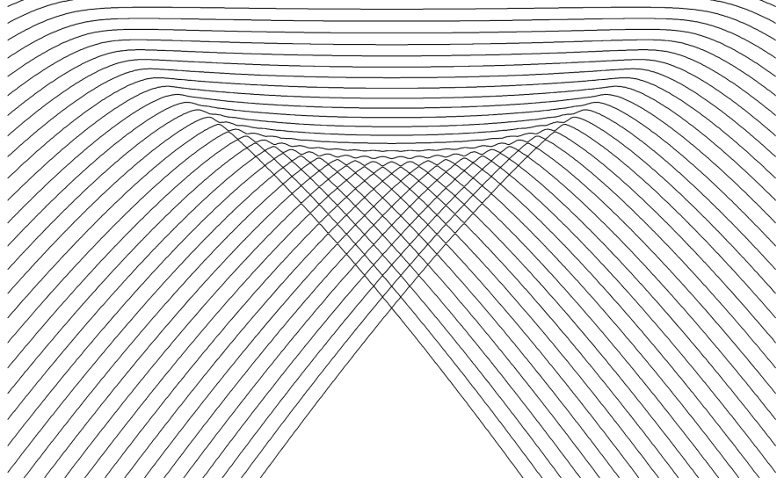
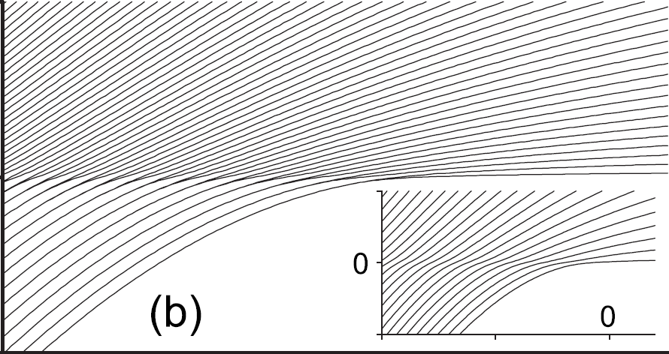
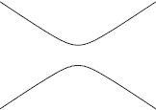
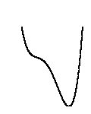
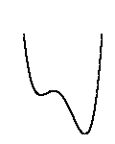
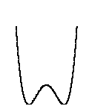
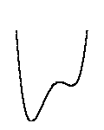
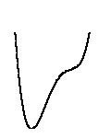
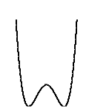
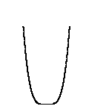
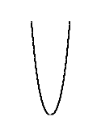
Quantum phase transition (QPT)
Nonanalytic change of the ground state energy $E_{0}\left(λ\right)$ under a continuous change of the control parameter.
1st order QPT
Continuous QPT (2nd order)
Energy level dynamics
E
λ
λ
$$V(q)$$
double-well form of the energy surface
quartic minimum in the energy surface
2
Notes:
Level dynamics
1st vs 2nd order, generic cases (potentials)
Assumptions: Zero temperature, Infinite size of the system

Slide 6
Exceptional points play an important role in the description of QPTs

Slide 7
Lipkin(-Meshkov-Glick) model
H.J. Lipkin, N. Meshkov, A.J. Glick, Nucl. Phys. 62, 188 (1965)
N. Meshkov, A.J. Glick, H.J. Lipkin, Nucl. Phys. 62, 199 (1965)
A.J. Glick, H.J. Lipkin, N. Meshkov, Nucl. Phys. 62, 211 (1965)
2 levels with capacity $N$
$N$ interacting fermions
$$J_{z}=\frac{1}{2}\sum_{i=1}^{N}{a_{i+}^{+}a_{i+}−a_{i−}^{+}a_{i−}}$$
SU(2) algebra
$$J_{+}=\sum_{i=1}^{N}{a_{i+}^{+}a_{i−}}$$
Quasispin $j$ is conserved:
$$\left[H,J^{2}\right]=0$$
$$J_{−}={\left(J_{+}\right)}^{+}$$
Only $j=\frac{N}{2}$ subspace considered – 1 degree of freedom
3
Notes:
Dicke without the photonic field
Various ways to introduce the model:
N interacting fermions on two energy levels
N interacting ½ spin particles
N two level atoms
Two interacting bosons

Slide 8
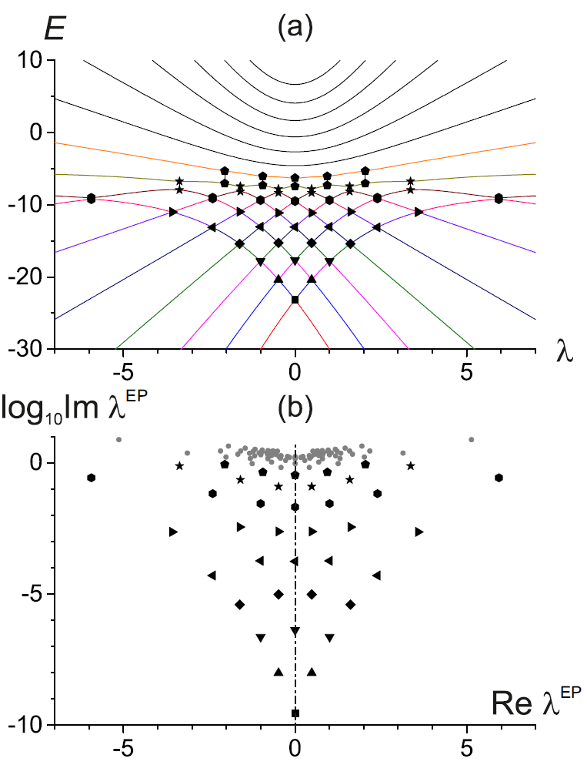
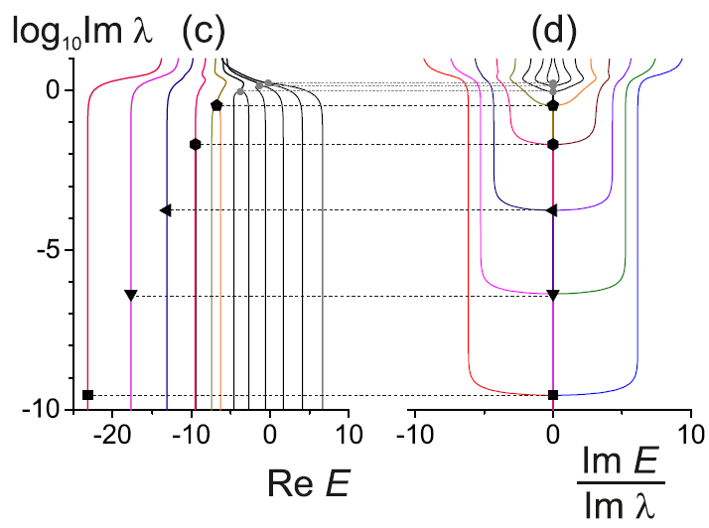
1st order QPT
$$H_{0}=J_{3}−\frac{6}{N}J_{1}^{2}$$
$$V=−J_{1}−\frac{1}{N}\left(J_{1}J_{3}+J_{3}J_{1}\right)$$
potential
$$E$$
$Re E$ merges
$Im E$ diverges
at an individual EP when $Im λ$ increased
deformed$↔$ deformed
4
$$N=15$$
Notes:
Minimal spacing between levels proportional to the distance of the EP from real axis

Slide 9
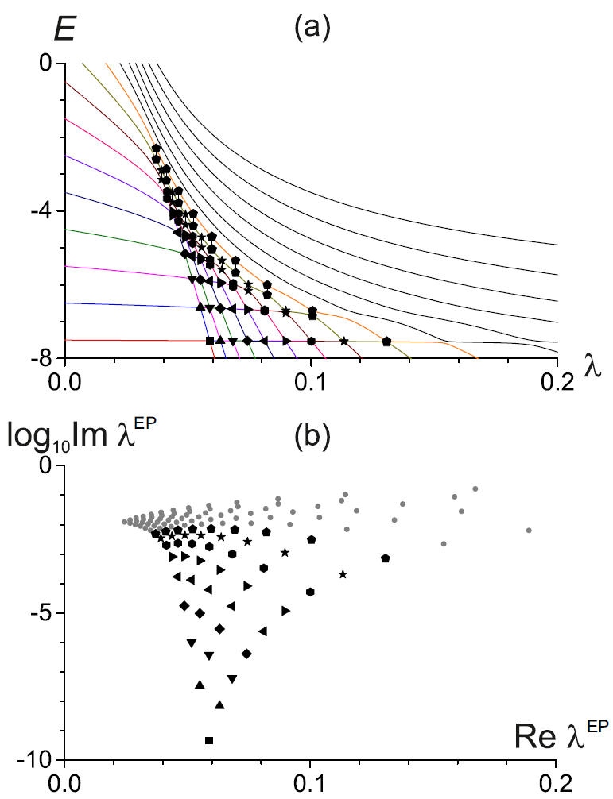
1st order QPT
$$H_{0}=J_{3}−\frac{6}{N}J_{1}^{2}$$
$$V=−J_{1}−\frac{1}{N}\left(J_{1}J_{3}+J_{3}J_{1}\right)$$
$$V=−\frac{1}{N}{\left[J_{1}+4\left(J_{3}+\frac{N}{2}\right)\right]}^{2}$$
$$H_{0}=J_{3}$$
$$x$$
potential
$$x$$
$$E$$
$$E$$
deformed$↔$ deformed
spherical$⟷$ deformed
5
$$N=15$$
Notes:
Parity symmetric vs asymmetric case

Slide 10
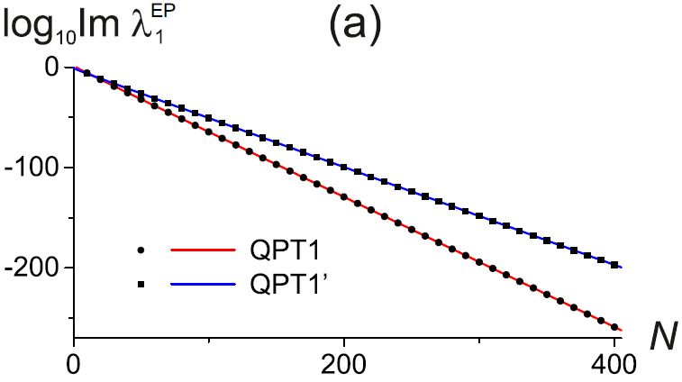
1st order QPT
$$H_{0}=J_{3}−\frac{6}{N}J_{1}^{2}$$
$$V=−J_{1}−\frac{1}{N}\left(J_{1}J_{3}+J_{3}J_{1}\right)$$
$$V=−\frac{1}{N}{\left[J_{1}+4\left(J_{3}+\frac{N}{2}\right)\right]}^{2}$$
$$H_{0}=J_{3}$$
potential
exponential convergence towards the real axis
$$E$$
$$E$$
deformed$↔$ deformed
spherical$⟷$ deformed
5
$$N=15$$
Notes:
Closest EP to the real axis
exponential decrease of the tunelling probability between two wells

Slide 11
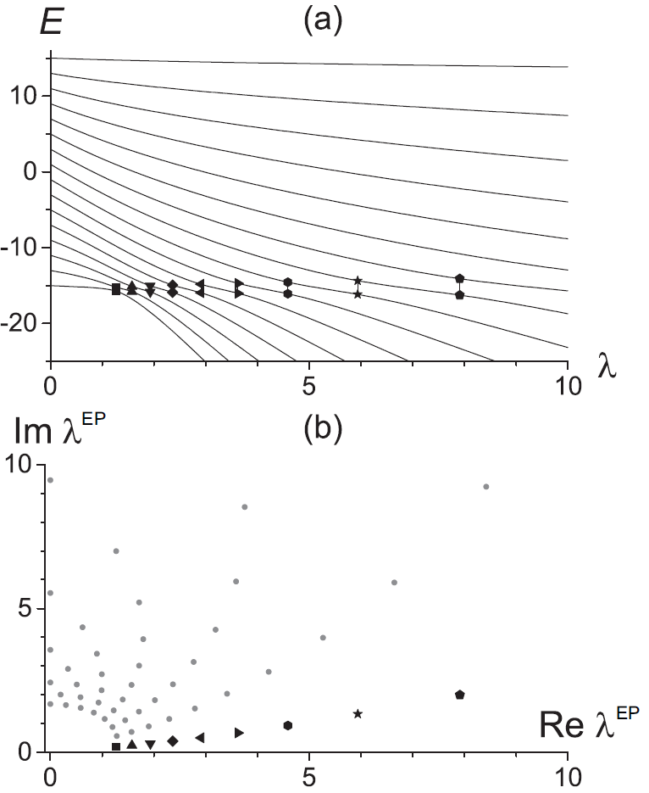
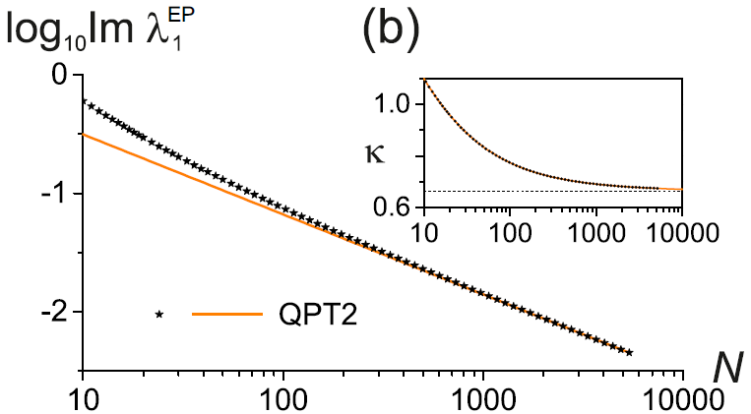
2nd order QPT
$$H_{0}=J_{3}$$
$$V=−\frac{1}{N}J_{1}^{2}$$
algebraic convergence towards the real axis
$$Im λ_{1}^{EP}∼N^{−κ}$$
6
$N=15$ even parity
W.D. Heiss, F.G. Scholz, H.B. Geyer, J. Phys. A: Math. Gen. 38, 1843 (2005)
M. Šindelka, L.F. Santos, N. Moiseyev, Phys. Rev. A 95, 010103 (2017)
Notes:
Impossible to link all avoided crossings between levels with EPs.
Screening
Connection to Yang-Lee zeros of the partition function

Slide 12
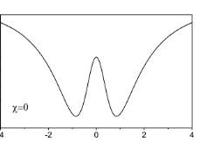
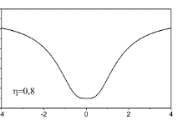
Critical Hamiltonians $H_{0}$
C1
C2
... to be compared with the Harmonic Oscillator
(HO)
$$E$$
+ random perturbation $V$
(averaged over the whole ensemble of interactions $V$)
7

Slide 13
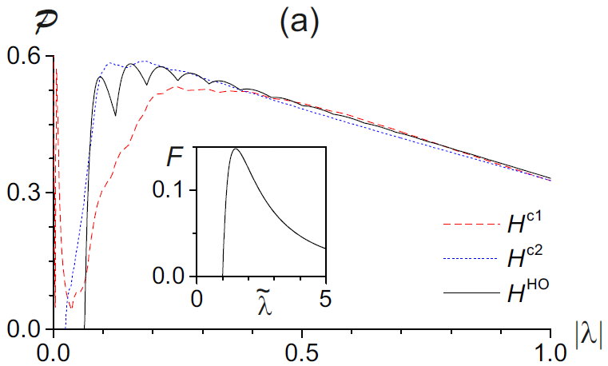
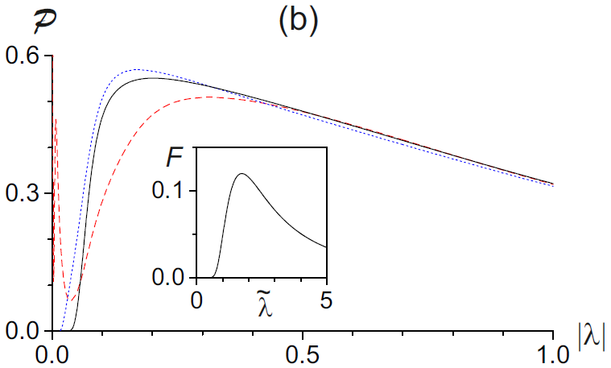
Diagonal perturbation
- corresponds to perturbations preserving all the symmetries of the original Hamiltonian
$$E$$
real crossings
λ
$$V=\left(\begin{matrix}R\left(0,σ^{2}\right) & ⋯ & 0 \\ ⋮ & ⋱ & ⋮ \\ 0 & ⋯ & R\left(0,σ^{2}\right)\end{matrix}\right)$$
$$V=\left(\begin{matrix}N\left(0,σ^{2}\right) & ⋯ & 0 \\ ⋮ & ⋱ & ⋮ \\ 0 & ⋯ & N\left(0,σ^{2}\right)\end{matrix}\right)$$
EP distribution can be calculated analytically
$σ^{2}$ fixed so that it is comparable with the variance of $H_{0}$ spectrum
Sharp peak at small $\left|λ\right|$
EPs shifted towards smaller $|λ|$
8
$$d=16$$
Notes:
R(0,sigma^2) – a number with uniform distribution on [-sqrt(3)*sigma, +sqrt(3)*sigma]

Slide 14
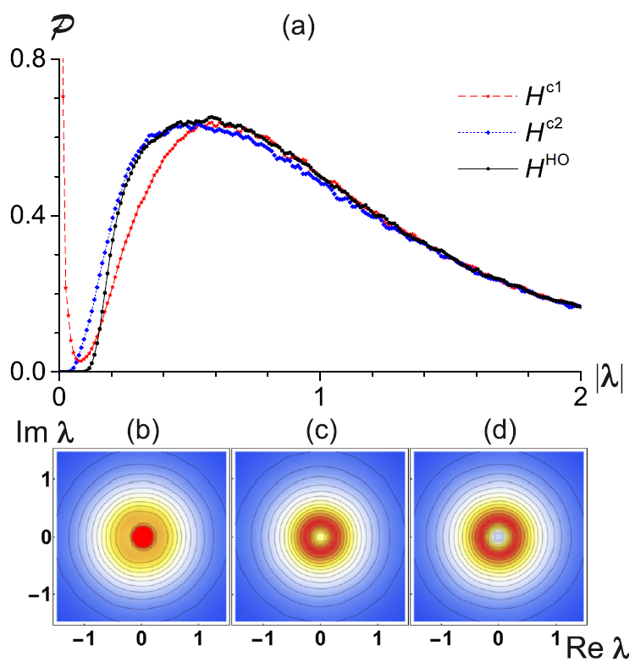
GOE perturbation
$$V=\left(\begin{matrix}N\left(0,{2σ}^{2}\right) & ⋯ & N\left(0,σ^{2}\right) \\ ⋮ & ⋱ & ⋮ \\ N\left(0,σ^{2}\right) & ⋯ & N\left(0,2σ^{2}\right)\end{matrix}\right)∈GOE$$
eigenbasis = random rotation of the unperturbed basis
C1
C2
HO
EP distribution in the complex $λ$ plane is rotationally symmetric around the origin $λ=0$
B. Shapiro, K. Zarembo,
J. Phys. A: Math. Theor. 50, 045201 (2017)
9
$d=16$, $∼{10}^{6}$ EPs

Slide 15
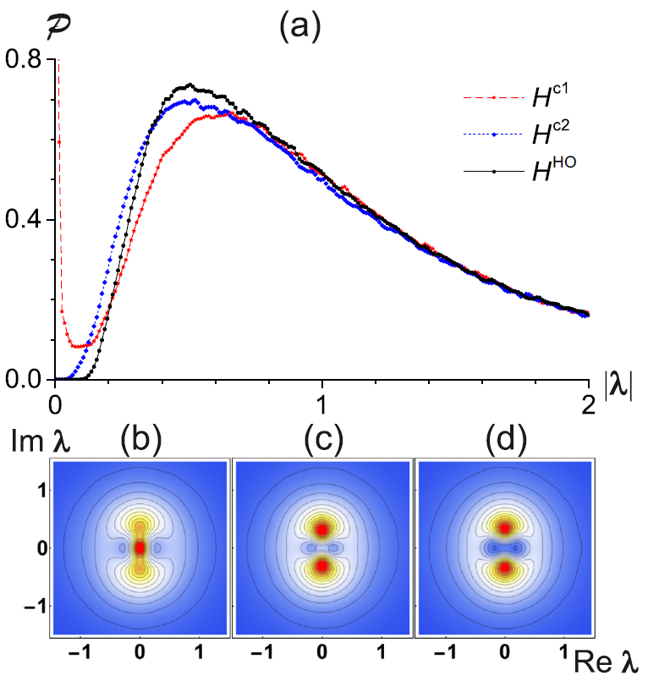
Off-diagonal perturbation
$$V=\left(\begin{matrix}0 & ⋯ & N\left(0,σ^{2}\right) \\ ⋮ & ⋱ & ⋮ \\ N\left(0,σ^{2}\right) & ⋯ & 0\end{matrix}\right)$$
iInitial symmetries are violated in a maximal way
Expected results partly similar to the matrices from $GUE$
Small $\left|λ\right|$ behaviour similar with the diagonal and GOE perturbation
C1
C2
HO
EPs the furthest from the real axis
10
$d=16$, $∼{10}^{6}$ EPs
Notes:
probability of conserving the unperturbed basis is zero

Slide 16
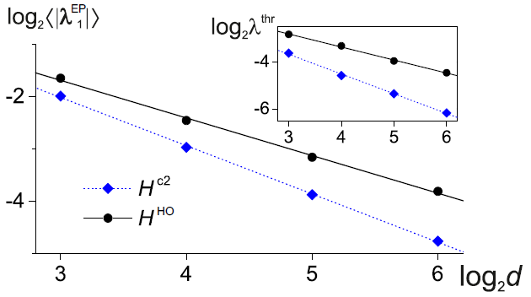
Scaling with matrix dimension $d$
Ensemble average of the distance of the closest EP from the origin
Distance of the closest EP from the origin in an ensemble of ${10}^{6}$ generated EPs
Power-law behaviour $d^{−c}$, where $c$ is higher for the critical Hamiltonian
11

Slide 17
Conclusions
1st order QPT
2nd order QPT
Ground-state affected by several EPs located at comparable distances from the real axis.
Connected with a single pair of EPs.
Exponential
Algebraic
convergence of the EPs to the real axis when the system’s size grows
accumulation of the EPs near $λ=0$ when the system is arbitrarily perturbed
EP distribution represents a strong signature of quantum criticality allowing us to discriminate between the first- and higher-order critical Hamiltonians
EP distribution may have consequences for the superradiance phenomenon in open quantum systems (work in progress)
P. Stránský, M. Dvořák, P. Cejnar, Physical Review E 97, 012112 (2018)
Thanks for your attention
Notes:
Open question: relation between thermal phase transitions and ESQPT in EPs
Open systems

