Slide 1
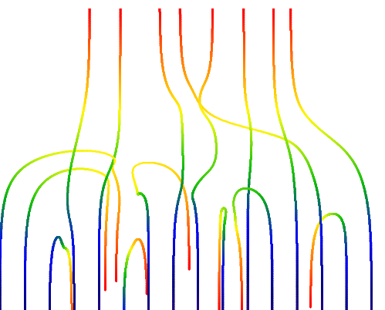
Nonhermitian Superradiance
Published in:
Physical Review E 97, 012112 (2019)
Pavel Stránský
Pavel Cejnar
Institute of Particle and Nuclear Physics
Charles University, Prague
Czech Republic
UNCE Seminar
UNCE/SCI/013
29 November 2019

Slide 2
Effective study of composite systems
Time-dependent Hamiltonian
System under study
described by Hamiltonian ${\hat{H}}^{\left(0\right)}$
𝑑-dimensional Hilbert space ℋ
External field $\hat{H}(t)$

Slide 3
Effective study of composite systems
Time-dependent Hamiltonian
Nonhermitian extension (decay, gain & loss)
System under study
described by Hamiltonian ${\hat{H}}^{\left(0\right)}$
𝑑-dimensional Hilbert space ℋ
continuum
Decay width $γ=\frac{ℏ}{2τ}$
Effective interaction
$n$-dimensional subspace $ℋ_{Decay}$
$${\hat{H}}^{\left(λ\right)}=H^{\left(0\right)}−iγ{\hat{P}}_{Decay}$$

Slide 4
Superradiance
Atom-field interacting systems
Open systems
Collective enhancement and time squeeze of the spontaneous radiation
(Dicke superradiance).
Coupling of the unperturbed states to continuum, creating a group of superradiant (short-living) and subradiant (long-living) states.

Slide 5
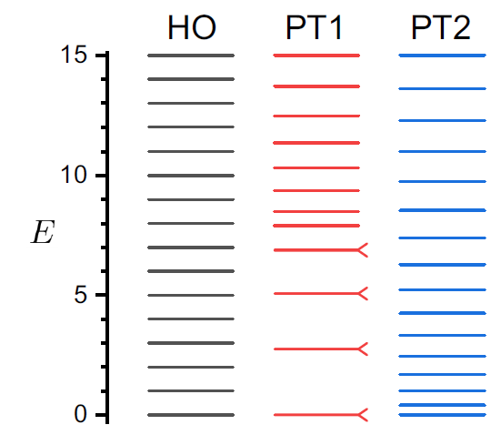
Model Hamiltonian
$${\hat{H}}^{\left(λ\right)}=\sum_{k=1}^{d}{E_{k}^{\left(0\right)}\left|\left.k\right\rangle \left\langle \left.k\right|\right.\right.}+\left(ε−iγ\right)\sum_{l=1}^{n}{\left|\left.φ_{l}\right\rangle \left\langle \left.φ_{l}\right|\right.\right.}$$
${\hat{H}}^{\left(0\right)}$ - diagonal, unpertubed system
decay-inducing part
$\left|\left.φ_{l}\right\rangle \right.$ – randomly rotated basis (via GOE)
$n$ – number of open channels

Slide 6
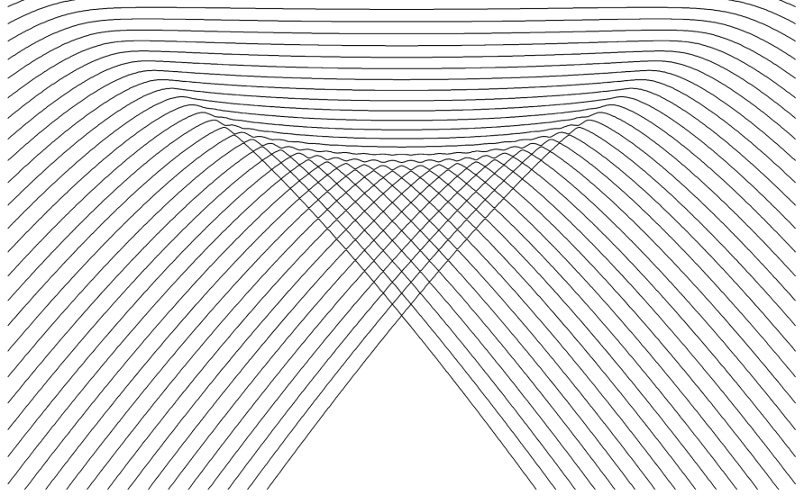
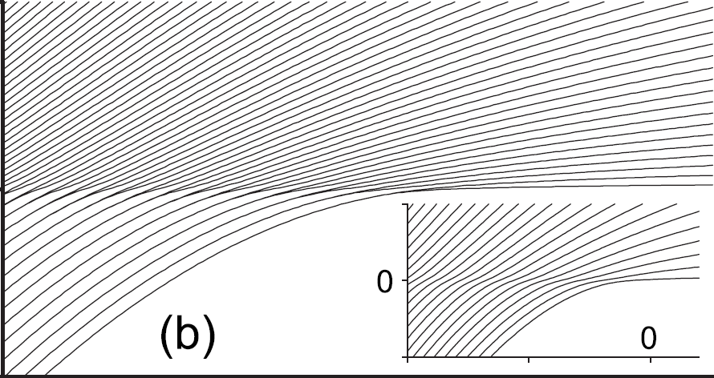
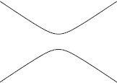
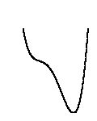
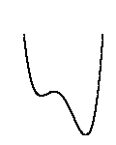
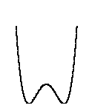
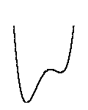
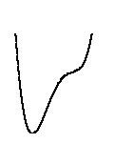
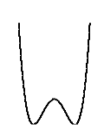
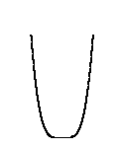
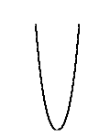
Quantum phase transition (QPT)
Nonanalytic change of the ground state energy $E_{0}\left(λ\right)$ under a continuous change of the control parameter.
1st order QPT
Continuous QPT (2nd order)
Energy level dynamics
E
λ
λ
$$V(q)$$
double-well form of the energy surface
quartic minimum in the energy surface
Notes:
Level dynamics
1st vs 2nd order, generic cases (potentials)
Assumptions: Zero temperature, Infinite size of the system

Slide 7
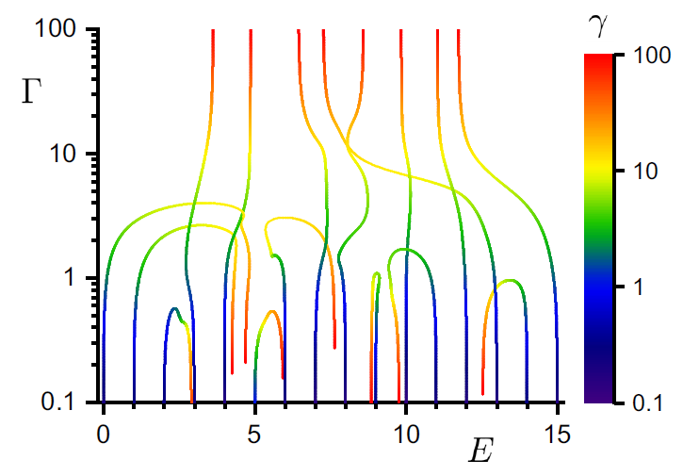
Level dynamics
Superradiant states
Subradiant states

Slide 8
Exceptional points
$$H\left(λ\right)=H_{0}+λV$$
$$\left[H_{0},V\right]≠0$$
$$E$$
In a generic situation: no real crossings
$$E_{i}\left(λ\right)≠E_{i+1}\left(λ\right)$$
(energies from the same symmetry subspace)
Avoided crossing theorem
λ
1
Notes:
external field strength
all operators Hermitian

Slide 9
Exceptional points
$$H\left(λ\right)=H_{0}+λV$$
$$\left[H_{0},V\right]≠0$$
$$E$$
In a generic situation: no real crossings
$$E_{i}\left(λ\right)≠E_{i+1}\left(λ\right)$$
(energies from the same symmetry subspace)
Avoided crossing theorem
$$Reλ$$
Nonhermitian extension of the Hamiltonian
$$Im λ$$
Energy levels cross at $\frac{1}{2}n\left(n−1\right)$ complex conjugate pairs of exceptional points$λ^{EP},λ^{EP∗}∈ℂ$
1
Notes:
Complex energy
EP – square-root type of branch points connecting two Riemann sheets
EP distribution symmetric under the complex conjugation
Peculiarity – self-orthogonality and degeneracy of eigenvector at the EP
Ways to find EPs:
Resultant (diskriminant)
Encircling an EP swaps two eigenlevels
Looking for eigenvector degeneracies

Slide 10
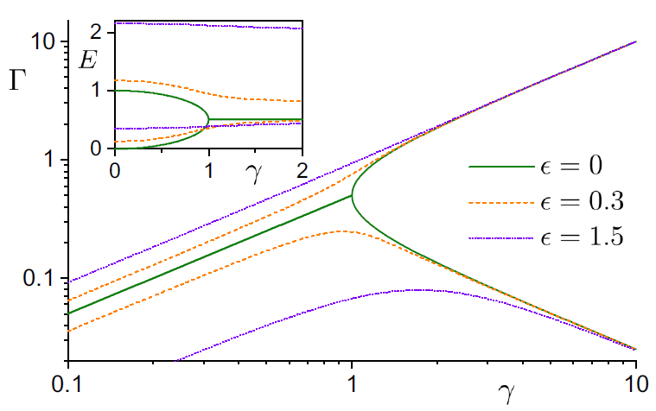
2D toy model
$${\hat{H}}^{\left(λ\right)}=\left(\begin{matrix}E_{1}^{\left(0\right)} & 0 \\ 0 & E_{2}^{\left(0\right)}\end{matrix}\right)+(ε−iλ)\left(\begin{matrix}\cos^{2}{θ} & \cos{θ}\sin{θ} \\ \cos{θ\sin{θ}} & \sin{θ}\end{matrix}\right)$$
superradiant
$$Γ\sim γ$$
Exceptional point
$$Γ\sim \frac{1}{γ}$$
$$Γ\sim γ$$
subradiant
$$λ_{EP}=−\left(E_{1}^{\left(0\right)}−E_{2}^{\left(0\right)}\right)e^{±2iθ}$$

Slide 11
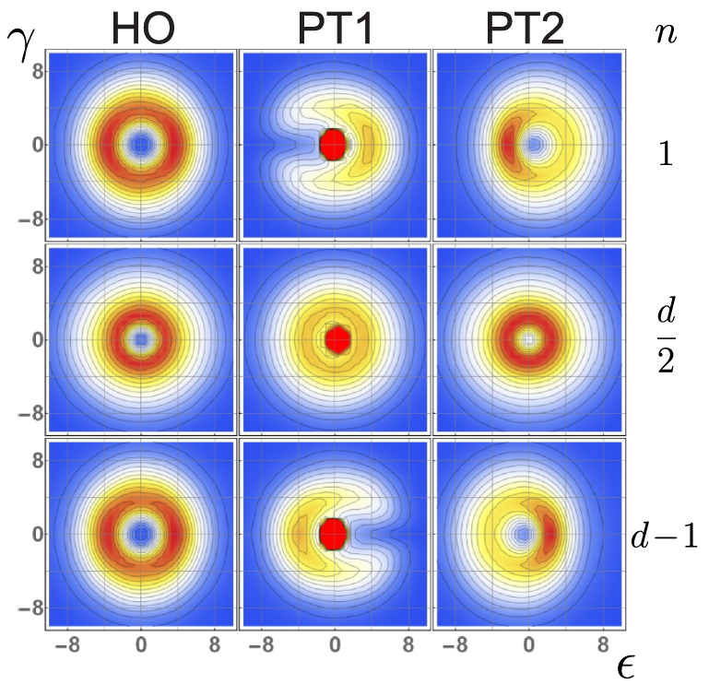
Distribution of the exceptional points $d=16$

Slide 12
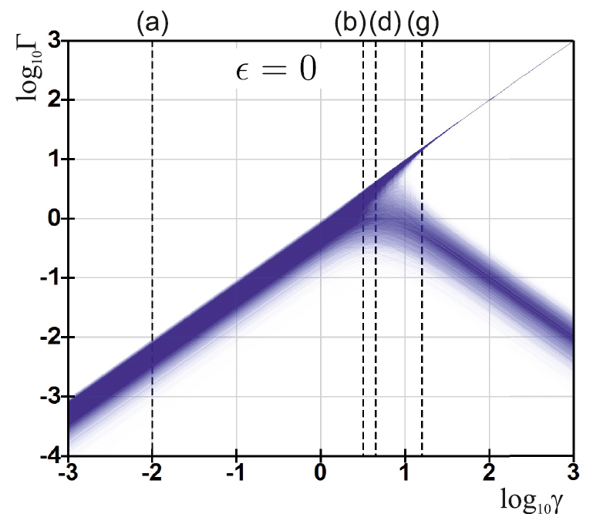
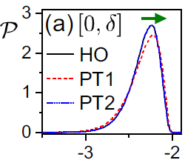
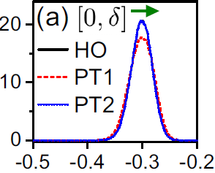
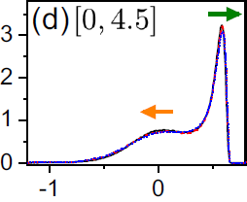
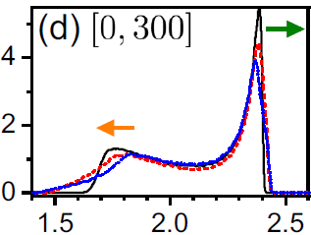
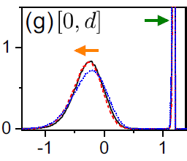
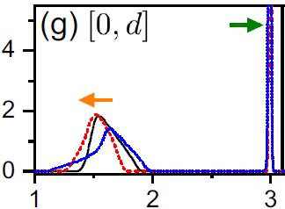
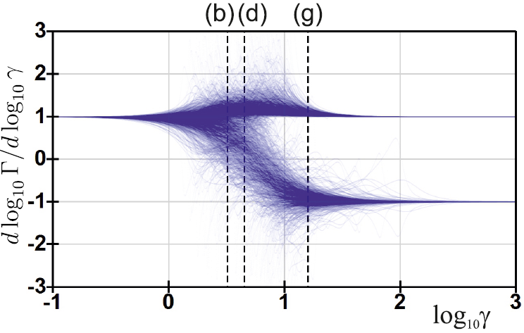
Bifurcation of decay widths
$$N=16$$
$$N=1024$$
$$ε=0$$
$$\log_{10}{Γ}$$
$$\log_{10}{Γ}$$
$$ℰ=E−iΓ$$

Slide 13
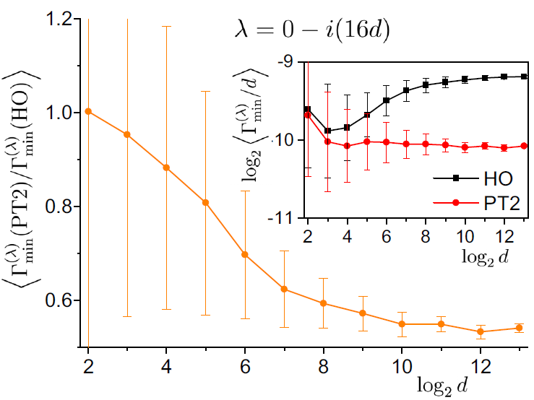
Minimal decay width scaling
$$λ=0−i\left(16d\right)$$

Slide 14
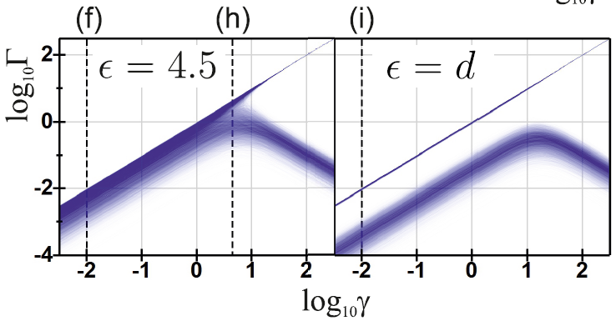
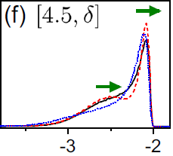
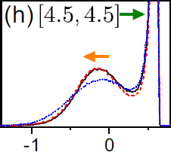
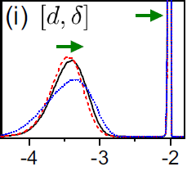
Bifurcation of decay widths
$$\log_{10}{Γ}$$

Slide 15
Summary
Nonhermitian superradiance (NHSR) is a splitting of energy eigenstates in an open quantum system into the groups of short- and long-living states with decay widths $Γ→∞$ and $Γ→0$.
NHSR is a universal effect qualitatively independent of the form of the initial Hamiltonian and the choice of the decaying subspace.
Initial (small-coupling) and asymptotic (large-coupling) are understood from elementary perturbative theory.
Intermediate stage is strongly influenced by the distribution of the exceptional points
Details of the NHSR dynamics depend on the structure of the real-energy spectrum of the $γ=0$ Hamiltonian.
I acknowledge the support form the UNCE/SCI/013 project.
Thank you for you attention

