Slide 1
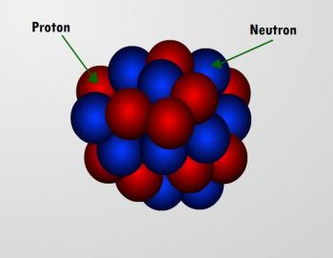
Residual Correlations
in Nuclear Masses
Pavel Stránský
(based on the Bachelor thesis of Samuel Mičo)
UNCE Seminar
UNCE/SCI/013
28 May 2021

Slide 2
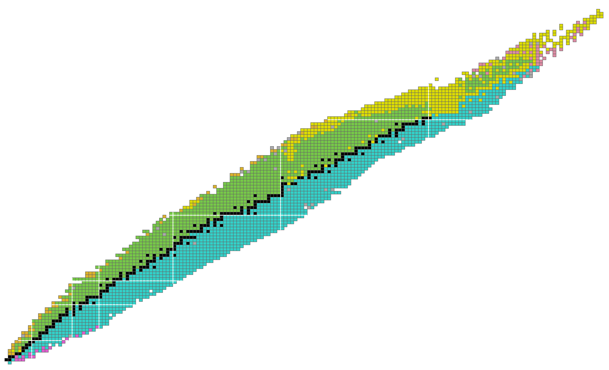


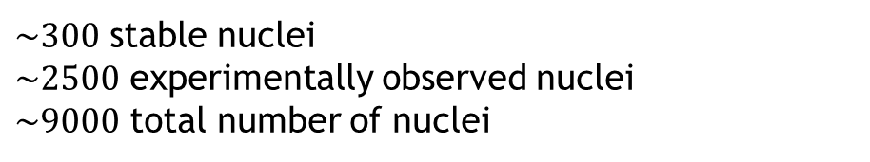


Nuclear chart
proton drip line
$\sim 300$ stable nuclei
$\sim 2500$ experimentally observed nuclei
$\sim 9000$ total number of nuclei
$$Z$$
$$N=Z$$
Principal decay channel
stable (valey of stability)
fission
neutron
neutron drip line
proton
β-
β+ (electron capture)
N
α

Slide 3
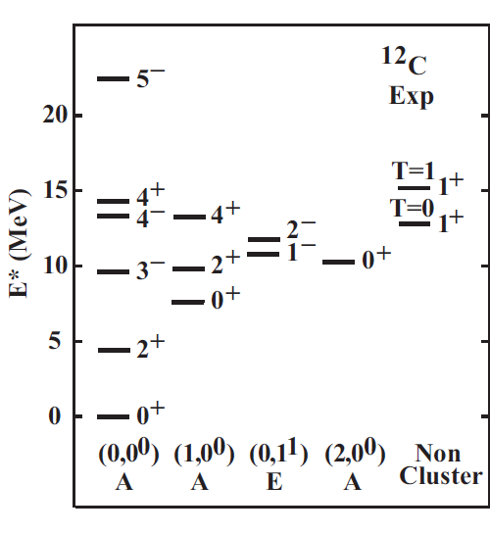
Characteristics of nuclei
2. energy spectrum
bands
3. EM transitions
1. ground-state (Mass)
The knowledge of nuclear masses and spectra is crucial for nuclear astrophysics.

Slide 4

Atomic Mass Evaluations
Experimental masses
AME 2003
A.H. Wapstra, G. Audi, C. Thibault, Nucl. Phys. A 729, 129 (2003)
G. Audi, A.H. Wapstra, C. Thibault, Nucl. Phys. A 729, 337 (2003)
2228
AME 2012
G. Audi, M. Wang, A.H. Wapstra, F.G. Kondev, M. MacCormick, X. Xu, B. Pfeifer, Chinese Phys. C 36, 1287 (2012)
M. Wang, G. Audi, A.H. Wapstra, F.G. Kondev, M. MacCormick, X. Xu, B. Pfeifer, Chinese Phys. C 36, 1603 (2012)
AME 2016
2438
W.J. Huang, G. Audi, M. Wang, F.G. Kondev, S. Naimi, X. Xu, Chinese Phys. C 41, 030002 (2017)
M. Wang, G. Audi, F.G. Kondev, W.J. Huang, S. Naimi, X. Xu, Chinese Phys. C 41, 030003 (2017)
2497
AME 2020
W.J. Huang, M. Wang, F.G. Kondev, G. Audi, S. Naimi, Chinese Phys. C 45, 030002 (2021)
M. Wang, W.J. Huang, F.G. Kondev, G. Audi, S. Naimi, Chinese Phys. C 41, 030003 (2021)
2550
??? 9000
$≈460$ years
Still a long way to go.

Slide 5
Improvement in precision
W.J. Huang, M. Wang, F.G. Kondev, G. Audi, S. Naimi, Chinese Phys. C 45, 030002 (2021)

Slide 6

Predictions of masses
Mass models can be:
Global
One formula/model with several parameters fitted from all the known nuclear masses, later used to predict unmeasured masses Examples:
FRDM (Finite-Range Droplet Model)
HFBM (Hartree-Fock-Bogoliubov Model)
Duflo-Zucker model
Etc.
Local
Models taking into account only a small number of neighbouring nuclei and give information only about a part of the nuclear chart:
Garvey-Kelson relations
Hypothesis
Chaotic fluctuations prevents the models to reach the precision higher than
$$≈{10}^{2} keV$$

Slide 7
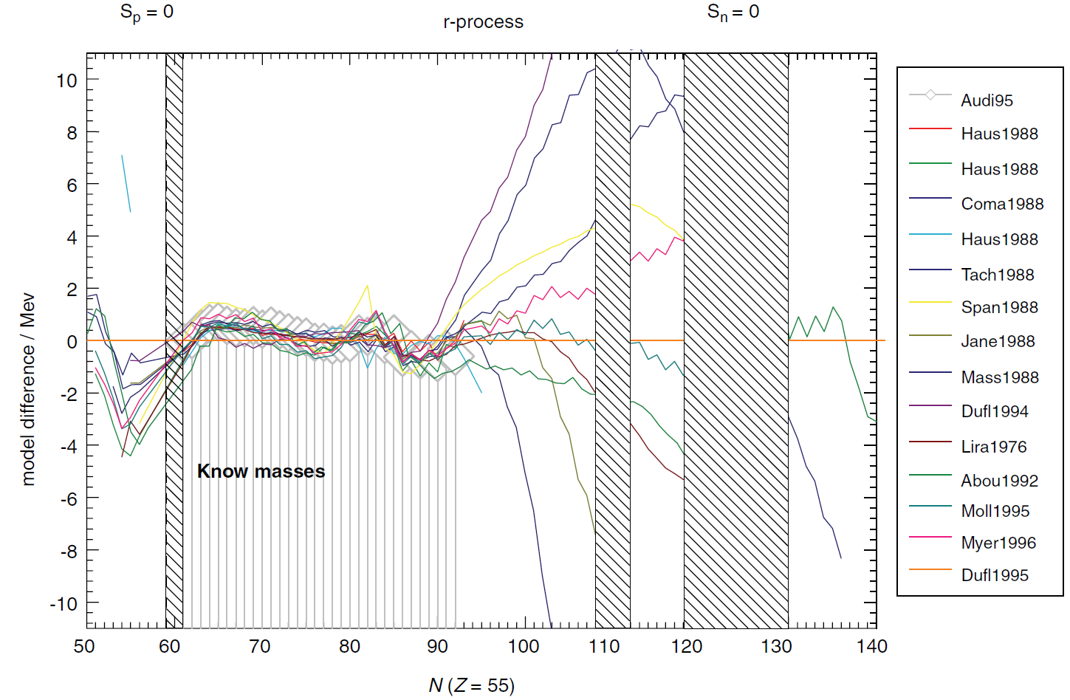
Predictive power of various models
prediction
fit
Cs isotopes

Slide 8

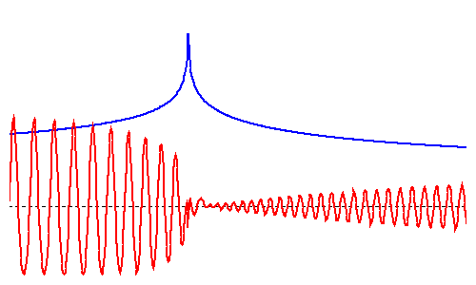

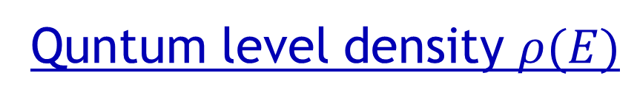
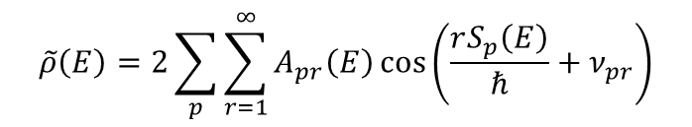
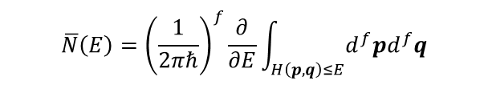

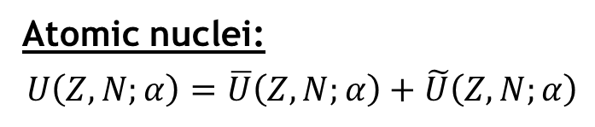
Quntum level density $ρ(E)$
quantum spectrum:
Semiclassical theory $ρ\left(E\right)=\overline{ρ}\left(E\right)+\tilde{ρ}(E)$
Smooth part
(Weyl formula)
Oscillating part
(Gutzwiller formula)
- Volume of the energy hypersuface in the classical phase space
- Get from all the classical periodic orbits and their repetitions
E
$$\overline{N}\left(E\right)={\left(\frac{1}{2πℏ}\right)}^{f}\frac{∂}{∂E}\int_{H\left(p,q\right)≤E}{d^{f}pd^{f}q}$$
$$\tilde{ρ}\left(E\right)=2\sum_{p}{\sum_{r=1}^{∞}{A_{pr}\left(E\right)\cos\left(\frac{rS_{p}\left(E\right)}{ℏ}+ν_{pr}\right)}}$$
Atomic nuclei:
$$U\left(Z,N;α\right)=\overline{U}\left(Z,N;α\right)+\tilde{U}\left(Z,N;α\right)$$
$$≈8 MeV/A$$
Microscopic fluctuations, shell effects
Quantum chaos

Slide 9
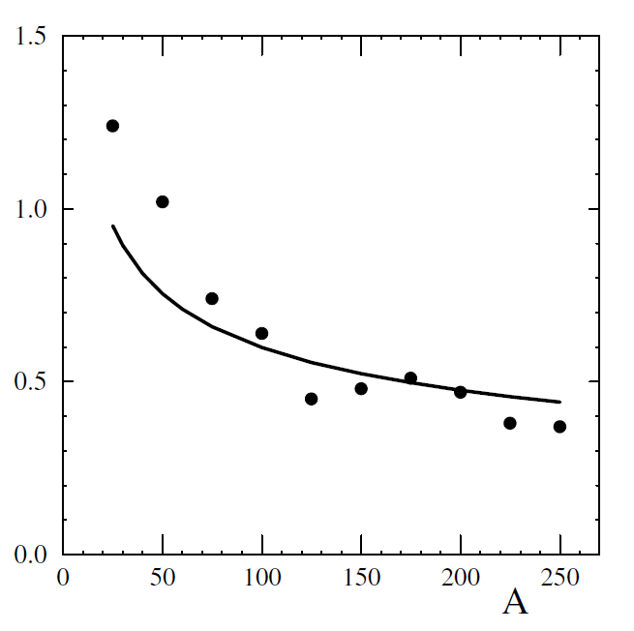

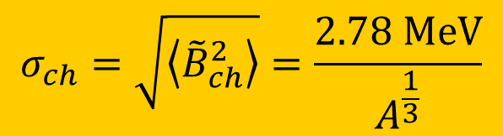
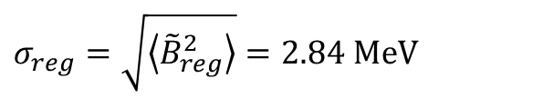
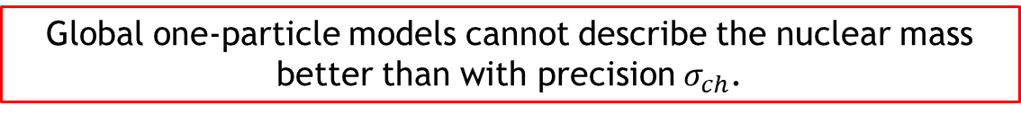

Precision limit for mass formulae
- Based on the Gutzwiller formula
$$σ_{reg}=\sqrt{\left\langle {\tilde{B}}_{reg}^{2}\right\rangle }=2.84 MeV$$
Droplet model + shell corrections
$$σ_{ch}=\sqrt{\left\langle {\tilde{B}}_{ch}^{2}\right\rangle }=\frac{2.78 MeV}{A^{\frac{1}{3}}}$$
RMS $ΔB$ (MeV)
$${\overline{σ}}_{ch}≈0.5 MeV$$
Global one-particle models cannot describe the nuclear mass better than with precision $σ_{ch}$.
O. Bohigas, P. Leboeuf, Nuclear Masses: Evidence of order-chaos coexistence, Phys. Rev. Lett. 88, 092502 (2002)
H. Olofsson, S. Åberg, O. Bohigas, P. Leboeuf, Correlations in nuclear masses, Phys. Rev. Lett. 96, 042502 (2006)

Slide 10

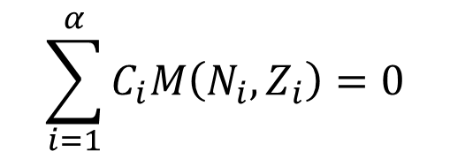
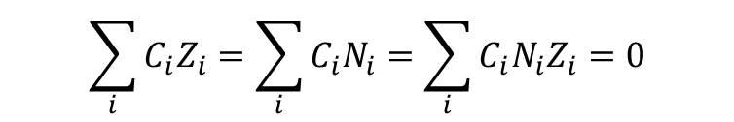
Garvey-Kelson relations
Parameterless model
(no need of interpreting and various model parameters)
Local model
(one formula describes relations only between neighbouring nuclei)
$$\sum_{i=1}^{α}{C_{i}M\left(N_{i},Z_{i}\right)=0}$$
$$\left|C_{i}\right|=1$$
Number of n-n, p-p and n-p interactions must cancel:
$$\sum_{i}{C_{i}Z_{i}}=\sum_{i}{C_{i}N_{i}}=\sum_{i}{C_{i}N_{i}Z_{i}=0}$$
Rather than a “model” one should call it an “algorithm”.
G. Garvey, I. Kelson, New nuclidic mass relationship, Phys. Rev. Lett. 16, 197 (1966)
G. Garvey et al, Set of nuclear-mass relations and a resultant mass table, Rev. Mod. Phys. 41, S1 (1969)

Slide 11
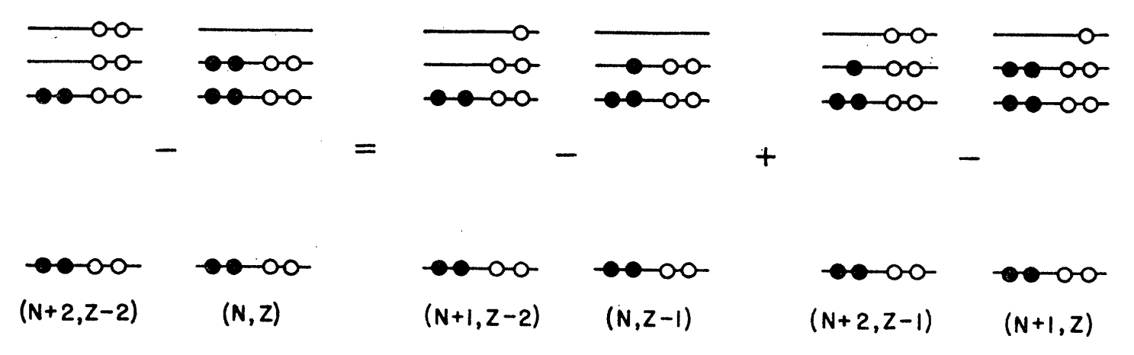
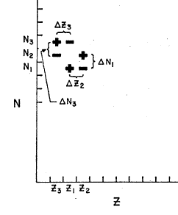
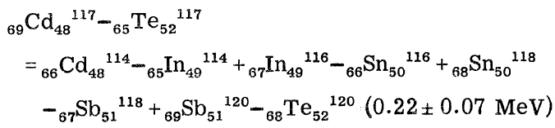
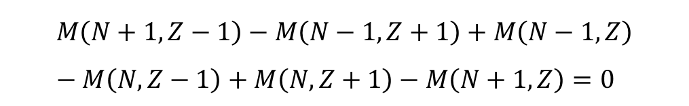
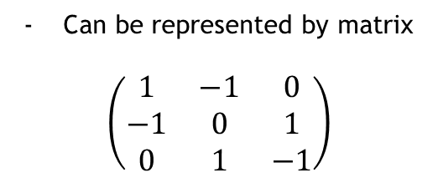
Garvey-Kelson relations
Example:
Can be represented by matrix
$$\left(\begin{matrix}1 & −1 & 0 \\ −1 & 0 & 1 \\ 0 & 1 & −1\end{matrix}\right)$$
$$M\left(N+1,Z−1\right)−M\left(N−1,Z+1\right)+M\left(N−1,Z\right)−M\left(N,Z−1\right)+M\left(N,Z+1\right)−M\left(N+1,Z\right)=0$$
G. Garvey, I. Kelson, New nuclidic mass relationship, Phys. Rev. Lett. 16, 197 (1966)
G. Garvey et al, Set of nuclear-mass relations and a resultant mass table, Rev. Mod. Phys. 41, S1 (1969)

Slide 12
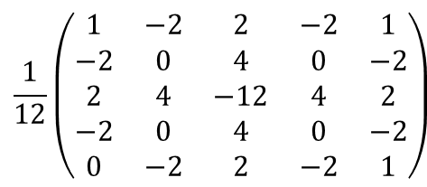
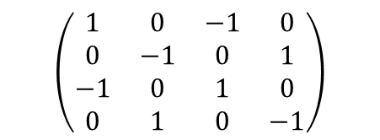
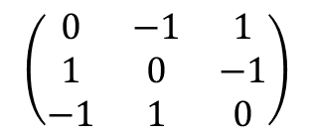
Garvey-Kelson relations
Example:
Can be represented by matrix
$$\left(\begin{matrix}1 & −1 & 0 \\ −1 & 0 & 1 \\ 0 & 1 & −1\end{matrix}\right)$$
$$M\left(N+1,Z−1\right)−M\left(N−1,Z+1\right)+M\left(N−1,Z\right)−M\left(N,Z−1\right)+M\left(N,Z+1\right)−M\left(N+1,Z\right)=0$$
GK1
Another possible formulae
$$\left(\begin{matrix}0 & −1 & 1 \\ 1 & 0 & −1 \\ −1 & 1 & 0\end{matrix}\right)$$
GK2
$$\left(\begin{matrix}1 & 0 & −1 & 0 \\ 0 & −1 & 0 & 1 \\ −1 & 0 & 1 & 0 \\ 0 & 1 & 0 & −1\end{matrix}\right)$$
$$\frac{1}{12}\left(\begin{matrix}1 & −2 & 2 & −2 & 1 \\ −2 & 0 & 4 & 0 & −2 \\ 2 & 4 & −12 & 4 & 2 \\ −2 & 0 & 4 & 0 & −2 \\ 0 & −2 & 2 & −2 & 1\end{matrix}\right)$$
G. Garvey, I. Kelson, New nuclidic mass relationship, Phys. Rev. Lett. 16, 197 (1966)
G. Garvey et al, Set of nuclear-mass relations and a resultant mass table, Rev. Mod. Phys. 41, S1 (1969)

Slide 13
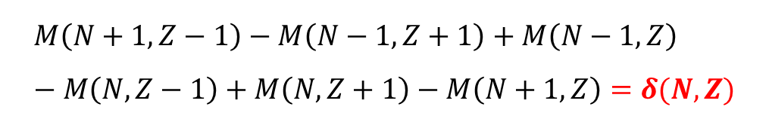
Garvey-Kelson relations
Example:
Can be represented by matrix
$$\left(\begin{matrix}1 & −1 & 0 \\ −1 & 0 & 1 \\ 0 & 1 & −1\end{matrix}\right)$$
$$M\left(N+1,Z−1\right)−M\left(N−1,Z+1\right)+M\left(N−1,Z\right)−M\left(N,Z−1\right)+M\left(N,Z+1\right)−M\left(N+1,Z\right)=δ(N,Z)$$
GK1
Another possible formulae
$$\left(\begin{matrix}0 & −1 & 1 \\ 1 & 0 & −1 \\ −1 & 1 & 0\end{matrix}\right)$$
We study properties of these deviations.
GK2
$$\left(\begin{matrix}1 & 0 & −1 & 0 \\ 0 & −1 & 0 & 1 \\ −1 & 0 & 1 & 0 \\ 0 & 1 & 0 & −1\end{matrix}\right)$$
$$\frac{1}{12}\left(\begin{matrix}1 & −2 & 2 & −2 & 1 \\ −2 & 0 & 4 & 0 & −2 \\ 2 & 4 & −12 & 4 & 2 \\ −2 & 0 & 4 & 0 & −2 \\ 0 & −2 & 2 & −2 & 1\end{matrix}\right)$$
G. Garvey, I. Kelson, New nuclidic mass relationship, Phys. Rev. Lett. 16, 197 (1966)
G. Garvey et al, Set of nuclear-mass relations and a resultant mass table, Rev. Mod. Phys. 41, S1 (1969)

Slide 14
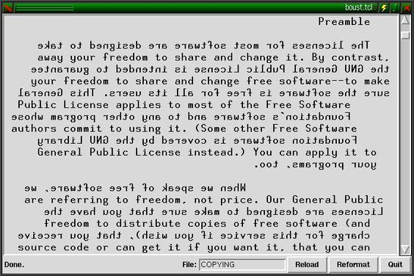
Noise in nuclear masses
?
Time series
boustrophedon
(style of writing in old scripts)
...
boustrophedon = like the ox turns [while plowing]
Notes:
bustrofedón (obracení volů)

Slide 15
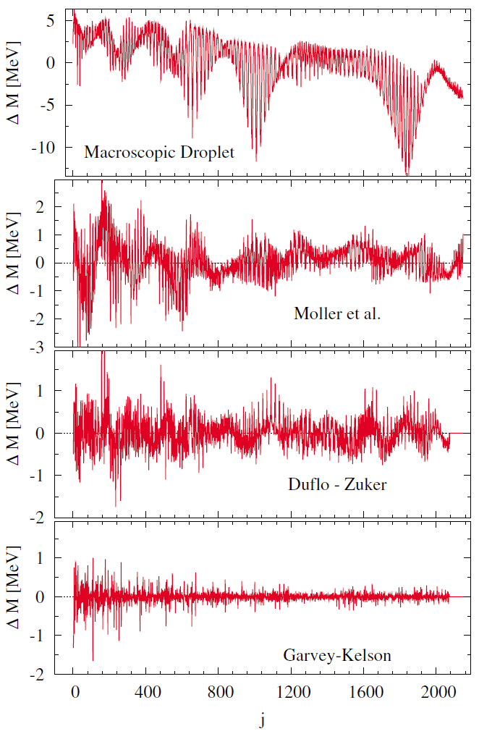
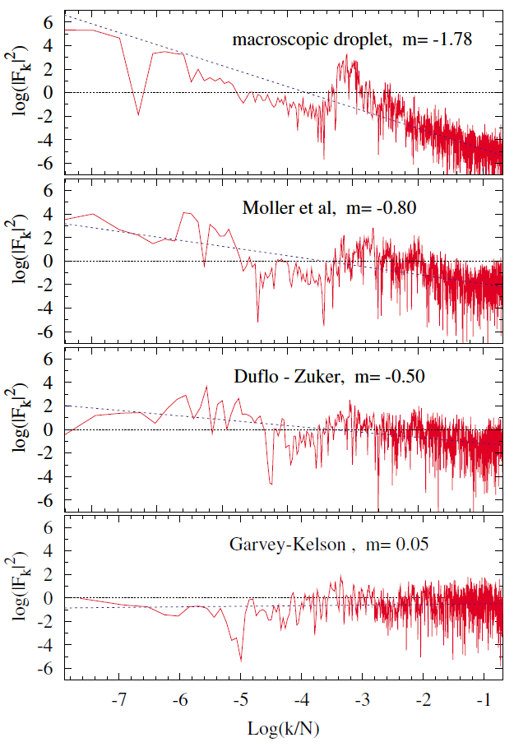
strong correlations
FRDM
Average error ~ 100 keV
White noise
J. Barea et al., Nuclear masses set bounds on quantum chaos, Phys. Rev. Lett. 94, 102501 (2005)

Slide 16
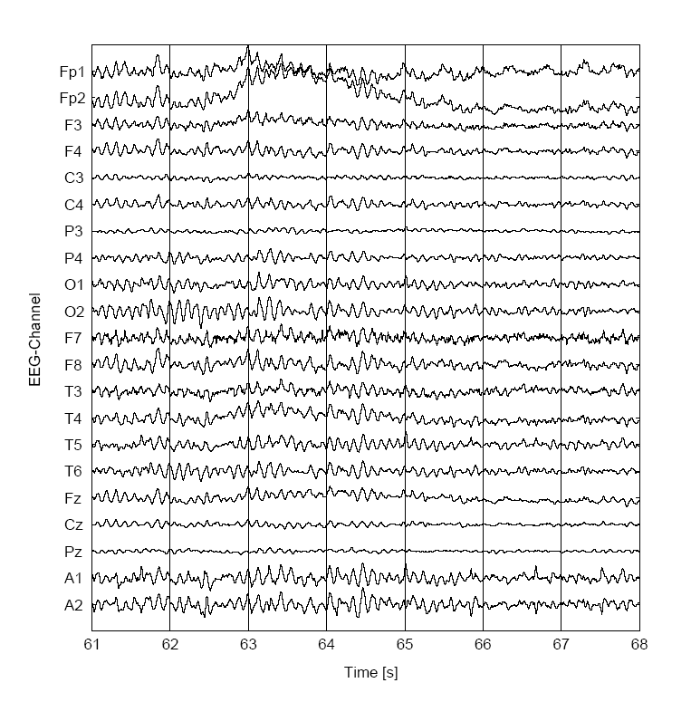
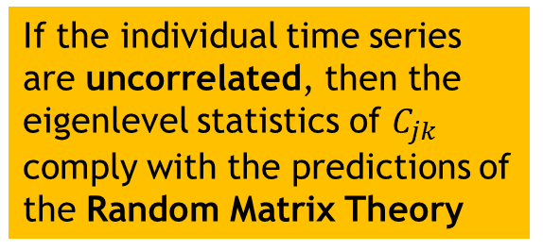
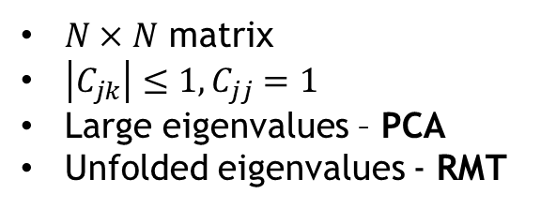


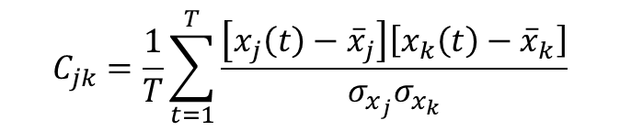

Correlation analysis
Multivariate time series
Correlation matrix
$$C_{jk}=\frac{1}{T}\sum_{t=1}^{T}{\frac{\left[x_{j}\left(t\right)−{\overline{x}}_{j}\right]\left[x_{k}\left(t\right)−{\overline{x}}_{k}\right]}{σ_{x_{j}}σ_{x_{k}}}}$$
$$N$$
$N×N$ matrix
$\left|C_{jk}\right|≤1,C_{jj}=1$
Large eigenvalues – PCA
Unfolded eigenvalues - RMT
If the individual time series are uncorrelated, then the eigenlevel statistics of $C_{jk}$ comply with the predictions of the Random Matrix Theory
$$T$$
NNSD: Wigner $P\left(s\right)=\frac{π}{2}se^{−\frac{π}{4}s^{2}}$
J. Wishart, Biometrika 20A, 32 (1928)
V.A. Marchenko, L.A. Pastur, Mat. Sb. 72, 507 (1967)

Slide 17
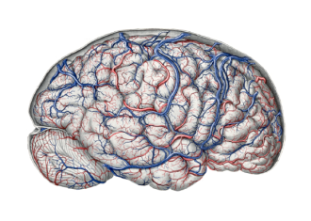
Correlation analysis
Multivariate time series
Correlation matrix
$$C_{jk}=\frac{1}{T}\sum_{t=1}^{T}{\frac{\left[x_{j}\left(t\right)−{\overline{x}}_{j}\right]\left[x_{k}\left(t\right)−{\overline{x}}_{k}\right]}{σ_{x_{j}}σ_{x_{k}}}}$$
$$N$$
Long-range spectral correlations
$N×N$ matrix
$\left|C_{jk}\right|≤1,C_{jj}=1$
Large eigenvalues – PCA
Unfolded eigenvalues - RMT
Short-range spectral correlation
If the individual time series are uncorrelated, then the eigenlevel statistics of $C_{jk}$ comply with the predictions of the Random Matrix Theory
$$T$$
NNSD: Wigner $P\left(s\right)=\frac{π}{2}se^{−\frac{π}{4}s^{2}}$
P. Šeba, Random matrix analysis of hyman EEG data, Phys. Rev. Lett. 91, 198104 (2003)

Slide 18
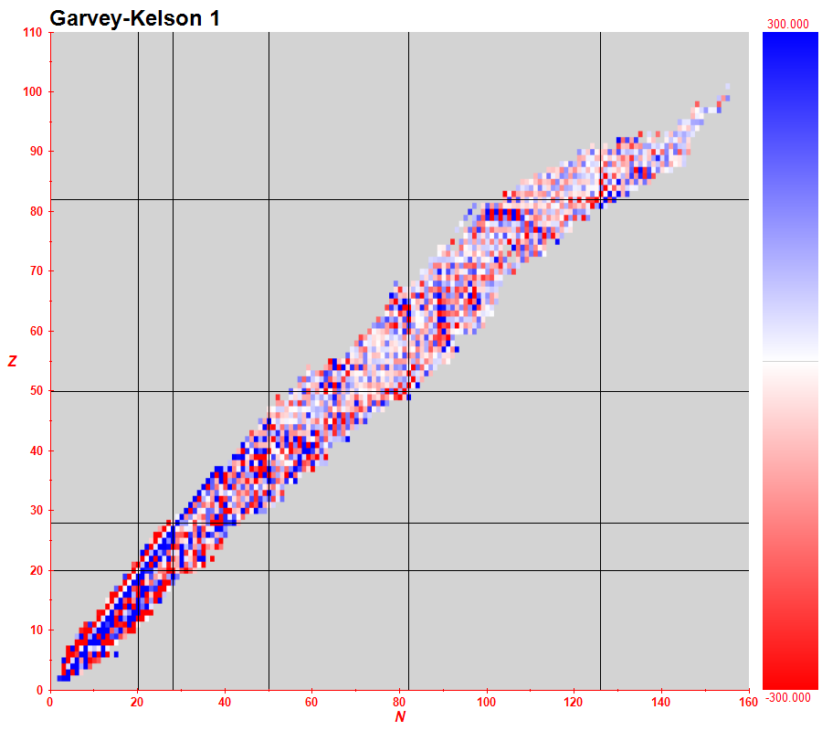
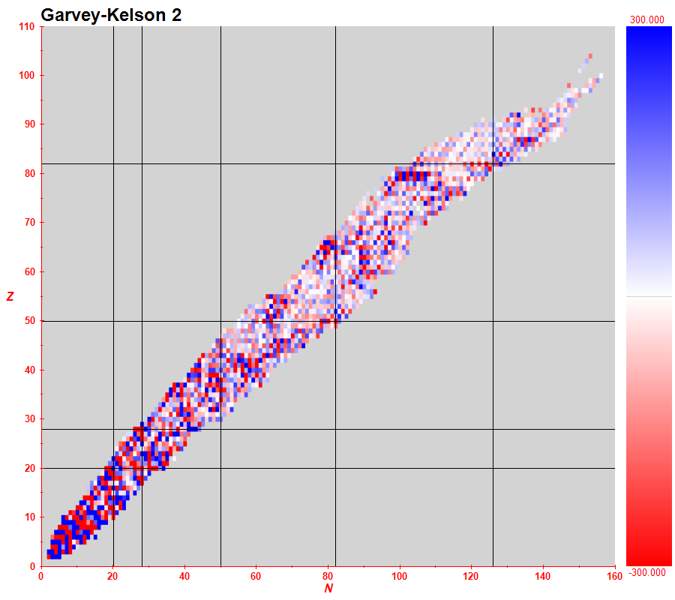
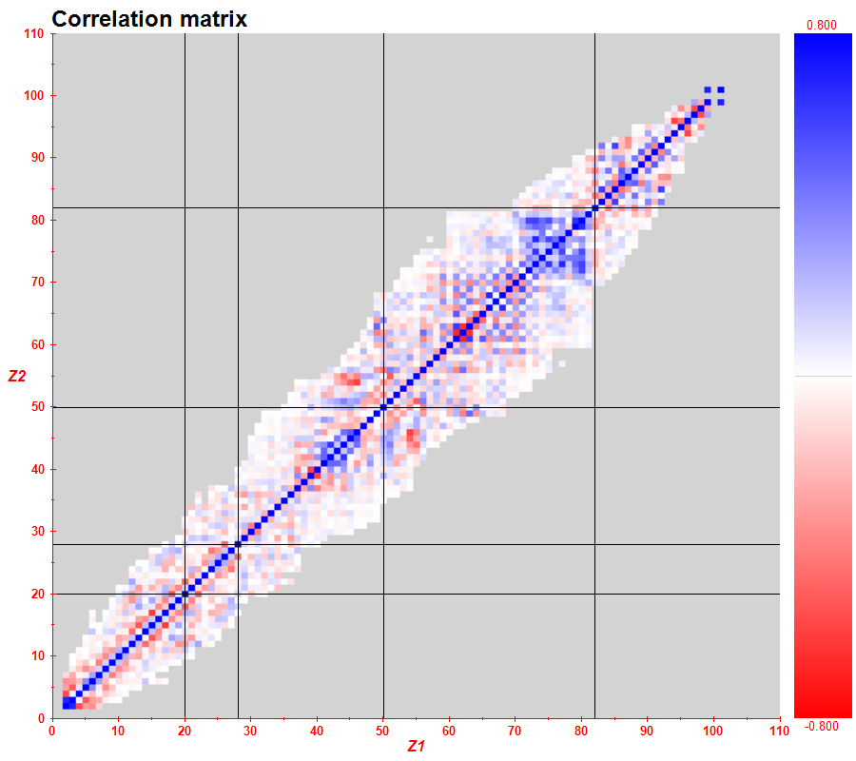
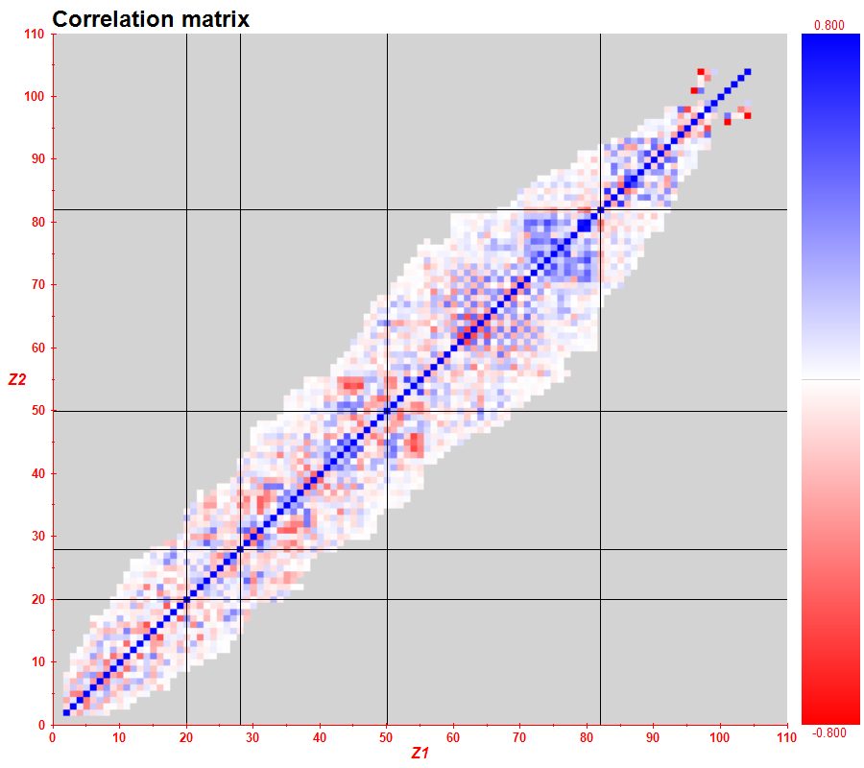

Slide 19
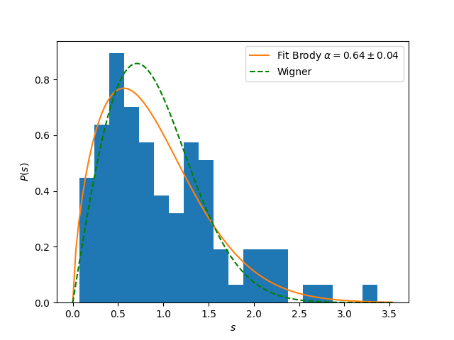
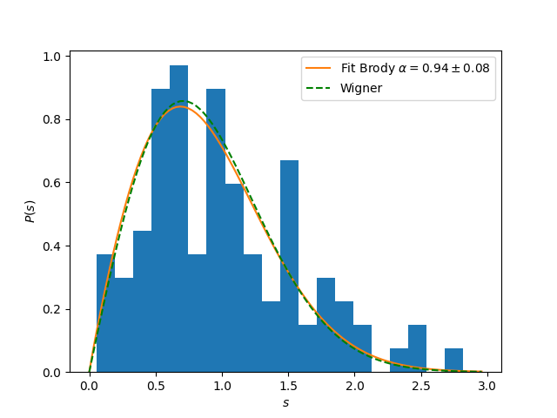
Eigenlevel correlation analysis
Fit to the Brody distribution: $α=1$ – Wigner (chaotic), $α=0$ - Poisson

Slide 20
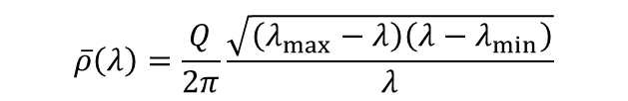

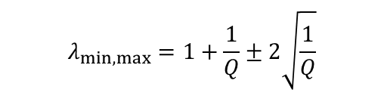
Smooth level density analysis
Stock market
$$\overline{ρ}\left(λ\right)=\frac{Q}{2π}\frac{\sqrt{\left(λ_{max}−λ\right)\left(λ−λ_{min}\right)}}{λ}$$
Theory:
$$λ_{min,max}=1+\frac{1}{Q}±2\sqrt{\frac{1}{Q}}$$
$$Q=\frac{T}{N}$$
- For totally uncorrelated signal
Smallest eigenvalues deviating from the theory – may carry some information
Largest eigenvalues – strong correlation (important principal components)
L. Laloux et al., Noise dressing of financial correlation matrices, Phys. Rev. Lett. 83, 1467 (1999)

Slide 21
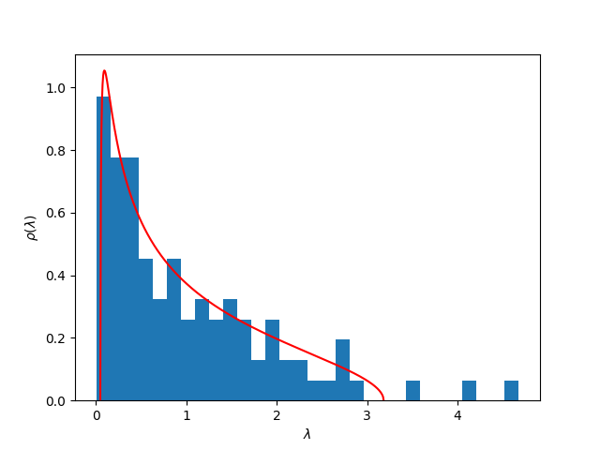
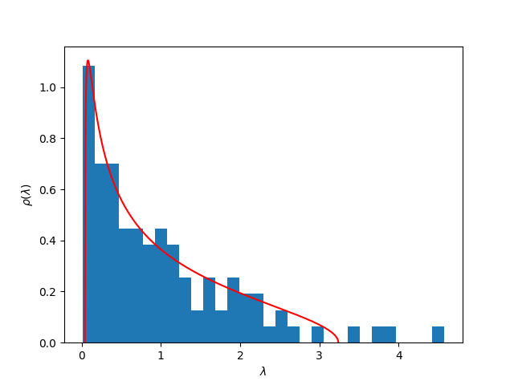
Eigenvalues of the correlation matrix
Important correlations
Important correlations

Slide 22
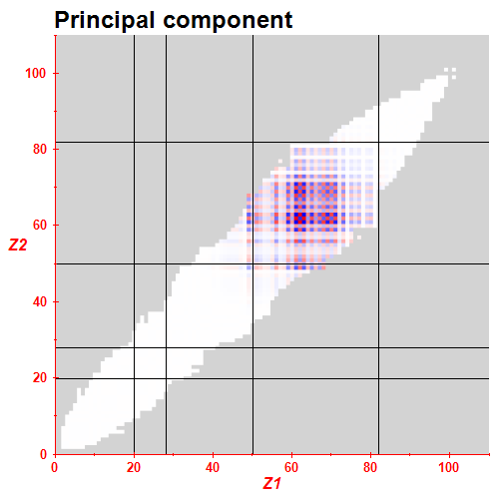
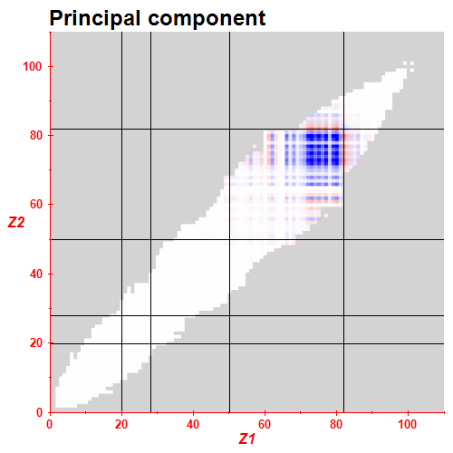
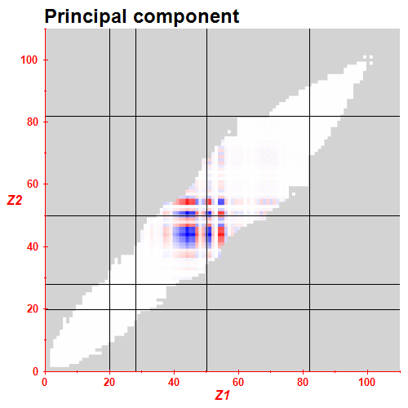
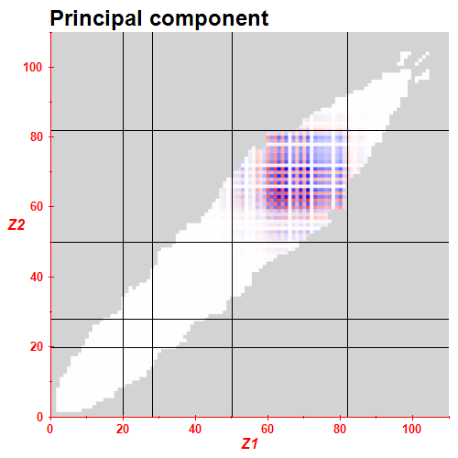
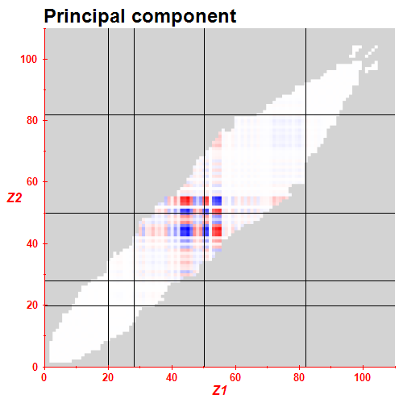
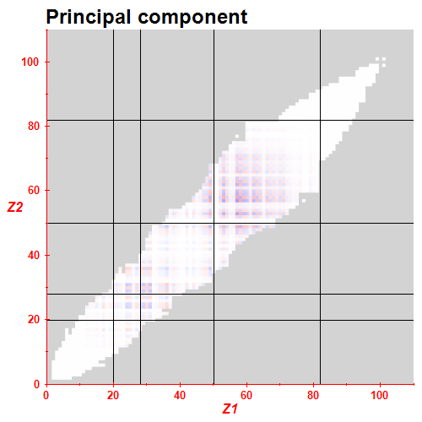
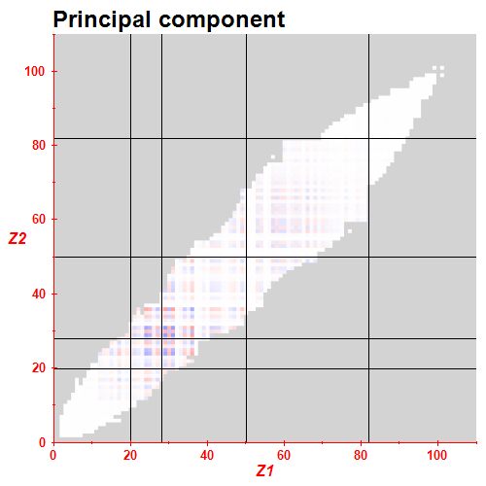


1
2
3
1
2
11
12
13
3
Principal component analysis

Slide 23

Conclusions:
Analysis of correlations in the deviations of the Garvey-Kelson relations (local relations between nuclear masses) confirm that there is a strong “chaotic” component in the nuclear masses. This makes bounds to the predictive power of global nuclear models.
1
2
3
1
2
Thanks for your attention
11
12
13
3
Principal component analysis

